Slide 1


Imaging Porous Media and Bright Spots for Reservoir Characterization in Niger Delta Basin Fields Using Seismic Attributes
ADIZUA, Okechukwu Frank (Ph.D)
University of Port Harcourt, Rivers State, Nigeria

Slide 2
Presentation Outline
Introduction
Statement of the Problem
Aim and Objectives of the Study
Significance of the Study
Materials and Methodology
Presentation of Results and Discussions
Summary and Conclusion
Final Remark

Slide 3
Introduction
A seismic attribute is any measure of seismic data that helps us better visualize or quantify features of interpretational interest (Brown, (2001); Chopra and Marfurt (2005 and 2008).
Taner, (2001) presented a comprehensive classification of attributes into two categories: geometrical and physical.

Slide 4
The seismic attribute of focus
Signal Envelope Attribute
It is a representation of the amplitude E(t) of an oscillatory function F(t). The quantity E(t) is of the same order as the absolute value of the amplitudes of the function.
…………………… (1)

Slide 5


The seismic attribute of focus
First Order Derivative (DE)
This is the time derivative of the envelope.
….…….(2)
Second Order Derivative (DDE)
This is given by:
….……(3)

Slide 6
Statement of the Problem
Subtle lithological variations, porous media (porosity) and even oil and gas reservoir bearing zones are sometimes difficult to clearly visualize on conventional seismic data.
Asset managers can integrate attributes to have greater understanding of their assets and plan exploration and production strategies at reduced cost with a huge certainty of finding hydrocarbons.

Slide 7
Aim and Objectives of the Study
The aim is to image porous media and bright spots using seismic attributes (signal envelope and its derivatives) to enhance reservoir characterization goals in the selected fields.
The objectives include;
Apply signal envelope around the zones of interest.
Interpretation of rock and fluid properties on the seismically enhanced volume.
Implement the first and second order derivatives of signal envelope around the zones of interest.
Comparing outputs of signal envelope with its derivatives for similarities and differences.

Slide 8
Significance of the Study
This study emphasizes technological advances in the use of attributes for interpretational purposes, with particular emphasis on signal envelope and its derivatives.
Their crucial role in enhancing reservoir characterization objectives would be demonstrated for the various fields in the Niger Delta Basin of Nigeria.

Slide 9
Materials and Methodology
Materials:
The data utilized includes; well headers, well deviations, log headers, wire line logs for several wells over the different fields, 3D post stack depth migrated offshore seismic volumes and a time depth relationship function from the fields.
High-end PC Workstation and Visualization tools.

Slide 10
Materials and Methodology
Methodology: (Summarized in workflows)
Identify hydrocarbon bearing sands on well logs.
Seismic to well ties.
Seismic tuning to zones of interest.
Volume realization for seismic attributes generation.
Generation of the signal envelope, first order derivative and second order derivatives of signal envelope.

Slide 11
Presentation of Results and Discussion
Identification of Hydrocarbon (Oil and Gas) bearing sands on Well Logs
Seismic to Well Tie
Figure 1: Seismic inline 3842 showing gamma ray log and resistivity log for well X1 and X2 in Field 4 after applying the time depth relationship function.

Slide 12
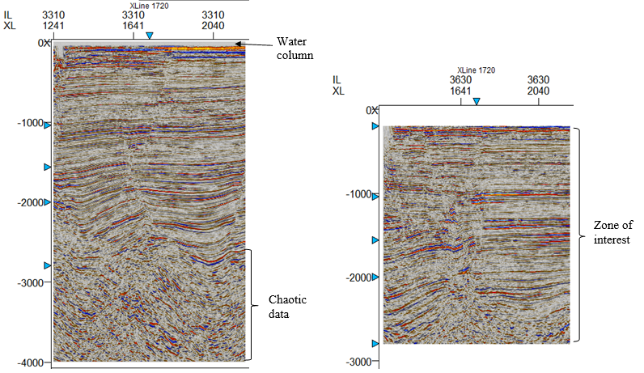
Presentation of Results and Discussion
Figure 2: Seismic data tuning to zone of interest. a) Original seismic amplitudes showing Inline 3310, b) Cropped seismic data showing elimination of the shallow and deep chaotic effects.

Slide 13
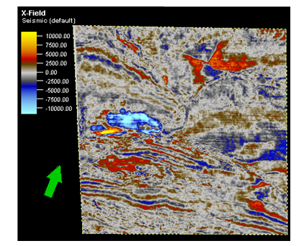
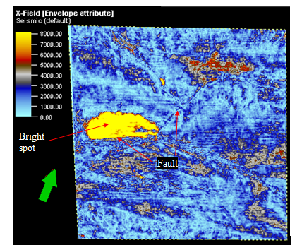
Presentation of Results and Discussion
Identification of Bright Spots
Figure 3: Bright spot not clearly identified Figure 4: Bright spot identified on
on original seismic time slice 972. envelope seismic attribute time slice 972.

Slide 14
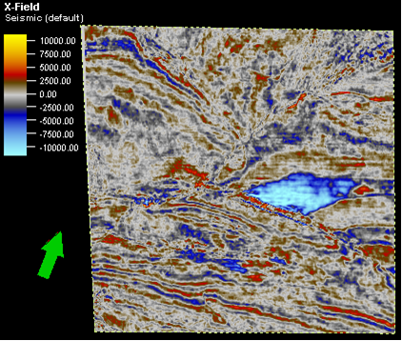
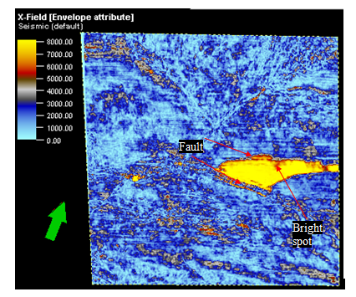
Presentation of Results and Discussion
Identification of Bright Spots
Figure 5: Bright spot not clearly identified Figure 6: Bright spot identified on
on original seismic time slice 1004. envelope seismic attribute time slice 1004.

Slide 15
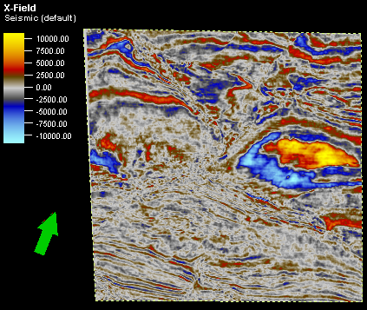
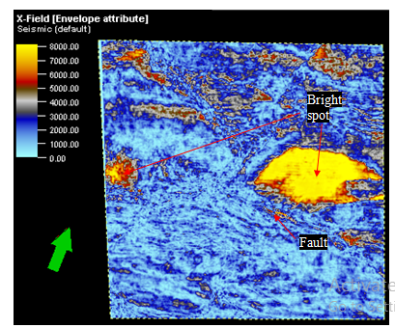
Presentation of Results and Discussion
Identification of Bright Spots
Figure 7: Bright spot not clearly identified Figure 8: Bright spot identified on envelope
on original seismic time slice 1404. seismic attribute time slice 1404.

Slide 16
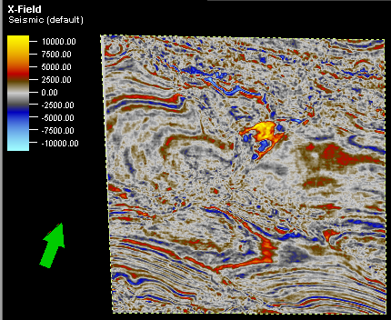
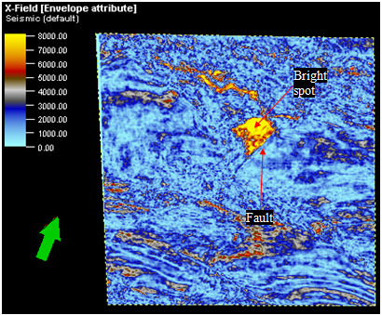
Presentation of Results and Discussion
Identification of Bright Spots
Figure 9: Bright spot not clearly identified Figure 10: Bright spot identified on
on original seismic time slice 1800. envelope seismic attribute time slice 1800.

Slide 17
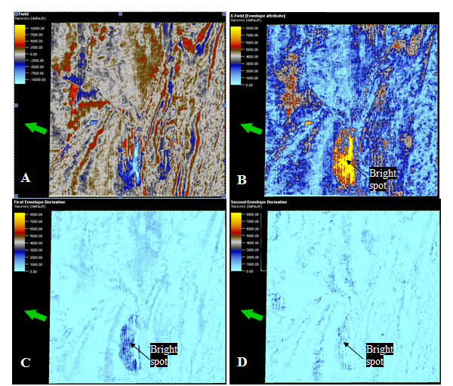
Presentation of Results and Discussion
Identification of Porous Media
All the porous media identified were bright spots associated with massive oil and gas accumulations and with very high porosities (Figures 3 - 10).
Comparison of Envelope and its Derivatives
Figure 11: Seismic time slice -960 ms showing identified bright spot on a) Seismic data, b) Envelope attribute, c)First envelope derivative, d) Second envelope derivative.

Slide 18
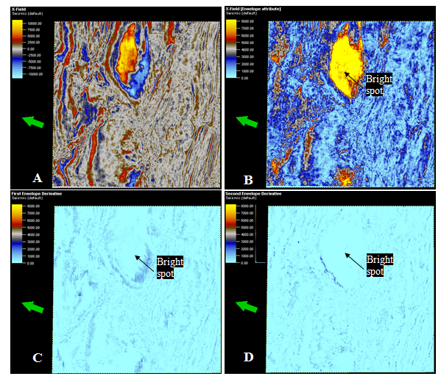
Presentation of Results and Discussion
Comparison of Envelope and its Derivatives
Figure 12: Seismic time slice -1404 ms showing identified bright spot on a) Seismic data, b) Envelope attribute, c)First envelope derivative, d) Second envelope derivative.

Slide 19
Summary of Findings
What are the key highlights from the study?
The envelope attribute is an effective tool for detecting porous media (porosity) and bright spots.
The first derivative of the envelope attribute was not good at identifying bright spots along time-slices, but were fairly good for identifying them on inlines. They were not good for picking porous media.
The second derivative of the envelope was not good in resolving porous media and bright spots.

Slide 20
Conclusion
What are the key deductions for the Fields?
The signal envelope attribute is therefore an invaluable tool used for enhancing seismic data for detection of porous media and bright spots across the fields investigated, thereby enhancing the overall reservoir characterization goals.
The first and second signal envelope derivatives performed very poorly at identifying the aforementioned features.

Slide 21
Final Remark
I am open to collaborations, exchanges, linkages and sabbatical opportunities.
Kindly contact me if you need more insights or are interested in my area of research.
e-mail: okechukwu.adizua@uniport.edu.ng
Mobile: +234(0)8138501347
+234(0)8036288530

Slide 22
Selected References
1. Adizua, O. F. and Eke, C. O. (2024). Application of signal envelope and its derivatives to enhance reservoir characterization of “X” field in the Niger Delta Basin. Ideas and Innovations in Earth Sciences, Kyiv, Ukraine. Paper presented at the 10th International Geosciences Conference of Young Researchers. Kyiv, 23-24 May, 2024.
2. Brown, A. (2001). Understanding seismic attributes. GEOPHYSICS 66(1), 47-48, doi: 10.1190/1.1444919
3. Chopra, S. and Marfurt, K. J. (2005). Seismic attributes for prospect identification and reservoir characterization. SEG Geophysical Development Series No. 11, 464p.
4. Chopra, S. and Marfurt, K. J. (2008). Emerging and future trends in seismic attributes. The Leading Edge 27(3), 298-318. Doi: 10.1190/1.2896620
5. Coren, F., Volpi, V. and Tinivella, U. (2001). Gas hydrate physical properties imaging by multi-attribute analysis – Blake Ridge BSR case study. Marine Geology 178(1), 197-210.
6. Koson, S., Chenrai,P. and Choowong,M. (2014). Seismic attributes and their applications in seismic geomorphology. Bulletin of Earth Science of Thailand, 6(1), 1-9.
7. Radovich, B. J. and Oliveros, R. B. (1998). 3D sequence interpretation of seismic instantaneous attributes from the Gorgon Field. The Leading Edge, v17, 1286-1293.
8. Sarhan, M. A. and Safa, M. G. (2017). Application of seismic attributes for detecting different geologic features within Kafr El Sheikh Formation, Temsah Concession, Nile Delta Basin. Scientific journal for Damietta Faculty of science. 7(1), 26-34.
9. Subrahmanyam, D. and Rao, P. H. (2008). Seismic attributes - a review. Hyderabad International Conference and Exposition on Petroleum Geology. 398-403.
10. Taner, M. T. (2001). Seismic attributes, CSEG Recorder 26, September 2001, p.48-56
11. Tounkara, F., Ehsan, M., Nasar Iqbal M., Al-Ansari, N., Hajana, M. I., Shafi, A. and Elbeltagi, A. (2023). Analyzing the seismic attributes, structura and petrophysical analysis of the lower Goru Formation: A case study from Middle Indus Basin Pakistan. Front Earth Sci. 10: 1034874. doi:10.3389/feart.2022.1034874

