Slide 1
Potato Landraces are More Resistant to Drought and Saline Stress: An Analysis of Germination Parameters
Abhisek Shrestha
College of Natural Resource Management- Bardibas
Agriculture and Forestry University
Nepal

Slide 2
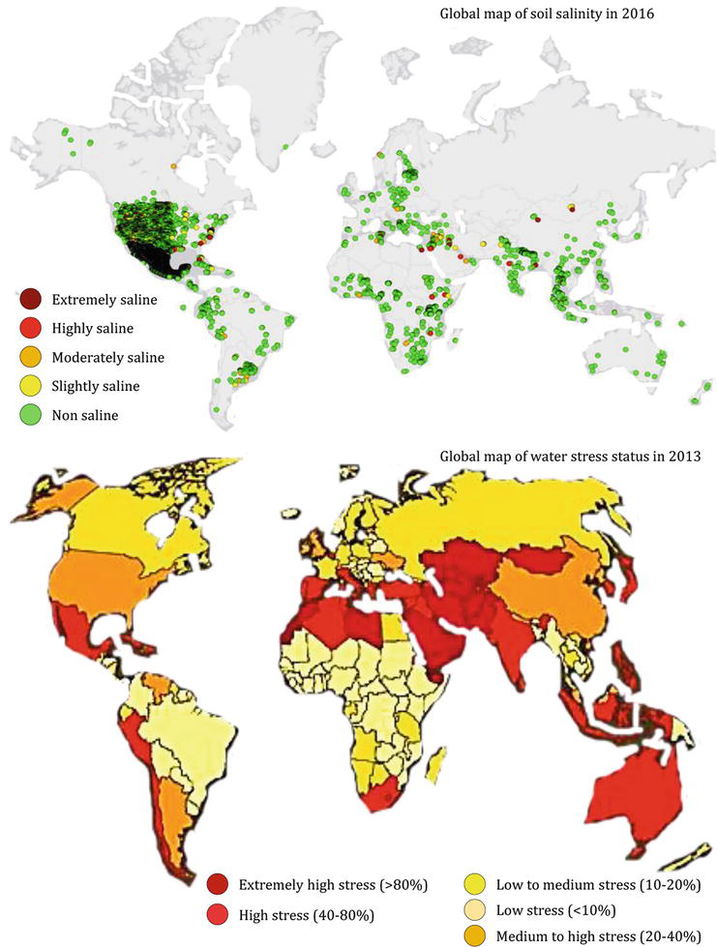
Introduction/problem statement/rationale of study
Potato (Solanum tuberosum L.)
one of the most important non grain food commodity, with the total global production of 437 million tonnes (FAOSTAT, 2021)
identified as moderately salt sensitive (Katerji, 2000)
sensitive to drought stress, due to its short and weak root architecture (Joshi et al., 2016)

Slide 3
Climatic change causing drought and salinity become serious problem globally through erratic/less rainfall, increased in temperature and silting due to flooding (Ahuja et al., 2010)
Nutrient deficiencies
Plant dehydration and even death
Hamper photosynthesis activities
Reduce tuberization
Leaf abscission
Overall impact of abiotic stresses on plant growth and development
Drought
Soil compaction
Inorganic/organic contamination
Diminished microbial activity
Ion toxicity
Oxidative stress reduced water uptake
Reduced photosynthesis
Salinity

Slide 4
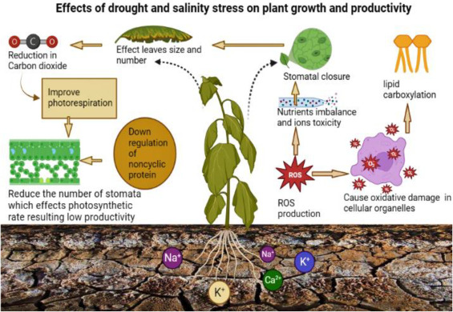

Slide 5
Objectives
General objective
To improve the productivity of potato through screening the landraces under abiotic stress
Specific objectives
To study different agro-morphological traits of potato seedling under saline and drought stress conditions
To study the growth and phenology of potato under saline and drought stress conditions

Slide 6
Research Hypothesis
Hypothesis
H₀=All landraces don’t show tolerance to saline and drought stress
H₁= At least some landraces show tolerance to saline and drought stress
Research question
Do available landraces traits are superior to cope with saline and drought stress problem?
Is any available of landraces that are broaden in genetic basis to use them in crop improvement?

Slide 7
Materials and Methods
Research Site: 29°26’49” N latitude and 81°29’12”E longitude, elevation 6400m(21,000ft)
Badimalika municipality-08, Martadi, Bajura
Research Design: Two factorial Completely Randomized Design (CRD)
Treatment: 18
Replications: 2
Plot( Tray) area: 40 ×30 cm2
Number of plots: 36
Date of Sowing : Chaitra-06,2079
Sowing density per Tray: 15 tuber
The applied fertilizer dose of potatoes was:
FYM: 298 gram per tray
Urea: 1.5 gram per tray
DAP: 2 gram per tray
MOP: 0.98 gram per tray

Slide 8
Treatment details
Fac A (Genotypes) | Fac B (stress)
Pandusen | Normal
Damkane | Saline (Salt dose 25g/L)
Dungri | PEG6000 induced drought (45g/L)
Basala chauka
Sim local
Desiree
Parameter recorded
Germination percentage(%)
Mean germination time
Plant height(cm)
Number of leaves
Number of branches
Root length(cm)

Slide 9
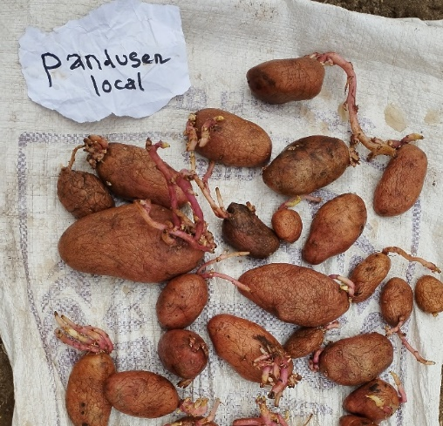
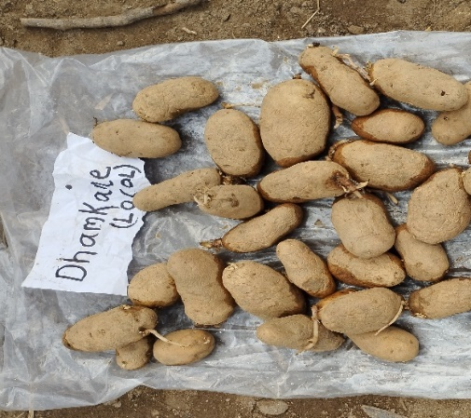
Description of Landraces used in experiment
Pandusen
Plant height:50-60 cm
• Number of haulm per plant:5-6
• No of leaves per plant: unknown
• No of branches per plant:15
• Stem diameter:7cm
• Flowering time:75-90 days
• Number of tubers per plant:15-20
• Tuber color: red
• Tuber weight:80-100g
• Maturity:120-135 days
Dhamkane
Plant height:60cm
• Number of haulm per plant:4-5
• No of leaves per plants:Unknown
• Number of branches per plant:15
• Stem diameter:7cm
• Flowering time:75days
• Number of tubers per plant:10-12
• Tuber color-White
• Tuber weight:40-50g
• Maturity:120-135 day

Slide 10
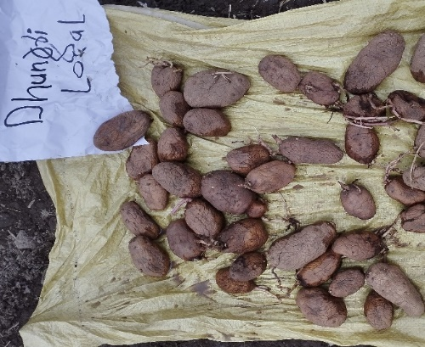
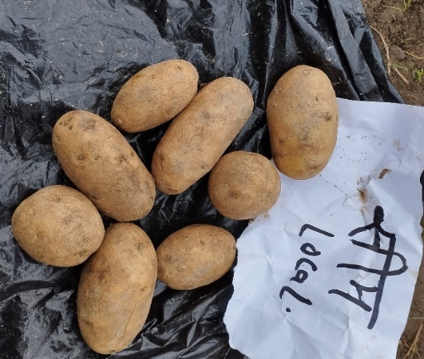
Dungri
Plant height:50-60cm
• No of haulm per plant:3-4
• No of leaves per plants: unknown
• Stem diameter:5cm
• Flowering time:60 days
• Number of tubers per plant:15-18
• Tuber color: white
• Tuber weight:50-60g
• Maturity:120-150 days
Sim local
Plant height:60 cm
• Number of haulm per plant:3-4
• No of leaves per plants: unknown
• Number of branches perplant:16
• Stem diameter:6cm
• Flowering time:60-75days
• Number of tubers per plant:15
• Tuber color: White
• Tuber weight:60-70g
• Maturity:120-150 Days

Slide 11
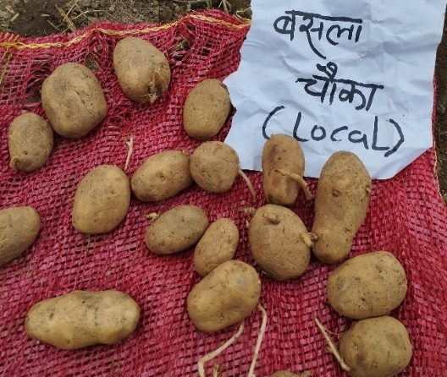
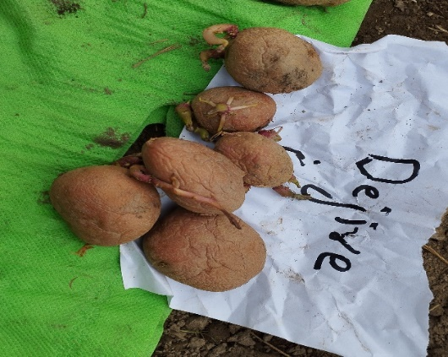
Basuala Chauka
Plant height:40-50cm
• Number of haulm per plant:5-6
• Number of branches per plant:10-15
• Stem diameter:5cm
• Flowering time :60-75 days
• Number of tubers per plant:10
• Tuber color: white
• Tuber weight:45-50g
• Maturity:120days
Desiree
Plant height:30-45 cm
• No of haulm per plant :5-7
• No of branches per plant:12-15
• Stem diameter:8 cm
• Flowering time :40-50 days
• No of tubers per plant:12-13
• Tuber color: Red
• Tuber weight:50g
• Maturity:90-120 days

Slide 12
Statistical Analysis
Data tabulated: Microsoft Excel (2021)
Statistical analysis: R (06.2 version)
Means comparison: Least Significant Difference at 5% level of significance
Reduction percentage in parameter in drought stress
R%= (T1-T2)/T1*100
where,
T1=Measurement of parameter in control
T2=Measurement of parameter in stress

Slide 13
Results and Discussion
Table 1. Germination percent and time affected by potato genotypes
Genotypes | Germination percentage(%) | Mean germination time
Pandusen Damkane Dungri Sim local Basala chauka Desiree | 80 80 85 85 85 80 | 31.20 34.33 34.25 35.70 36.38 33.80
LSD(0.05) SEm(±) CV (%) | Ns 6.12 14.84 | Ns 1.54 8.98

Slide 14
Table 2. Germination % and time affected by stress condition
Stress | Germination percentage | Mean Germination time
Control | 88.33ª | 32.65ª
Drought | 76.67^{b} | 35.90^{b}
Saline | 66.66^{c} | 38.81^{c}
LSD(0.05) SEm(±) CV (%) | 10.8 3.54 14.84 | 2.74 0.89 8.98
Grand mean | 82.5 | 34.27
Stress condition had negative impact in seed germination and remarkable increase in mean germination time with PEG induced water stress which is in accordance with (Alebrahim et al., 2008) and (Zahra Khodarahmpour, 2012) in maize

Slide 15
Table 3. Germination % and time affected by potato genotype and stress condition
Treatment | Germination percentage(%) |  |  | Mean germination time(MGT)
 | Normal | Drought | Saline | Normal | Drought | Saline
Pandusen | 90 | 70 | 60 | 29.56 | 32.83 | 32.83
Damkane | 80 | 80 | 70 | 32.87 | 35.77 | 35.77
Dungri local | 90 | 80 | 60 | 32.84 | 35.67 | 35.57
Sim local | 90 | 80 | 70 | 34.75 | 36.65 | 36.65
Basala chauka | 90 | 80 | 70 | 34.50 | 38.25 | 38.25
Desiree | 90 | 70 | 70 | 31.40 | 36.20 | 36.20
Mean reduction |  | 11.85 | 14.89 |  | 3.28 | 3.28
Individual genotypes have various impact with different stress, showed their potential to cope this stress condition due to their genetic gain, adaptation strategies (Sahat et al., (2022)

Slide 16
Table 4. Plant height affected by potato genotypes
Treatment | Plant height(cm)
Variety Pandusen Damkane Dungri Sim local Basala chauka Desiree | 45DAS | 90DAS
Pandusen local Damkane local Dungri local Basala chauka Sim local Desiree | 7.29ª 6.34^{ab} 8.16ª 5.25^{bc} 3.88^{c} 6.71^{ab} | 19.63^{ab} 17.92^{b} 24.19ª 15.74^{b} 14.97^{b} 14.88^{b}
LSD(0.05) SEm(±) CV (%) | 1.09* 0.36 19.66 | 2.88* 0.94 18.12

Slide 17
Table 5. Plant height affected by stress condition
Stress | Ph 45 DAS | Ph 90 DAS
Control | 7.04ª | 19.81ª
Drought | 5.49^{b} | 15.88^{b}
Saline | 4.21^{c} | 12.93^{c}
LSD(0.05) SEm(±) CV (%) | 10.8*** 3.54 14.84 | 2.88*** 0.94 18.12
Grand mean | 82.5 | 17.89

Slide 18
Table 6. Interaction effect of stress and genotype in plant height
Variety | Plant height(cm) |  |  | Reduction due to drought | Reduction due to saline
 | Normal | Drought | Saline
Pandusen | 21.88 | 17.39 | 12.60 | 19.09 | 42.4
Damkane | 19.67 | 16.19 | 14.95 | 18.61 | 23.9
Dungri local | 26.08 | 22.32 | 12.60 | 15.49 | 51.6
Sim local | 17.02 | 14.47 | 9.10 | 15.69 | 46.5
Basala chauka | 17.63 | 12.32 | 14.30 | 34.77 | 18.8
Desiree | 17.12 | 12.65 | 12.65 | 28.82 | 26.10
Mean |  |  |  | 21.36% | 34.7
Reyes et al., 2023 also reported peg stress had significant reductions in plant height (32.1%) in sugarcane

Slide 19
Table 6. Effect of genotype in root length, leaves number and braches per plant
Treatment | Leaves/plant | Branches/plant | Root length
Pandusen Damkane Dungri Sim local Basala chauka Desiree | 85.5ª 66.7^{ab} 79.6ª 72.2ª 40.3^{c} 66.9^{ab} | 15.9ª 10.5^{bc} 13.6^{ab} 9.5^{bc} 7.5^{c} 10.5^{bc} | 18.8 14.5 16.3 16.1 14.3 16.0
LSD(0.05) SEM(±) CV,% | 25.57 8.30 24.56 | 4.53 1.46 25.9 | Ns 1.35 16.7

Slide 20
Table 7. Effect of stress in leaves/plant, branches, root length
Stress | Leaves/plant | Branches/plant | Root length (cm)
Control | 77.3ª | 19.9.0ª | 16.8ª
Drought | 57.7^{b} | 9.5^{c} | 15.2^{b}
Saline | 41.3^{c} | 13.0^{b} | 6.2^{c}
LSD(0.05) SEm(±) CV (%) | 14.7*** 4.79 24.5 | 2.33*** 0.21 15.9 | 1.0.3*** 0.12 19.8
Grand mean | 67.5 | 16.4 | 16.0

Slide 21
Table 8. Interaction impact of stress and genotypes in leaf number in potatoes
Variety | Number of leaves per plant@90 DAS |  |  | Reduction due to drought | Reduction due to saline
 | Control | drought | saline
Pandusen | 99.5 | 71.67 | 57 | 24.42 | 42.7
Damkane | 77.5 | 56 | 43.6 | 26.96 | 43.7
Dungri | 87.67 | 71.65 | 35.5 | 22.37 | 59.5
Sim local | 81.1 | 63.35 | 33.6 | 23.99 | 58.5
Basala chauka | 47.44 | 33.67 | 38.9 | 33.14 | 17.9
Desiree | 71.17 | 50.83 | 49.4 | 27.34 | 30.5
Mean |  |  |  | 26.97 | 46.5

Slide 22
Table 9: Interaction impact of stress and genotypes in plant per branches of potato
Variety | Number of branches per plant@90 DAS |  |  | Reduction due to drought | Reduction due to saline
 | Normal | Drought | saline
Pandusen | 23.2 | 13 | 13.8 | 43.9 | 38.3
Damkane | 28.4 | 9.3 | 15.6 | 67.2 | 29.8
Dungri | 20.6 | 11.6 | 13.4 | 43.6 | 29.9
Sim local | 16 | 8.1 | 7.1 | 49.3 | 56.2
Basala chauka | 13.6 | 6.5 | 12.5 | 52.2 | 10.3
Desiree | 17.6 | 8.5 | 14.6 | 51.7 | 10.6
Mean |  |  |  | 51.2 | 32.6

Slide 23
Table 10: Interaction impact of stress and genotypes in root length in potatoes
Variety | Root length @90 DAS |  |  | Reduction due to drought | Reduction due to saline
 | Normal | Drought | saline
Pandusen | 20.5 | 17.1 | 6.6 | 16.5 | 67.8
Damkane | 15.6 | 13.5 | 9.4 | 13.4 | 39.7
Dungri | 17.2 | 15.4 | 5.9 | 10.4 | 65.6
Sim local | 14.5 | 17.8 | 4.9 | -22 | 66.2
Basala chauka | 15.6 | 13 | 4.6 | 16.6 | 70.5
Desiree | 17.5 | 14.5 | 5.9 | 17.1 | 66.2
Mean |  |  |  | 9.5 | 63.0
Salinity causes a reduction in the number of leaves (Chourasia, 2021), plant height, root length, number of branches and number of leaves (Sunjeet Kumar, 2021)
Saline stress affects germination and seedling growth in various species, such as sugarbeet and cabbage, soyabean, lentil, leading to decreased shoot and root length. (Neji Tarchoun, 2022)

Slide 24
Conclusion
Stress like drought and saline impact negatively in seedling growth and development
Sim local and Dungri local had showed lower reduction in growth parameter in term of germination, MGT,plant height and leaf number in drought
Dhamkane and Basala chauka found to be more tolerant to salinity stress

Slide 25
Thank You

