Slide 1
Non-Invasive soluble biomarkers in cancer-a tool for personalized medicine
Dr. Afsheen Raza
Associate Professor,
Department of Biomedical Sciences, College of Health Sciences,
Abu Dhabi University, UAE

Slide 2
Non-Invasive soluble biomarkers in cancer-
a tool for personalized medicine
Background-non-invasive biomarkers
Immune checkpoints and Immune checkpoint inhibitors (ICI)
Factors affecting ICI treatment response
Global data on Blood based biomarkers in ICI treatment
Study data
Conclusion

Slide 3
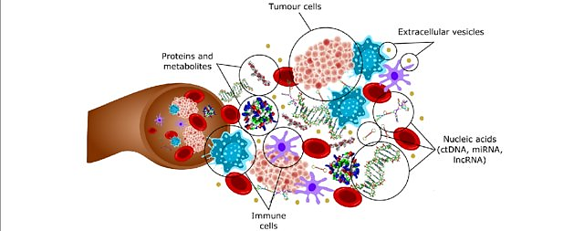
Non-Invasive Soluble Biomarkers
Biological molecules found in blood or other body fluids.
Range from circulating tumor DNA (ctDNA), exosomes, cytokines, and metabolites secreted into the blood, urine, saliva etc.
Rizo et l.,10.1186/s12943-018-0757-5

Slide 4
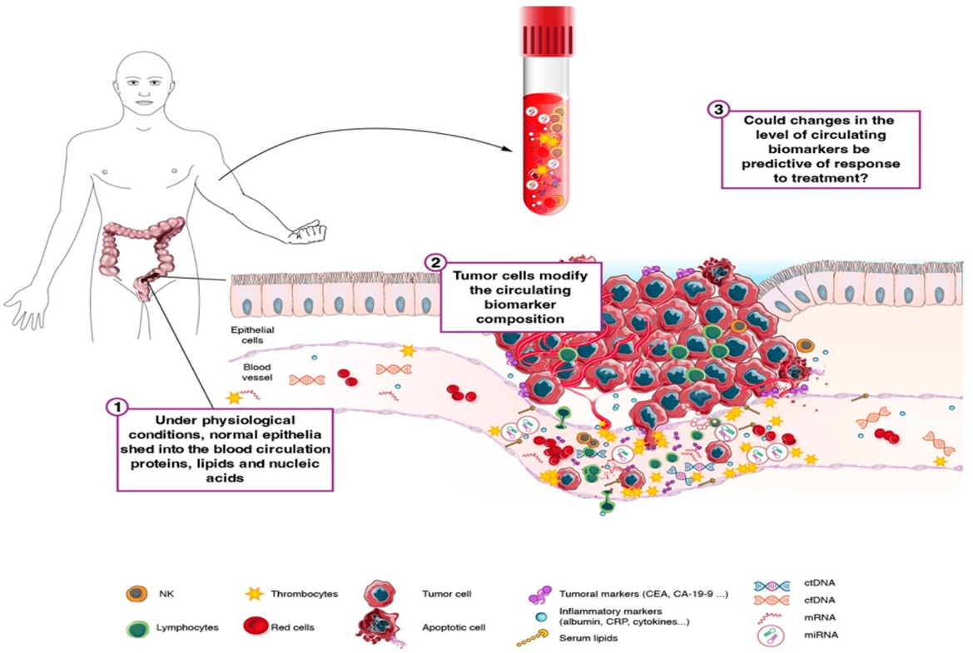
Non-Invasive Soluble Biomarkers
Overexpression of mutated gene product
Secretion of altered cellular proteins
by tumor cells
Distortion of the basement membrane during cell invasion and angiogenesis
https://doi.org/10.3390/ijms252111535

Slide 5
Tissue markers in Cancer treatment
Limitations
Invasive procedure
Tissue collection multiple times
Remote localization
Heterogeneity
False Positives
Size limitations (< 8mm not detected)
Conflicting data reported in RCTs
Non-Invasive , Easily Accessible Predictive Biomarkers

Slide 6
Why Non-Invasive Soluble Biomarkers?
Ease in Early cancer detection, prognosis, and longitudinal monitoring of treatment response-
NON-INVASIVE
Tool for precision and personalized medicine

Slide 7
Immune Checkpoints & Immune Checkpoint Inhibitors

Slide 8
Immune Checkpoints
Co-stimulatory or Co-inhibitory immuno-receptors that tightly regulate T cell activation
If antigen/MHC and TCR binding engages co-stimulatory receptors
T cell proliferation-death to cancer cells
If antigen/MHC and TCR binding engages co-inhibitory receptors
T cell suppression-death to T cells

Slide 9
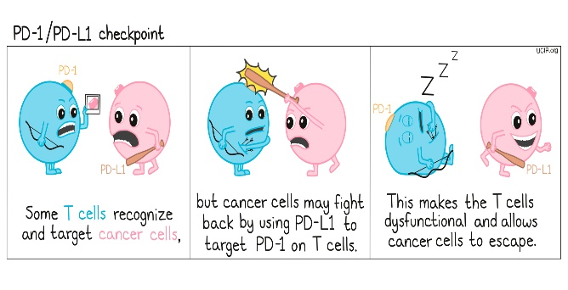
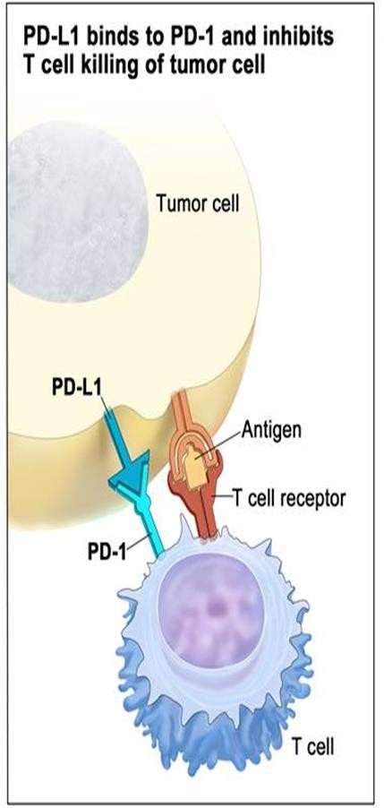
Immune Checkpoints
Cancer cells express inhibitory ligands (PD-L1)
BIND
co-inhibitory immune checkpoint receptor
(PD-1) on the T cell
decreases anti-tumor immune responses of T cells
increases Immune escape in cancer cells

Slide 10
Immune Checkpoints Inhibitors (ICI)
Immune Checkpoint Inhibitors-
Monoclonal antibodies-
Target/block interaction of
co-inhibitory receptors (PD-1) with inhibitory ligands (PD-L1)
Anti-tumor responses
Immune escape
Fig.Wang GX. https://doi.org/10.1148/rg.2017170085

Slide 11
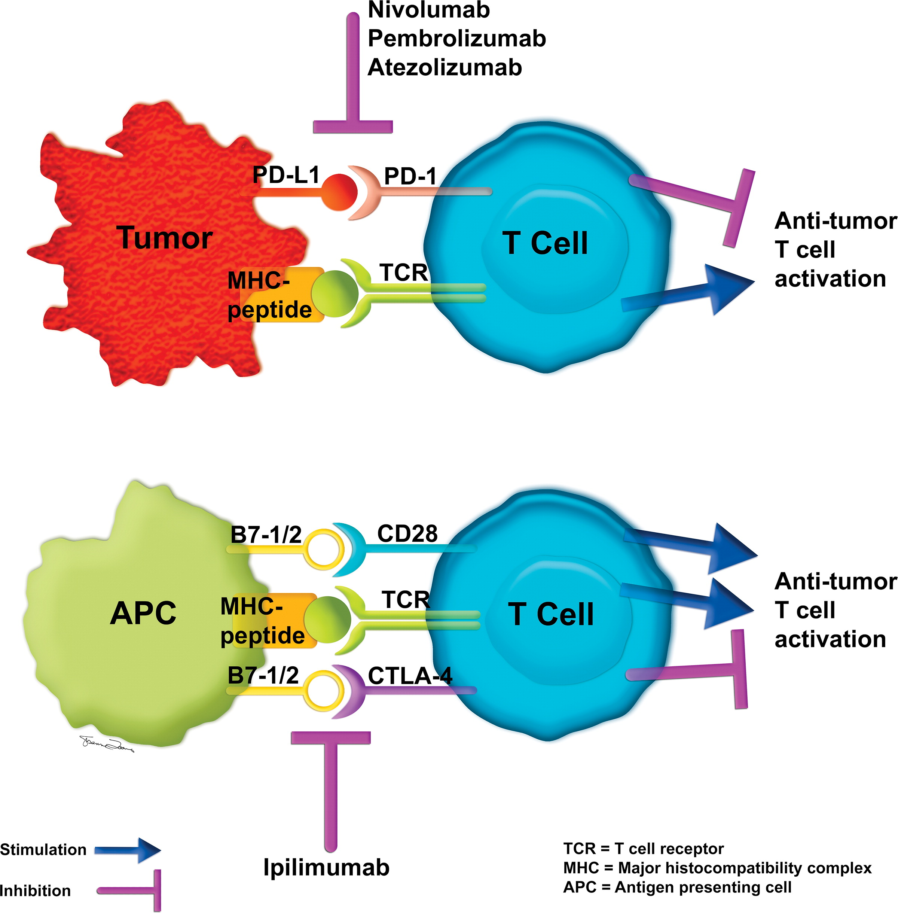
FDA approved Immune checkpoint inhibitors
Anti-CTLA-4
Anti-PD-L1
Anti-PD-1
Atezolizumab
Durvalumab
Avelumab
Pembrolizumab
Nivolumab
Cemiplimab
Dostarlimab
Ipilimumab
Tremelimumab
Response Rate between 20-40%

Slide 12
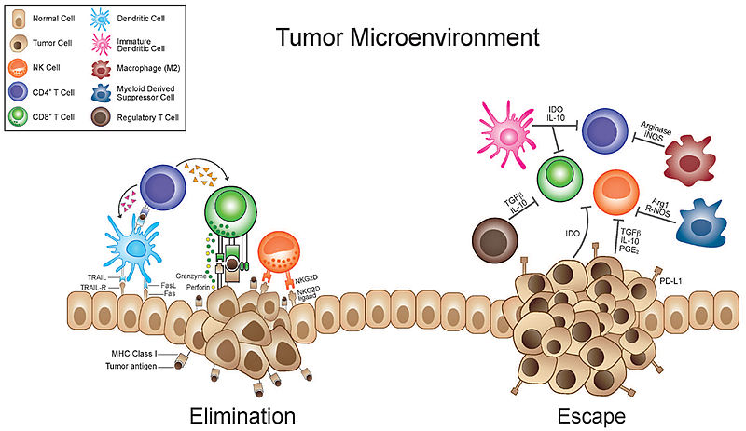
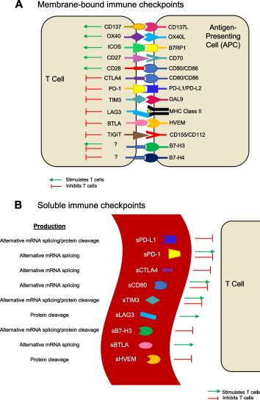
Factors affecting ICI treatment response
Immune checkpoint receptors/ligands can be released into the circulation
in soluble forms
May affect treatment dynamics
either in an immune inhibitory or immune stimulatory manner
http://www.frontiersin.org/files/Articles/51138/fonc-03-00197-HTML/image_m/fonc-03-00197-g001.jpg

Slide 13
Global Studies on clinical significance of soluble immune checkpoint molecules in ICI treated patients
sPD-1 | Tumor | Treatment | Expression levels | Outcome | Ref
 | NSCLC | Anti-PD-1 | Low | Response | Zizzari, I.G., et al., Pers Med, 2020
 | Melanoma | Anti-PD-1 | High at pre-treatment | Poor prognosis and survival | Ugurel, S., et al., Ann Oncol, 2020
sPDL-1 | NSCLC | Anti-PD-1 | High | Poor prognosis | Gong, B., et al., J Exp Med, 2019
 | Melanoma | Anti-CTLA-4 | High at pre-treatment | Poor prognosis | Zhu, X. and J. Oncotarget, 2017
sPDL-2 | NSCLC | Anti-PD-1 | Low | Response | Zizzari, I.G., et al., Pers Med, 2020
 | NSCLC | Anti-PD-1 | Low at pre-treatment | High risk of immune related adverse events | Costantini, A., et al., Oncoimmunology, 2018
sCTLA-4 | Melanoma | Anti-CTLA-4 | High at pre-treatment | Response | Leung, A.M., et al., Front Oncol, 2014
 | Melanoma | Anti-CTLA-4 | High at pre-treatment | Response high risk of immune related adverse events | Pistillo, M.P., et al., Cancer Immunol Immunother, 2019
 | NSCLC | Anti-PD-1 | Low | Response | Zizzari, I.G., et al., Pers Med, 2020

Slide 14
Study Question
Is there a role of soluble immune checkpoint molecules as
early predictive biomarkers
in ICI treated Non-small cell lung cancer (NSCLC) patients?

Slide 15
Published paper
DOI 10.3389/fimmu.2023.1157100

Slide 16
Study population
Serum samples from 31 metastatic advanced stage NSCLC patients taken before treatment
15 patients (48%): Anti-PD-1 (Pembrolizumab/Nivolumab)
3 patients (10%) Anti-PD-L1 (Durvalumab)
13 patients (42%) Combination chemotherapy+ Immunotherapy (Chemo+Pembrolizumab)

Slide 17
Methodology
Immune oncology multiplexing kits utilized to assess the expression of serum biomarkers:
T cell exhaustion or stimulation markers
Natural Killer Cell (NK) cell checkpoint markers
B7 family of immune checkpoint regulators
Immuno-Oncology Checkpoint Human ProcartaPlex Panel 1, 2 and 3 (ThermoScientific)

Slide 18
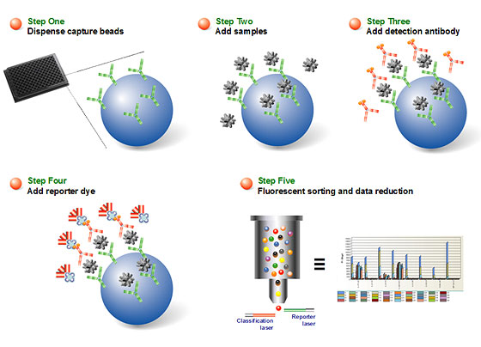
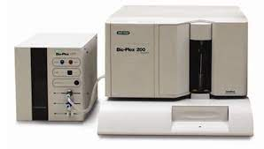
Methodology
The concentration of serum biomarkers was measured by Luminex Bio-Plex 200 system (BIO-RAD).
Analyte concentrations were calculated against a seven-point standard curve using a five-parametric fit algorithm in xPONENT v4.0.3.

Slide 19
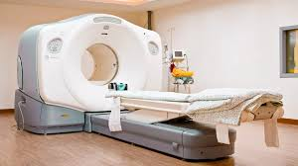
Clinical assessment of response
Response to treatment was assessed via:
PET-CT imaging data
Clinical assessment per RECIST criteria
Progression-free survival (PFS):
Period from blood sample collection
(before the first dose) till
date of clinical and radiological disease progression or death within 6-8 months from the start of the treatment

Slide 20
Comparison of soluble biomarkers in responding and non-responding patients

Slide 21
Comparison of soluble biomarkers in responding and non-responding patients
In Non-Responding patients
Significant Upregulation of the immune inhibitory biomarkers
Soluble CD80 (p=0.023*), sTIMD4 (p=0.033*), and CEA (p=0.008**)

Slide 22
Comparison of soluble biomarkers in responding and non-responding patients
Pre-treatment levels of soluble CD80, sTIMD4 and CEA
may play a significant role in immune modulation and treatment response in ICI treated NSCLC patients.

Slide 23
Comparison of soluble biomarkers in responding and non-responding patients
These markers help in immune escape and tumor progression in NSCLC:
soluble CD80
Being splice variant of membranous CD80 it can still bind to:
inhibitory T cell receptor CTLA-4 leading to co-inhibition of T cells
membrane-bound CD80 on antigen-presenting cells reducing its interaction with T cells
Studies on prostate cancer, hematological malignancies, renal cell carcinoma, and NSCLC have associated:
high levels of serum CD80 expression with enhanced invasiveness and poor prognosis

Slide 24
Comparison of soluble biomarkers in responding and non-responding patients
soluble TIMD4 (T Cell Immunoglobulin and Mucin Domain Containing 4)
promotes lung cancer cell proliferation leading to poor overall survival
mechanism of TIMD4-mediated cancer progression remains unknown
soluble CEA (Carcinoembryonic antigen)
Elevated CEA levels associated with tumor size, lymph node status, stage of disease, and treatment monitoring
In ICI-treated NSCLC patients’ high pre-treatment CEA-worse PFS and OS

Slide 25
Determination of optimal cut-off values of soluble biomarkers to discriminate responders from non-responders

Slide 26
Cut-off values of soluble biomarkers to discriminate responders from non-responders
Analyte | Cut-Off Value | AUC Value | Sensitivity/Specificity
sCD80 | <91.7pg/ml | 0.7262 | 73%/71%
sTIMD4 | <600pg/ml | 0.7250 | 75%/66%
sCEA | <1614pg/ml | 0.778 | 67%/83%
These cut-off values were utilized for analyses of Progression free survival
in patients

Slide 27
Association of soluble biomarkers with progression free survival

Slide 28
Association of soluble biomarkers with progression free survival
The association of higher than cut-off and lower than cut-off values of the soluble biomarkers with PFS- Kaplan Meier (log-rank) test
Patients with levels of CD80 and CEA, Higher than cut-off values :
Poor PFS (median survival of 4 months and 3.5 months)
Patients with levels of CD80 and CEA, Lower levels than cut-off values :
Significantly associated with better progression-free survival
CD80 (p=0.042*) and CEA (p=0.037*)
No significant association of TIMD4 cut-off value with PFS was observed (p=0.05)

Slide 29
Association of soluble biomarkers with progression free survival Kaplan Meier (log-rank) test
Patients with levels of CD80 and CEA, Higher than cut-off values :
Poor PFS (median survival of 4 months and 3.5 months)
Patients with levels of CD80 and CEA, Lower levels than cut-off values :
better progression-free survival; CD80 (p=0.042*) and CEA (p=0.037*)
No significant association of TIMD4 cut-off value with PFS was observed (p=0.05)

Slide 30
Cox proportional hazard regression analysis to identify independent predictive biomarkers

Slide 31
Cox proportional hazard regression analysis
Independent predictor of better progression-free:
CEA lower than the cut-off value (p=0.012)

Slide 32
Summary
In ICI treated NSCLC patients:
soluble CD80, TIMD4 and CEA may have utility as non-invasive early/pre-treatment biomarkers of response
Lower levels than the cut-off value of CD80 and CEA are significantly associated with
better progression-free survival
CEA lower than the cut-off value is independent predictors of better PFS
Limitations:
Small sample size
Recommendations:
Larger longitudinal studies with larger cohorts-better understanding on the utility of these novel biomarkers as predictors of response in various cancers/treatment types

Slide 33
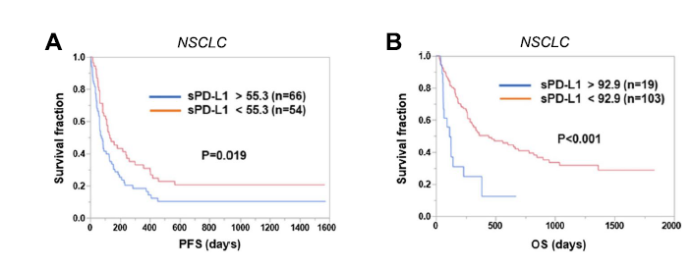
Future Perspectives

Slide 34
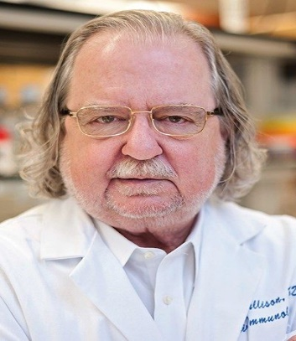
Thank you
Prof. James Allison (Year 2018 Nobel Prize winner-
Discovery of Immune checkpoint inhibitor therapy
“The biggest challenge in immunotherapy now is figuring out
why an immune drug works in some patients and not in others;
to do that we need to go back to basic science”

