Slide 1
Title: SYNTHESIS OF CHITOSAN BASED HYDROGEL FOR CHROMIUM (VI) REMOVAL FROM TANNERY WASTEWATER
Dr.Muhammad Afzaal
Sustainable development Study Center Government College University Lahore

Slide 2
Introduction
Leather is the final product of animal hides, after going through many physical and chemical processes.
Raw hide is tanned using Chromium Sulphate,
It triggers collagen crosslinking between collagen fiber bonds
Results in a flexible, robust structure of leather that is long-lasting, resistant to putrefaction, and useful in a variety of contexts.

Slide 3
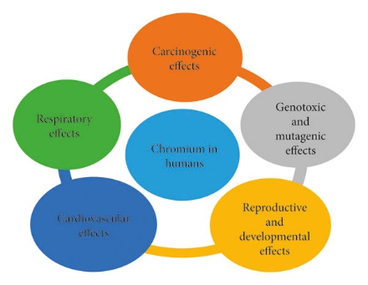
Problem Statement
Removing heavy metals from tannery wastewater is a significant challenge since they accumulate throughout the whole food chain due to bioaccumulation, which is not biodegradable and results in illnesses, poisoning, diseases and cancer.

Slide 4
Tannery Wastewater Treatment Process and Gaps between Them
Several methods have been developed and applied for the removal of heavy metals contained in aqueous solutions, including
Chemical Precipitation,
Ionic Exchange,
Filtration Membrane,
Oxidation-reduction Process,
Dialysis,
Electro dialysis and Electrolytic Extraction.
Most of the developed methods have high cost, formation of secondary pollutants, high energy consumption, long processing times, poor adsorbent regeneration, and low chromium removal percentage.

Slide 5
Adsorption
The methods for the removal of heavy metals contained in aqueous solutions based on adsorption are simple, inexpensive, effective, and easy to operate and access.
The adsorbents used for the adsorption and removal of heavy metals contained in water and wastewater need to be inexpensive, biodegradable, and non-toxic.
The most common adsorbents include zeolites, clays, silicates, biomass, polymers, hydrogels, composite.

Slide 6
Hydrogel
Natural polysaccharide-based hydrogels are adsorbents formed by hydrophobic/hydrophilic three-dimensional polymer networks capable of absorbing large amounts of water.
These adsorbents can be efficiently employed for the adsorption of dyes, proteins, agricultural nutrients, and heavy metals.
The aim of this work is to study the adsorption and removal of Cr (VI) ions contained in aqueous solutions using a chitosan-based hydrogel as alternative adsorbent.

Slide 7
Research Objectives
Preparation and characterization of hydrogel by using chitosan, Polyvinylpyrrolidone (PVP) and sepiolite.
This research is designed for
Removal of heavy metal, Cr (VI) from waste water to reduce its harmful impacts on public, aquatic life and environment.
Characterization of sorption capacity of chitosan-based hydrogel, before and after treatment with chemicals, for removal of Cr (VI) from wastewater.

Slide 8
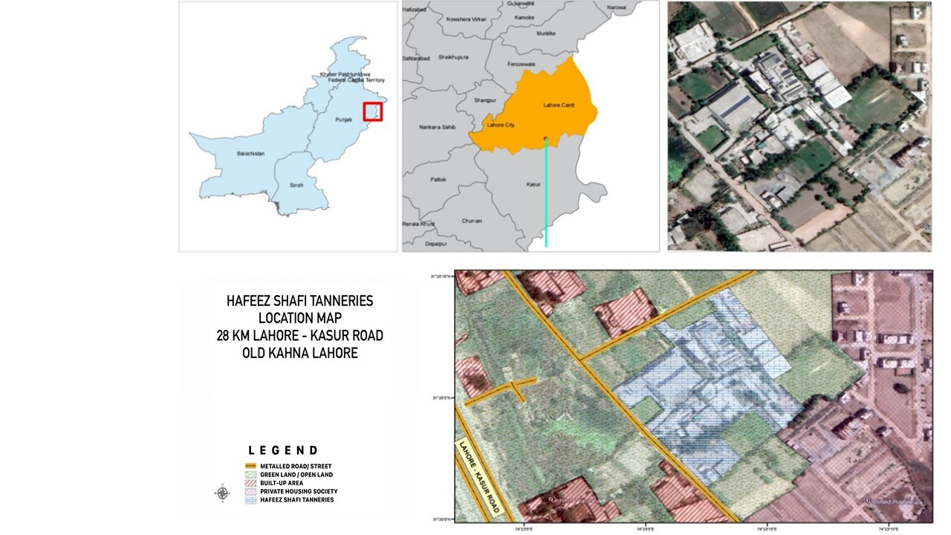
Materials and Methods
Sampling Site
For collection of tannery waste water, Hafeez Shafi tanneries were selected. It is located around 28km away from central Lahore on Lahore-Kasur road near old Kahna, Lahore.

Slide 9
Hydrogel Formulation
Functionalization of Sepiolite Clay
Preparation of Chitosan/Polyvinylpyrrolidone Hydrogel
Preparation of Chitosan/ Polyvinylpyrrolidone/Sepolite Hydrogel Films

Slide 10
Preparation of Hydrogel Films
Add ethanol and TEOS (as crosslinker) solution to functionalize halloysite clay
Add 2% formic acid in chitosan to make chitosan solution
Mix both of these PVA and Chitosan solution to make a blend
Add blended solution into the functionalize
Halloysite clay
Add distilled water in PVA to make PVA solution
Cast solution into petri dish and place it in oven for oven dry
Separate film from the petri dish and store it in a zipper bag

Slide 11
Characterization of Hydrogel
Scanning Electron Microscope (SEM) Analysis of Nanocomposite Hydrogels
X-Ray Diffraction (XRD) Analysis of Hydrogels
Fourier Transform Infrared Radiations (FTIR)

Slide 12
Adsorption Experiment for Chromium Removal

Slide 13
Effect of Different Parameters on Adsorption
Effect of pH
Effect of Contact Time
Effect of Initial Concentration
Effect of Temperature

Slide 14
Results

Slide 15
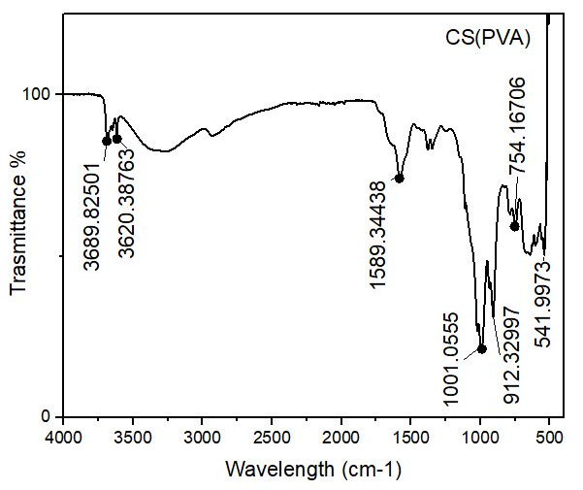
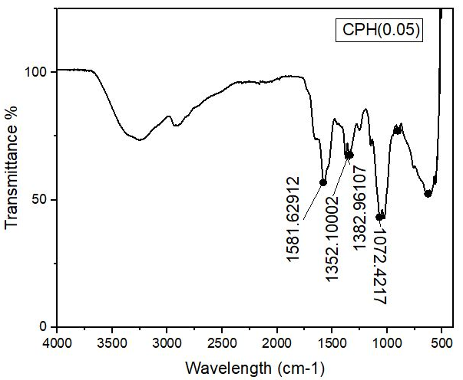
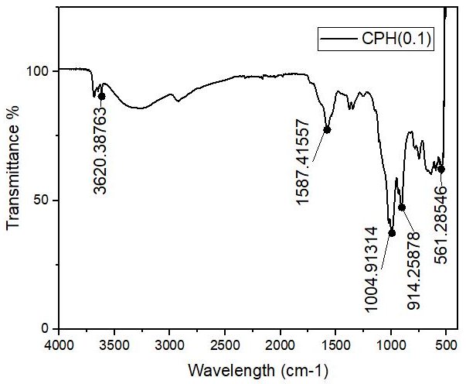
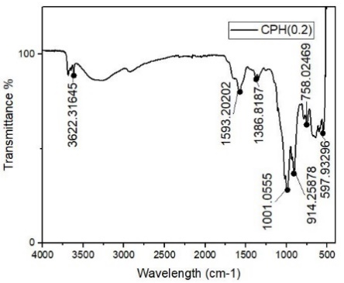
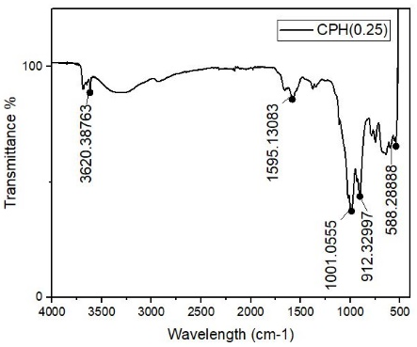
Fourier transform infrared spectroscopy (FTIR) Analysis

Slide 16
Fourier Transform Infrared Spectroscopy (FTIR)
Samples | Functional Group
CS(PVP) | C-C , C=O, and C-O
CPS(0.01) | OH, C = C and C-O alkoxy
CPS(0.03) | N-H, C=C, C-O, and Si=O
CPS(0.05) | N-H, C=C, C-O, Si=O and C=C
CPS(0.1) | OH, C = C, C-O alkoxy, Si=O group

Slide 17
Scanning Electron Microscope (SEM) Analysis of Nanocomposite Hydrogels

Slide 18
SEM images of hydrogels (a) for CS/ PVP control (b) for CPS (0.01) (c) for CPS (0.03) (d) for CPS (0.05) (e) for CPS (0.1)

Slide 19
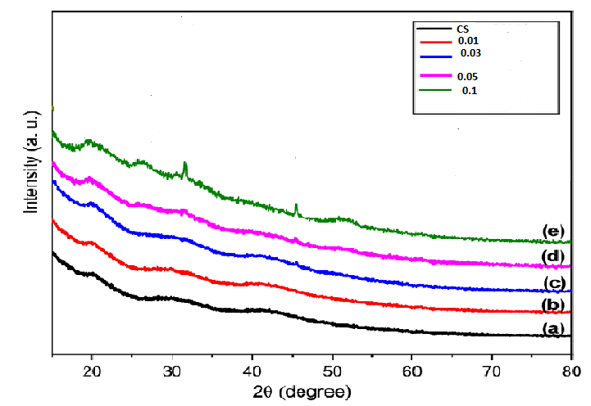
X-Ray Diffraction (XRD) Analysis of Hydrogels
X Ray diffraction of Chitosan based Hydrogel (a) for CS/PVP (b) for CPS (0.01) (c) for CPS (0.03) (d) for CPS (0.05) (e) for CPS (0.1)

Slide 20
Swelling Response of Hydrogels in Distilled Water

Slide 21
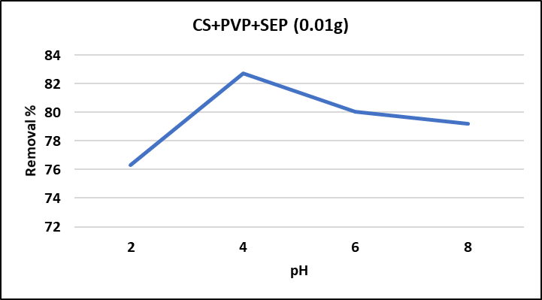
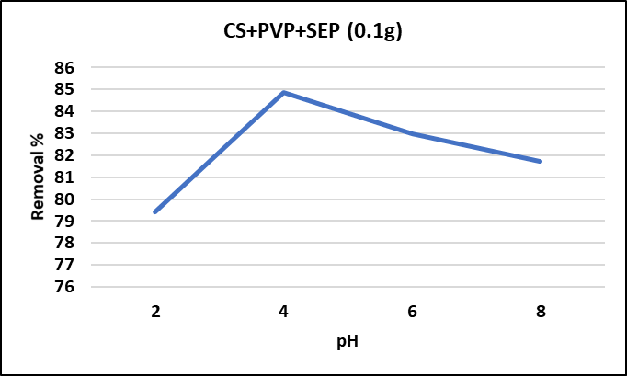
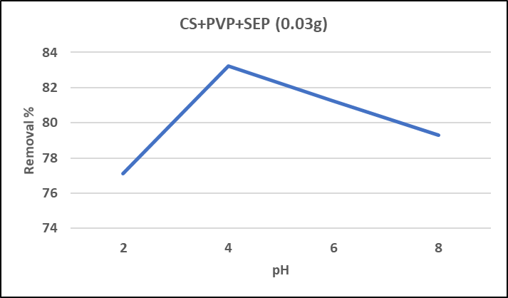
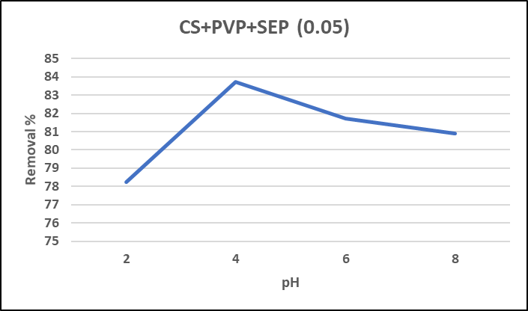
Effect of pH

Slide 22
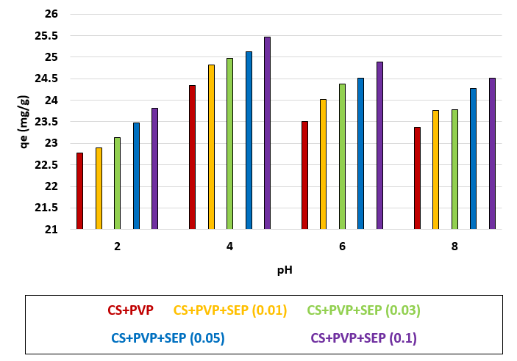
Effect of pH on Adsorption Capacity of Chromium (VI)

Slide 23
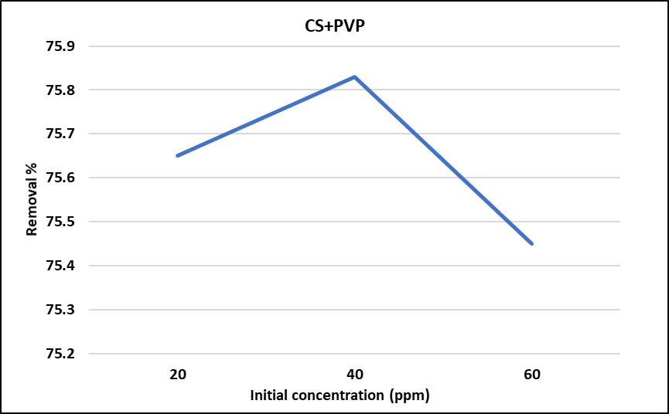
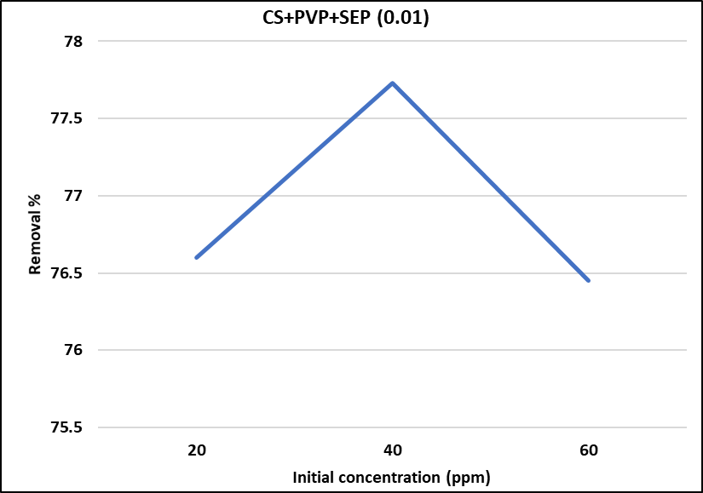
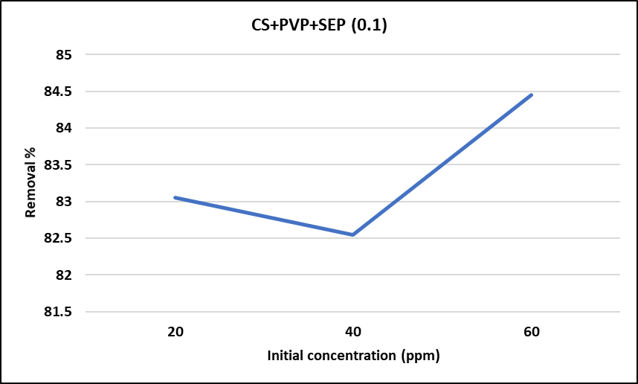
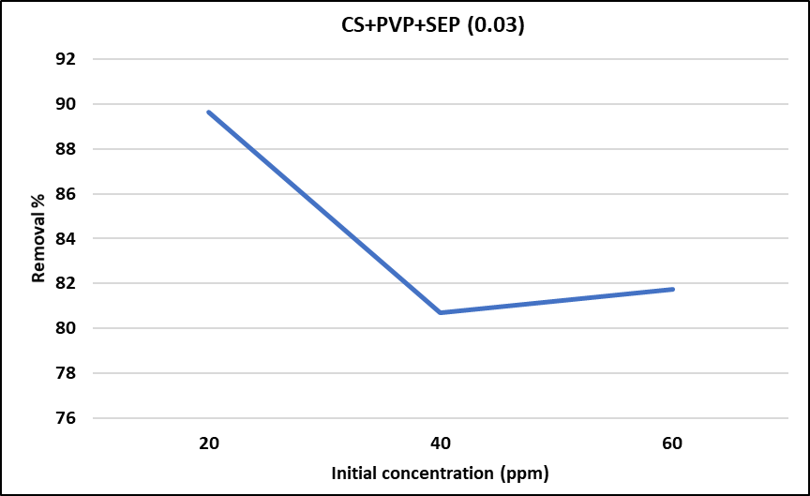
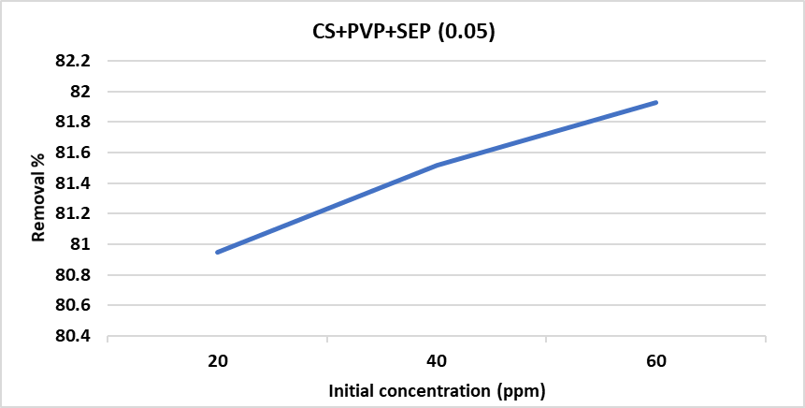
Effect of Initial Concentration

Slide 24
Effect of Initial Concentration for the Adsorption of Chromium (VI)

Slide 25
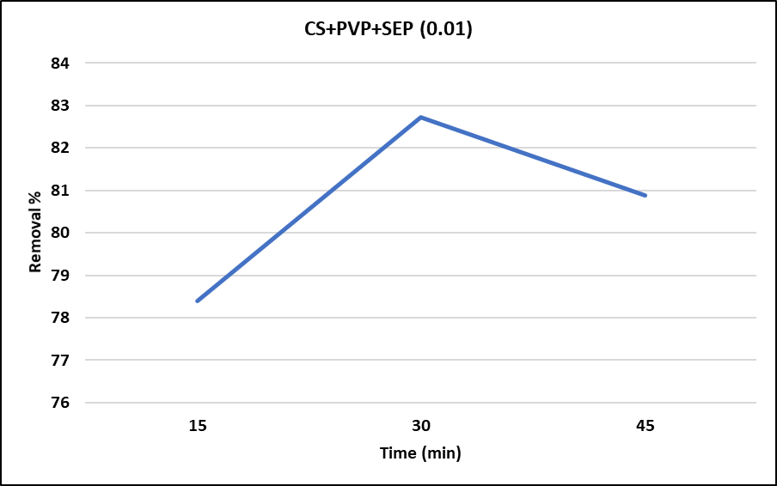
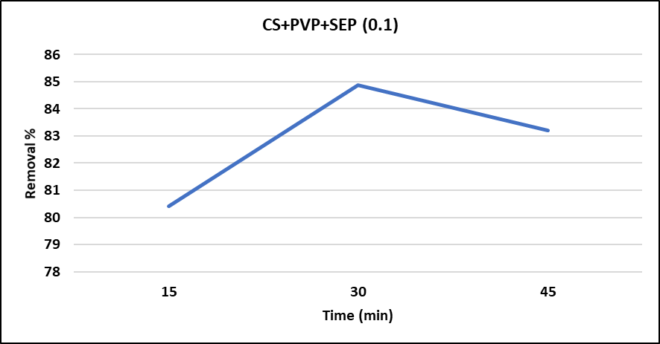
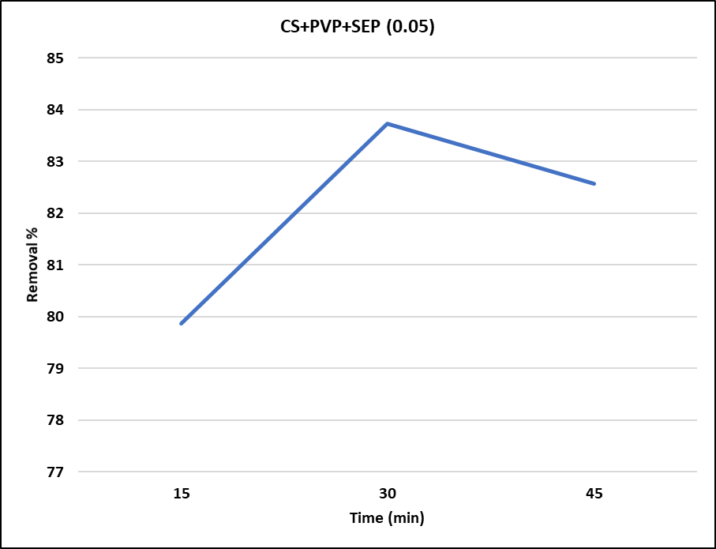
Effect of Contact Time

Slide 26
Effect of Contact Time on Adsorption of Chromium (VI)

Slide 27
Comparison of Chitosan-based hydrogel with other Absorbents on the basis of their removal efficiency and Adsorption capacity
Sr. No | Hydrogel Adsorbents | Adsorption Capacity (Q_{e}) mg/g | Removal Efficiency (%) | References
1. | Gelatin-chitosan hydrogel particles | - | Hg (II)-98, Pb (II)-34, Cd (II)-20, and Cr (III)-16 | Lone et al., 2019
2. | Soybean hydrogel | Cd (II)-1.43 mmol/g and Pb (II)-2.04 mmol/g | - | Zhang et al., 2020
3. | Poly (acrylamide-co-sodium methacrylate) hydrogel | Cu (II)-24.05 and Cd (II)-33.0 | Cu (II)-48 and Cd (II)-66 | Milosavljevi´c et al., 2014
4. | Graphene oxide composite hydrogel | Cu (II)-5.99 | - | Choi e al., 2020
5 | Chitosan (CS), glucan (GL) and N'N-methylenebisacrylamide (NMBA) hydrogel | Cu (II)-365 mg g−1, Co (II)-251 mg g−1, Ni (II)-207 mg g−1, Pb (II)-424 mg g−1, and Cd (II) 356 mg g−1. | - | Jiang et al., 2019
6 | 3D printable polyethyleneimine based hydrogel | - | Cu (II)-90.38%, Ni (II)-59.87%, Cd (II)-46.27%, Co (II)-38.66%, and Pb (II)-6.45% | Finny et al., 2022
7 | Acrylamide grafted chitosan hydrogel | Cr (VI)- (427 mg/g) | - | Sethi et al., 2022
8. | Carboxymethyl cellulose/polyethylenimine hydrogel (CMC/PEI) | Cr (VI)-6.01 mmol g−1 | Cr (III)-6.04% | Song et al., 2019
9. | CL-g-pAA hydrogell | Cr (VI)-85.47 mg g -1 | Cr (VI)-65% | Wang et al., 2018
10 | CL-g-pDMC hydrogel | Cr (VI)-105.26 mg g -1 | 1st cycle Cr (VI)-95%, 5th cycle 80% (CrVI) | Wang et al., 2018
11 | Cu–Fe embedded cross-linked cellulose hydrogel (nFeCu-CH) | 9.5-20 mg/l | 88% of Cr (VI) | Wang et al., 2021
12 | Chitosan-PVP crosslinked with Sepiolite | 25.46 mg/l | 84.7% of Cr (VI) | This study

Slide 28
Conclusion
Under different conditions, the absorption of Cr(VI) varies in all hydrogels.
With increasing time, all of the hydrogels showed a high swelling behavior giving the following trend;
CS+PVP+SEP (0.1)> CS+PVP+SEP (0.05)> CS+PVP+SEP (0.01)>
CS+PVP+SEP (0.03)> CS+PVP
Similarly, at pH 2,4,6 and 8, the trend of absorption between different hydrogel was;
CS+PVP+SEP (0.1)> CS+PVP+SEP (0.05)> CS+PVP+SEP (0.03)>
CS+PVP+SEP (0.01) > CS+PVP.
Similar increasing trends were seen in case of contact time and initial concentrations.
The highest absorption of 5045% was observed in CS+PVP+SEP (0.1). The maximum removal efficiency was shown by CS/PVP/Sep (0.1) hydrogel at pH 4 (84.7%).

Slide 29
Conti…..
CS+PVP+SEP (0.1) showed highest efficiency of 84-85% removal of Cr(VI) at 4 PH, 25ºC temperature, with initial concentration of 60ppm and equilibrium time interval of 30 minutes.
A reduction in hydrogel crystallinity is seen following the addition of Nano clay and cross linker to modified chitosan.
The electrostatic force of the attraction was dominant in the adsorption process. The adsorbent in its prepared state was friendly to the environment and simple to recover and regenerate.
Therefore, chitosan-based hydrogel adsorbent should be used as a promising adsorbent for the removal of Cr (VI) from tannery wastewater.

Slide 30
Future Recommendations
This hydrogel was applied to only one heavy metal. While the tannery waste water is a mixture of different salts, chemicals and acids that release multiple pollutants in water. So, there is a need to investigate the efficiency of chitosan-based hydrogel in the presence of different other heavy metals and chemicals.
Need to educate the local tanners regarding impacts Tannery waste water
Strict actions like policy making, rule of law and implementation of these rules, regulation and laws is necessary.

Slide 31
Thank You

