Slide 1


Impact of River Geomorphology on nitrogen retention and retention processes
Dr. Md. Ataul Gani
Associate Professor
Department of Botany
Jagannath University
Dhaka 1100, Bangladesh

Slide 2
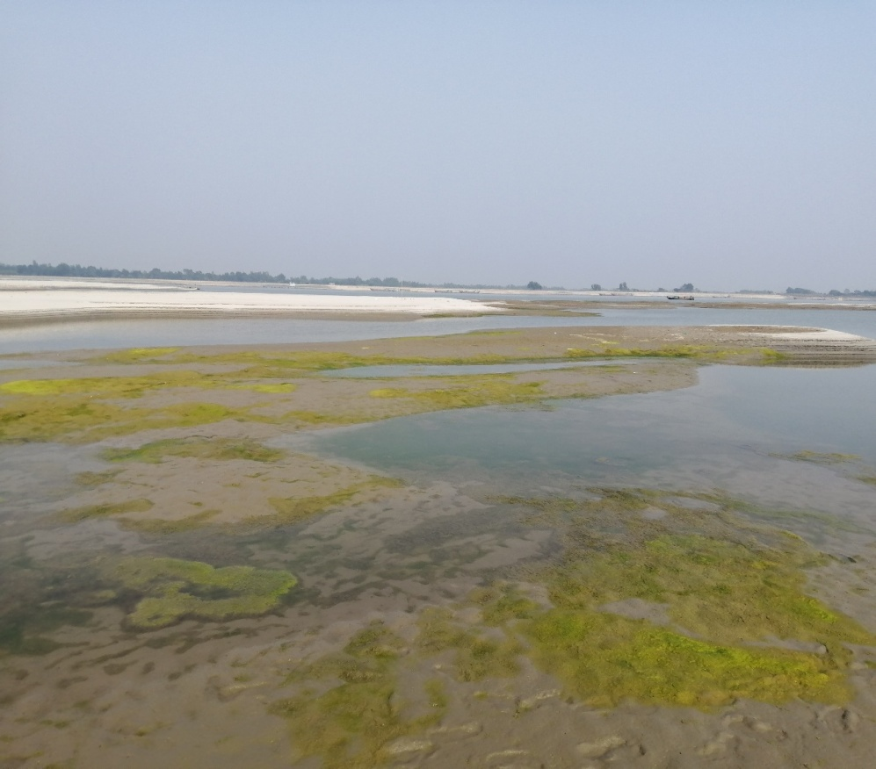
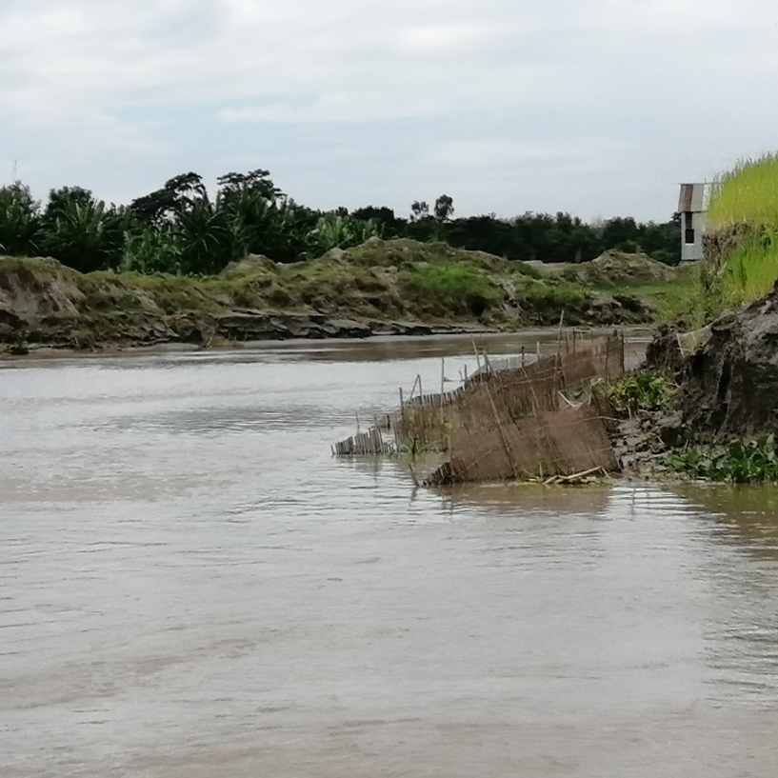
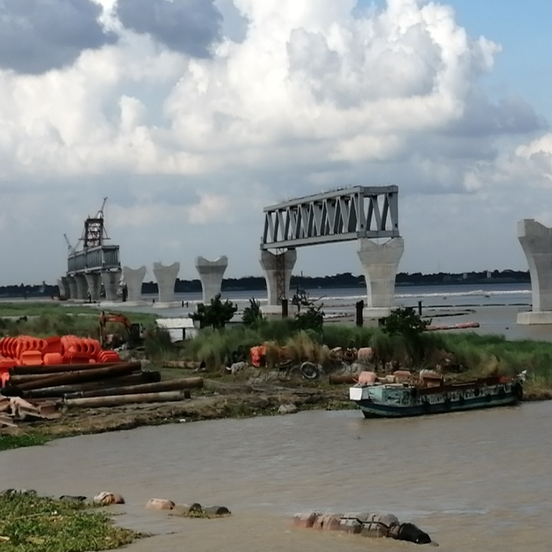
Geomorphic units and Nutrient retention
Geomorphic units (GUs) are the building blocks of the rivers, can contribute to nutrient retention.
Natural and human-induced activities change the structure of GUs in the river channel.
Bar (dry)
Main channel
Water depressions
Bar with vegetation cover (wet)

Slide 3
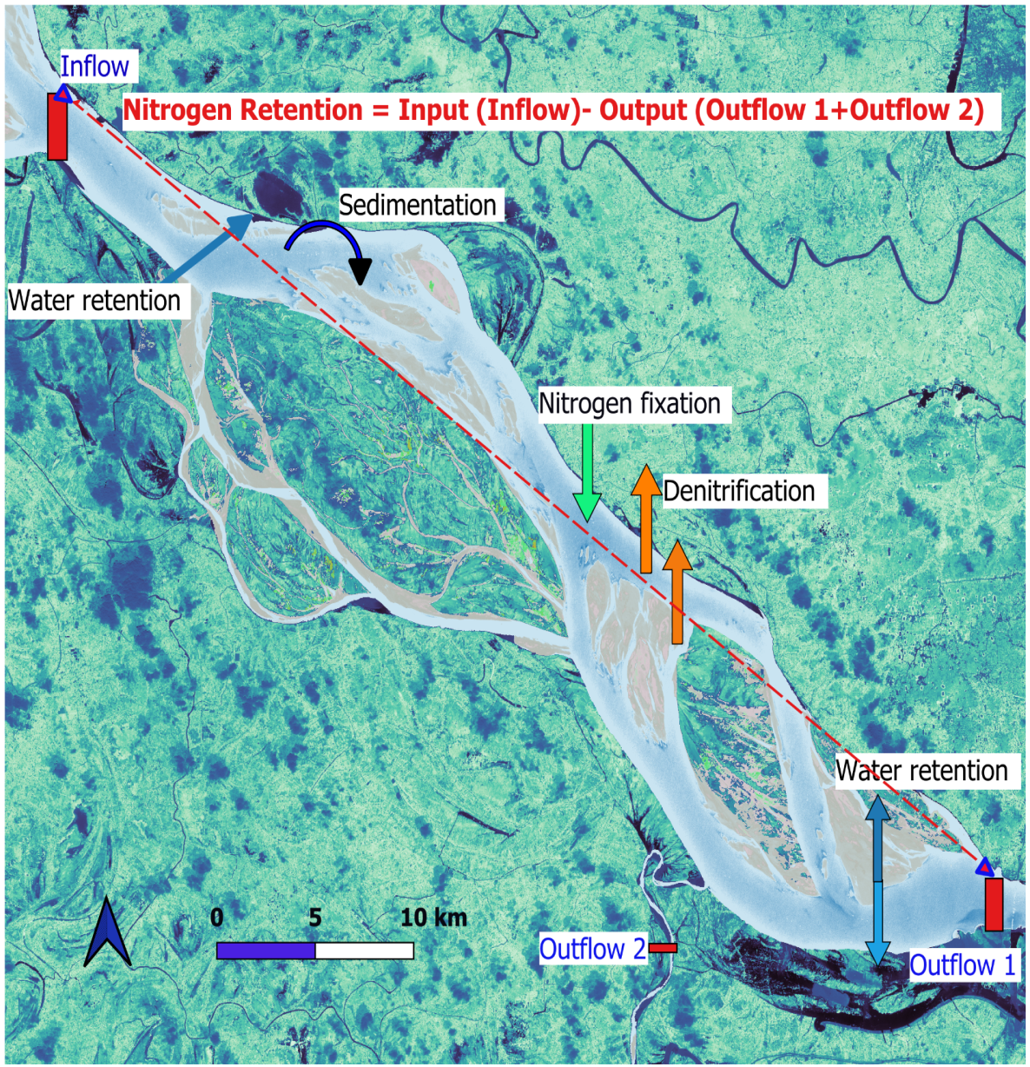
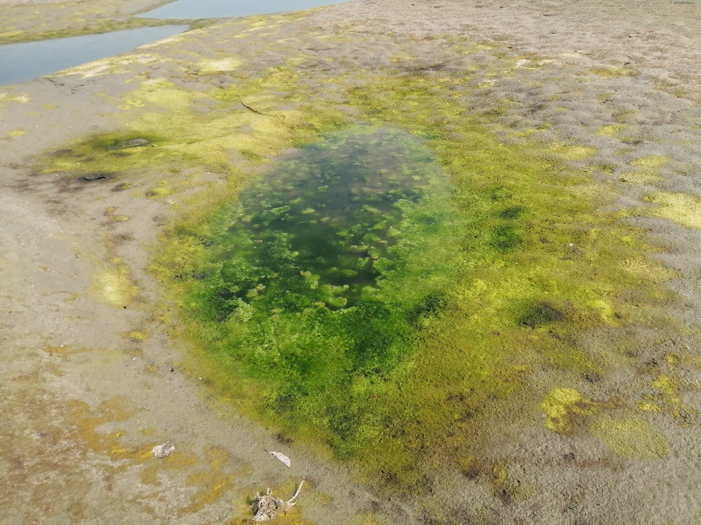
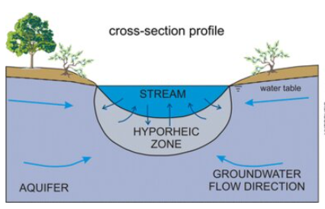

Nitrogen retention and retention processes
Nitrogen retention by rivers is of global interest due to increased coastal pollution leading to
eutrophication,
harmful algal blooms
hypoxia
Denitrification
Modified after Lasagna et al. 2016

Slide 4
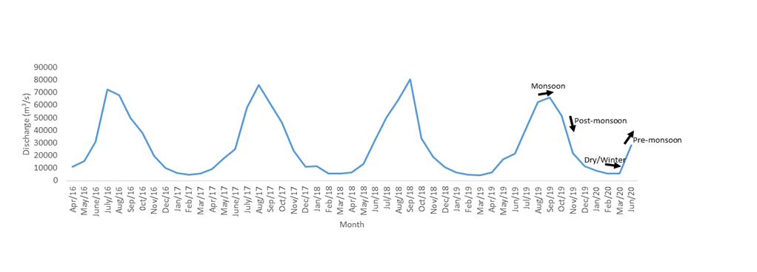
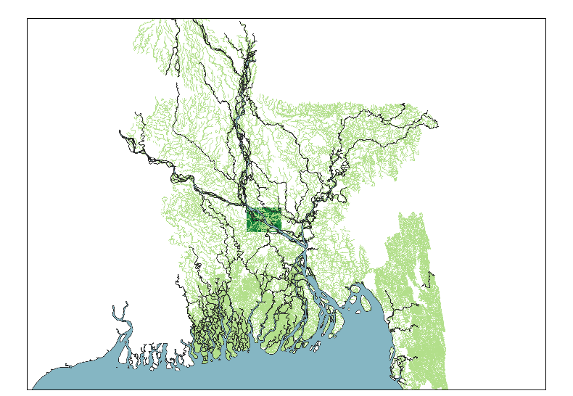
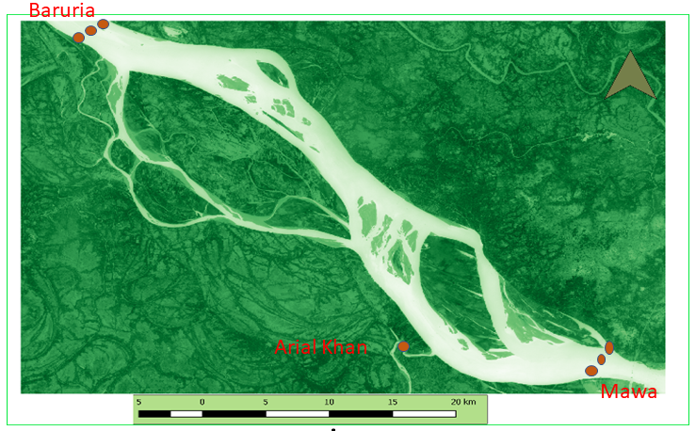
Case Study: Padma River
The Ganges and Brahmaputra join and flow as the Padma River
Channel morphology
Straight line meandering braided
straight again
The study area 50 km long
Max discharge: 90000 m³/s
Min discharge: 3500 m³/s
Brahmaputra
Ganges
Padma

Slide 5
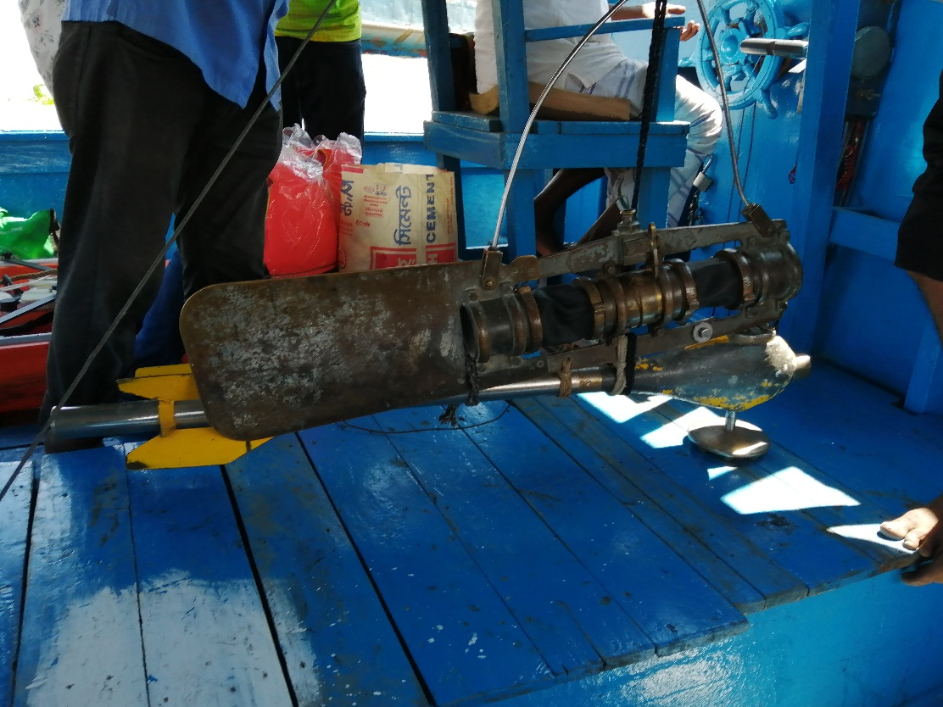
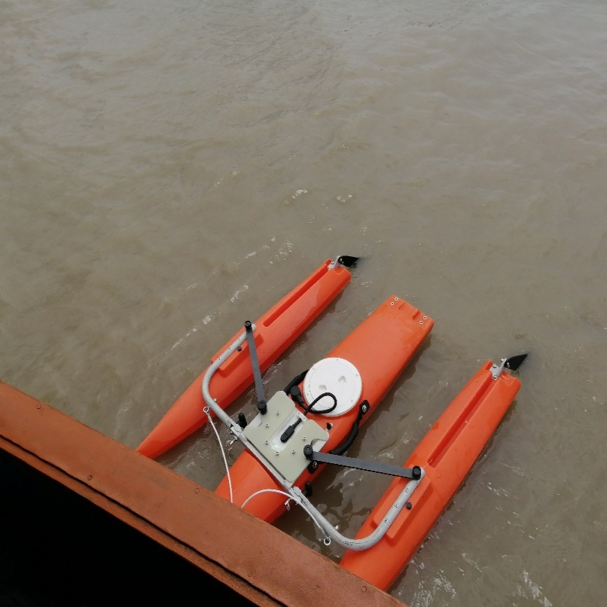
Field sampling design
Monthly water samples at 3 sampling points and from 20% and 80% depth
Potential denitrification rate (PDR) and Nitrogen fixation rate (NFR) (dry/winter season)
Binkley sampler
Discharge (ADCP)

Slide 6
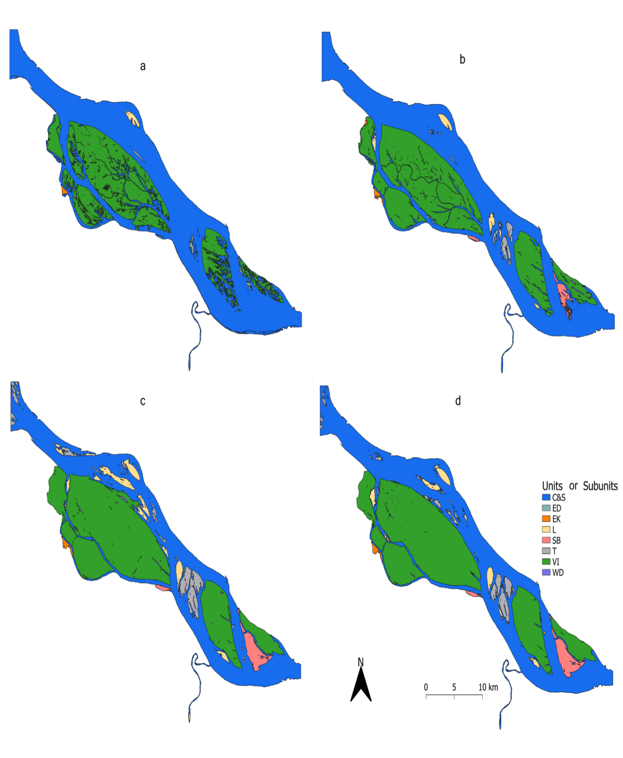
Nutrient retention/export relevant GUs of Padma River
Monsoon 2019 Q=59213.33 m³/s
Post-monsoon 2019
Q=43114.29 m³/s
The approach of Rinaldi et al. (2015) was used for the identification and classification of GUs
Winter/Dry 2020 Q=8284.29 m³/s
Pre-monsoon 2020
Q=16982.50 m³/s
C&S=Main and Secondary channel; EK=Unvegetated Bank; L= Longitudinal Bar; T= Transverse Bar; SB=Side Bar VI= Island; ED; Dry channel; WD= Water Depression

Slide 7
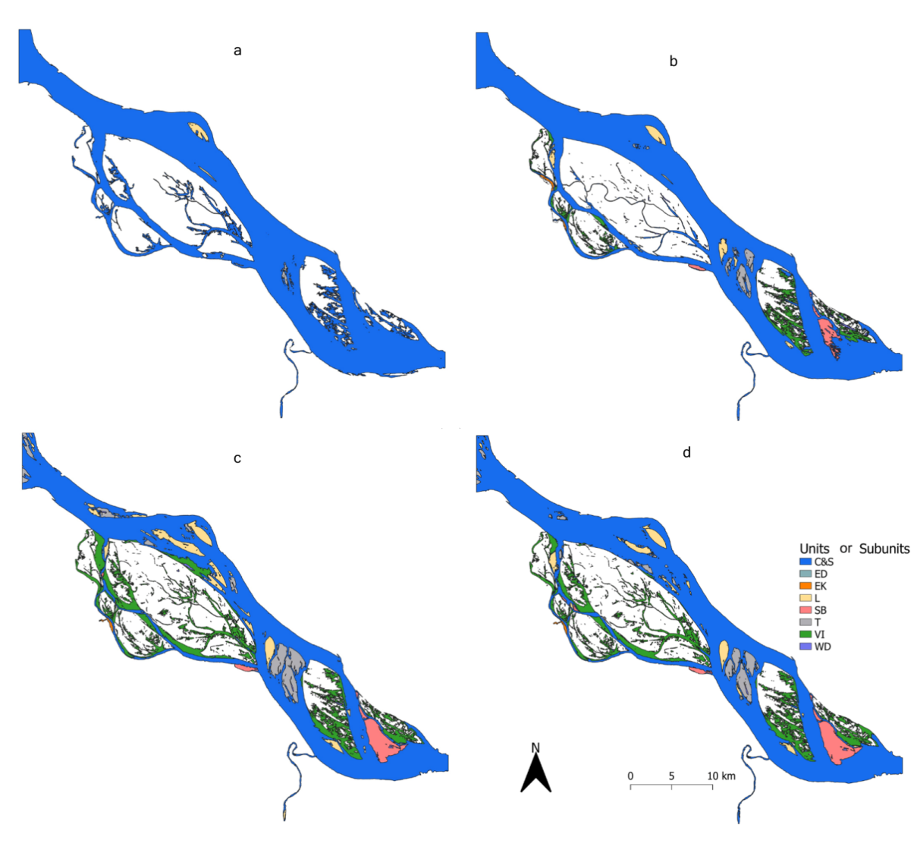
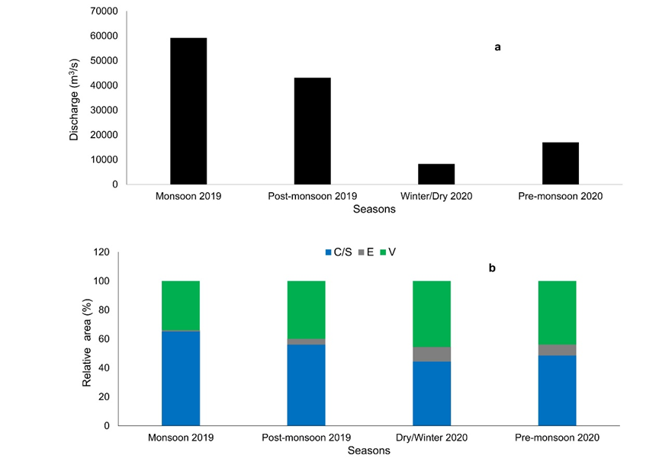
Nutrient retention/export relevant GUs of Padma River
Monsoon 2019 Q=59213 m³/s
Post-monsoon 2019
Q=43114 m³/s
Winter/Dry 2020 Q=8284 m³/s
Pre-monsoon 2020
Q=16982 m³/s
C&S=Main and Secondary channel; EK=River Bank; L= Longitudinal Bar; T= Transverse Bar; SB=Side Bar VI= Island; ED; Dry channel; WD= Water Depression

Slide 8
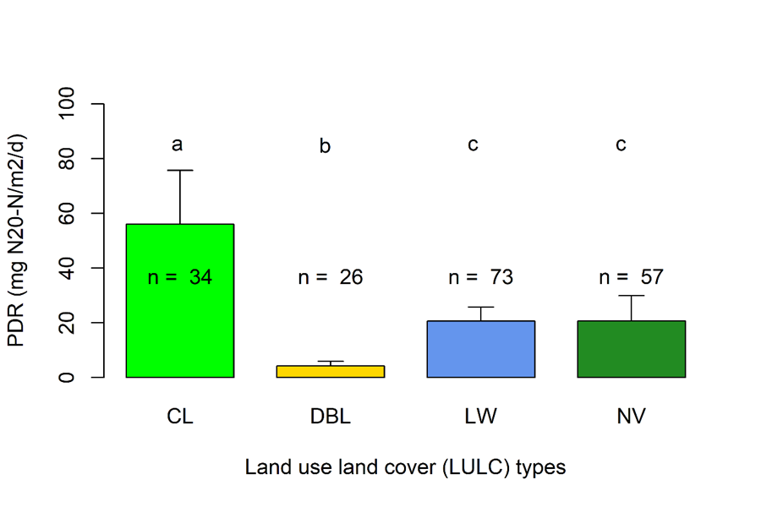
Potential denitrification rate (PDR) in different LULC types
CL=Cropland,
DBL=Dry bare land
LW=Land with water
NV=Natural vegetation

Slide 9
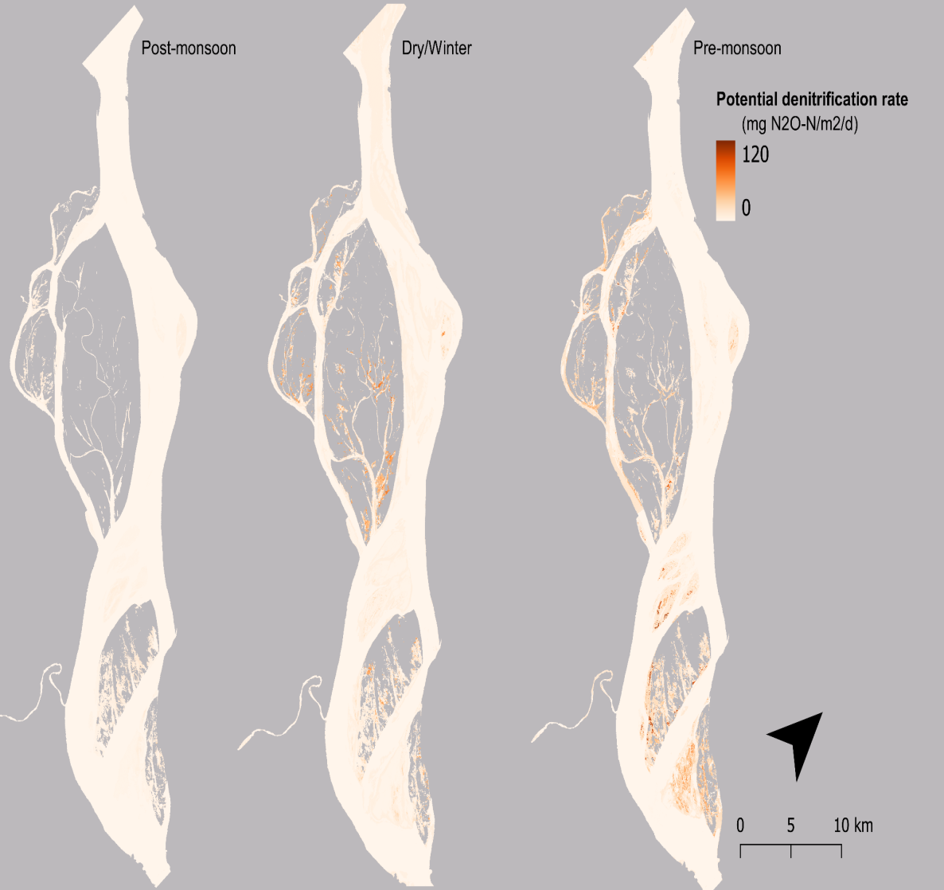
Spatiotemporal distribution of potential denitrification rate (PDR)
Linear mixed model
Sentinel 2 band 11
Normalized difference vegetation index (NDVI)
Land use land cover (LULC)

Slide 10
Impact of geomorphic units on potential denitrification rate (PDR)

Slide 11
River Hydrology

Slide 12
Measured TN retention
Mass balance
 | Post-monsoon | Dry/Winter | Pre-monsoon | Monsoon | Annual
Measured Ret (t) | 12928 | 1946 | 2493 | 104347 | 121715
% Retention | 10.6 | 1.6 | 2 | 85.7 | 100

Slide 13
Estimation of TN retention processes
Nitrogen loss due to water retention (NLWR)

Slide 14
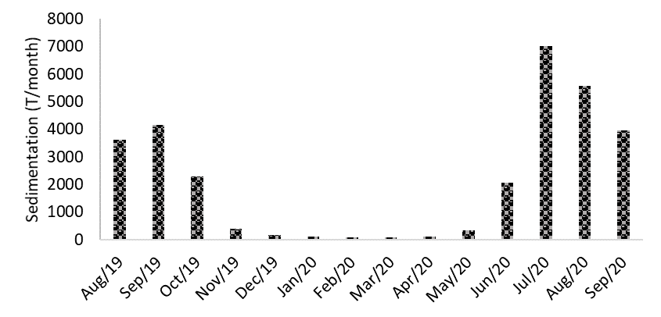
Estimation of TN retention processes
Nitrogen sedimentation

Slide 15
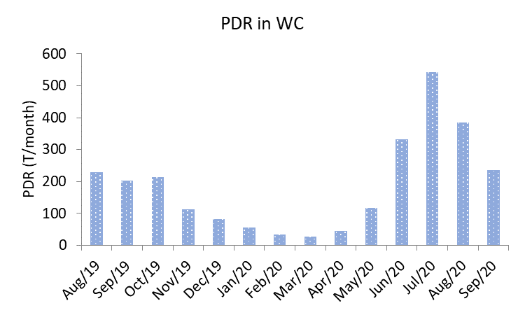
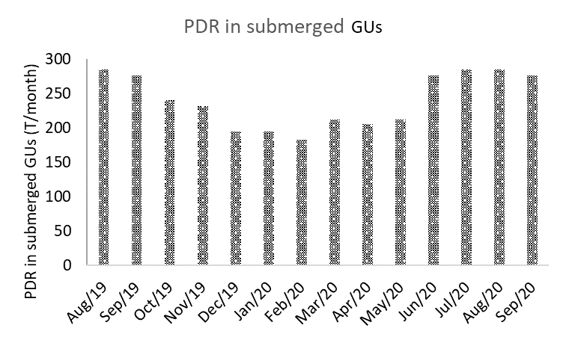
Estimation of TN retention processes
Potential denitrification rate (PDR)
N₂ fixation rate (NFR)

Slide 16
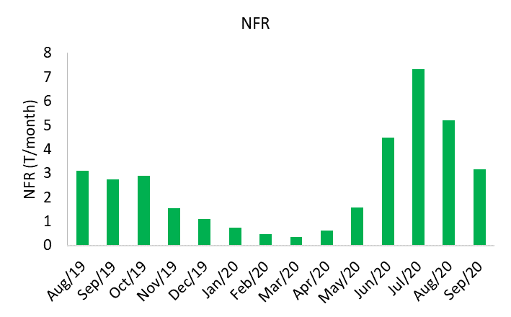
Estimation of TN retention processes
N₂ fixation rate (NFR)

Slide 17
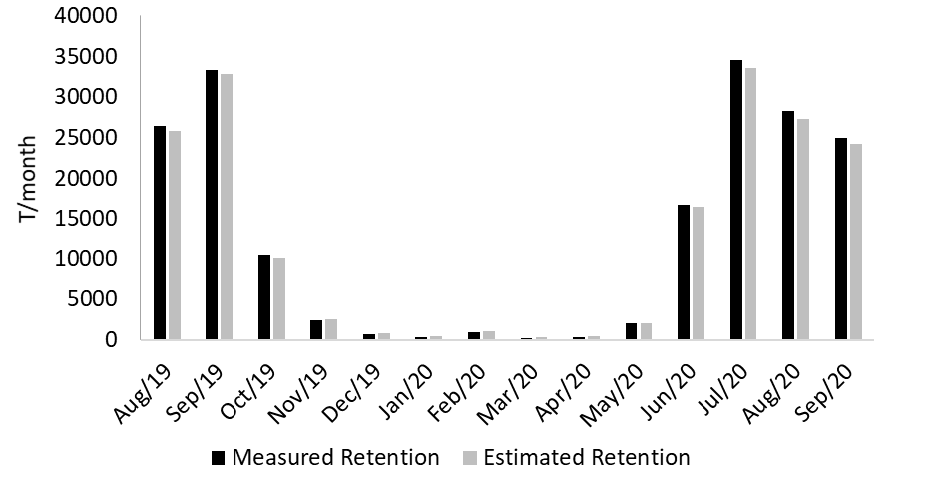
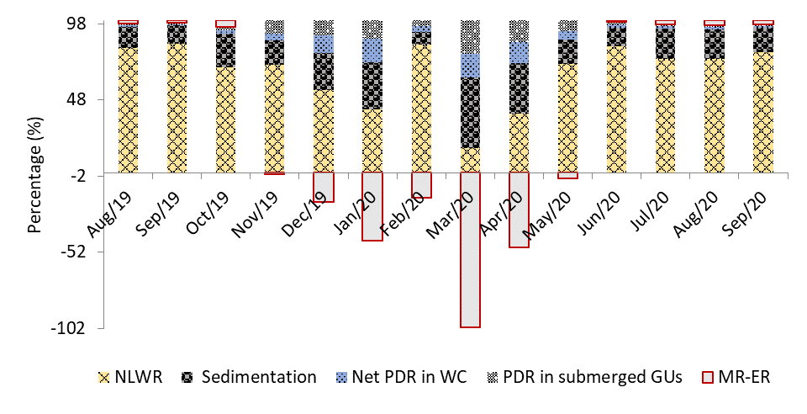
Measured vs Estimated TN Retention
i) Other retention processes
ii) Variation of GUs and fertilisation for cropping
i) Monsoon: Measured Ret. > Estimated Ret.
ii) Non-monsoon: Measured Ret. < Estimated Ret.

Slide 18
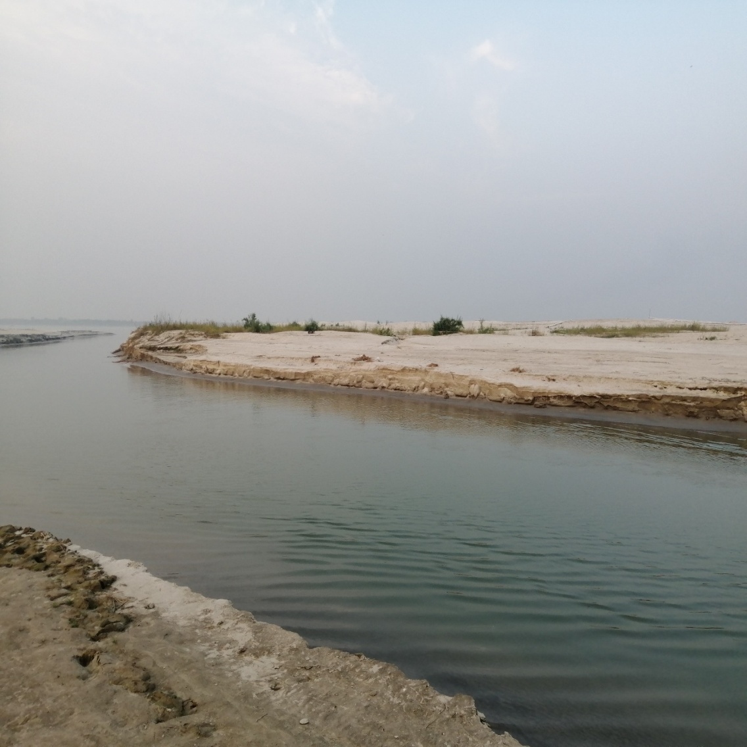
Conclusions
Padma River in Bangladesh faces numerous natural and human-derived problems, which affect its geomorphology and nitrogen retention. The present research shows that changes in geomorphic units in the river can impact nitrogen retention capacity and alter nitrogen export scenarios to the coastal areas.

Slide 19
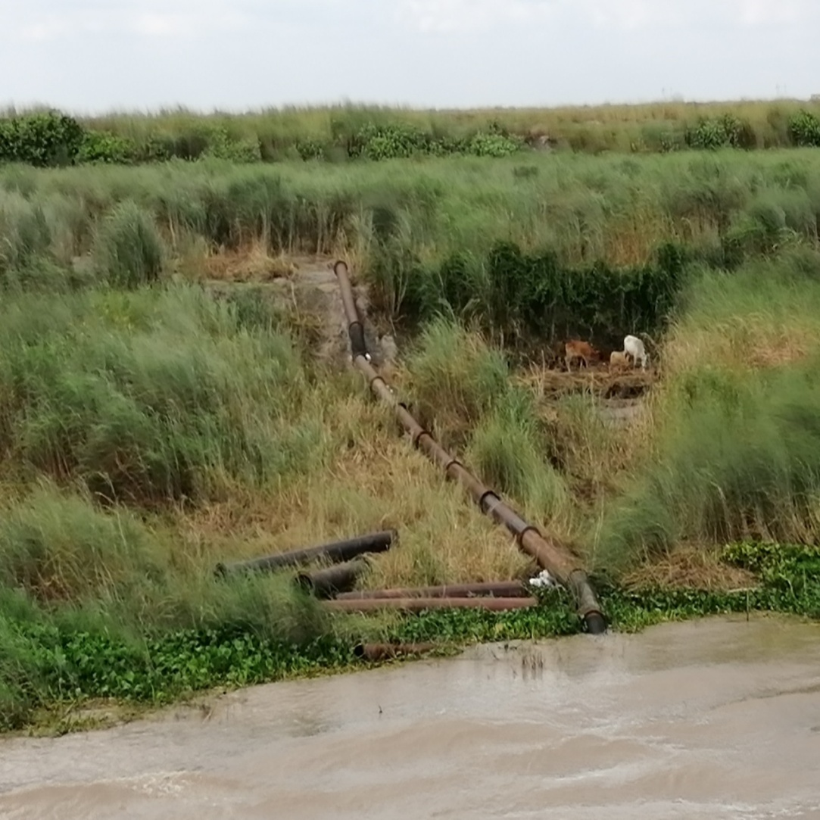
Conclusions
Removing all GUs is not a scientific solution for river management. However, strategic dredging works can be done for river management considering the minimum influence on river geomorphology and less effect on nitrogen retention and export mechanisms.
The results of the present work can be implemented in other geomorphologically complex floodplain river systems in the sub-tropical and tropical regions.

Slide 20
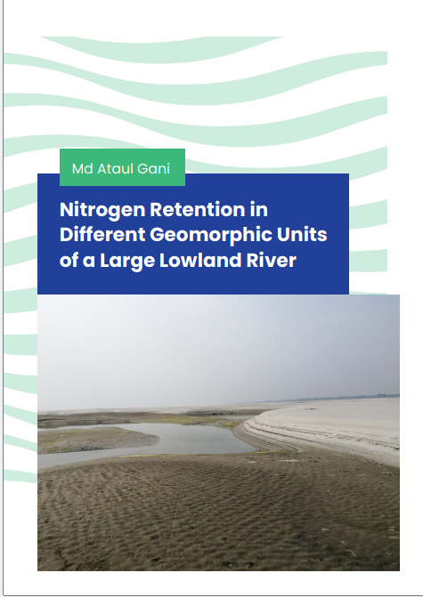
Bibliography
Gani M. A., van der Kwast J., McClain M. E., Gettel G., Irvine K. (2022). Classification of Geomorphic Units and Their Relevance for Nutrient Retention or Export of a Large Lowland Padma River, Bangladesh: A NDVI Based Approach. Remote Sens. 14, 1481. https://doi.org/10.3390/rs14061481
Gani M. A., Gettel M. G., van der Kwast J., Irvine K., McClain M. E. (2024a),. Nitrogen retention of a large tropical floodplain river. Authorea. DOI: 10.22541/au.172983065.51969423/v1
Gani M. A., van Dam A. E., van der Kwast J. McClain M. E., Irvine K. A., Gettel M. G. (2024b). Estimation of potential denitrification and its spatiotemporal dynamics in seasonally inundated geomorphic units of a large tropical river using satellite data. Science of the Total Environment (preprint).doi:10.2139/ssrn.4935746

Slide 21

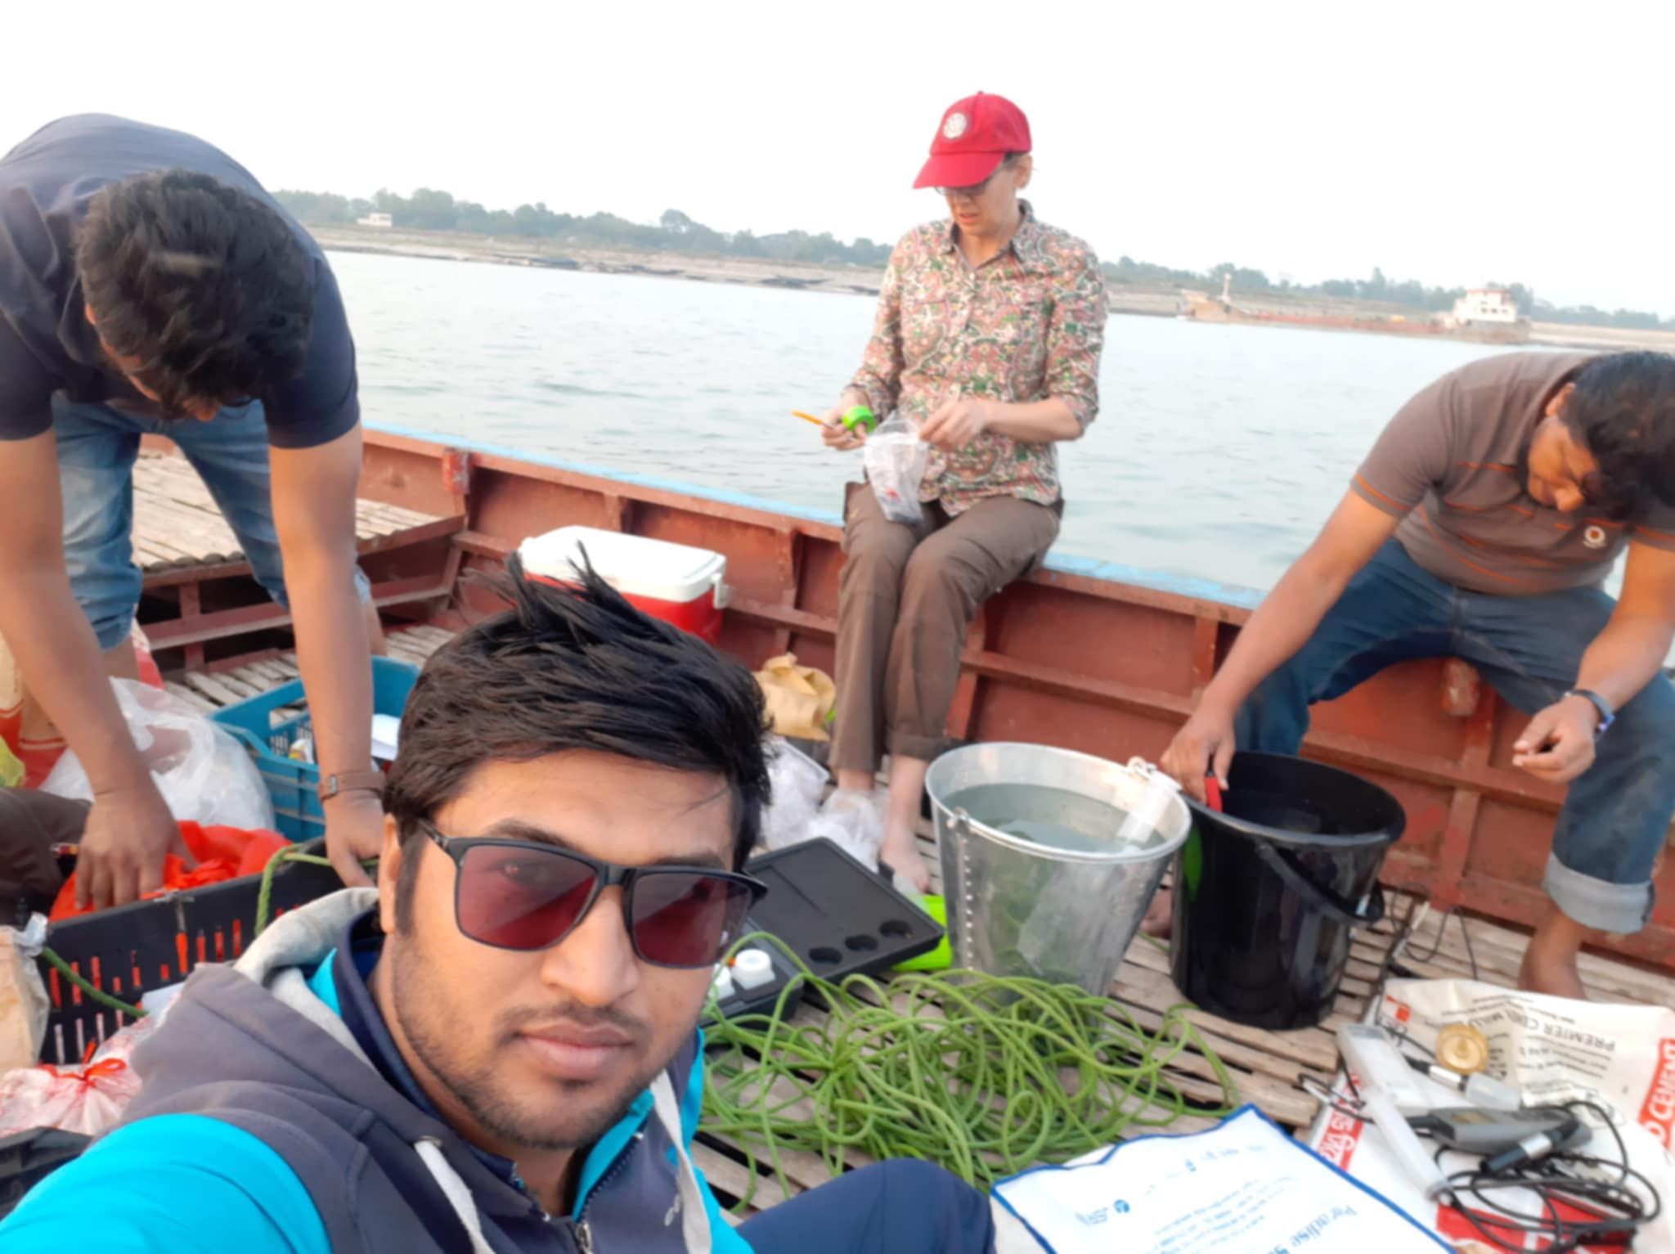

THANK YOU

