Slide 1

Enhancing Compressed Earth Block: Effect of banana trunk fiber and powder on mechanical properties
Athanas Konin
Laboratory of Civil Engineering,
Felix Houphouët-Boigny National Polytechnic Institute, BP 1093 Yamoussoukro, Côte d’Ivoire (Ivory Coast)

Slide 2
Presentation Plan
Introduction
Materials and Methods
Results and Discussion
Conclusion
2

Slide 3
1. Introduction
Building with CEB has become more popular due to it being an environmentally friendly process, easier construction, low cost
But, crude CEB needs stabilization (or reinforcement) to improve their physical and mechanical properties
Traditional stabilization (cement or lime) has a strong impact on global warming and also increase the material costs
I
III
Bailly et al.,2024
III
Therefore, scientists are looking for partial or total replacement of cement in CEB
Tang et al.,2022
Minke,2000
3

Slide 4
1. Introduction
I
II
III
What is the reinforcement ?
What are the desired performances ?
In which conditions ?
  Natural,
  Artificial
  Physical
  Mechanical
  Casting
  Curing
Evaluate the impact of bio-based materials in achieving sustainable construction
Dry density
Water absorption
Compressive strength
4

Slide 5
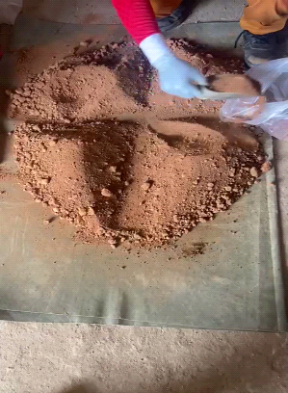
2. Materials and Methods
2.1. Specimens' preparation
Granular fraction | Dry soil (wt%)
0.063 < Ø < 2mm (sand) | 65
0.002 < Ø < 0.063mm (silt) | 10
Ø < 0.002mm (clay) | 25
Table 1. Design mixes of studied samples
Mix type | OPC | Fibers (20 mm) | Powder | Water | CEB designation
UB | 0% | 0% | 0% | 10% | Unstabilized CEB
BC | 5% | 0% | 0% | 11% | Cement (CEM I 52.5) stabilized CEB
BP | 0% | 0% | 0.30% | 11% | Banana powder stabilized CEB
BF | 0% | 0.30% | 0% | 12% | Banana fibers stabilized CEB
BPF | 0% | 0.20% | 0.10% | 12% | Banana fibers and powder stabilized CEB
5

Slide 6
2. Materials and Methods
2.2. CEBs’ casting, curing and testing process
Casting: Mixes were cast using an automatic press (pressure of 10 MPa/min)
Curing process: After removing from the molds, specimens were kept for 28 days in a curing room (T = 25°C; RH = 90%)
Tests performed: - Dry density test (NF EN 1015-10)
          Water absorption test (NF EN 1015-18)
          Compressive strength test (XP 13-901)
6

Slide 7
3. Results and Discussion
3.1. Dry density and compressive strength
Specifically, banana fibers alone enhanced compression resistance by a factor of 3.26 (with an increase in dry density of about 13%), while combining them with banana powder yielded in a slight decrease of approximately 22%
7

Slide 8
3. Results and Discussion
3.2. Water absorption and compressive strength
Adding banana fibers or cement led to increase the water absorption of CEBs (with an increase about 25% and 50% respectively for CEB stabilized with cement and banana fibers)
8

Slide 9
3. Results and Discussion
3.3. Effect of CEB reinforcement type
Effect of cement
Hydration of cement releases two phases: CSH (Calcium Silicate Hydrate) and CSAH (Calcium SulfoAluminate Hydrate).
CSH forms a gel that reduce the porosity of the blocks by binding the grains together,
CSAH is responsible for the formation of ettringite , which:
Improve early strength
Limit drying shrinkage
Reduce clay swelling
9

Slide 10
3. Results and Discussion
3.3. Effect of CEB reinforcement type
Effect of Banana fibers
Banana fibers help to limit craks caused by drying shrinkage and improve the ductility of the compressed earth blocks (CEB).
Banana fibers in CEBs lead to an increase in compressive strength and water absorption.
Effect of Banana powder
Banana powder as cement replacement helps to increase CEBs compressive strength (banana powder has a higher specific area than OPC)
Banana powder leads an increase in dry density and water absorption
10

Slide 11
4. Conclusion
Cement stabilization, despite providing the highest mechanical strength with a factor of 7, comes with a substantial environmental cost due to high production energy and carbon footprint (Miller et al.,2021).
while banana fibers and powder as a natural reinforcement resulted in a moderate reduction in internal cohesion (decreasing in compressive strength about 58% compared to cement-stabilized CEBs), the inclusion of fibers significantly improved the compressive strength of the block (increasing in strength by a factor of 3.26 compared to unstabilized CEBs) (Mostafa and Uddin, 2015), (Lakhiar et al., 2021).
Thus, banana fibers and powder offer sustainable alternatives, due to improvements in the mechanical properties of CEB performance while minimizing environmental impact
11

Slide 12
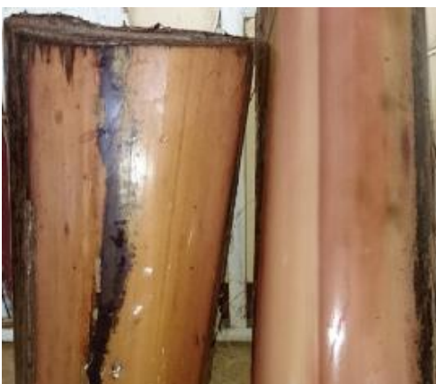
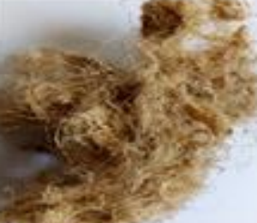
Thank you for your attention
12

