Slide 1
Title: Advancing Commercial Aviation: Modern Flight Control System Applications
Presenter Name Wulfran Fendzi Mbasso
Affiliation / Institute Technology and Applied Sciences Laboratory, U.I.T of Douala, University of Douala

Slide 2
Introduction
Background of the Study
Evolution from mechanical to digital fly-by-wire flight control systems.
Increasing aviation demand for safety, efficiency, and environmental impact reduction.
Modern aviation faces challenges such as cybersecurity threats, economic feasibility, and environmental sustainability.

Slide 3
Literature Review and Related Works
Modern Flight Control Systems
Digital Fly-by-Wire Systems: Replacing mechanical linkages with electronic interfaces for increased control accuracy.
Adaptive Control Systems: Adjusting to real-time flight conditions to enhance stability and safety.
Fault-Tolerant Mechanisms: Ensuring safe operations even in case of system failures.
Artificial Intelligence (AI) in Aviation: Using AI for predictive maintenance, decision-making, and automation.
Research Gaps
Cybersecurity threats in automated systems.
High implementation costs and affordability concerns.
Lack of AI-driven flight optimization and machine learning integration.
Regulatory challenges in certifying AI-based control systems.

Slide 4
Research Gaps and Motivations
Identified Challenges
System Trustworthiness: Automated flight control systems must be secure against cyber threats.
Affordability: High cost of implementing advanced systems remains a barrier.
Environmental Considerations: Hybrid-electric propulsion needs compatibility with FCS.
AI and Machine Learning: Limited application in commercial aviation.

Slide 5
Contributions and Novelty
Key Contributions
A Model-Based Framework integrating AI and automation for enhanced flight control.
AI-Driven Flight Control improving decision-making and autonomous capabilities.
Green Aviation Compliance reducing fuel consumption and emissions.
Cybersecurity Enhancements mitigating risks in highly automated control systems.

Slide 6
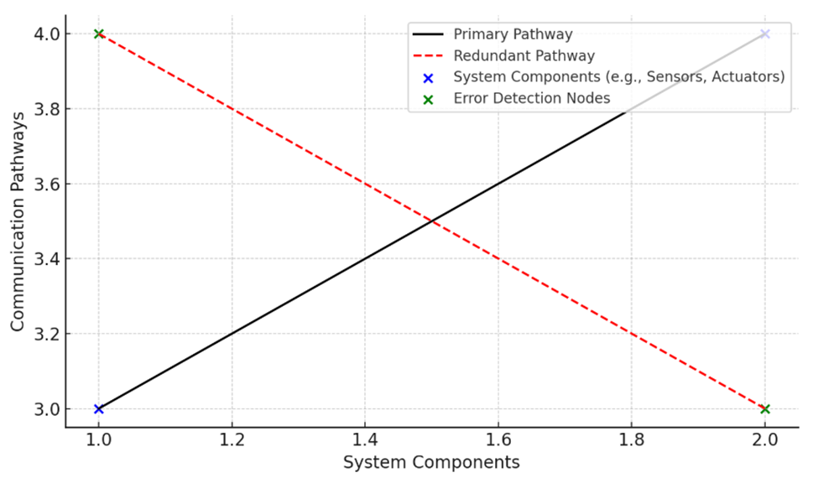
Methodology
Model-Based Design Framework
System Modeling – Mathematical representation of aircraft dynamics using control equations.
Simulation and Testing – Evaluating control system performance in MATLAB/Simulink.
Validation – Using Hardware-in-the-Loop (HIL) and Processor-in-the-Loop (PIL) testing to validate real-world applicability.
AI and Automation Integration – Implementing AI-driven adaptive control strategies.
Equations for Flight Dynamics
Adaptive Control Law: u(t) = -Kx(t)+R, where u(t) is the control input, K is the gain matrix, and R is the reference input.
Figure 1: Fault-Tolerant Flight Control Architecture

Slide 7
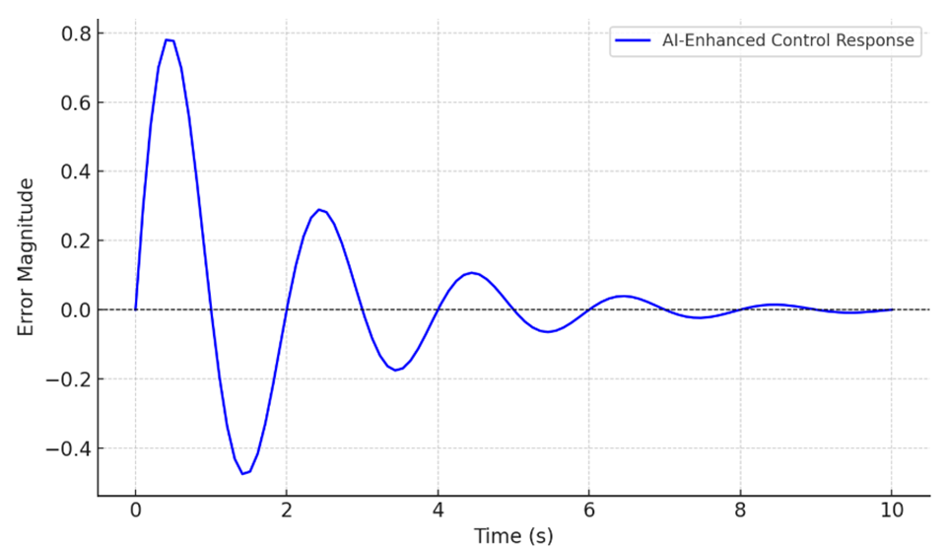
AI and Automation Integration
AI-Driven Flight Control Enhancements
Adaptive Control: AI dynamically adjusts flight control systems based on environmental factors.
Predictive Maintenance: AI analyzes historical data to predict potential failures.
Autonomous Operation: AI enhances decision-making for safer and more efficient flights.
Case Study: AI-assisted autopilot reducing pilot workload by 40%.
Figure 2: Simulation Results of AI-Enhanced Adaptive Control Systems

Slide 8
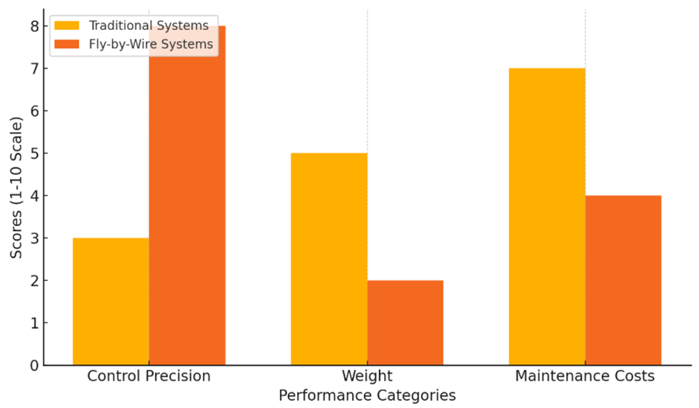
Results and Discussion
Simulation Results
Stability Improvement: AI-driven control law reduces errors quickly.
Fuel Efficiency Increase: 20% reduction in fuel consumption.
Fault-Tolerant Operations: Redundant pathways ensure safety.
Figure 3: Performance comparison of FBW vs. traditional systems across safety, efficiency, and reliability metrics.
Performance Metric | Traditional Systems | AI-Based System | Improvement
Fuel Efficiency | 100% | 120% | +20%
Automation Rate | 40% | 90% | +50%
Safety and Fault Tolerance | Moderate | High | Significant

Slide 9
Case Study - Hybrid-Electric Aircraft
Key Performance Metrics
Metric | Traditional Systems | Proposed Framework | Improvement (%)
Fuel Efficiency | 100 | 120 | +20%
Automation Rate | 40% | 90% | +50%
Emissions Reduction | - | -15% | +15%
Maintenance Costs Reduction | - | -15% | +15%

Slide 10
Applications and Challenges
Practical Applications
Enhanced Handling: AI improves pilot assistance.
Performance Enhancement: Reduced maintenance & fuel costs.
Environmental Impact: Supports carbon footprint reduction.
Challenges
Certification Complexity: Compliance with ICAO, EASA, FAA regulations.
Investment Costs: High initial setup and maintenance expenses.
Cybersecurity Risks: Threats to automated flight control systems.

Slide 11
Future Perspectives
Emerging Trends
AI-Driven Flight Optimization: Enhancing autonomous aviation.
Sustainable Aviation Technologies: Hybrid-electric propulsion advancements.
Next-Generation Flight Control: Integration with electric and hydrogen engines.
Integration with Digital Twin Technology: Real-time monitoring and optimization.

Slide 12
Conclusion
AI and automation integration enhance flight control efficiency and reliability.
Proposed model reduces fuel consumption by 20% and maintenance costs by 15%.
Industry adoption and compliance with aviation regulations essential.
Future research: real-world testing, cybersecurity enhancements, and expanding AI capabilities in aviation.

Slide 13
References
Leveson, N. G. (2012) - Engineering a Safer World: Systems Thinking Applied to Safety. This reference covers system safety and is useful for discussing the reliability and security of modern flight control systems.
Bagloee, S. A., Tavana, M., Asadi, M., & Oliver, T. (2016) - Autonomous Vehicles: Challenges, Opportunities, and Future Implications for Transportation Policies. Relevant for your discussion on AI and automation in aviation.
Du, Y. (2024) - Advances in Flight Control Systems for Modern Commercial Aircraft. Covers recent developments in flight control systems and automation.
Ilie Nicolin & Bogdan Adrian Nicolin (2019) - The Fly-By-Wire System, INCAS BULLETIN. Explains the shift from traditional to digital Fly-By-Wire systems.
A.V. Efremov, et al. (2023) - Adaptive Flight Control System for Flight Safety Improvement in Reentry and Other High-Velocity Vehicles. Discusses adaptive control mechanisms and their role in aviation safety.
Arslan Ahmed Amin et al. (2024) - Development of Intelligent Fault-Tolerant Control Systems with Machine Learning, Deep Learning, and Transfer Learning Algorithms. Essential for your discussion on AI-enhanced control systems.
Shazah Ishtiaq & Nor Azlina Abd Rahman (2021) - Cybersecurity Vulnerabilities and Defense Techniques in Aviation Industry. Relevant for discussing the security risks associated with modern automated flight control systems.
Mehdi Soleymani et al. (2024) - Hydrogen Propulsion Systems for Aircraft: A Review on Recent Advances and Ongoing Challenges. This reference ties into the sustainability aspects of modern aviation and hybrid-electric propulsion.

