Slide 1
Vaping and Its Determinants: A Focused Study on ADU community
Haleama Al Sabbah, Malak Qonbia, Fatima Al Ruwishan, Muna Khaled , Maha Ali
Abu Dhabi University
Feb. 2025

Slide 2
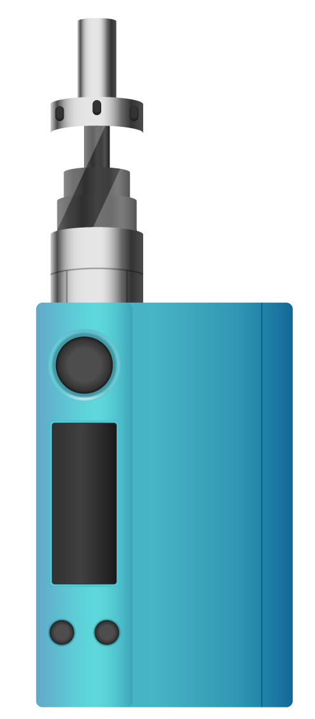
TABLE OF CONTENTS
Introduction
Objectives
Literature Review
Methodology
Results
Discussion
Strength and implications
Limitations and recommendations
Acknowledgment

Slide 3
Introduction
E-cigarettes, often known as vapes, are battery-operated devices that produce vapor by heating e-liquid, which users then inhale. Though they still contain nicotine and other chemicals, these devices are frequently seen as safer substitutes for regular cigarettes (Centers for Disease Control and Prevention).
This study investigates the frequency of vaping and the variables affecting its use among students at Abu Dhabi University. It looks at how social, psychological, and cultural elements influence vaping habits and seeks to offer guidance for successful public health initiatives.

Slide 4
Objectives
1. Main Objective
To determine the prevalence and contributing factors of vaping within the ADU community.
2. Specific Objectives
To assess the association between age, gender, socioeconomic status, cultural background, perception of harm, and access to e-cigarettes on the prevalence of vaping in the Abu Dhabi University community.
To assess the influence of students' knowledge and perceptions regarding the health risks of vaping on their vaping behaviour’s within the ADU community.
To idenntify the psychological and behavioral aspects, including stress, mental health issues, and prior smoking behaviors, that promote vaping among ADU students.
To examine the association of social media and peer networks on e-cigarette use among teenagers and non-smokers amongst ADU community.

Slide 5
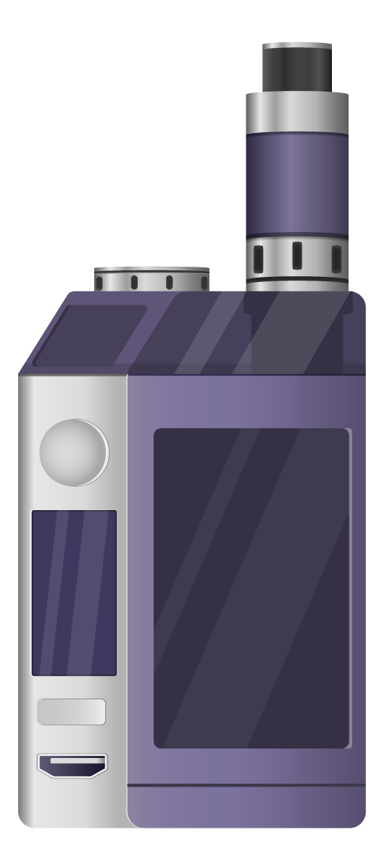
Literature Review
Social Factors: Peer acceptance and social media significantly influence vaping, with platforms both spreading misinformation and offering opportunities for health campaigns (Truth Initiative, 2021; Hill et al., 2024).
Psychological Factors: Stress, anxiety, and low-risk perceptions drive vaping, often used as a coping mechanism among students (Truth Initiative, 2021; Hill et al., 2024).
Behavioral Factors: Curiosity, stress relief, and prior smoking habits are key motivators, making e-cigarettes both a smoking alternative and a gateway to nicotine use (Truth Initiative, 2021; Hill et al., 2024).

Slide 6
Methodology
Study Design & settings:
Descriptive cross-sectional study conducted at ADU university.
2. Population and Sampling:
ADU students, instructors, and administrative staff aged 18 years and older.
Convenience sampling was employed to recruit participants from the ADU population.
Participants were recruited via university communication platforms (emails, direct messages).

Slide 7
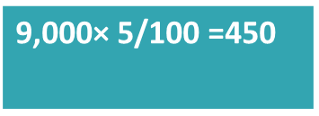
Methodology
3. Sample size:
450 participants were targeted to achieve statistical power and account for resource constraints, ensuring sufficient data within the two-week collection period.
After cleaning, 450 valid responses remained from total 470 ; 20 incomplete ones were excluded due to incomplete answers

Slide 8
Methodology
4. Ethical Considerations
Approval: Ethical clearance was obtained from the Abu Dhabi University institution research board Committee(CHS-0000029).
Consent: Informed consent was secured from all participants .
Confidentiality: Anonymity and data protection protocols were rigorously applied.

Slide 9
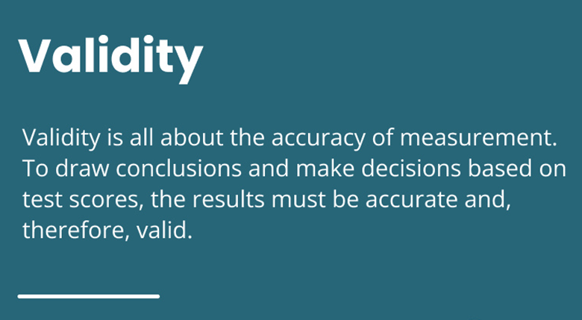
Methodology
5. Validity & Reliability:
Ensures that the questionnaire accurately measures the intended variables. Some questions were adapted from existing research and properly referenced.
The questionnaire underwent expert review and pilot testing to further ensure its validity
6. Pilot study:
A pilot study was conducted with five members to test the clarity and effectiveness of the questionnaire, ensuring its suitability for the main study.

Slide 10
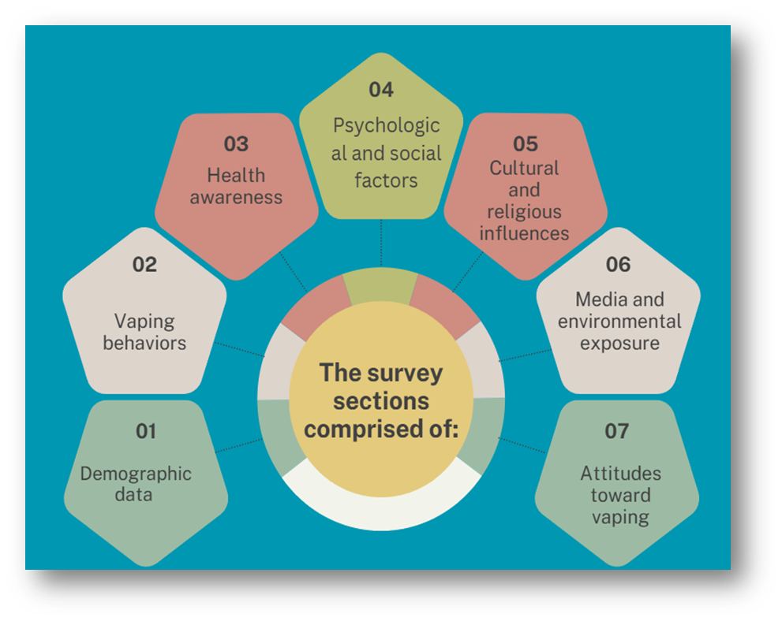
Methodology
7. Data Collection Method:
Instruments: A structured questionnaire was developed to address various aspects of vaping behavior and its determinants. The questionnaire included 7sections .
Data Analysis:
Software: Data were analyzed using SPSS version 28.

Slide 11
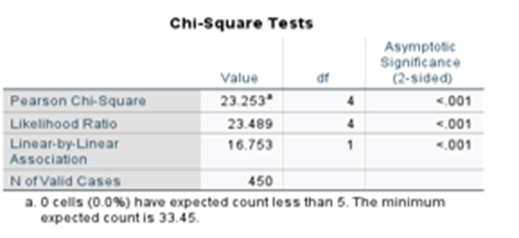
Methodology
Before analysis, The dataset underwent thorough cleaning to ensure its quality. This involved:
Checking for duplicate entries and addressing missing data appropriately .
Excluded, incomplete answers .
Descriptive analysis: Was performed to summarize demographic characteristics and vaping patterns.
Statistical significance :
Statistical Tests
Chi-square tests : were used for categorical variables.
Spearman correlation: for continuous variables.

Slide 12
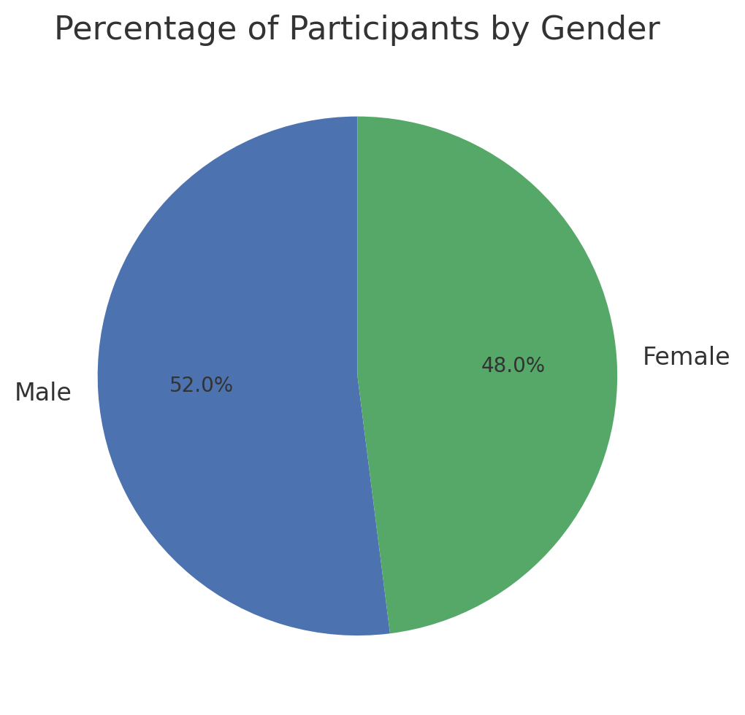
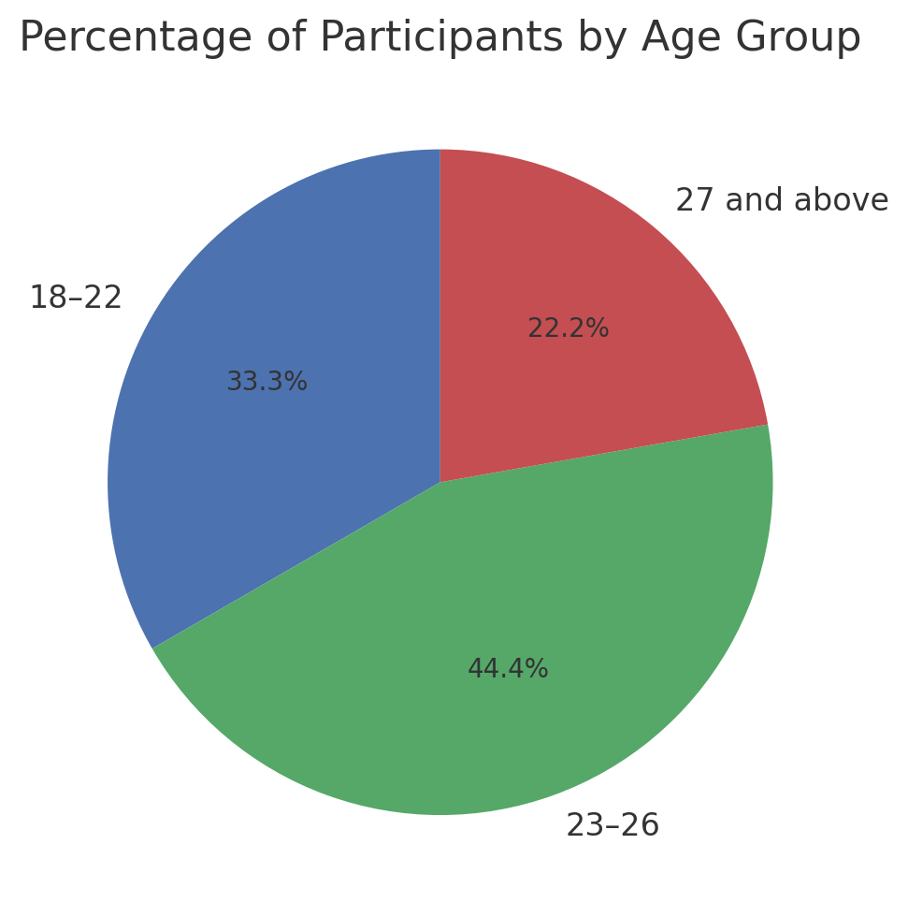
Results & Findings
Sociodemographic Information
Fig1. participants by gender
Fig2. participants by age groups
Key Insight: 52% of participants are male.48% of participants are female.
Key Insight: This distribution suggests that most participants in the study are young adults, with the 23-26 group being the most represented.

Slide 13
Sociodemographic Information
FIG3. Disturbution of current status at ADU
Key Insight: This chart indicates a balanced distribution of participants across different status categories, with a slightly higher representation of Undergraduate and Graduate Students compared to Staff/Administrative Personnel and Others.

Slide 14
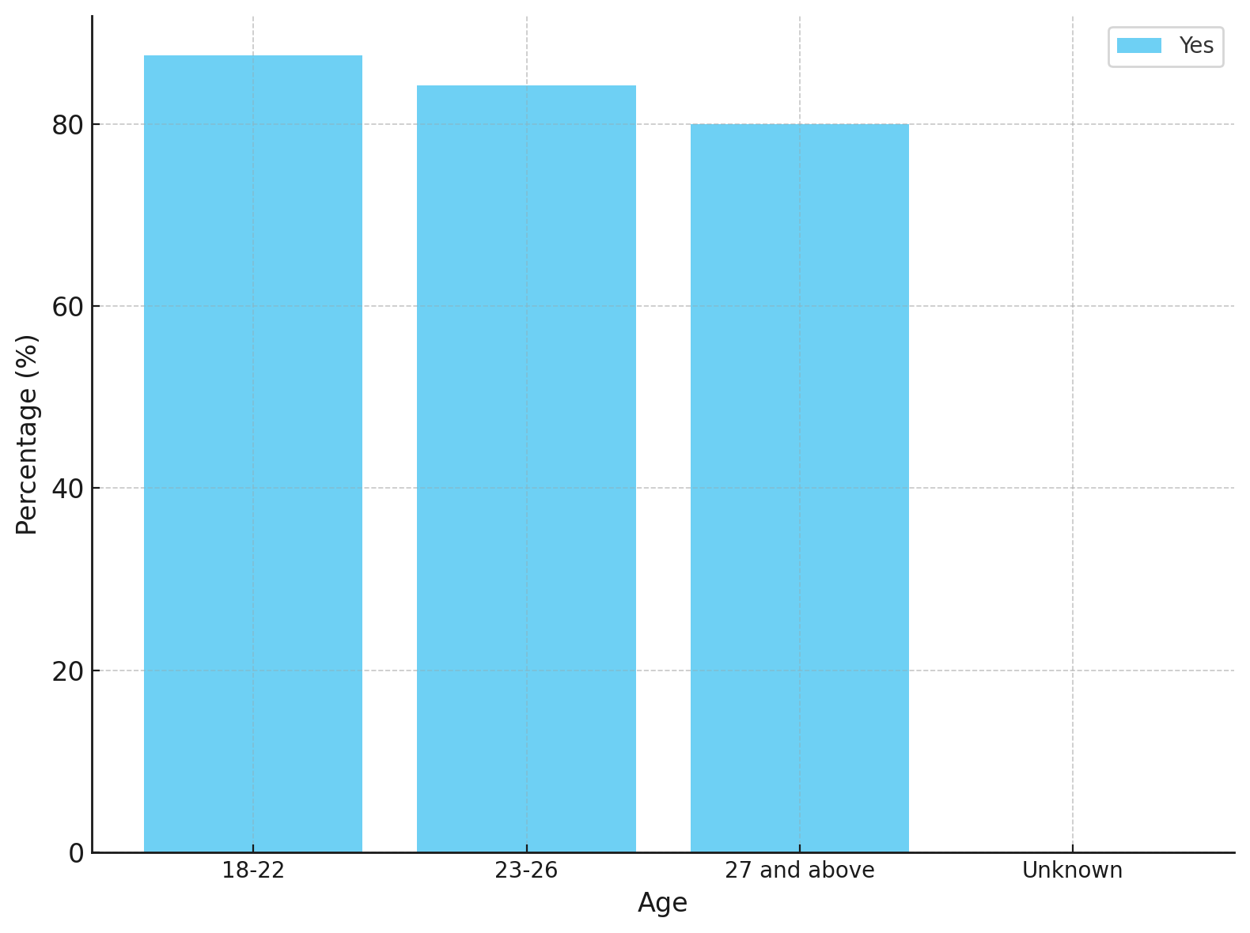
Sociodemographic Information
Key Insights:
Younger participants (18–22) are most likely to vape.
Vaping prevalence decreases with age.
Association with Age: While younger participants (18–22) had the highest number of vapers, no statistically significant association was found between vaping status and age.
FIG4. Percentage of vaping participants by Age Group
Notes:
Figure1. compares vaping behavior between male and female participants in our survey. Out of the total 450 participants, 193 are current vapers, while 257 do not vape. Looking at the breakdown, 47% of males vape, which is 113 out of 240, compared to 38% of females, or 80 out of 210.
While this shows that slightly more males vape than females, the difference is minimal and not statistically significant, as indicated by the p-value of 0.055.
Fig2. This chart shows the relationship between vaping status and age. The largest group of participants is aged 18 to 22, and within this group, we see a noticeable split between vapers and non-vapers. While non-vapers still slightly outnumber vapers, this age group has the highest number of vapers compared to the other age groups.
For participants aged 23 to 26, the number of vapers and non-vapers is more balanced, showing that vaping behavior becomes more evenly distributed in this age range. Finally, for those aged 27 and above, the number of both vapers and non-vapers drops significantly, indicating that vaping prevalence decreases as age increases.
Fig3. This chart explores the reasons participants started vaping. Peer influence is the most reported reason, followed by stress relief, highlighting the significant role of social and psychological factors. Social media influence and quitting smoking are also relevant, but curiosity and other factors contribute less. These findings underscore the importance of addressing social pressures and stress in interventions aimed at reducing vaping prevalence among students.

Slide 15
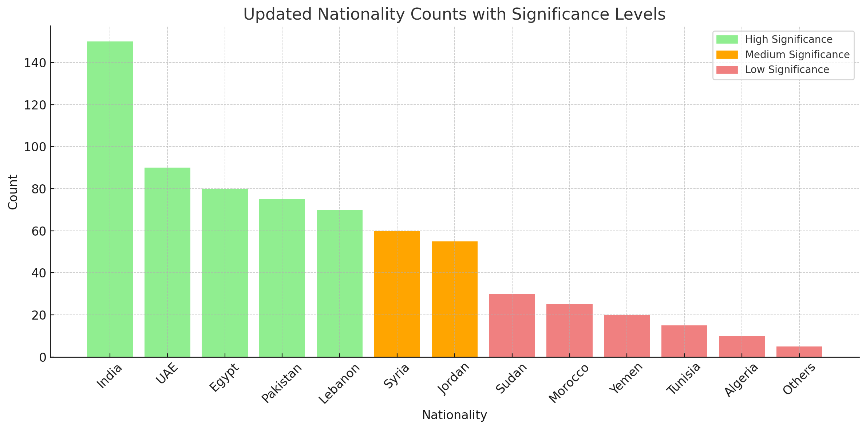
Sociodemographic Information
Fig5. Comparison of Vaping Prevalence: UAE nationals vs. Expats
Fig6.Percentage Distribution of Participants by Nationality and Significance
Key insights: UAE nationals has a low vaping prevalence (10%) compared to other nationalities due to:
- Cultural norms discouraging vaping (Al-Omari et al., 2017).
- Stricter public health policies: limiting vaping (Shaikh et al., 2020).
- Better access: to vaping products in other regions, especially Western countries (Soteriades et al., 2020).
Notes:
UAE shows a low vaping prevalence of about 10%, in contrast to Other countries with a significantly higher prevalence (~90%).The difference can be attributed to factors like:Cultural norms in the UAE that discourage smoking and vaping (Al-Omari et al., 2017).
Stricter public health policies in the UAE that limit vaping accessibility (Shaikh et al., 2020).
Greater access to vaping products in other countries, particularly in Western regions (Soteriades et al., 2020).
The lower vaping prevalence in the UAE may reflect the influence of cultural, regulatory, and accessibility factors.This stark contrast emphasizes how public health policies and social norms can shape the behaviors of individuals within different regions.

Slide 16
Prevelance Rate Of Vaping By Gender
Prevalence of Vaping in the Sample Population
Males: 47.1% of males (113 out of 240) currently vape.
Females: 38.1% of females (80 out of 210) currently vape.
Overall: 42.9% of participants (193 out of 450) report that they currently vape.
Key Insights:
Higher prevalence among males: Males have a higher prevalence of vaping (47.1%) compared to females (38.1%).
Non-vapers: The majority of participants in the study are non-vapers, with 57.1% (257 participants) reporting no current vaping.
Implication: Vaping is a significant behavior in the sample, but the overall prevalence remains under 50%, suggesting that it is not yet a widespread behavior for most participants.
Fig7. Vaping Prevalence by Gender
Notes:
Key Observations:
The male prevalence rate (47.1%) is slightly higher than the female prevalence rate (38.1%), which is consistent with trends in global studies where males tend to have higher vaping or smoking rates.
Overall, 193 participants vape, which is a substantial portion (42.9%) of the total sample, indicating that vaping is a common behavior within the sample population, although it is still lower than non-vaping individuals (257 participants, or 57.1%).

Slide 17
Perception And Awareness Of Health Warnings And Harm Reduction In Vaping
Effectiveness of health warnings:
34.7% stopped vaping showing that health warnings can strongly impact but health warning alone may not be sufficent for all in cessation.
32.4% reduced their vaping frequency indcating partial behavioral change.
Limitations: 32.9% showed no change, highlighting the need to strengthen educational effort.
Table1. Health warnings and vaping behaviours
Notes:
Fig7 . The analysis shows that over 200 participants (approximately 55%) believe vaping is less harmful than smoking, while around 150 participants (45%) do not share this belief, as indicated in the graph. This reflects a widespread misconception influenced by marketing and the absence of combustion in vaping, compared to traditional smoking, which produces over 7,000 chemicals, including tar and carcinogens, leading to well-documented health risks such as lung cancer, heart disease, and COPD. The key insight is that while vaping may pose fewer risks compared to smoking, it still presents significant health concerns. Public health efforts must address these misconceptions, emphasizing the risks associated with vaping, and develop targeted strategies to reduce both smoking and vaping behaviors, particularly among young and vulnerable populations.

Slide 18
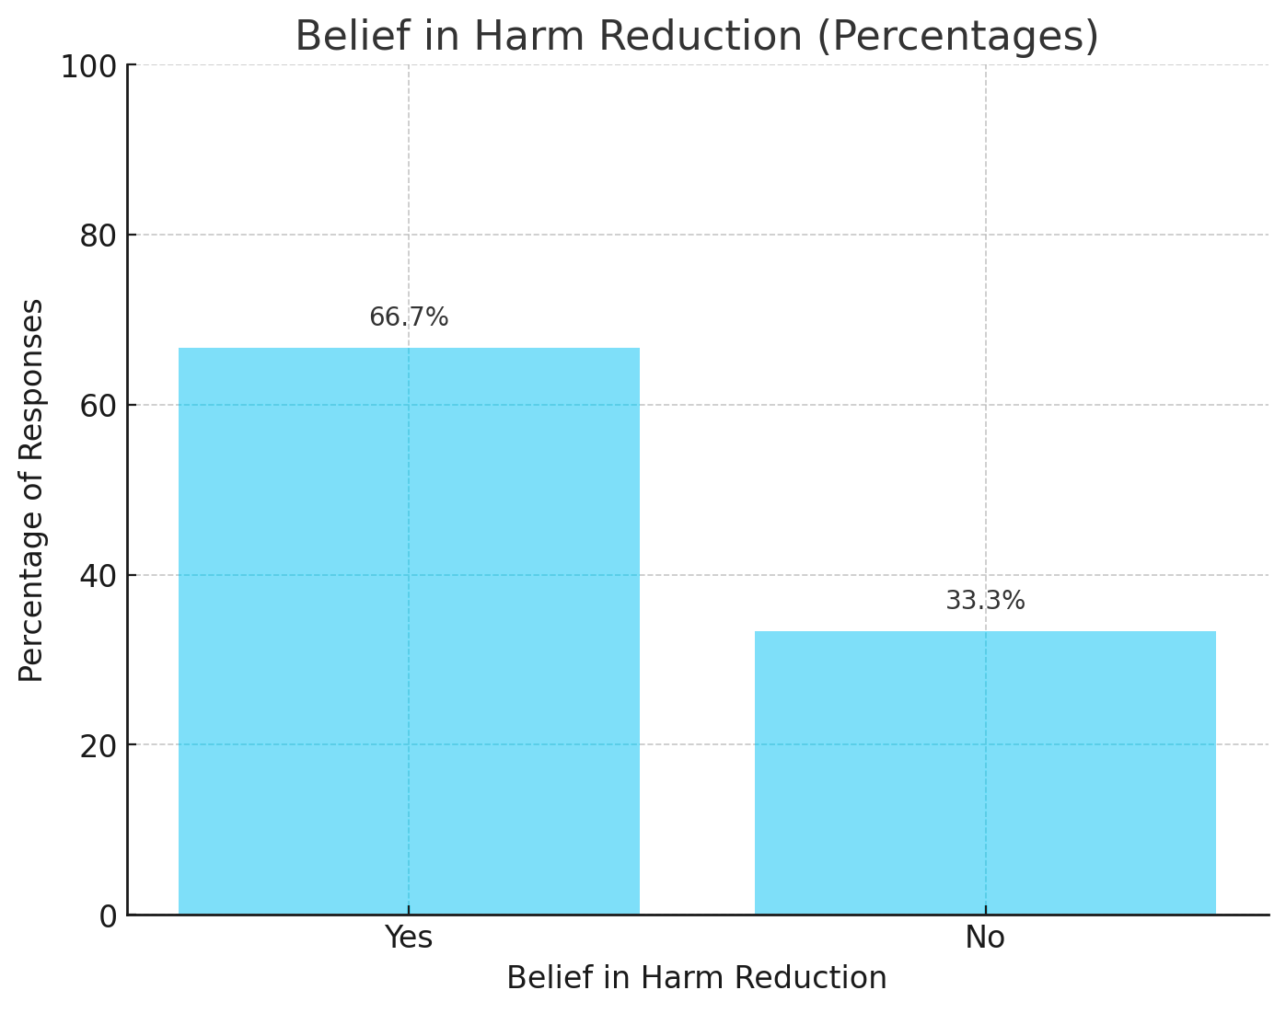
Perception And Awareness Of Health Warnings And Harm Reduction In Vaping
Beliefs and risks
66.7% believe vaping is less harmful than smoking, reflecting misconceptions driven by marketing.
Vaping still poses health risks including exposure to nicotine, formaldehyde, and other harmful chemicals.
Figure8. belief in harm reduction in using vapes
Notes:
Fig7 . The analysis shows that over 200 participants (approximately 55%) believe vaping is less harmful than smoking, while around 150 participants (45%) do not share this belief, as indicated in the graph. This reflects a widespread misconception influenced by marketing and the absence of combustion in vaping, compared to traditional smoking, which produces over 7,000 chemicals, including tar and carcinogens, leading to well-documented health risks such as lung cancer, heart disease, and COPD. The key insight is that while vaping may pose fewer risks compared to smoking, it still presents significant health concerns. Public health efforts must address these misconceptions, emphasizing the risks associated with vaping, and develop targeted strategies to reduce both smoking and vaping behaviors, particularly among young and vulnerable populations.

Slide 19
Percentage Distribution Of Reasons For Starting Vaping
Fig9. Percentage Distribution of Reasons for Starting Vaping
Key findings:
Curiosity (25%) and Peer Influence (25%) are the leading reasons for starting vaping, aligning with findings from WHO and CDC, which identify these factors as key drivers among youth and young adults. Peer pressure and acceptance play a major role in their decision to vape (WHO, 2019; CDC, 2020).
Social media Influence (20%) is significant, as CDC notes that vaping promotion via social media platforms like Instagram and YouTube contributes to the normalization of vaping among young people (CDC, 2020).
Notes:
curiosity and Peer Influence:
WHO and CDC highlight that curiosity and peer influence are primary reasons for adolescents and young adults to start vaping. Peer acceptance plays a major role, as young individuals are often influenced by their friends and social circles (WHO, 2019; CDC, 2020).
Social Media Influence:
Both WHO and the CDC emphasize the growing role of social media in promoting vaping among young people. E-cigarette content, often shared by influencers on platforms like Instagram and YouTube, contributes to the normalization of vaping behaviors (CDC, 2020).
Health Risks:
Despite the perception of vaping as a harmless alternative to smoking, WHO and CDC stress that vaping still poses significant health risks. These include nicotine addiction and exposure to harmful chemicals such as formaldehyde and acetaldehyde, which are present in e-cigarette vapor (WHO, 2018; CDC, 2020).
Stress Relief and Smoking Cessation:
The desire for stress relief and using vaping as a tool to quit smoking are common reasons among adults. However, CDC points out that e-cigarettes are not FDA-approved as cessation tools and their long-term safety remains unproven (CDC, 2020).

Slide 20
Significant Results
Key Insight:
The chart demonstrates that peer acceptance significantly influences vaping behavior, with higher levels of peer acceptance (such as "Somewhat Unacceptable" and "Neutral") associated with a higher percentage of individuals who vape.
Statistical Significance: The Chi-Square test result. (p < 0.001) indicates a strong statistical link between peer acceptance and vaping behavior, emphasizing the role of social norms and peer pressure in shaping vaping habits.
FIG10. Peer pressure and vaping status
Notes:
Fig4. This table highlights the strong link between peer group social acceptance and vaping behavior. Participants who see vaping as socially acceptable, whether 'somewhat' or 'very acceptable,' are more likely to vape. Conversely, those who view it as 'not acceptable at all' show much lower vaping rates.
The Chi-square test confirms this relationship is statistically significant, with a p-value of less than 0.001.
Fig5. This table demonstrates the strong association between stress and vaping behavior. Participants who report feeling stressed 'often' or 'always' are far more likely to vape compared to those who experience stress 'never' or 'rarely.'
The Chi-square test confirms this is statistically significant, with a p-value of less than 0.001.

Slide 21
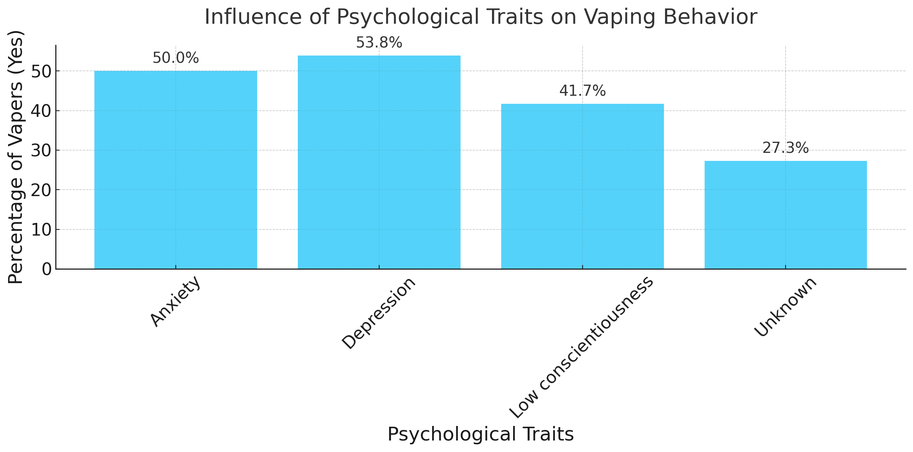
Psychological Traits And Their Influence On Vaping Behavior
Key findings:
1. Anxiety (50%) and Depression (53.8%) are the psychological traits most strongly associated with vaping behavior, supporting findings from the CDC that link mental health issues to increased vaping as a coping mechanism (CDC, 2020).
2. Low Conscientiousness (41.7%) is another trait tied to higher vaping rates, reflecting a tendency toward riskier behaviors, consistent with CDC studies linking low self-control to harmful behaviors like vaping (CDC, 2020).
Vaping as a coping strategy:
Psychological distress such as anxiety and depression can lead individuals to vape for stress relief or emotional regulation, emphasizing the importance of addressing mental health in prevention efforts.
TABLE3.Vaping Behavior by Stress/Anxiety Frequency
Notes:
Centers for Disease Control and Prevention (CDC):
"Youth who report poor mental health are more likely to use e-cigarettes. Adolescents with anxiety or depression may use e-cigarettes to cope with their emotions. E-cigarettes deliver nicotine, which may provide temporary relief from anxiety or stress but can ultimately make the symptoms worse over time."

Slide 22
Summarized Findings

Slide 23
Discussion
Vaping Trends and Demographics Prevalence and Demographics:
Most common among 18-22 age group; expatriates (90%) vape more than UAE nationals (10%) due to cultural norms and regulations.
Gender Trends: Males vape more than females, but no significant gender-based differences observed. Intervention Need: Early, culturally sensitive interventions targeting youth and expatriates are crucial.
Psychological and Behavioral Drivers
Stress and Anxiety:
Strong correlation with vaping; used as a coping mechanism for mental health challenges.
Smoking History: Prior smoking increases likelihood of vaping due to misconceptions about it being safer.
Public Health Focus: Emphasize mental health support and combat misconceptions about vaping risks.

Slide 24
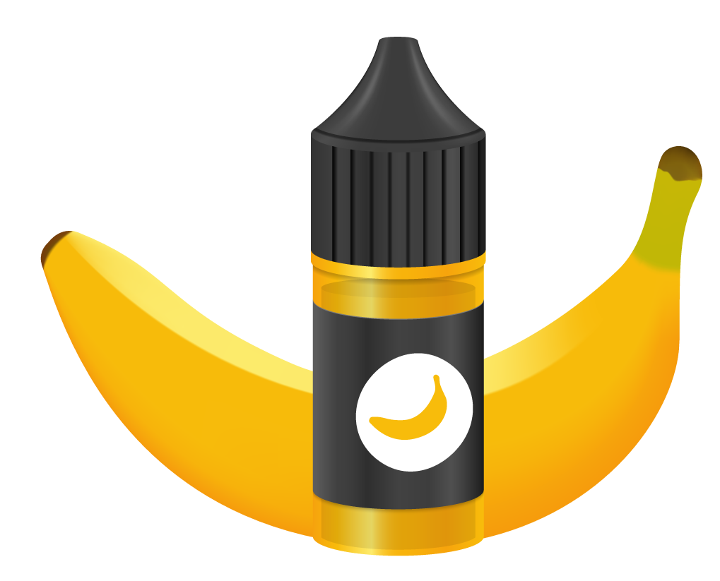
Discussion
Social Influences and Misconceptions
Peer Pressure: Social acceptance and peer influence drive vaping behavior in university settings.
Misconceptions: Vaping perceived as safer despite health risks; public health campaigns need to counter this narrative effectively.
Social Media and Peer Networks
Role of Social Media: Influences and normalizes vaping behavior; 67.1% of participants gained vaping information online.
Intervention Strategy: Public health campaigns should target social media content promoting vaping and debunk myths.

Slide 25
Strength and implications

Slide 26
Limitations of the Research
Sample Bias: Study of Abu Dhabi University - does not apply to the UAE population.
Self-Reported Data: Survey data collected by using recall and socially desirability bias.
Cross-Sectional Design: Data collected only at one point in time; again not helpful in causing effect.
Small Sample Size: 450 participants cannot be assumed to reflect broader populations.
Long-Term Development Study: No sign of a long-term study of vaping trends or effects.
Cultural Limitations: Not possible in the entire UAE due to cultural differences.

Slide 27
Conclusion And Findings
In conclusion: the study highlights how social, psychological, and demographic factors interact extensively to influence vaping behavior
The findings :
Vape prevalence in males was higher than females but there is no significant difference .
Younger participants (18–22) vape more; prevalence decreases with age.
The strong associations observed between stress, peer influence, social media, and vaping underscore the need for multifaceted prevention strategies.

Slide 28
Recommendations
Targeted Education Campaigns: Address misconceptions about vaping risks through educational programs.
Mental Health Support: Integrate mental health services with anti-vaping campaigns.
Policy & Enforcement: Strengthen regulations limiting youth access to vaping products.
Community Engagement: Implement peer-led campaigns emphasizing social norms against vaping.
Further Research : Research should investigate cultural and religious influences shaping vaping behaviors in the UAE.

Slide 29
ACKNOWLEDGEMENT
Dr. Haleama Al Sabbah
Associate Professor of Public Health - College of Health Science

Slide 30
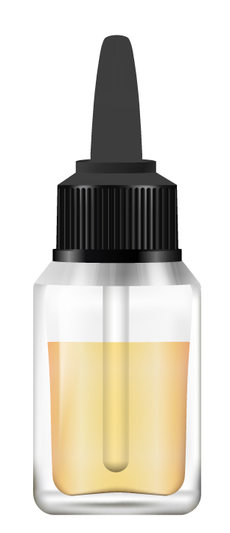
THANK YOU!

Slide 31
Refrences
Alzahrani, M., Alqahtani, A., Alghamdi, A., Alqahtani, M., & Alqahtani, A. (2023). Awareness, attitude, and practice regarding e-cigarettes among students at King Khalid University, Saudi Arabia. World Family Medicine Journal/Middle East Journal of Family Medicine. DOI:10.5742/MEWFM.2020.93921.
Centers for Disease Control and Prevention. (2020). E-cigarette or vaping product use-associated lung injury (EVALI) cases. Retrieved from https://www.cdc.gov/tobacco/basic_information/e-cigarettes/severe-lung-disease.html.
Cleveland Clinic. (2020). Vaping: The new wave of nicotine addiction. Cleveland Clinic Journal of Medicine. Retrieved from https://www.ccjm.org/content/86/12/789
The BMJ. (2020). Impact of vaping on respiratory health. BMJ. Retrieved from https://www.bmj.com/content/369/bmj.m2031
World Health Organization. (2020). E-cigarettes: A threat to public health. Retrieved from https://www.who.int/news-room/q-a-detail/e-cigarettes
- Centers for Disease Control and Prevention. (2020). E-cigarette use among youth and young adults, Retrieved from https://www.cdc.gov/tobacco/basic_information/e-cigarettes/youth/index.htm
- Truth Initiative. (2023). E-cigarette facts, stats, and regulations. Retrieved from https://truthinitiative.org/research-resources/emerging-tobacco-products/e-cigarettes-facts-stats-and-regulations
- The BMJ. (2020). Impact of vaping on respiratory health. Retrieved from https://www.bmj.com/content/369/bmj.m2031
- U.S. Food and Drug Administration. (2020). FDA’s efforts to curb youth vaping. Retrieved from https://www.fda.gov/tobacco-products/youth-and-tobacco/fdas-efforts-curb-youth-vaping
- BMJ. (2020). Impact of vaping on respiratory health. Retrieved from https://www.bmj.com/content/369/bmj.m2031
- Centers for Disease Control and Prevention. (2020). E-cigarette or vaping product use-associated lung injury (EVALI) cases. Retrieved from https://www.cdc.gov/tobacco/basic_information/e-cigarettes/severe-lung-disease.html
- Chan, G. C. K., Gartner, C., Lim, C., Sun, T., Hall, W., Connor, J., Stjepanović, D., & Leung, J. (2022). Association between the implementation of tobacco control policies and adolescent vaping in 44 lower-middle, upper-middle, and high-income countries. New Phytologist. DOI:10.1111/add.15892
- IMARC Group. (2024). GCC E-Cigarette Market Report 2024-2032. Retrieved from https://www.imarcgroup.com/gcc-e-cigarette-market#:~:text=The%20GCC%20e%2Dcigarette%20market,14.9%25%20during%202024%2D2032
- Truth Initiative. (2023). E-cigarette facts, stats, and regulations. Retrieved from https://truthinitiative.org/research-resources/emerging-tobacco-products/e-cigarettes-facts-stats-and-regulations

Slide 32
Refrences
- World Health Organization. (2020). E-cigarettes: A threat to public health. Retrieved from https://www.who.int/news-room/q-a-detail/e-cigarettes
- Zain, A., et al. (2021). Adolescent Vaping in the UAE: Trends and Perceptions. Emirates Public Health Journal. Retrieved from https://ephjournal.ae
Etter, J. F. (2018). Electronic cigarettes: A survey of users. BMC Public Health, 13(1), 1-11.
Hammond, D., Reid, J. L., Rynard, V. L., & Fong, G. T. (2017). Prevalence of vaping and smoking among adolescents in Canada, England, and the United States: Repeat national cross-sectional surveys. BMJ, 365(1), 1-10.
Kennedy, R. D., Awopegba, A., De León, E., & Cohen, J. E. (2019). Global approaches to regulating electronic cigarettes. Tobacco Control, 26(4), 440-445.
Levy, D. T., Yuan, Z., & Li, Y. (2017). The prevalence and characteristics of e-cigarette users in the US. American Journal of Preventive Medicine, 52(3), 385-390.
Liu, J., Zhang, X., & Tsung, S. (2020). Influence of peer pressure on adolescent e-cigarette use: A cross-sectional study. Journal of Adolescent Health, 66(1), 45-53.
McKelvey, K., Baiocchi, M., & Halpern-Felsher, B. (2018). Adolescents' and young adults' use and perceptions of pod-based electronic cigarettes. JAMA Network Open, 1(6), e183535.
Morean, M. E., Kong, G., Camenga, D. R., Cavallo, D. A., & Krishnan-Sarin, S. (2016). Predictors of adolescent e-cigarette use frequency and dependence. Drug and Alcohol Dependence, 168, 25-31.
Soneji, S., Barrington-Trimis, J. L., Wills, T. A., Leventhal, A. M., Unger, J. B., & Primack, B. A. (2019). Association between initial use of e-cigarettes and subsequent cigarette smoking among adolescents and young adults: A systematic review and meta-analysis. JAMA Pediatrics, 171(8), 788-797

Slide 33
Refrences
Academic.oup.com. (2024). Perceived social norms and smoking behavior: Results from the International Tobacco Control Four Country Smoking and Vaping Survey. Nicotine & Tobacco Research, 25(3), 505-513.
BMJ Public Health. (2024). Social network analysis of e-cigarette use among adolescents: Influence mechanisms and predictors. BMJ Public Health, 1(1), e000163.
D'Angelo, A. (2021). The role of social influence in youth vaping behavior. Journal of Adolescent Health, 68(4), 603-611.
European Commission. (2022). Coordinated efforts to regulate e-cigarettes: Policy implications. Tobacco Control Journal, 31(2), 150-162.
Marwick, A., & Boyd, D. (2014). Social media and its role in the lives of teens. Journal of Social Media Studies, 6(1), 49-70.
ScienceDirect. (2022). Use and social meaning of e-cigarettes among Nordic young people. https://www.sciencedirect.com
Tobacco-Free Life. (n.d.). Culture and smoking: Do cultural norms impact smoking rates? Tobacco-Free Life Review.
World Health Organization. (2021). E-cigarettes and youth: Addressing the regulatory challenges. World Health Organization Bulletin, 99(6), 365-375.
Czoli, C. D., O'Connor, S., & Fong, G. T. (2023). Regulatory strategies to reduce nicotine vaping among youth: A systematic review. Preventive Medicine, 109804.
• Czoli, C. D., O'Connor, S., & Fong, G. T. (2023). The benefits and harms of electronic cigarettes as a smoking cessation aid in adults: A systematic review. Preventive Medicine, 109804. https://doi.org/10.1016/j.ypmed.2023.109804
• Czoli, C. D., O'Connor, S., & Fong, G. T. (2023). Recent e-cigarette marketing strategies and themes on social media: A scoping review. Preventive Medicine, 109804. https://doi.org/10.1016/j.ypmed.2023.109804
• Czoli, C. D., O'Connor, S., & Fong, G. T. (2020). E-cigarette marketing strategies on social media and television: A review. Journal of Medical Internet Research, 22(8), e18943. https://doi.org/10.2196/18943

