Slide 1
Hepatoprotective , Renoprotective, antioxidant properties and effects of lipid and glucose metabolism of Azanza garckeana seed oil in male albino rats
Hatil Hashim EL-Kamali
Department of Botany, Faculty of Science and Technology, Omdurman Islamic University, Omdurman, Sudan.
hatilhashim@gmail.com
Rafiah Awad Mohamed Adam
Department of Nutrition and Food Technology
Faculty of Sciences and Technology, Omdurman Islamic University, Omdurman, Sudan

Slide 2
Azanza garckeana
Azanza garckeana, commonly known as the “African velvet tamarind,” is a plant belonging to the family Malvaceae. Traditionally, it has been used in various African cultures for its medicinal properties, including its potential benefits for liver and kidney health. Azanza garckeana has been reported to possess various pharmacological properties, including antioxidant, anti-inflammatory, and hepatoprotective effects.

Slide 3
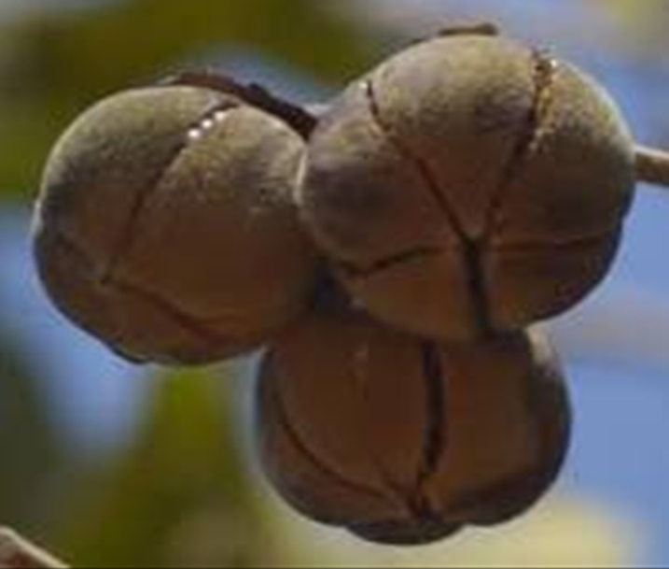
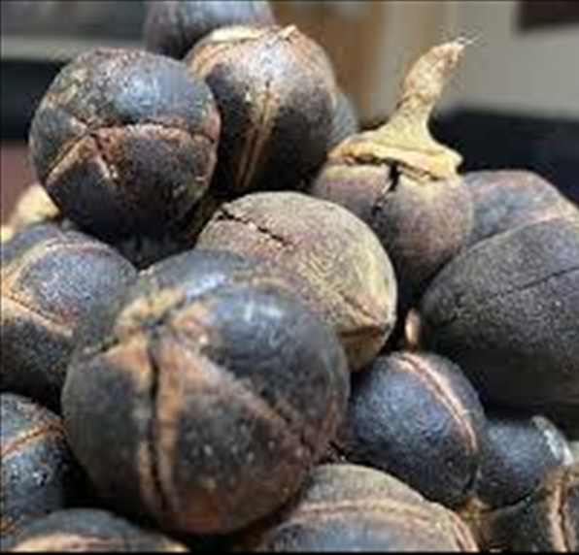
Azanza garckeana fruit is widely consumed in Africa both as food and as herbal medicine.

Slide 4
Objectives
This study investigates the hepatoprotective , renoprotective, antioxidant properties and effects of lipid and glucose metabolism of Azanza garckeana seed oil in male albino rats. Liver function was assessed by measuring AST, ALT, and ALP levels. Various doses of the extract followed by paracetamol administration [Paracetamol-induced hepatotoxicity]. Kidney function, assessed through serum creatinine and blood urea levels. The antioxidant activity was assessed using DPPH and ATBS assays. Metabolic health markers, including cholesterol, triglycerides and glucose, were also evaluated.

Slide 5
Materials and Methods
Animal Model: Male albino rats weighing 150-200 grams.
Grouping: Rats were divided into several groups:
1. Control (untreated) Group I
2. Paracetamol-only group [750 mg/Kg b.w] (administered paracetamol to induce liver injury). Group II
3. Azanza garckeana treated groups (various doses of the oil followed by paracetamol administration).

Slide 6
Dosage: The oil is typically administered orally at doses 1 ml oil/Kg b.w. Group III
and 2 ml oil/Kg b.w. Group IV prior to paracetamol exposure (2 g/Kg).
The experiment was conducted for 14 days.
Assessment Parameters:
Biochemical Analysis: Serum levels of liver enzymes (AST, ALT, ALP) and renal parameters (creatinine, urea). In addition to Cholesterol, triglycerides and glucose levels.

Slide 7
Results and Discussion
Biochemical Findings: AST, ALT, and ALP levels are commonly used markers of liver function. Elevated levels of these enzymes typically indicate liver damage. Paracetamol-induced hepatotoxicity resulted in a significant increase in ALT and ALP, reflecting liver damage.
Rats treated with Azanza garckeana exhibited significantly reduced serum levels of AST, ALT, and ALP compared to the paracetamol-only group, indicating hepatoprotection.

Slide 8
Table 1. Effect of Azanza garckeana seed oil on hepatic enzymes
Group no. | Group name | AST (U/L) | ALT (U/L) | ALP(U/L)
I | Normal control | 34.83 ± 1.90 | 9.60±1.21 | 15.07±1.54
II | Negative control (paracetamol) | 35.17±2.43 | 29.73±8.88* | 73.50±10.69**
III | A. garckeana oil (1 ml/kg) + paracetamol | 33.67±2.39 | 13.75±2.44 | 11.65±2.45##
IV | A. garckeana oil (2 ml/kg) + paracetamol | 32.33 ±1.80 | 10.30±1.20# | 15.67± 3.28##

Slide 9
Hepatoprotective effect
At 1 ml/kg, the Azanza garkeana seed oil significantly reduced ALT and ALP levels close to the normal. At 2 ml/kg, the reduction in liver enzyme levels was even more pronounced, suggesting a dose-dependent hepatoprotective effect. The fact that both doses of A. garckeana oil significantly reduced liver enzymes indicates that it has hepatoprotective properties and mitigates liver damage caused by paracetamol.

Slide 10
A.garkeana hepatoprotective and renoprotective
The oil appears safe for the liver at both doses studied (
1 ml/kg and 2 ml/kg), with no signs of hepatotoxicity.
Renal function markers (creatinine, urea) were significantly improved in the Azanza garckeana groups, reflecting its renoprotective effects.
The findings indicate that Azanza garckeana possesses significant hepatoprotective and renoprotective properties in the context of paracetamol-induced injury. The protective effects can be attributed to its antioxidant and anti-inflammatory actions, which mitigate oxidative stress and inflammation associated with liver and kidney damage.

Slide 11
Kidney Function
Paracetamol did not cause significant damage to kidney function, as seen in the normal creatinine and urea levels. Both 1 ml/kg and 2 ml/kg doses did not show any adverse effects on kidney function. In fact, the creatinine and urea levels in the oil-treated groups were similar to or slightly better than the control group. A. garckeana seed oil shows no signs of renal toxicity at the doses tested. The data suggest that the oil is safe for the kidneys, with no observed negative impact on renal markers.

Slide 12
Table 2. Effect of Azanza garckeana oil on renal damage induced by Paracetamol
Group no. | Group name | Serum creatinine (mg/dl) | Blood urea (mg/dl)
 | Normal control | 0.65±0.072 | 42±2.27
II | Negative control (paracetamol) | 0.67±0.06 | 43.67±3.21
III | A. garckeana oil (1 ml/kg) + paracetamol | 0.65±0.05 | 40.83±1.87
IV | A. garckeana oil (2 ml/kg) + paracetamol | 0.62±0.048 | 41.5±2.39
Results were expressed as mean ± S.E.M, n = 6. *p < 0.05 vs. control,
**p < 0.01 vs. control, #p < 0.5 vs. paracetamol, ##p < 0.01vs. paracetamol

Slide 13
Metabolic Health Markers
Cholesterol, triglycerides, and glucose levels are vital indicators of metabolic health. Abnormalities in these parameters could suggest metabolic disturbances or toxicity. Paracetamol lowered cholesterol and triglyceride levels, likely due to liver damage, and had a modest effect on glucose levels. Both doses of the oil (1 ml/kg and 2 ml/kg) restored cholesterol and triglyceride levels toward normal. Glucose levels were also maintained within a normal range.

Slide 14
Table 3. Effect of Azanza garckeana oil on plasma total cholesterol, triglycerides and glucose in hepatotoxic rats
Group no. | Normal control | plasma total cholesterol (mg/dl) | triglycerides (mg/dl) | glucose (mg/dl)
 | Negative control (paracetamol) | 63.67 ± 1.76 | 43.67±1.86 | 49.00±2.21
II | A. garckeana oil (1 ml/kg) + paracetamol | 74.83 ± 1.85** | 54.17±1.17** | 55.00±2.52
III | A. garckeana oil (2 ml/kg) + paracetamol | 77.33 ± 1.56 | 57.67±1.20**# | 54.17±2.62
IV | Normal control | 74.17± 4.70* | 52.17±4.17* | 57.33± 3.90
Results were expressed as mean ± S.E.M, n = 6. *p < 0.05 vs. control,
**p < 0.01 vs. control, #p < 0.5 vs. paracetamol, ##p < 0.5 vs. paracetamol

Slide 15
DPPH and ATBS assays
DPPH and ATBS assays are used to assess the antioxidant capacity of substances. The oil demonstrated a moderate antioxidant activity (57.37% and 55.97% for DPPH and ATBS assays, respectively), although not as strong as ascorbic acid (positive control). The moderate antioxidant activity of A. garckeana oil suggests it has the ability to scavenge free radicals and reduce oxidative stress.

Slide 16
Table 4. Antioxidant activity of Azanza garckeana seeds oil
Test | % | Positive Control (Ascorbic acid)
DPPH | 57.37 | 97
ATBS | 55.97 | 98

Slide 17
Conclusion
The results of the study highlight the potential of Azanza garckeana as a protective agent against paracetamol-induced liver and kidney injury in male albino rats. Its antioxidant and anti-inflammatory properties contribute to its therapeutic efficacy, supporting its traditional use in managing liver and kidney disorders. Further research could pave the way for the development of herbal formulations that incorporate Azanza garckeana for clinical applications in hepatoprotection and renoprotection.

Slide 18
Thank You

