Slide 1

Title:
A cohort study on oxidative stress
Indications in children exposed to
cellphone and cell tower radiation
Presenter Name (Bold)
Dr.Indra VIjay Singh
Meghana V
Moodlakatte Institute Of
Technology, Kundapura-Karnatka-India

Slide 2
BACKGROUND
Radiofrequency electromagnetic fields (RF-EMF) are ubiquitous; the application of this technology has increased a lot over the past few decades ^{1,2,3}
    Medical use – radiofrequency ablation, imaging
    Telecommunications – mobile phones, Wi-Fi
    The usually frequencies are from 100kHz – 300GHz
RF-EMF can have effects on health – general health effects such as headache, sleep disturbances, or specific health effects such as neurodevelopmental delays in children and adolescents ^{1,2,3}
They may also have effects on the hormone levels of children and also lead to oxidative stress

Slide 3

INTRODUCTION
Oxidative Stress: Imbalance between free radicals and antioxidants.
Aim: Predict Superoxide Dismutase (SOD) activity and assess oxidative stress.
Health Impact: Explores effects of EMR from mobile phones and cell towers on children.
Biomarker: SOD activity used to evaluate oxidative stress.
Parameters:Radiation exposure levels, Fibrinogen concentration.
Neural Networks: Advanced models for predicting SOD activity.
Decision Trees: Polynomial transformations for feature enhancement and prediction.
1
1
2
3
1
1
4
5
5
6
7
5

Slide 4
LITERATURE REVIEW
SL.NO | AUTHOR | TITLE | YEAR | DESCRIPTION
1 | Kağan VERYER1 | OXIDATIVE STRESS: THE MECHANISM AND EFFECT OF REACTİVE OXYGEN SPECIES | 2023 | Reactive oxygen species (ROS) play a dual role in biological systems, contributing to essential cellular functions while also causing oxidative damage to proteins, lipids, and DNA. Antioxidant compounds help neutralize ROS, preventing oxidative stress-related diseases. Understanding ROS mechanisms is crucial for developing therapeutic strategies, including next-generation antibiotics.
2 | Barbora Katrenˇ cíková 1, Magdaléna Vaváková 1,Zuzana Paduchová 1, Zuzana Nagyová 2, Iveta Garaiova 3, Jana Muchová 1, Zdenka ˇDuraˇ cková 1,andJanaTrebatická 4 | Oxidative Stress Markers and Antioxidant Enzymes in Children and Adolescents with Depressive Disorder and Impact of Omega-3 Fatty Acids in Randomised Clinical Trial | 2021 | The study links oxidative stress (OS) to depressive disorder (DD) in youth, showing elevated OS markers and reduced antioxidant activity in depressed individuals. Omega-3 supplementation improved antioxidant defenses, suggesting its potential therapeutic benefits for managing depression.
3 | Claudia Consales, Caterina Merla, Carmela Marino,and BarbaraBenassi | Electromagnetic Fields, Oxidative Stress, and Neurodegeneration | 2012 | The review found no confirmed evidence that low-level RF fields above 6 GHz, such as those used in 5G, pose health risks, with surface heating being the main biological effect. However, it calls for better study designs and long-term monitoring to assess potential impacts.
4 | Z. ĎURAČKOVÁ1 | Some Current Insights into Oxidative Stress | 2009 | Oxidative stress (OS) plays a dual role in health, contributing to diseases like neurodegeneration, cancer, and inflammation while also influencing cellular signaling and adaptation. Its effects depend on redox balance, intensity, and duration, with antioxidants offering benefits but potentially being counterproductive in excess.

Slide 5
RESERACH GAP
01
02
03
04
05
Combined effects
Risk Assessment
Practical Model
Prediction Clarity
Advanced Methods
Few studies focus on radiation and fibrinogen together in children.
Lacks a threshold-based system for easy evaluation.
Bridges the gap between theory and real-life applications.
Adds decision tree visuals for better understanding.
Uses neural networks and decision trees for improved accuracy over basic models.

Slide 6
IMPLEMENTATION
RADIATION
Features
SOD ACTIVITY
FIBRINOGEN

Slide 7
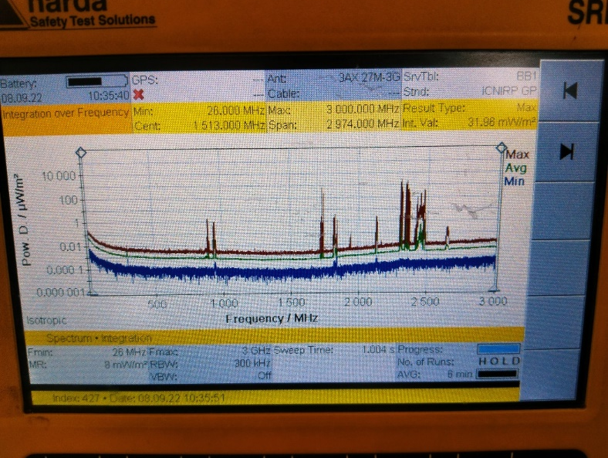
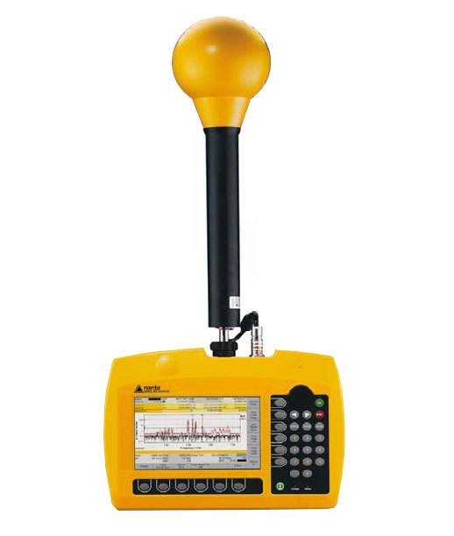
METHODS
Radiation assessment
  Level of radiation in the house: Measured by using NARDA SRM-3600 (Nardaworldwide, Germany)
Notes:
Summarize your research in three to five points.

Slide 8
METHODS
Laboratory Assessment
  Superoxide dismutase (Thermo Fisher Scientific), Colorimetric Activity Kit
  Glutathione Peroxidase (Sigma Aldrich), Colorimetric Activity Kit
  Myeloperoxidase (Abcam), Sandwich (Quantitative)
  Thrombomodulin (Abcam), Sandwich (Quantitative)
  Fibrinogen (Abcam), Sandwich (Quantitative)
  hCRP (Beckman and Coulter, AU 480 Biochemistry Analyser)
  Ferritin (Beckman and Coulter, AU 480 Biochemistry Analyser)
Notes:
Summarize your research in three to five points.

Slide 9
RESULTS
 | Exposed (up 300 m) (45.3%) | Unexposed (> 300 m) (54.7%) | P value
 | Median (IQR) | Median (IQR)
h C-Reactive Protein (mg/L) | 2.00 (0.95, 5.90) | 0.90 (0.70, 4.80) | 0.046
Superoxide dismutase (µ/ml) | 2.93 (1.77, 3.28) | 1.84 (1.48, 3.00) | 0.03
Glutathione Peroxidase (nmol/min/ml) | 995.3 (877.5, 1429.3) | 871.9 (369.8, 1222.2) | 0.29
Fibrinogen (pg/ml) | 528.9 (348.4, 557.1) | 380.5 (223.6, 558.2) | 0.31
Myeloperoxidase (pg/ml) | 40.58 (21.27, 81.33) | 68.81 (27.98, 112.84) | 0.18
Thrombomodulin (ng/ml) | 2.70 (0.81, 6.06) | 0.96 (0.79, 3.14) | 0.14
Ferritin (ng/ml) | 13.45 (8.00, 22.2) | 15.50 (9.20, 22.40) | 0.58
Notes:
Summarize your research in three to five points.

Slide 10
RESULTS
Correlation Matrix - LOR

Slide 11
RESULTS
Heat-plot - LOR

Slide 12
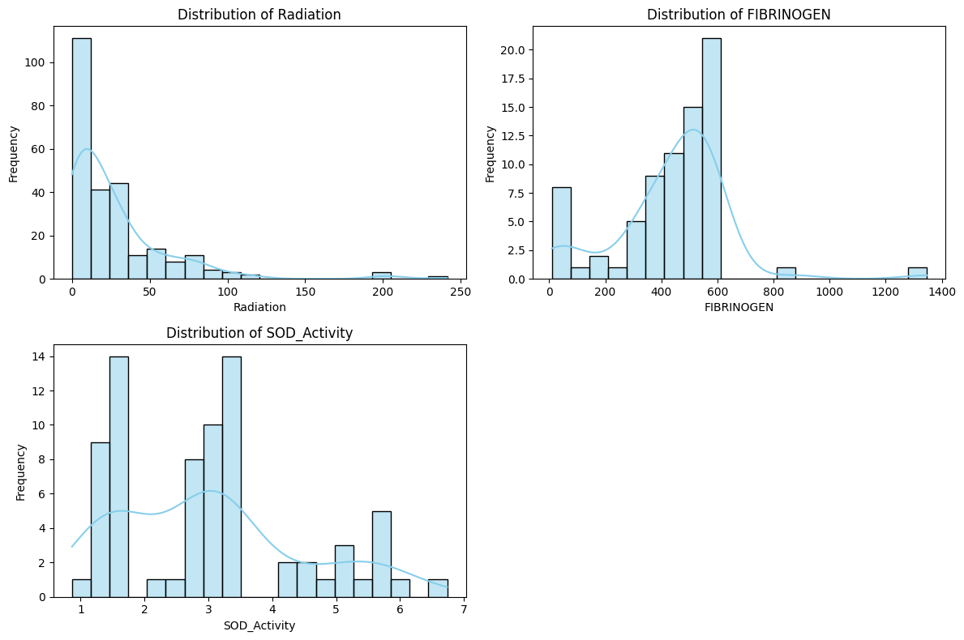
DISTRIBUTION OF DATA
Most radiation levels are low, with a few higher values.
Fibrinogen levels are mostly between 400 and 700, with some higher values.
SOD activity has groups around certain values, showing different patterns.
1
2
3

Slide 13
NEURAL NETWORK REGRESSION MODEL
Splitting the dataset
Data pre-processing
Model Development
Model
Data Collection
Model Evaluation

Slide 14
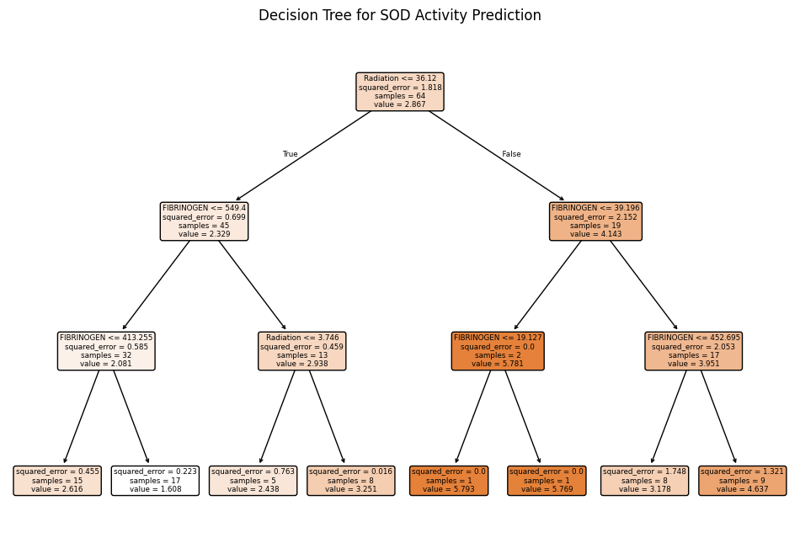
DECISION TREE
Initial Split
Refinement
Leaf Nodes

Slide 15
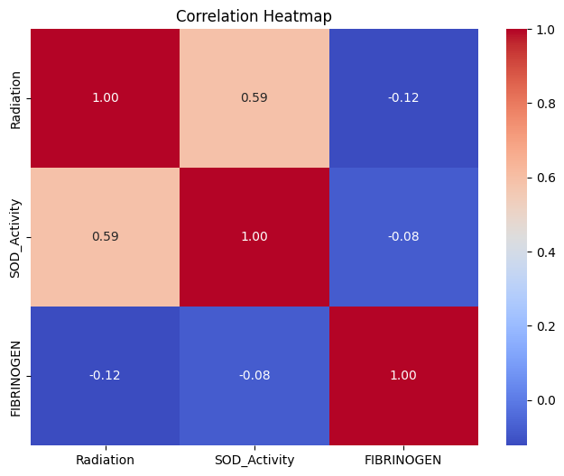
RESULT
CLASSIFICATION REPORT
CORRELATION HEATMAP
 | precision | recall | F1score | Support
Not exposed | 1.00 | 0.82 | 0.90 | 11
Exposed | 0.50 | 1.00 | 0.67 | 2
Accuracy |  |  | 0.85 | 13
Macro Avg | 0.75 | 0.91 | 0.78 | 13
Weighted avg | 0.92 | 0.85 | 0.86 | 13

Slide 16
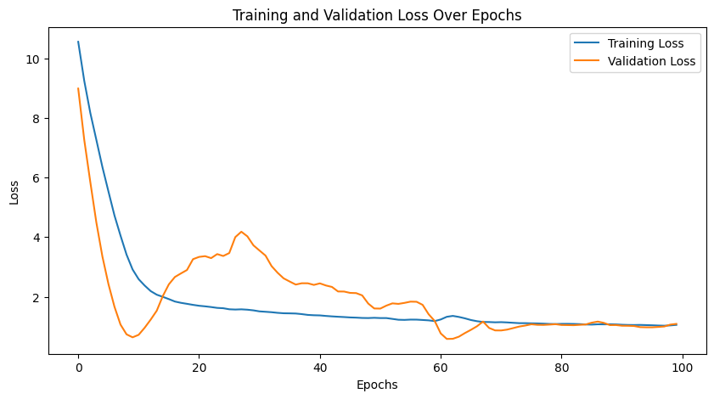
TRAINING AND VALIDATION CURVE
ERROR METRICS
Mean Absolute Error (MAE) | 0.7863
Mean Squared Error (MSE) | 0.8273
Root Mean Squared Error (RMSE) | 0.9096

Slide 17
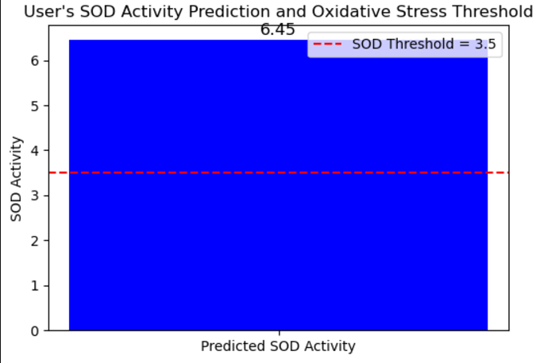
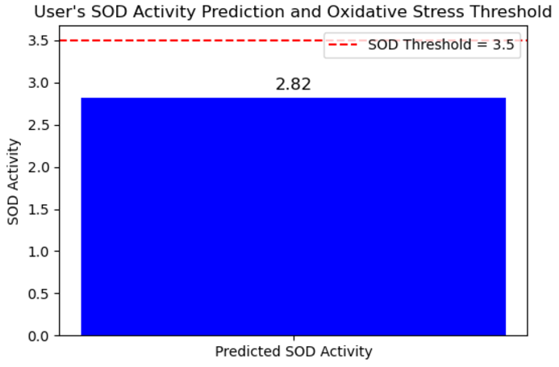
CLASSIFICATION

Slide 18
Condition | Radiation Levels | SOD Activity | Fibrinogen Levels | Relationship
Early Oxidative Stress | 🔼 Increases | 🔼 Increases | 🔼 Increases | All Increase Together
Chronic Oxidative Stress | 🔼 High (sustained) | 🔽 Decreases | 🔼 Increases | Radiation remains high, SOD decreases, Fibrinogen stays high (Inverse Relationship)
Recovery Phase | 🔽 Decreases | 🔼 Increases | 🔽 Decreases | SOD recovers, Fibrinogen decreases, Radiation is reduced

Slide 19
ADVANTAGES AND DISADVANTAGES
ADVANTAGES | DISADVANTAGES
Robust Machine Learning Model | Possible Overfitting Due to Small Dataset
Effective Data Preprocessing | Limited Features Used for Prediction
Good Performance Metrics | Class Imbalance in Classification Task
Clear Visualization & Interpretation | High Computational Cost Due to Polynomial Expansion
Threshold-Based Classification for Easy Decision Making | Decision Tree Depth is Limited

Slide 20
CONCLUSION
Objective: Predict SOD activity and assess oxidative stress in radiation-exposed children.
Methods: Use neural networks and decision trees with polynomial features.
Accuracy: Achieves 85% but needs improvement for imbalanced data.
Impact: Shows ML’s role in health monitoring and personalized care.
Future Work: Add more factors and apply deep learning.

Slide 21
FUTURE SCOPE
Real-World Implementation
Comparative Studies
Expand Predictive Parameters
Enhance Machine Learning Model

Slide 22
REFERENCES
[1] GRadiation impact from Cell Phones and Towers on Human Health and Environment - A Review February 2023 International Journal of Scientific Research in Science and Technology DOI:10.32628/IJSRS T2310176 Authors:Anil R. Saradva
[2] Mobile phone and base stations radiation and its effects on human healthand environment: A review Nadimikeri Jayarajua, M. Pramod Kumarb, G. Sreenivasuluc, T. Lakshmi Prasadb,*,B. Lakshmannad, K. Nagalaksmie, M. Madakkaf
[3] Pathophysiology of cell phone radiation: oxidative stress and carcinogenesis with focus on male reproductive system Nisarg R Desai1,2, Kavindra K Kesari3 and Ashok Agarwal*1
[4] Oxidative Stress Markers and Antioxidant Enzymes in Children and Adolescents with Depressive Disorder and Impact of Omega-3 Fatty Acids in Randomised Clinical Trial Barbora Katrenˇ cíková 1,†, Magdaléna Vaváková 1,†, Zuzana Paduchová 1, Zuzana Nagyová 2, Iveta Garaiova 3, Jana Muchová 1, Zdenka ˇDuraˇ cková 1,*,‡ andJanaTrebatická 4,‡
[5] Oxidative Stress: Harms and Benefits for Human Health Gabriele Pizzino,1 Natasha Irrera,1 Mariapaola Cucinotta,2 Giovanni Pallio,1 Federica Mannino,1 Vincenzo Arcoraci,1 Francesco Squadrito,1 Domenica Altavilla,2 and Alessandra Bitto1
[6] Some Current Insights into Oxidative Stress Z. ĎURAČKOVÁ1 1Institute of Medical Chemistry, Biochemistry and Clinical Biochemistry, Faculty of Medicine, Comenius University, Bratislava, Slovakia
[7] Electromagnetic Fields, Oxidative Stress, and Neurodegeneration Claudia Consales, Caterina Merla, Carmela Marino, and BarbaraBenassi
[8] oxidative stress: the mechanism and effect of reactİve oxygen species kağan veryer1
[9] p d, premlal & varkey, eldose. (2018). mobile tower radiation and its impacts on child health: a study conducted in an ecologically sensitive area of western ghats. international journal of electrical and computer engineering (ijece)
[10] The international journal of science & technoledge oxidative stress: a review anand kumar keshari ph.d. student, department of biochemistry, institute of medical sciences, banaras hindu university varanasi, india akhilesh kumar verma ph.d student, department of biochemistry, institute of medical sciences, banaras hindu sciences banaras hindu university varanasi, india ragini srivastava assistant professor, department of Biochemistry, Institute of Medical Sciences, Banaras Hindu University Varanasi, India.

Slide 23
Thank You

