Slide 1
Comparing Classical and Quantum Algorithms in Analyzing NASA’s Kepler Mission Data
Dr. Avaz Naghipour
Mr. Mohammad Hossein Asheri
Department of Computer Engineering, University College of Nabi Akram, Tabriz, Iran

Slide 2
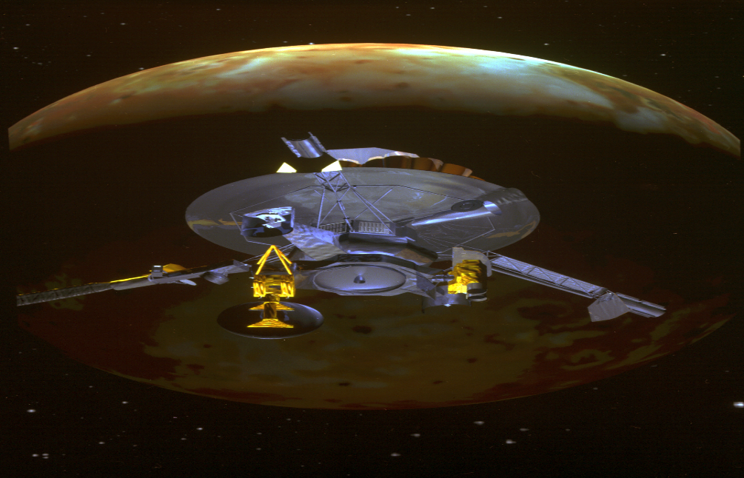
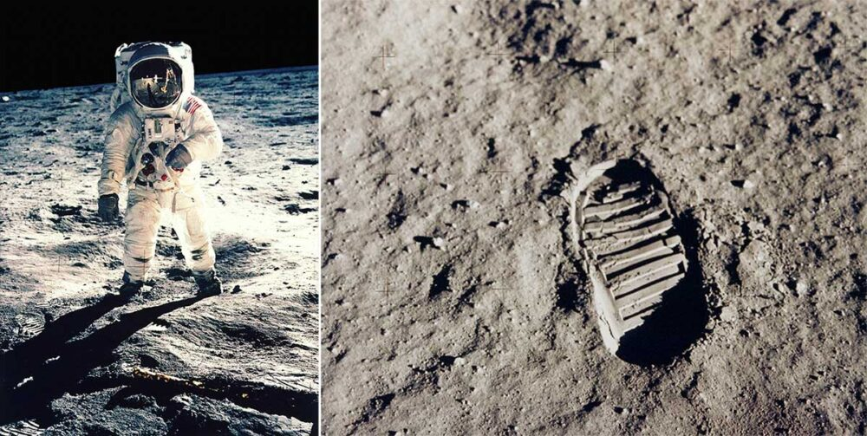
Introduction
Humankind has always been trying to understand what exists in space. For this reason, with the advancement of science and technology, many trips have been made to space. Some of these explorations include:
Apollo 11 mission to travel to the Moon Russia's Venera robotic mission to Venus
Galileo robotic mission to Jupiter Cassini satellite mission to Saturn

Slide 3
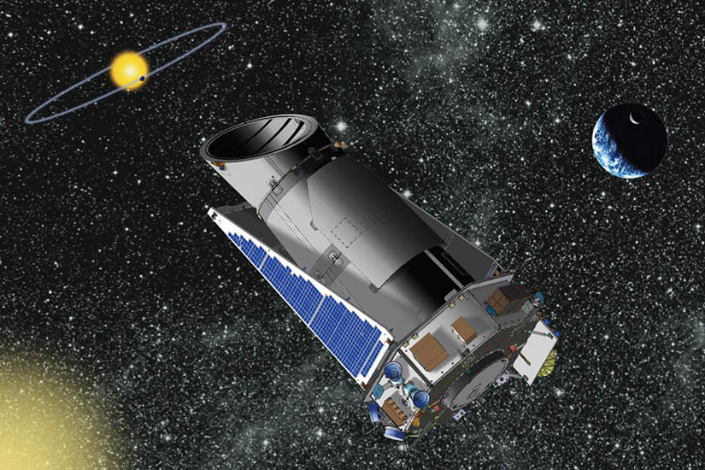
NASA's Kepler Mission
The $600 million Kepler mission was launched in March 2009 with the aim of helping to identify Earth-like planets throughout the Milky Way galaxy. Initially, the Kepler mission was expected to last three and a half years, but the precise use of the telescope's fuel allowed the mission to continue for 9 years, 7 months, and 23 days. The Kepler mission led to the identification of over 2,600 exoplanets, some of which may potentially harbor extraterrestrial life. The data from this important mission is published by the University of California, Berkeley, in collaboration with NASA.

Slide 4
Kepler Dataset
The indicators examined in this mission include:
Orbital period Transit duration Planetary radius
Planetary temperature Planetary pollution Stellar radius

Slide 5
Algorithms
PegasosQSVC
A machine learning method designed for classifying data using quantum kernels. This algorithm is particularly useful in classification problems involving large and complex datasets. Its hyperparameters include:
Hyperparameters
C
Larger values of C cause the model to focus more accurately on the training data, while smaller values of C may help with better generalization.
quantum_kernel (qkernel):
This kernel is calculated quantum mechanically and can help improve the model's accuracy.
num_steps (tau) :
This parameter affects the training time and the final accuracy of the model.

Slide 6
QNN
A machine learning model that uses neural networks for classifying data. This model can be enhanced using quantum techniques.
Hyperparameters
estimator_qnn:
This model can include both quantum and classical layers and helps in learning complex features of the data
optimizer (COBYLA):
COBYLA is a derivative-free optimization algorithm used for optimizing the model parameters
callback (callback_graph):
This function can be used for monitoring training progress, storing results, or visualizing data.

Slide 7
VQC
A quantum machine learning algorithm that uses parameterized quantum circuits to classify data. This algorithm combines quantum and classical computing, utilizing classical optimization methods to adjust the parameters of the quantum circuit.
Hyperparameters
Optimizer
This algorithm can incorporate various methods that help balance accuracy and training speed.
Sampler
This parameter represents a quantum sampler that is used to generate quantum samples from different states.
Callback Graph
This function can be used to monitor training progress, save results, or visualize data.
Ansatz
It determines how the qubits are interconnected and what types of quantum operations are performed on them.
Feature Map
This mapping can help the model identify and extract important features of the data.

Slide 8
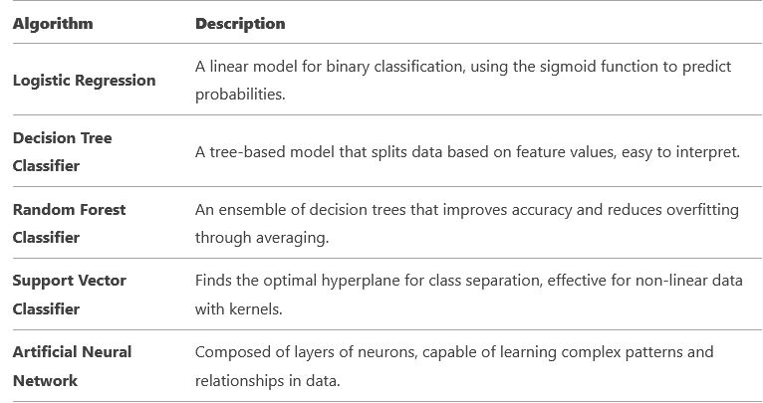
Classical Algorithms

Slide 9
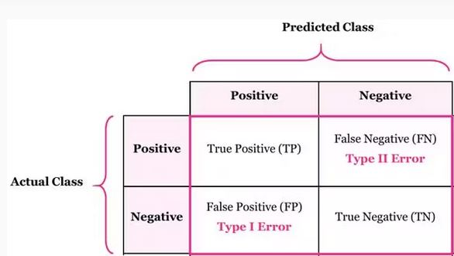
Confusion Matrix
A confusion matrix is an intuitive table that lets us see the detailed classification results of an algorithm on a test set by analyzing its rows, columns, or entries. Confusion matrices represent counts from predicted and actual values.

Slide 10
Accuracy = (TP + TN )/( TP+FP+TN+FN)
Evaluation Metrics
Recall =( TP)/ (TP + FN)
Precision = (TP) / (TP + FP)
F1- Score = (2 $×$ Precision $×$ Recall )/ (Precision + Recall)

Slide 11
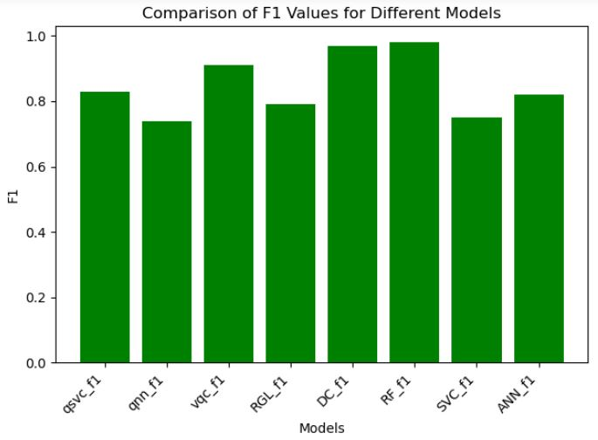
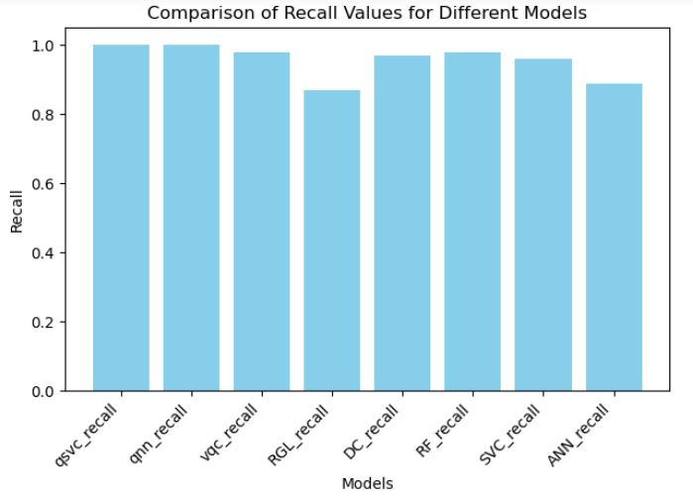
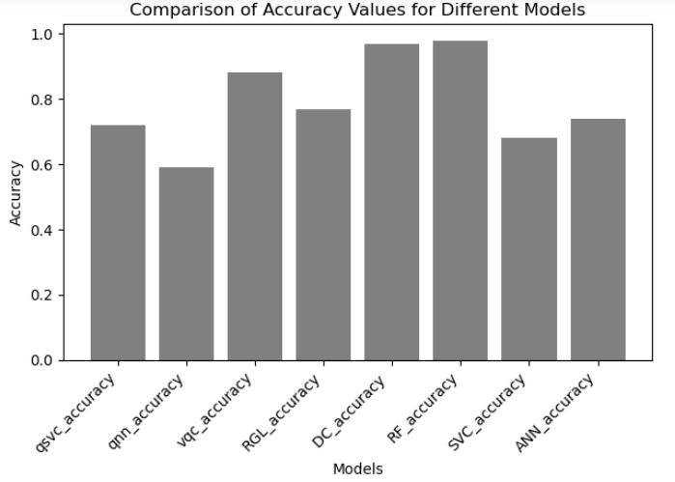
RESULTS

Slide 12
Simulators
Quantum computing simulators are tools that allow researchers and developers to test and evaluate quantum algorithms without the need for access to actual quantum hardware. Below are some well-known simulators for performing quantum computations.
Google Cirq: Cirq is an open-source software framework developed by Google for creating, editing, and executing quantum algorithms. Cirq is optimized for working with noisy intermediate-scale quantum (NISQ) computers and includes simulators for testing algorithms before running them on actual hardware
Qiskit: Qiskit is an open-source software framework developed by IBM that enables users to design, simulate, and execute quantum algorithms. Qiskit supports both local and cloud-based simulators and provides powerful tools for developing and testing quantum algorithms.
Rigetti Forest: Rigetti Computing offers a quantum computing platform that includes quantum simulators and access to actual quantum hardware. This platform supports the Quil programming language and the PyQuil software framework.

Slide 13
Real Quantum Computers
Currently, several leading companies and research institutions are actively developing and offering real quantum computers.
IBM Q:
IBM is a pioneer in quantum computing and offers the IBM Q platform, providing access to quantum computers via the cloud. IBM is also developing quantum processors with increasing numbers of qubits.
Intel Quantum Computing:
Intel is developing quantum processors based on superconducting and spin qubit technologies. The company is also collaborating with research institutions to advance this field.
Xanadu Quantum Cloud:
Xanadu, a Canadian company, is developing photonics-based quantum computers and offers a cloud platform for accessing quantum computing resources.

Slide 14
Comparison

Slide 15
Future Challenges

