Slide 1

Shape Memory Phenomena and Crystallographic Aspects of Reversibility in Shape Memory Alloys
Osman Adiguzel
Firat University, Elazig, Turkey

Slide 2
Shape Memory Alloys and Shape Memory Effect
Shape memory alloys take place in a class of advanced smart materials by exhibiting a peculiar property called shape memory effect. This phenomenon is initiated with thermomechanical treatments on cooling and deformation and performed thermally on heating and cooling, with which shape of the material cycles between original and deformed shapes in reversible way. This phenomenon is governed by the crystallographic transformations, thermal and stress induced martensitic transformations.
These alloys exhibit another phenomenon, called superelasticity, which is performed in only mechanical manner with stressing the material and releasing in the parent austenite phase region, and shape recovery occurs instantly upon releasing, by exhibiting elastic material behavior.

Slide 3
Processing of SME and SE in bulk level

Slide 4
Shape Memory Effect (SME) and Superelasticity (SE)
Shape Memory Effect is governed by crystallographic transformations, thermal and stress induced martensitic transformations and evaluated by the structural changes in atomic scale and crystallographic level.
Superelasticity is also result of stress induced martensitic transformation and performed with mechanically stressing and releasing in elasticity limit at a constant temperature in the parent austenite phase region.

Slide 5
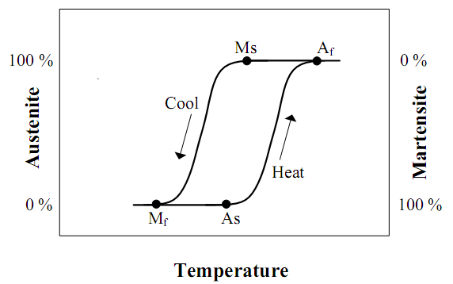
Temperature Hysteresis of Shape Memory Alloys

Slide 6
Shape Memory Effect (SME) and Superelasticity (SE)
Shape Memory Effect is governed by crystallographic transformations, thermal and stress induced martensitic transformations and evaluated by the structural changes in atomic scale and crystallographic level.
Superelasticity is also result of stress induced martensitic transformation and performed with mechanically stressing and releasing in elasticity limit at a constant temperature in the parent austenite phase region.

Slide 7
SME, SE and Martensitic Transformations
Shape memory behaviour is evaluated by the microstructural changes in atomic scale caused by internal stresses, and shape chance occurs in bulk level. Shape memory effect is governed by thermal, and stress induced martensitic transformations.
Thermal induced martensitic transformations occur with cooperative movements of atoms by means of lattice invariant shear in <110 > -type directions on the {110} - type planes of austenite matrix and ordered parent phase structures turn into twinned martensite structures. The twinned structures turn into detwinned martensite structures by means of stress induced transformation by stressing the material in the martensitic condition.
Superelasticity is also governed by stress induced martensitic transformation and ordered parent phase structures turn into detwinned martensite structure with stressing.

Slide 8
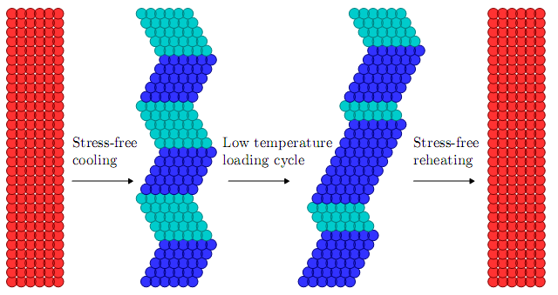
Schematic of Shape Memory Cycle
High symmetric ordered austenite phase structures turn into the twinned structures, martensite variants blue and green), on cooling. Twinned martensite structures turn into the detwinned martensite structure, by means of stress induced martensitic transformation with stressing at low temperature. Detwinned martensite structures revert back to the ordered parent phase structures, by means of reverse austenitic transformation upon heating.

Slide 9
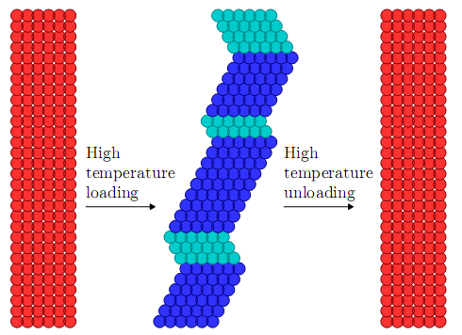
Schematic of Superelasticity
Stressing of the material in high temperature parent phase region, parent phase can generate stress-stabilized martensite, which reduces the energy required to accommodate an applied deformation. Material structure turns into the ordered parent phase structure upon removing the stress.

Slide 10
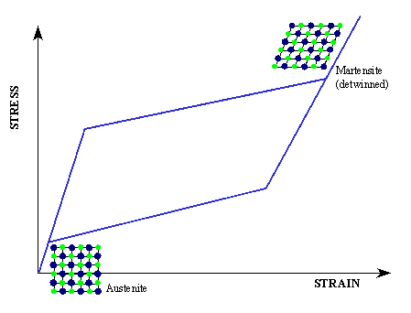
Superelastic behaviour and stress-strain diagram of Superelaticity!
Stress-strain curve exhibit non-linear behavior, and stressing and releasing paths are different, and hysteresis loop refers to the energy dissipation.

Slide 11
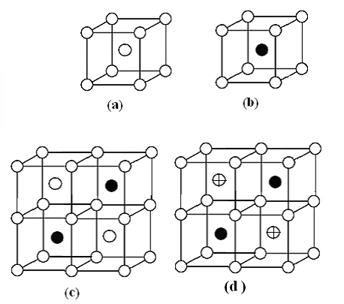
Basic β - phase structures
( a ) – Basic bcc ( A2) unit cell,
( b ) – CsCl -(B2) – type unit cell,
( c ) – Cu3Al - ( DO3 ) - type unit cell (half),
( d ) – Cu2AlMn - (L21 ) – type unit cell (half).

Slide 12
Experimental
Alloys
1. CuZnAl (Alloy 1)
Cu- 26.1%Zn - 4% Al ( in weight)
Cu- 24.2%Zn - 9% Al (in atomic)
Ms = 36 °C , Mf = 30 °C
2. CuAlMn (Alloy 2)
Cu- 11.0%Al - 6% Mn ( in weight)
Cu- 22.4%Al - 6% Mn ( in atomic)
Ms = 133 °C , Mf = 98 °C
Ms , Mf : Martensite start and finish temperatures.
Both alloys are fully martensitic at room temperature.

Slide 13
Thermal treatments
Specimens obtained from these alloys were solution treated for homogenisation in the β-phase field as following and then quenched in iced-brine and aged at room temperature.
CuZnAl alloy: at 830°C for 15 minutes and quench in iced-brine.
CuAlMn alloy: at 700°C for 20 minutes and quench in iced-brine.
Powder specimens
Powder specimens for X-ray examination were prepared by filling the alloys.
Powder specimens were sealed in evacuated quartz tubes and given β-phase homogenisation treatments:
CuZnAl alloy: at 830°C for 15 minutes and quench in iced-brine.
CuAlMn alloy: at 700°C for 15 minutes and quench in iced-brine.
Powder diffractograms were obtained for all the specimens at different stages of ageing in a long time interval.

Slide 14
X-Ray diffractograms
1. CuZnAl Alloy
Long-term aging at RT for about fifteen years after quenching
0 0 18
_
128 208
1 2 10
_
122 202
__
2 0 10

Slide 15
2. CuAlMn Alloy
Long-term aging at RT for about fifteen years after quenching
0 0 18
_
128 208
_
122 202
1 2 10
__
2 0 10

Slide 16

Interplane relations
A series of x-ray diffractograms have been taken from both alloy samples in a long-time interval, and some changes have been observed in diffraction angles and peak intensities and characteristics with aging duration.
In particular, some of the successive peak pairs have shifted toward each other. These successive peaks provide the following relation:
where n=4 for 18R martensite.
These plane pairs can be listed as follow for 18R structure; (122)-(202), (128)-(208), (1 2 10) – (2 0 10), (040)- (320).
At the long term investigation ( nearly 15 years), it is observed that these peak pairs come close each other with aging duration. These changes reveal the changes in the crystal structure of the material.

Slide 17
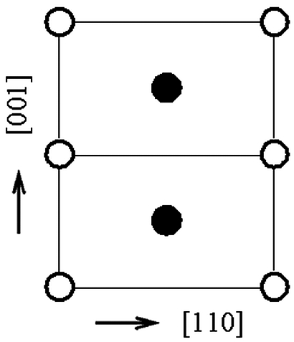
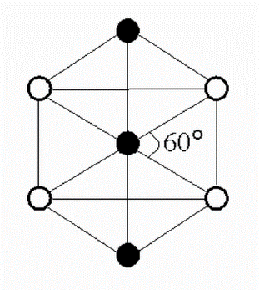
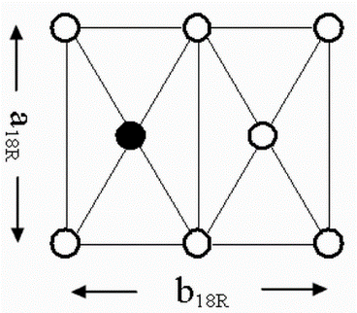
The effect of atom sizes on basal plane
The martensitic phase is based on one of the {110}β planes of parent phase. The (110) basal plane which has a rectangular shape in parent phase is subjected to hexagonal distortion and undergoes a hexagon. This process is schematically illustrated below.
( a ) ( b ) ( c )
Atomic configuration of the (110) plane of DO3 - type ordered β-matrix (a) before and (b) after hexagonal distortion, (c) principal basal plane axes of the 18R structure.

Slide 18
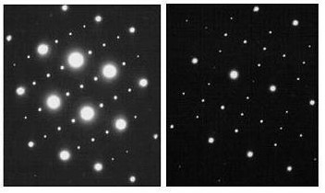
Electron Diffractions
Electron Diffractions patterns taken from CuZnAl and
CuAlMn alloys also exhibit super-lattice reflection

Slide 19
Conclusions
Shape memory effect is evaluated by the structural changes in microscopic scale by means of martensitic transformation.
The fundamental structures of the β-type martensites are orthorhombic close-packed structures which consist of an array of close-packed planes in copper based SMAs.
The β-type martensites have the layered structures and are characterized by the stacking sequences depending on the order in parent phase.
Copper based ternary alloys have the DO3 - type superlattice in parent austenite phase, and the following stacking sequence occurs with martensitic transformation; AB’CB’CA’CA’BA’ BC’BC’AC’AB’ (18R).
Based on austenite-martensite relation, the basal plane of 9R (or 18R) martensite originates from the {110}-type planes of the parent phase, on which lattice invariant shears occur in the <110>-type directions during the transformation.

Slide 20
References
1. J. Ma, I. Karaman and R.D. Noebe, High Temperature Shape
Memory Alloys, International Materials Reviews, 55(5), 257-315 (2010).
2. Dimitris C. Lagoudos (editor), Shape Memory Alloys, Modeling
and Engineering Applications, Springer (2008).
3. L. Sun, W.M. Huang, Z. Ding, Y. Zhao, C.C. Wang, H. Purnawali and C.
Tang, Materials & Design 33, 577, 2012.
4. K. Otsuka and T. Kakeshita, MRS Bulletin, 27(2), 91-100 (2002).
5. M. A. Rahman, Recent Patents on Mechanical Eng., 1, 65-67 (2008).
6. R. D. James and K. F. Hane, Acta Materialia, 48 (1), 197-222 (2000).
7. L. Sun, W.M. Huang, Z. Ding, Y. Zhao, C.C. Wang, H. Purnawali and
C. Tang, Stimulus-responsive shape memory materials: A review,
Materials & Design, 33, January 2012, Pages 577–640
8. Y.F. Hsu, W.H. Wang, The stress-induced martensitic transformation and
Superelasticity in a β Cu–Zn alloy containing α1 plates, Materials
Characterization 48 (2002), 1–10.
9*. S. Barbarino, et al., A review on shape memory alloys with applications to morphing aircraft, Smart Mater. Struct. 23 (2014) 063001 (19pp), IOP
Publishing

Slide 21




Thank you very much
for your attention!

