Slide 1


Title: Effect of Lactoferrin Loaded Nanoparticle Formulation for Postmenopausal Osteoporosis
Presenter Name: Dr. Priya Patel
Department of Pharmaceutical Sciences,
Saurashtra University,
Rajkot, Gujarat, India

Slide 2
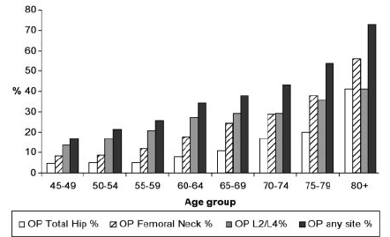

Introduction
Postmenopausal osteoporosis
According to WHO One in two post menopausal women have osteoporosis.
Menopause related bone loss
3-5 years with rapid bone loss
Mainly trabecular bone
Age related bone loss
10-20 years with slower bone loss
Involves cortical and trabecular bone

Slide 3
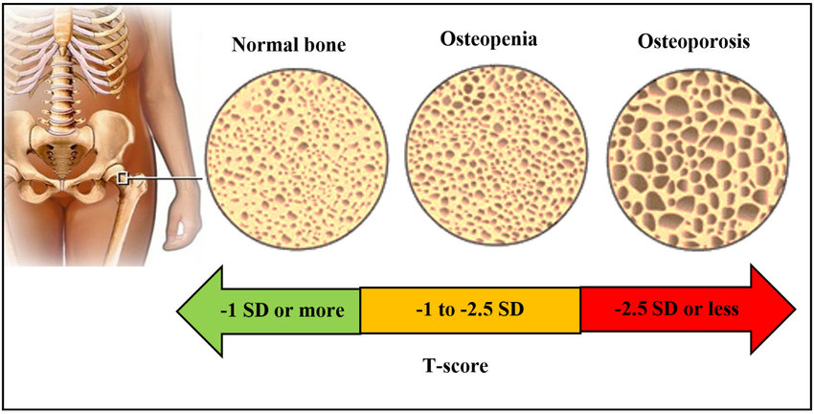
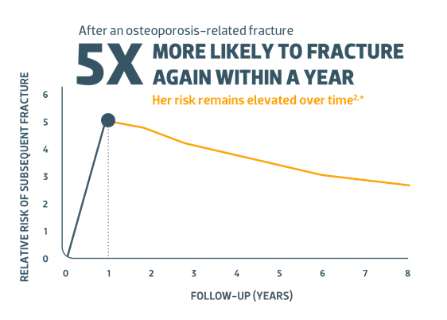
Characterized by:
Bone mineral density (BMD) or bone mineral content (BMC) is 2.5 standard deviations or more below the mean of the young adult reference range.
Major Postmenopausal problems
Bone loss
Weaken immune system
Bacterial and Viral infection
Vaginal dryness

Slide 4
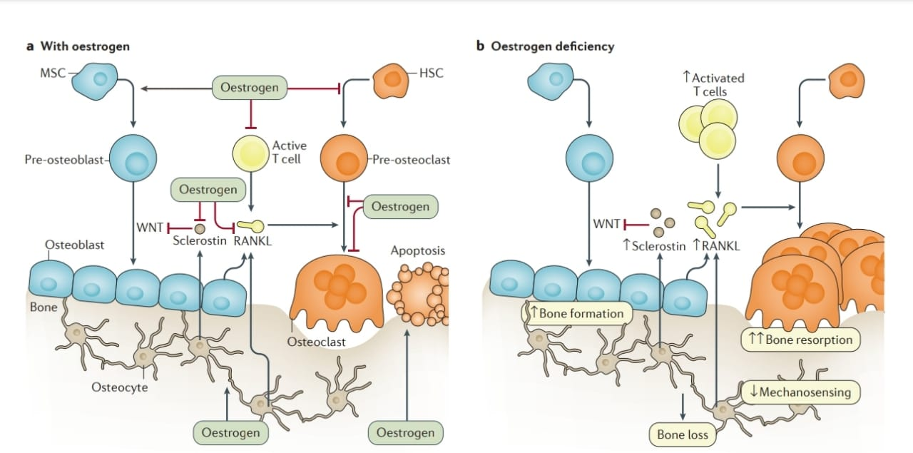
Pathophysiology

Slide 5

CONVENTIONAL TREATMENTS AND ITS PROBLEMS
ORAL: Tablets, Capsules, Oral Jelly
Gastrointestinal tolerability, Esophagitis, Esophageal reflux, Need to be taken two hour after or before meal, Need to be taken with large amount of water
INTRAVENOUS: Injections, Infusion
Flu like symptoms, Pain in joint and muscle, Fever, headache

Slide 6
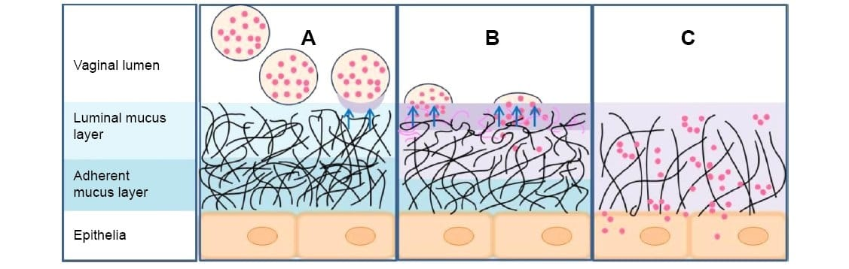
Preparing Lactoferrin nanoparticle loaded in situ gel for vaginal delivery of bisphosphonates in postmenopausal women.
Lactoferrin is a multifunctional glycoprotein of the transferrin family.
Lactoferrin has activity like antimicrobial, antiviral, immunomodulatory, bone regeneration etc.so, Lactoferrin nanoparticle by vaginal route has positive effect on bone regeneration and in vagina it prevent bacterial or viral infection. Also used as a carrier for Nano drug delivery system.

Slide 7
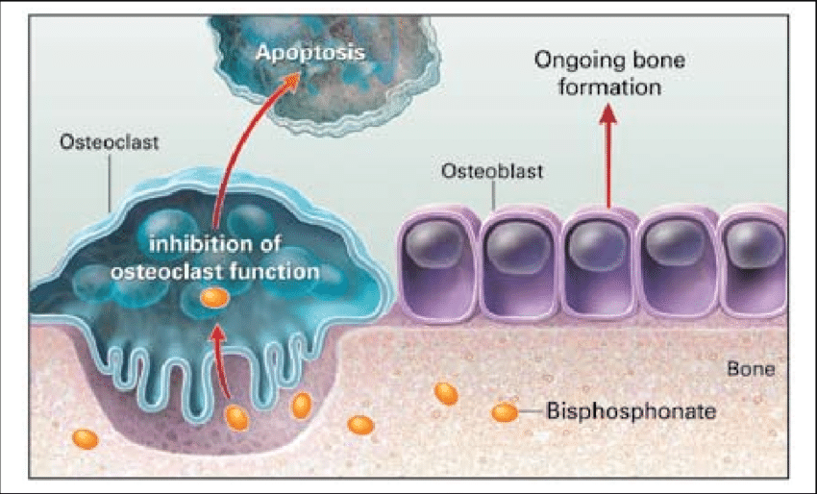
Bisphosphonates: It slow down bone resorption by reducing osteoclast function, improve bone density and reduced risk of fracture. Bisphosphonates given by vaginal route reduced side effect related to oral and IV route and also directly goes into systemic circulation. We can deliver 10-30 times more bisphosphonates by vaginal route.

Slide 8
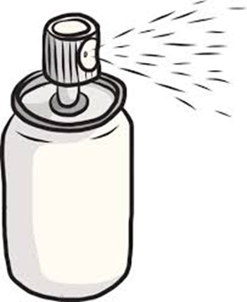
Major Post menopausal Problem
Importance of Insitu gel approach
Mucoadhesion
Vaginal dryness
Increase retention time
Vaginal dryness
Bone Loss
Bacterial and Viral Infections

Slide 9
Rational
Oral bisphosphonates have some side effects like gastrointestinal tolerability, esophagitis, esophageal reflux and IV flu-like symptoms, fever, headache and pain in muscles or joints. So, avoid oral and IV route related side effects by vaginal route of application.
Directly goes in to systemic circulation so avoid first pass metabolism
Sustain release drug delivery
Lactoferrin as a polymer has bone regeneration property and also has antimicrobial, antiviral and immunomodulatory effect.
Reduced postmenopausal dryness in vagina
Patient compliance
Easy application

Slide 10
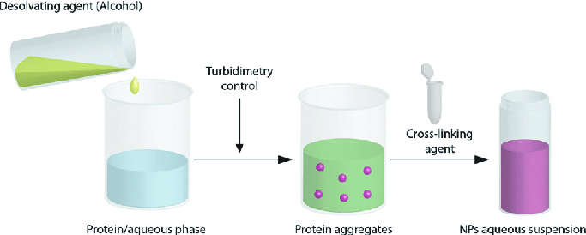
Preliminary study
Desolvation method:
Nanoparticles method
Solvent Evaporation
Nanoprecipitation
Desolvation

Slide 11
Preliminary screening
Factors | Value
Lactoferrin concentration (mg) | 50
 | 100
 | 150
Organic solvent | Acetone
 | Ethanol
Surfactant | Tween 20
 | Tween 80
 | Pluronic f128
Surfactant concentration (%) | 1
 | 2
 | 3
Homogenization speed (RPM) | 500
 | 1500
Homogenization time (hr) | 6
 | 12
For the preparation of nanoparticles by Desolvation method there are many factors which directly affect the formulation and process parameters are screened.

Slide 12
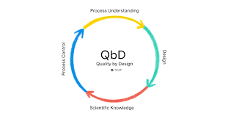
QbD Approach
Selection of QTPP Elements
Selection of CQA Elements for Nanoparticles
Ishikava diagram

Slide 13
QTPP Elements
 | Profile component | Target | Justification
Physical attributes | Color | Acceptable to patient | Color, odor and appreance were not considered as critical, as they are not directly linked to patient efficacy and safety
 | Appearance | Acceptable to patient
Dose | Dosage form | Nanoparticles | It helps in getting better absorption of drug and it leads to increase bioavailability of drug
 | Morphology | Uniform spherical | For sustinrelease and high drug loading
 | Category | Sustained release | Release action for longer period of time in sustain manner
 | Route of administration | Vaginal | To achieve direct systemic circulation and reduced side effect related to other routes.
Performance | Packaging | Spray | Improved patient compliance
 | Stability | As per ICH Guideline | To retain therapeutic potential of the drug during storage

Slide 14
CQA For Nanoparticles
Quality attributes of the drug product | Target | Justification
Particle size | 150-400 nm | Specific range of particle is crucial to determine the effectiveness of drug. Nanoparticle less than 100 nm can diffuse in cervicovaginal mucus as rapidly as in water and the particle size larger than 500 has smaller diffusion rate so, particle size between 150-400 has efficient transport of intravaginal diffusion.
Entrapment efficiency (%) | >70% | Higher entrapment efficiency is directly affect drug release
Drug release | 70-100% | Amount of drug release needed for clinical effectiveness.

Slide 15
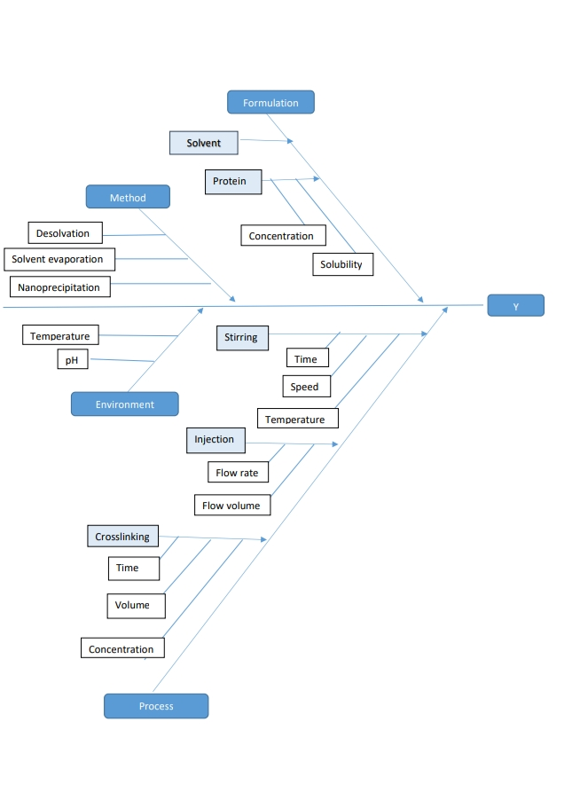
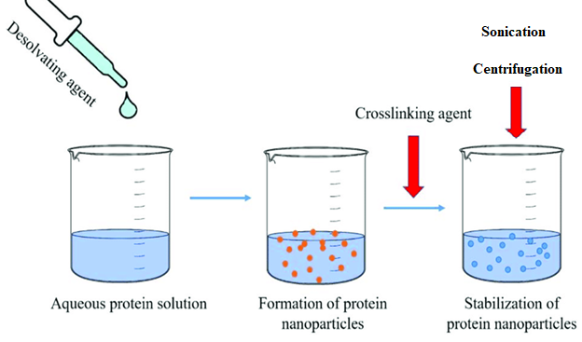
Desolvation method
Ishikava diagram

Slide 16
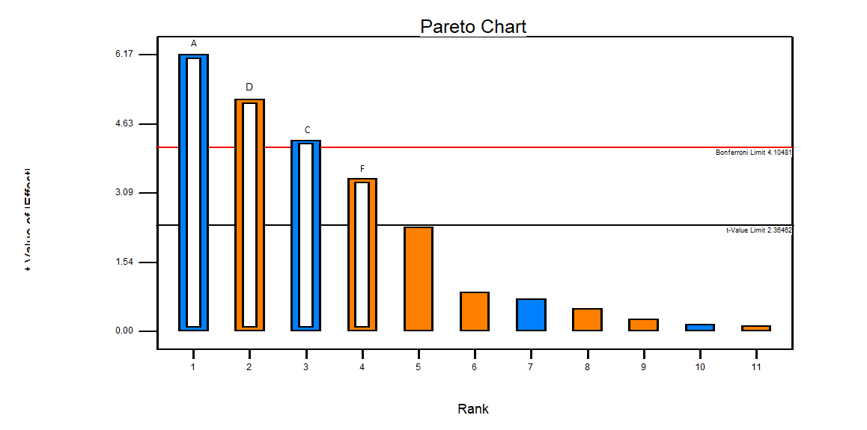
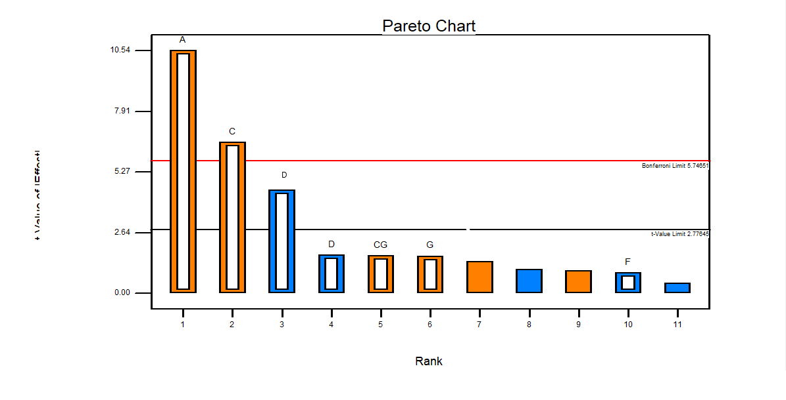
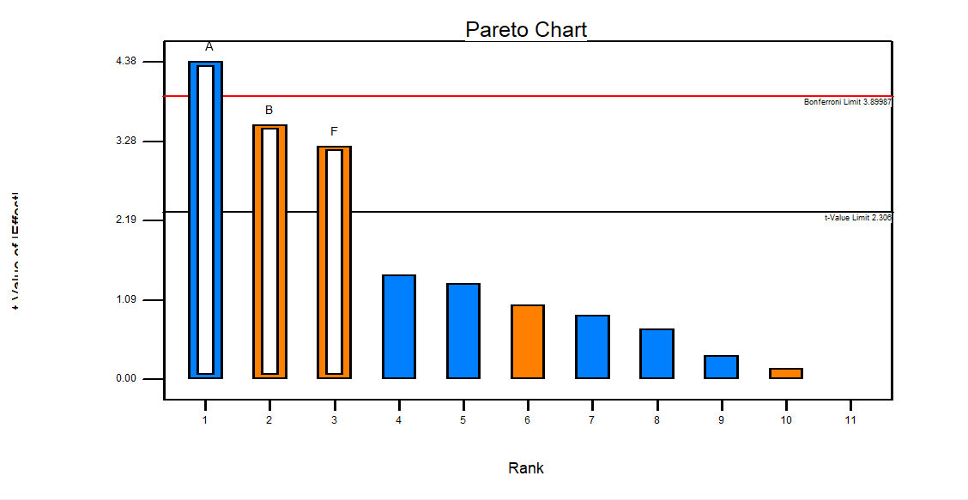
PARETO CHART
Particle Size
From these above all graph we can conclude that Concentration of Polymer, Flow rate and Stirring speed is highly affect the formulation so, we select those factor for Box-Behnken Design.
PDI
%Drug Release

Slide 17
Optimization of nanoparticles by Box-Behnken Design
Independent and Dependent factor
Independent variable | Low(-1) | Medium(0) | High(+1)
X1=Concentration of polymer(mg) | 50 | 100 | 150
X2=Flow rate(ml/min) | 1 | 2 | 3
X3=Speed (RPM) | 500 | 1000 | 1500
Dependent variables:
Y1=Particle size(nm) | 150-400 nm
Y2=%EE | >70
Y3=%Drug release | 70-100%

Slide 18
Box-Behnken Design
Batch no. | Conc. of Polymer(mg) | Flow rate(ml/min) | Stirring Speed (RPM) | Particle size (nm) | %EE | %Drug release at 24 h
1 | 100 | 2 | 1000 | 139±0.09 | 89.73±0.98 | 91.2±0.98
2 | 50 | 2 | 1500 | 200±0.79 | 78.82±0.89 | 80.76±0.94
3 | 150 | 1 | 1000 | 246±0.45 | 76.32±0.76 | 82.31±0.85
4 | 150 | 2 | 500 | 314±0.43 | 78.41±0.98 | 84.56±0.85
5 | 100 | 2 | 1000 | 198±0.67 | 84.39±0.79 | 87.90±1.09
6 | 100 | 3 | 500 | 189±0.09 | 83.36±0.45 | 89.86±1.12
7 | 100 | 3 | 1500 | 121±0.98 | 88.13±0.57 | 90.13±0.79
8 | 50 | 2 | 500 | 197±0.76 | 86.28±0.61 | 88.18±0.99
9 | 100 | 1 | 1500 | 327±0.52 | 78.17±078 | 82.63±0.85
10 | 100 | 1 | 500 | 302±1.07 | 73.67±0.81 | 80.28±0.83
11 | 100 | 2 | 1000 | 346±0.12 | 76.53±0.91 | 88.49±0.69
12 | 150 | 3 | 1000 | 198±0.43 | 85.70±0.72 | 81.18±1.05
13 | 150 | 2 | 1500 | 276±0.79 | 77.35±0.79 | 89.54±1.11
14 | 50 | 1 | 1000 | 231±0.98 | 85.67±0.89 | 81.34±1.07
15 | 50 | 3 | 1000 | 311±0.87 | 76.54±0.60 | 85.16±0.98

Slide 19
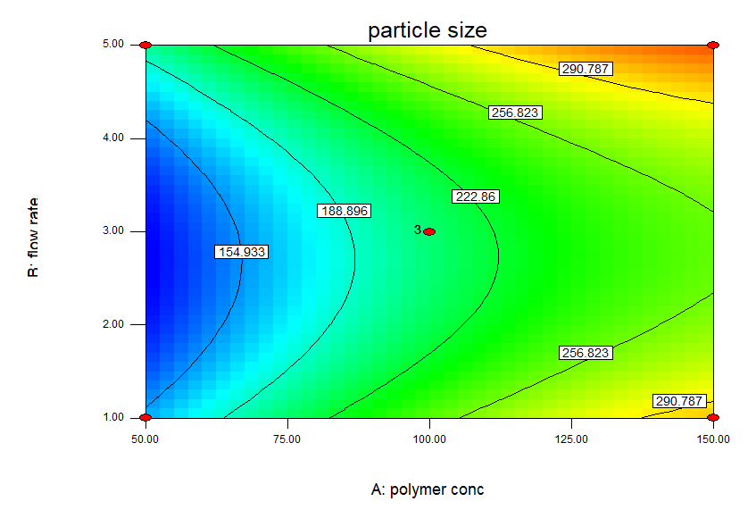
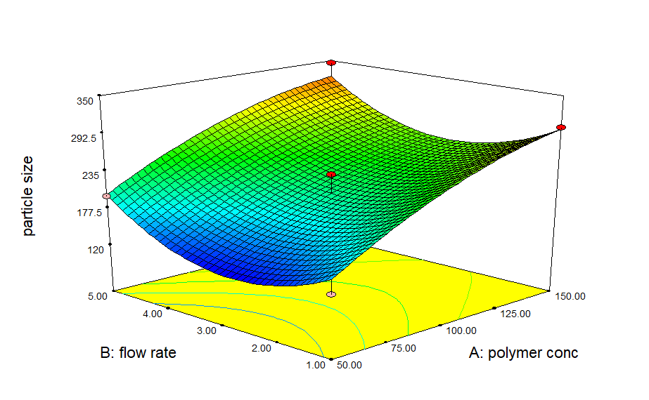
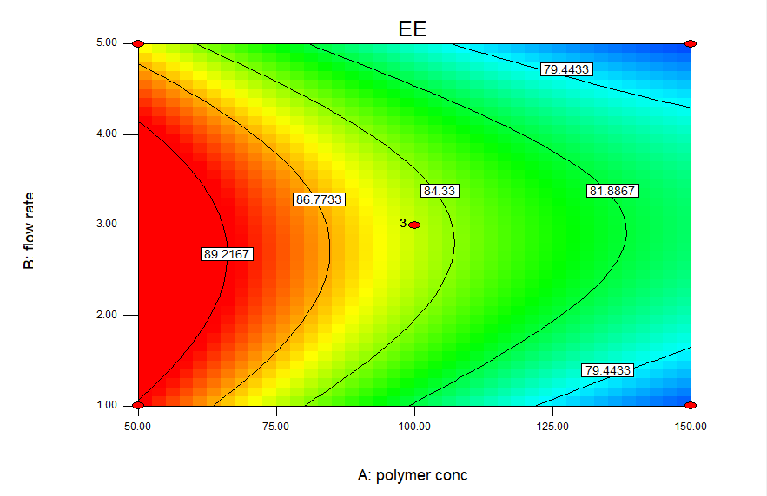
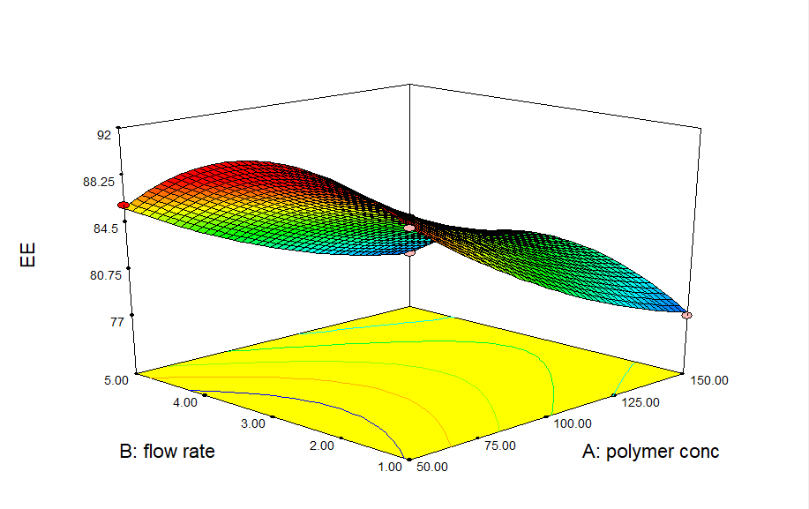
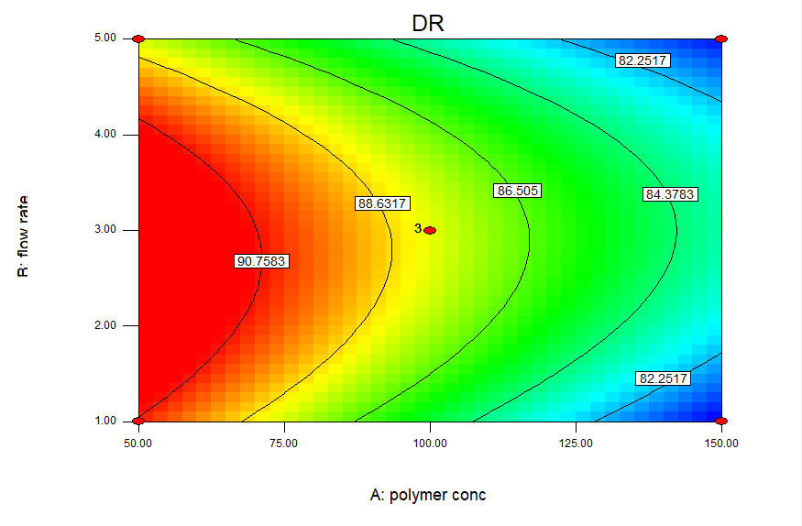
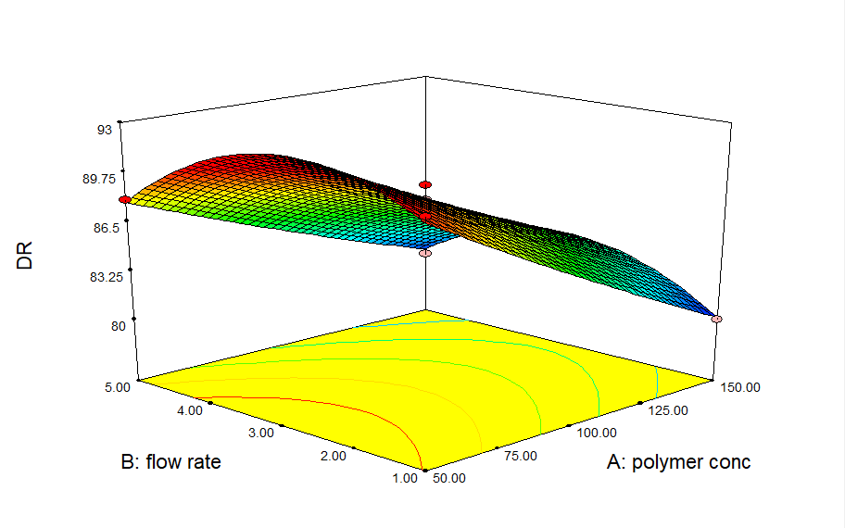
Contour plots and Surface plots of BBD
Particle Size
% EE
% Drug Release

Slide 20
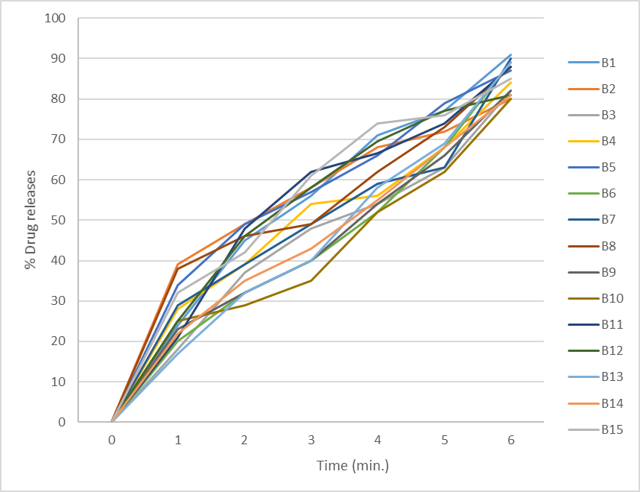
In Vitro drug Release study of Various batches of Box-Behnken design

Slide 21
ANOVA
Responses | SS | df | MS | FValue | p-value (Prob > F) | SD | R²
Y1 | 64902.08 | 9 | 7211.34 | 9.97 | 0.0104 | 26.89 | 0.9472
Y2 | 330.68 | 9 | 36.74 | 734.85 | <0.0001 | 0.22 | 0.9992
Y3 | 243.58 | 9 | 27.06 | 36.09 | 0.0005 | 0.87 | 0.9848
The results of ANOVA performed to identify insignificant factors. Here, F_{cal} is less than F_{tab} for the response. So model is valid for the response.

Slide 22
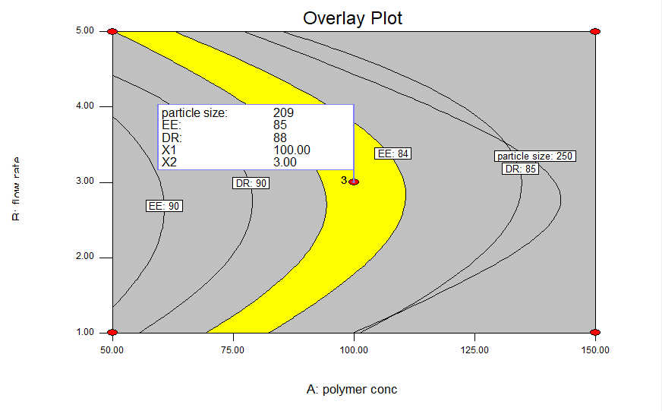
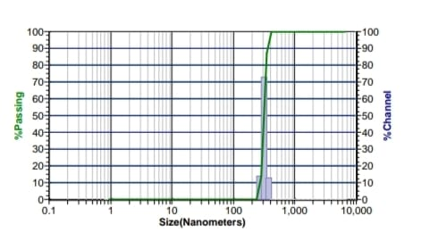
Checkpoint Batch
Sr. no | Parameters | Predicted value | Experimental value | %Relative Error
1 | Particle size (nm) | 209 | 203±0.13 | 2.87
2 | %EE | 85 | 81.32±0.98 | 4.32
3 | %Drug Release | 88 | 83.82±0.87 | 4.75

Slide 23
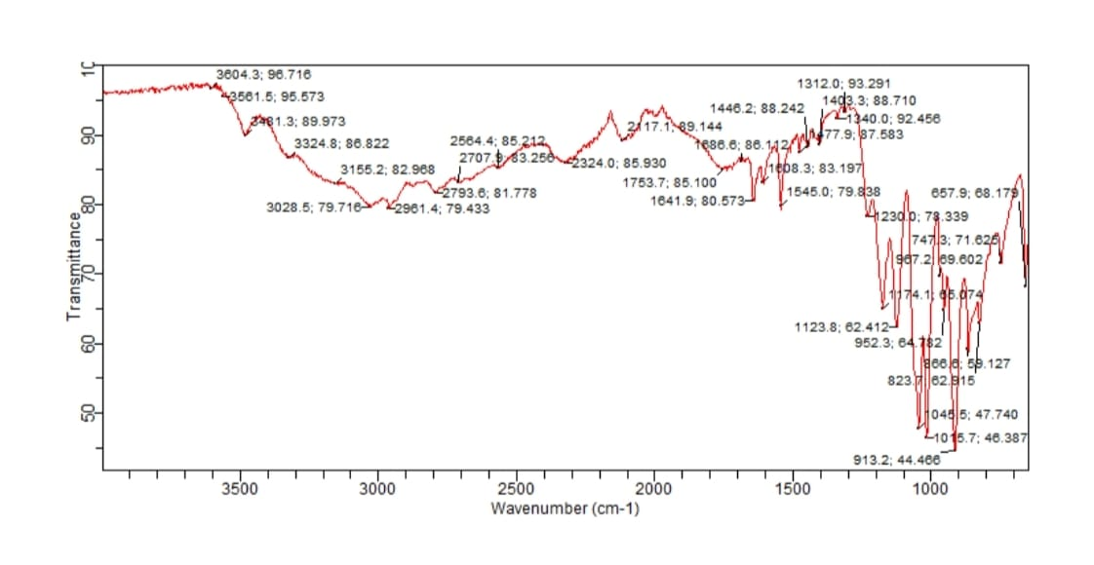
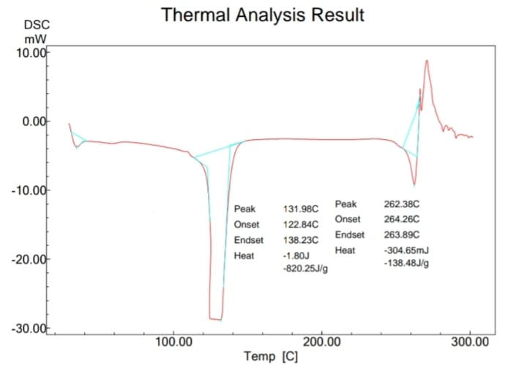
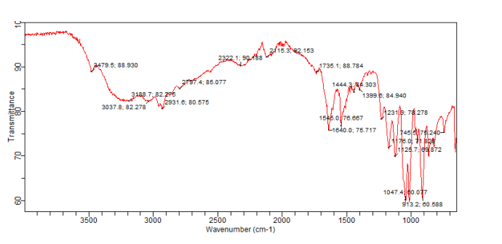
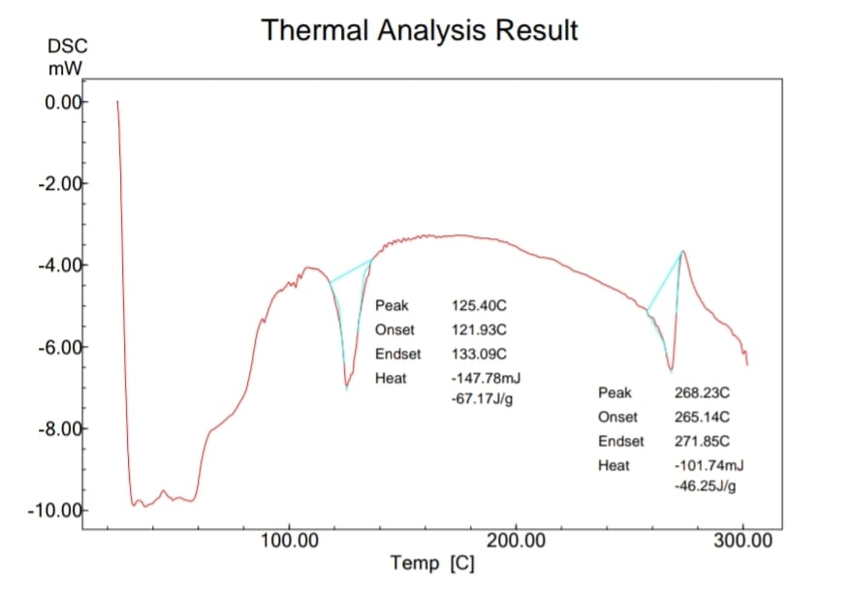
FT-IR & DSC
A
B
FTIR and DSC A) Alendronate Sodium B) Formulation

Slide 24
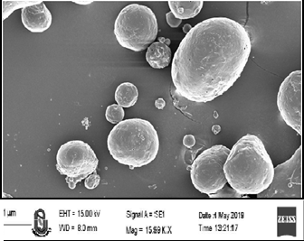
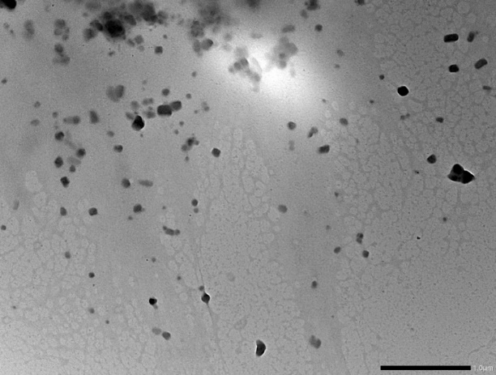
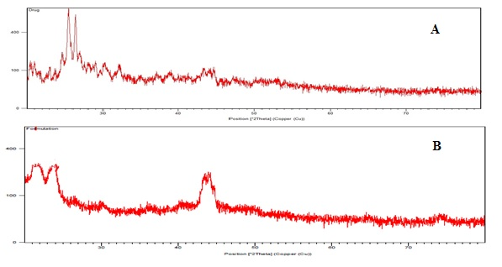
SEM and TEM
XRD
Shows diffraction peaks of nearly half intensity within the same range, which reflects a reduction of the crystalline nature to the amorphous form. These results indicate that Alendronate Sodium was successfully encapsulated into the nanoparticles as a molecular dispersion.

Slide 25
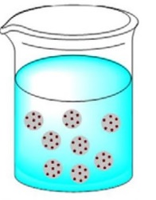
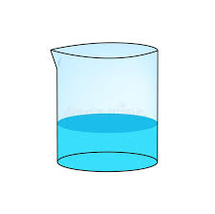
Preparation of Temperature sensitive Insitu gel
“Cold method” technique was utilized to prepare in situ gel by Different polymer and combination of polymer with different concentration polymers are taken and selection of polymer is based on viscosity study, Gelation time and Gelation temperature.
Polymers | Concentration (%)
Chitosan | 0.1
 | 0.2
 | 0.3
Carbopol 934 | 1
 | 2
 | 3
Carbopol 934:Pluronic f127 | 1:16
Carbopol 934:Pluronic f127 | 1:18
Carbopol 934:Pluronic f127 | 1:20
Incorporated in to
Optimized batch Nanoparticles
Insitu gelling system

Slide 26
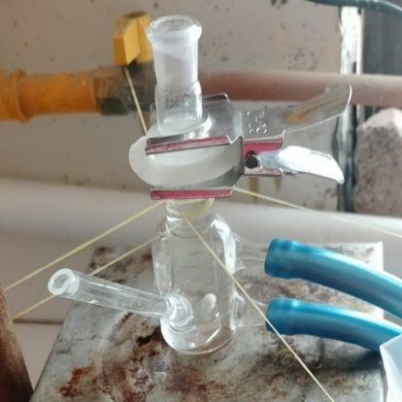
Preparation of In situ gelling system Contain Nanoparticle
Carbopol 934:Pluronic F127(1:9)
Evaluation parameters | Result
Viscosity | 2189 cp
Gelation time | 41 ± 1 sec
Gelation temp. | 28 ± 0.70 °C
pH | 4.98±0.2
T_{sol-gel} | 36.666 ± 1.154
Mucoadhesive Strength (g) | 65.66 ± 1.15
Spredability (cm) | 6.56 ± 0.05
Parameters | Result
Hardness/firmness (g) | 36.70 ± 2.0
Work of adhesion (g.s) | 20.84 ± 3.20
Cohesiveness | 0.54 ± 0.2
Springiness (mm) | 28.36 ± 0.82
Penetrometry (N) | 0.21 ± 0.07

Slide 27
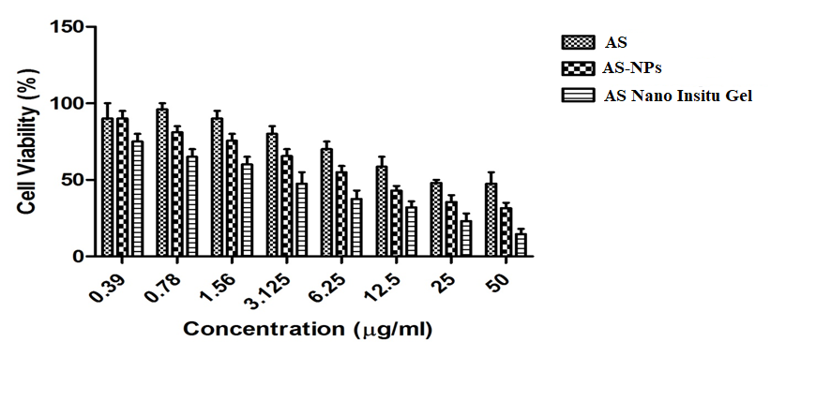
Cytotoxicity Study
MC3T3-E1 cells
The results showed that the 50% cellular growth inhibition (IC50) values of NPs and NPs loaded Insitu gel were 10.21 μg mL−1 and 4.524 μg mL−1, respectively, which suggested that NPs loaded Insitu gel have been reported to reduce the cell viability and thereby expected to increase the mineralization efficacy of AS by reducing its efflux from cells mediated by the P-glycoprotein through gel carrier.

Slide 28
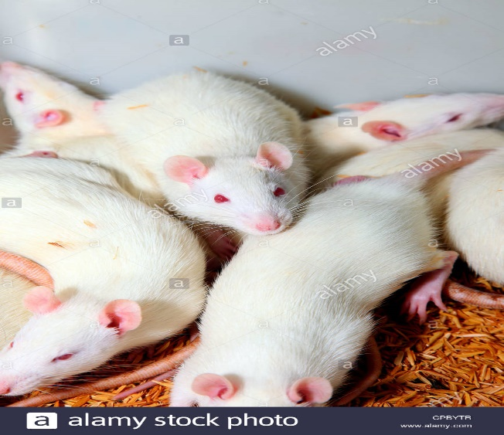
In vivo study
The Pharmacokinetic studies were carried out on two different groups each consisting of six rats:
• Group I: Marketed Alendronate sodium tablet; oral route
• Group II: Nano Insitu Gel; Vaginal Route
Parameters | Nano Insitu Gel | Marketed Alendronate sodium tablet
Cmax | 801.21±101.92 ng/ml | 121.11±89.21 ng/ml
Tmax | 1h | 3h
AUC | 7895.45 ± 212.25 ng.h2/ml | 523.54±89.31 ng.h2/ml
Bioavailability | 9.25 | -

Slide 29
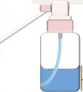
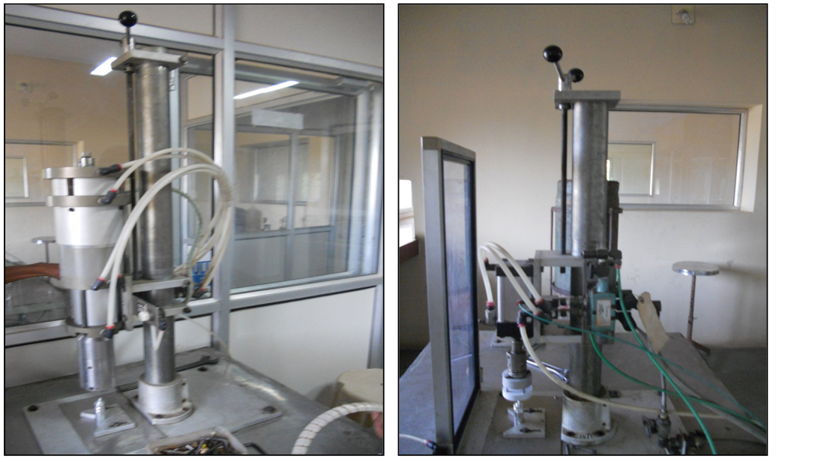
Container related evaluation
Actuation no. | Drug content per actuation (%)
1 | 92.78±0.134
100 | 93.12±0.145
200 | 95.56±0.243
300 | 88.76±0.189
480 | 90.83±0.215
Test | Prepared Formulations
Vapour Pressure (psig) | 70-75
Evaporation Rate | Excellent
Number of deliveries per container | 500
Spray Pattern | Uniform
Average Diameter of Spray Pattern | 0.9 ± 1.21 cm

Slide 30
Short-term stability study Per ICH Guidelines
The formulation was kept at 30 ±2°C for one month. The formulation was put through a series of tests after one month, including particle size, %EE and %Drug release including nanoparticle before and after a one-month stability research, which revealed that no parameter changed during the stability study.
Sr.no | Test Parameters | Before stability | After stability
1 | Particle size | 243±0.67 | 254 ± 0.13
2 | %EE | 82.33 ±0.03 | 81.09 ± 0.76
3 | %Drug release | 89.65 ± 0.13 | 86 ± 0.09

Slide 31

Conclusion
Vaginal delivery of bisphosphonates in the form of nanoparticle contain in situ gel has advantages over oral and IV route. By this route it gives sustained release effect and reduced dosing frequency with better adhesion. Also this formulation reduced postmenopausal side effect like dryness by using in situ gel approach. Using lectoferrin as a polymer also has bone regeneration property.
So, by combine action of bisphosphonates, lactoferrin with Insitu gelling approach gives better bone regeneration in Post menopausal osteoporosis with improved patient compliance.

Slide 32
References
Kanis JA. Assessment of fracture risk and its application to screening for postmenopausal osteoporosis: synopsis of a WHO report. Osteoporosis international. 1994;4(6):368-81.
Eastell R, O'Neill TW, Hofbauer LC, Langdahl B, Reid IR, Gold DT, Cummings SR. Postmenopausal osteoporosis. Nat Rev Dis Primers. 2016;2:16069.
Eastell R, Walsh JS, Watts NB, Siris E. Bisphosphonates for postmenopausal osteoporosis. Bone. 2011 Jul 1;49(1):82-8.
Aderibigbe B, Aderibigbe I, Popoola P. Design and Biological Evaluation of Delivery Systems Containing Bisphosphonates. Pharmaceutics. 2016;9(1):2.
Elzoghby AO, Abdelmoneem MA, Hassanin IA, Abd Elwakil MM, Elnaggar MA, Mokhtar S, Fang JY, Elkhodairy KA. Lactoferrin, a multi-functional glycoprotein: Active therapeutic, drug nanocarrier & targeting ligand. Biomaterials. 2020;263:120355.
Das T, Venkatesh MP, Kumar TP, Koland M. SLN based alendronate in situ gel as an implantable drug delivery system–A full factorial design approach. Journal of Drug Delivery Science and Technology. 2020;55:101415.
Dong J, Tao L, Abourehab MA, Hussain Z. Design and development of novel hyaluronate-modified nanoparticles for combo-delivery of curcumin and alendronate: fabrication, characterization, and cellular and molecular evidences of enhanced bone regeneration. International journal of biological macromolecules. 2018;116:1268-81.
Pandey AP, More MP, Karande KP, Chitalkar RV, Patil PO, Deshmukh PK. Optimization of desolvation process for fabrication of Lactoferrin nanoparticles using quality by design approach. Artificial cells, nanomedicine, and biotechnology. 2017;45(6):1101-14.

Slide 33



