Slide 1
Climate-Smart Agriculture for Driving Sustainability Pathways in North Africa
Rachid Mrabet
National Institute of Agricultural Research (INRA), Rabat, Morocco

Slide 2
Agenda
A tipping point for our planet!
Why North Africa: The urgency of the situation!
What are Sustainable Pathways?
Climate Smart Agriculture: Stark choices
Speeding-Up Sustainability!
Unlocking Potentials!
Key take-home messages!

Slide 3
A tipping point for our planet!
The future of our planet is at stake.
We are in the midst of a climate emergency and sustainability, and the window to act is closing fast.
Droughts and other (compound) extremes propagate into the entire socio-economic and environmental systems, provoking a cascade of impacts.
The world is rapidly urbanizing aggravate already fragile shrinking land and water resources while creating urban poverty.
No country in the world has achieved or is on track to achieve its SDGs!
(EGP, 2024)

Slide 4
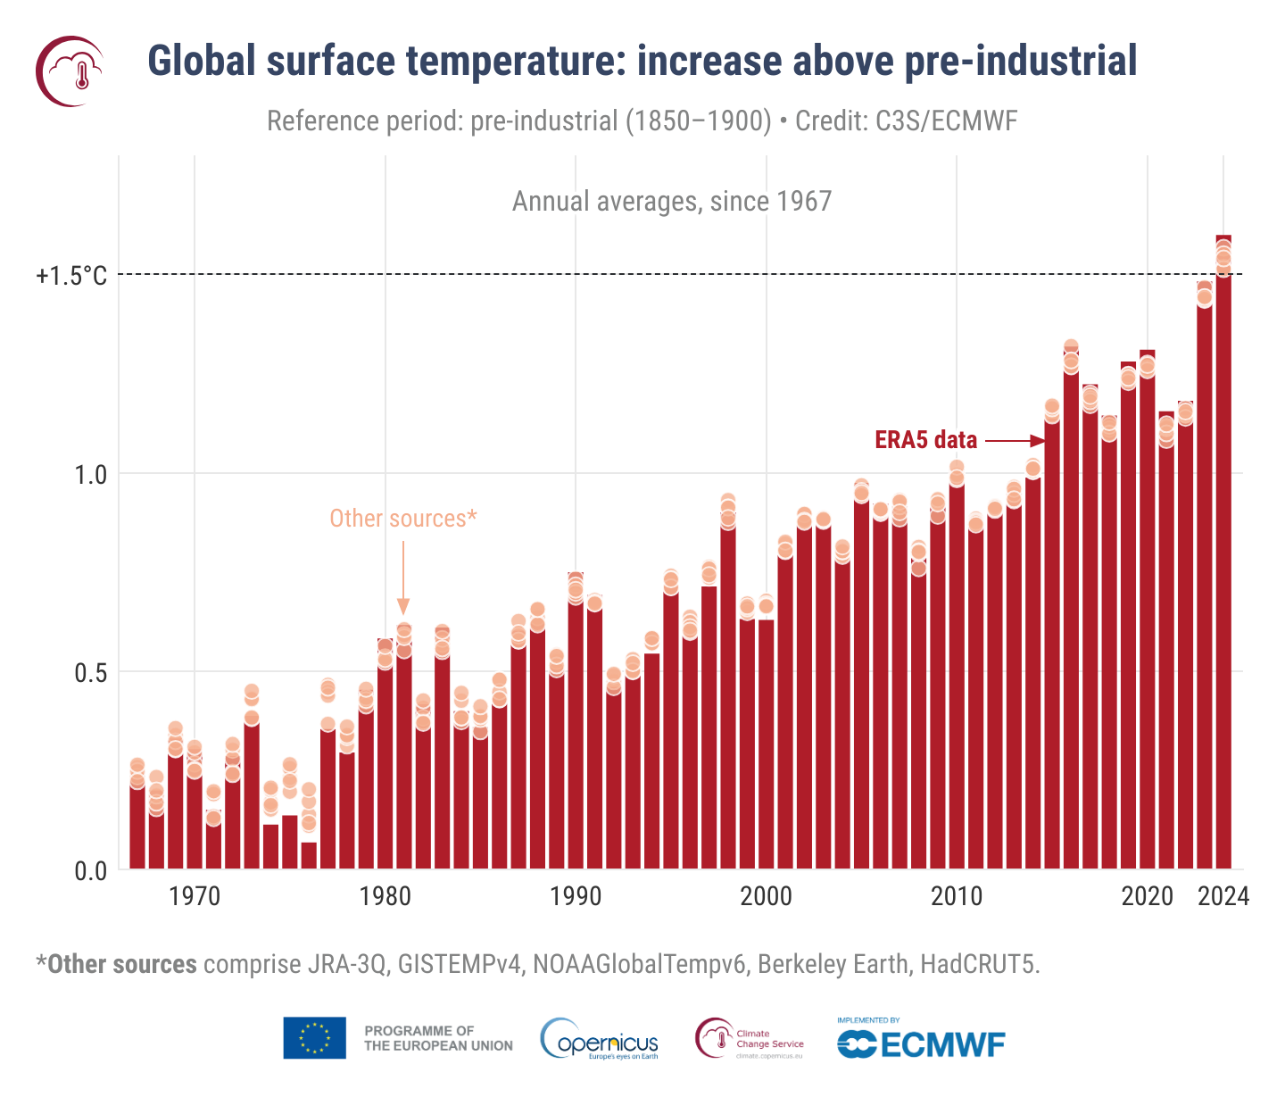
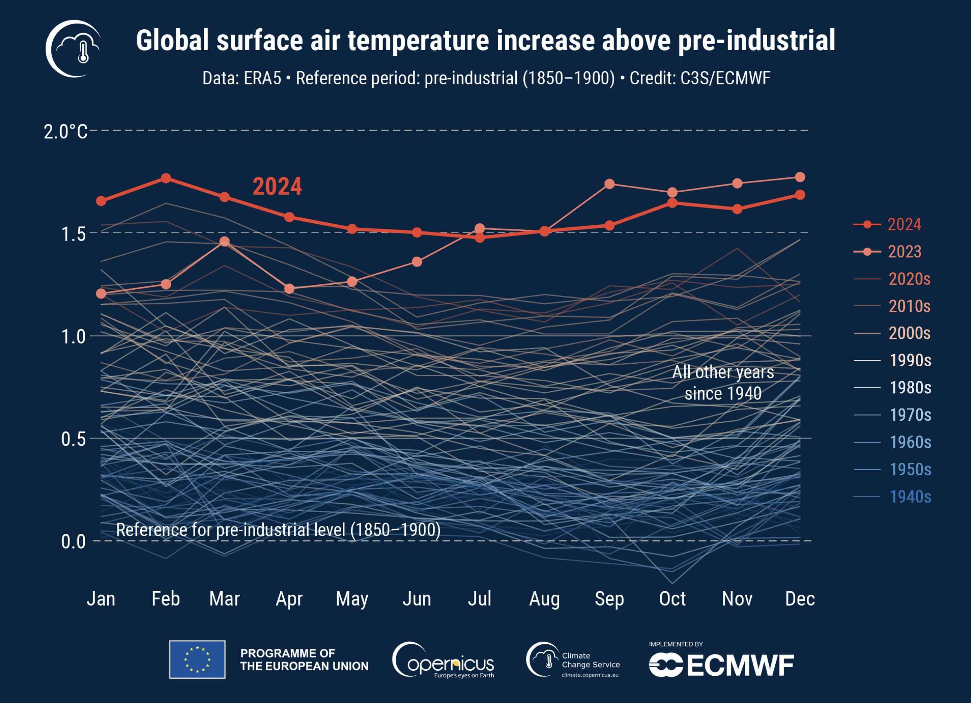
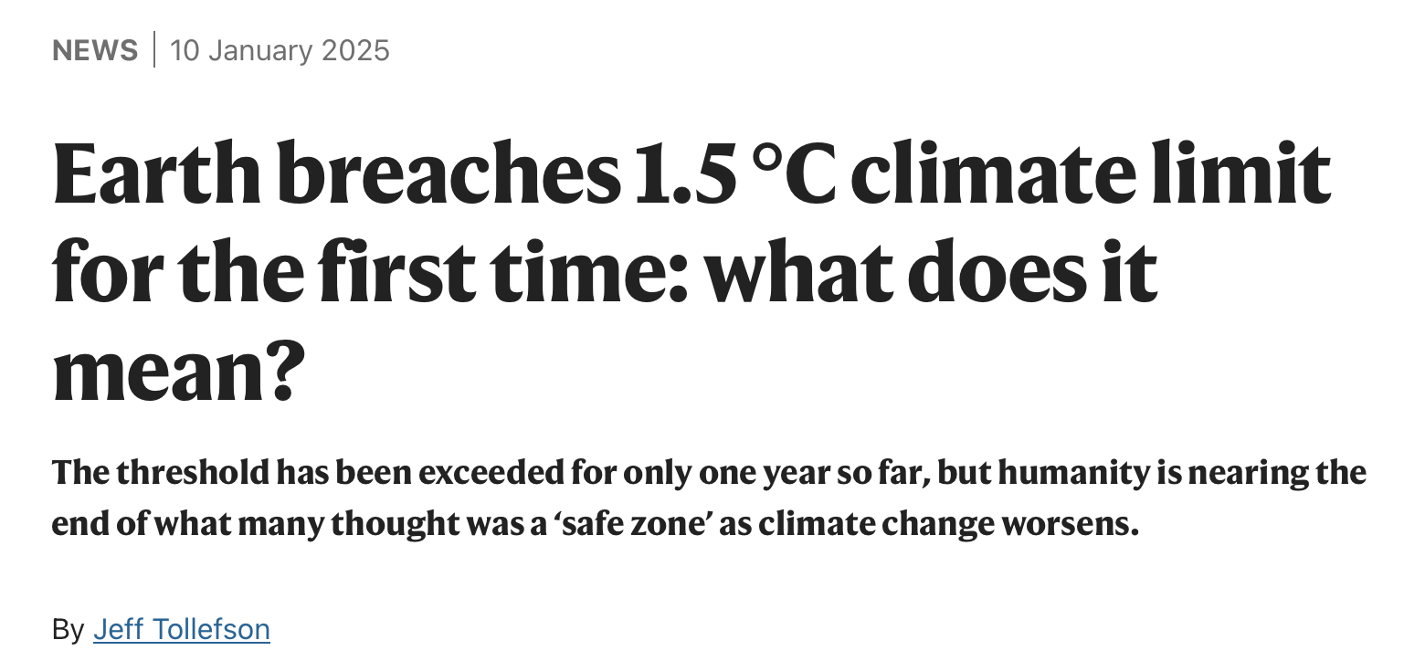
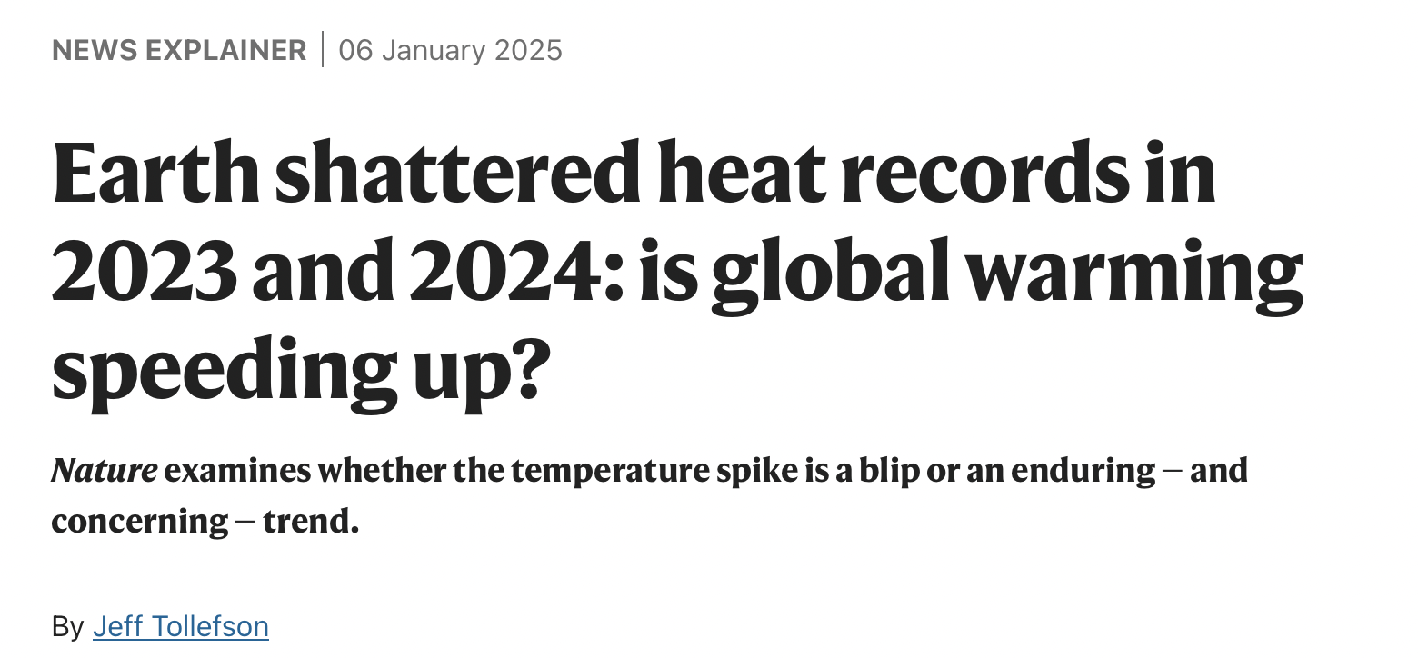

Slide 5
Climate race!
Without significant emissions reductions from all nations — wealthy and developing alike — the world will not meet its decarbonization goals, exposing everyone to the existential crisis.
To get on track for 1.5°C, the cuts of GHG emissions of 42 % are needed by 2030 and 57 % by 2035.

Slide 6
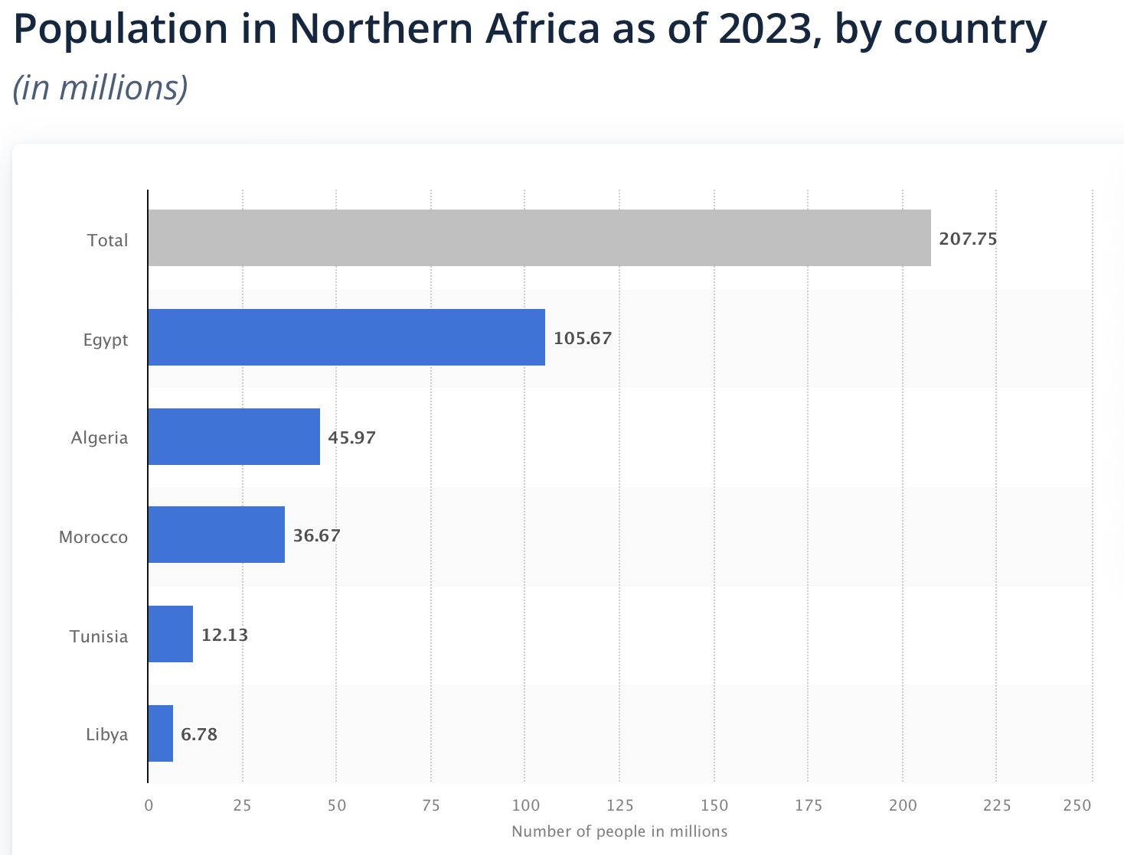
Why North Africa: The urgency of the situation
North Africa’s population has more than tripled in size between 1960 and 2023 reaching 208 million people.
Arable land is scarce as the region is dominated by deserts and a harsh environment.
Forestland cover is limited in the region.
North Africa is a hotspot of all environmental shocks.
Land degradation is a significant feature of the region.
Soil salinity, water erosion and pollution are major challenges.
North Africa faces disproportionate burden from climate change and adaptation costs.

Slide 7
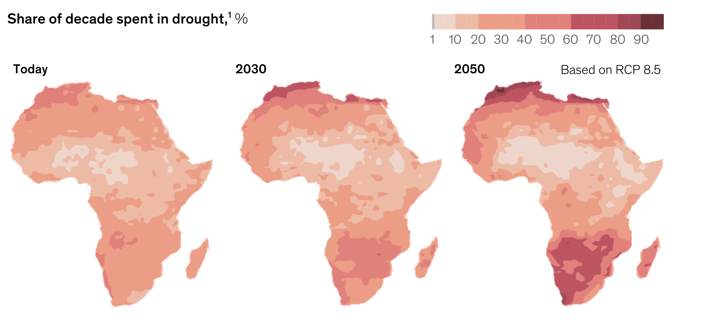
North Africa Braces for a Dangerously Dry Future
North Africa is in its sixth consecutive year of drought, most directly impacting Morocco, Algeria and Tunisia.
Drought is increasing in frequency, intensity, and geographical reach over recent decades.
Regional rainfall has decreased more broadly over the past several decades due to the effects of climate change, which are anticipated to worsen in the coming years.
https://www.weforum.org/stories/2024/04/african-cities-climate-change-resilience/

Slide 8
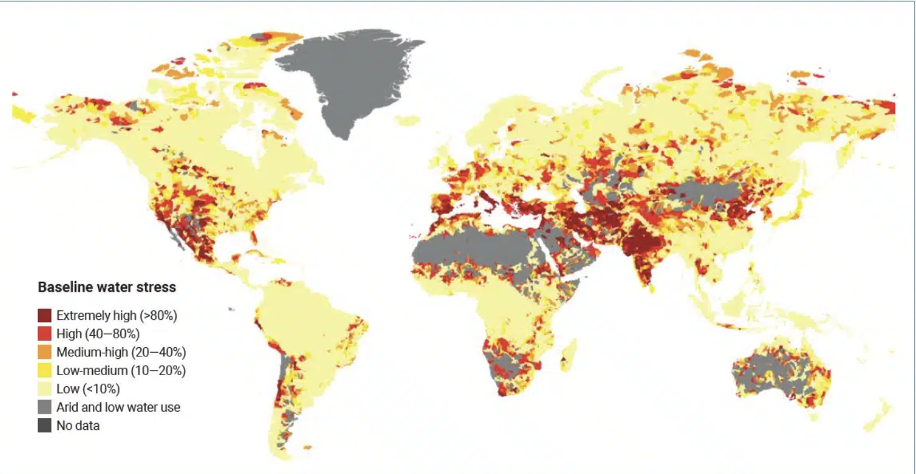
Water scarcity: Global Water Security Is at Risk
North Africa is one of the most water-stressed regions in the world.
A combination of water scarcity and desertification is taking its toll on many countries in the region, leaving many communities under stress.

Slide 9
Second fastest warming region in the world after the Arctic.
In 2020, +1.5°C compared to the pre-industrial period.
Multifaceted challenges in the Mediterranean basin with cascadingand large-scale impacts

Slide 10
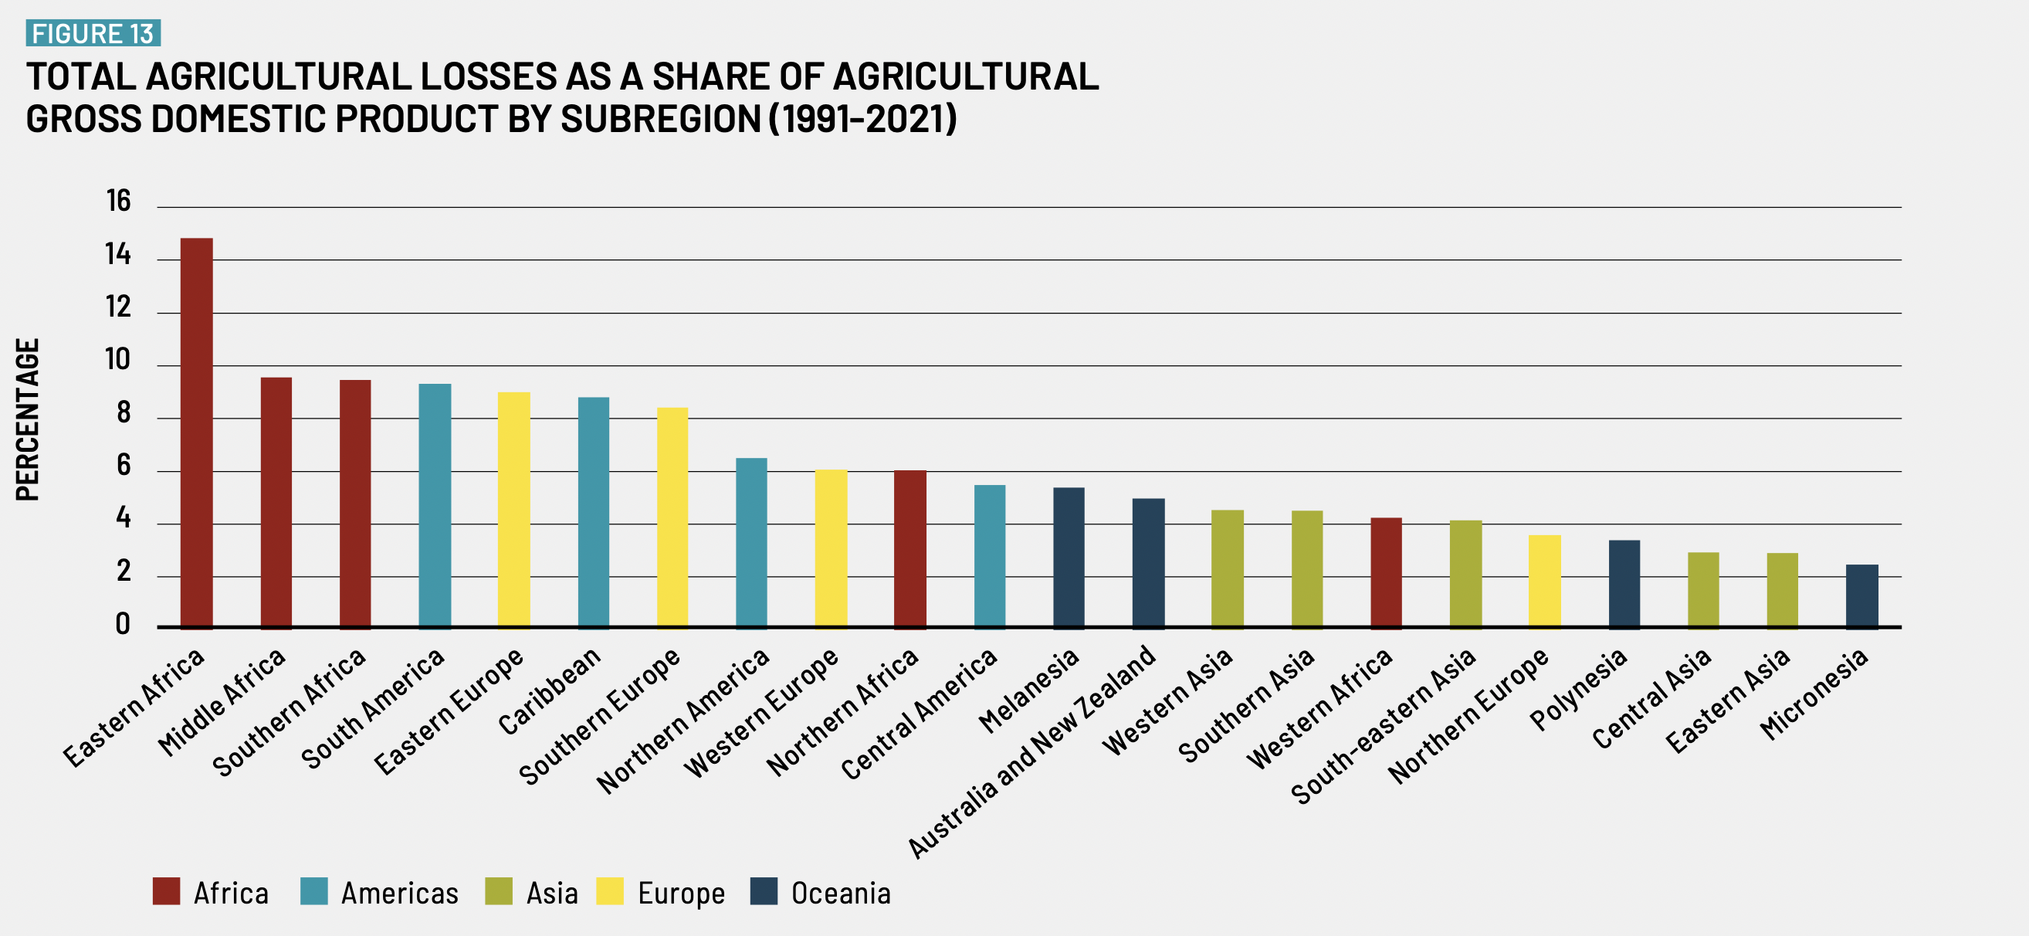
Sustainable Food systems in North Africa: a daunting task, but not an impossible one
The current structure of North African food systems significantly contributes to environmental, climate, and health issues, including resource depletion, biodiversity loss, ecosystem degradation, pollutant emissions, and unhealthy dietary patterns
According to international studies, SDG2 (End hunger, achieve food security and improved nutrition and promote sustainable agriculture) is particularly off-track in North Africa.
Food system challenges, including food insecurity, malnutrition, and poverty, persist in North Africa.
North Africa is a net importer of staple food.
Practices across the food system are on an unsustainable trajectory, encompassing issues such as land & resource use and food production.
Food loss represents 8% of AGDP in North Africa

Slide 11
Unlocking potential: hopes in Innovation
Contribution share of agriculture, forestry, and fishing sector to the gross domestic product (GDP) in North Africa in 2023, by country
The intersection of green growth, the climate race, and food systems is a critical area for action.

Slide 12
Production and reserves of phosphate North Africa and the world
Phosphate is critical for food & nutrition security

Slide 13
Hope for the future: Sustainable Pathways!
Despite the challenges, there is still reason for hope.
Availability of knowledge, technology, and resources to address climate change and to create a more sustainable future.
By embracing transformative changes, North Africa can still steer away from the tipping point and thrive.
North Africa needs to act and change mindsets from governments, businesses, NGOs and individuals.
Food and agriculture systems must be realigned to new paradigms and routed in sustainable pathways!

Slide 14
What are Sustainable Pathways?
Sustainability focuses on meeting the current needs of the food system while ensuring its future viability.
Resilience enhances the system’s capacity to anticipate, absorb, recover from, and adapt to disruptions and shocks.
The transition to sustainable & resilient food systems is both an economic opportunity and a cornerstone for achieving the objectives of sustainable development.
Sustainable pathways represent a commitment to a long-term journey towards a more resilient world and sustainable future.

Slide 15
Climate-smart agriculture (CSA): Stark choices
Starting points are diverse given differences in histories, contexts and values and trajectories are multiple.
CSA is an approach that helps
to guide actions needed to transform and reorient agricultural systems to effectively support development and ensure food security in a changing climate.
to manage agriculture that aims to increase productivity and incomes while also adapting to climate change and reducing GHG emissions.
It's not a specific set of practices, but rather a way of thinking about agriculture that takes into account the complex challenges of food security and climate change.

Slide 16
Core Objectives of CSA
Sustainably increasing agricultural productivity and incomes
Adapting and building resilience to climate change
Reducing and/or removing greenhouse gas emissions
Climate-smart agriculture (CSA) offers a powerful approach to accelerate the sustainability shift by addressing the interconnected challenges of food security and climate change.

Slide 17
CSA Practices: Speeding Up Sustainability Shift
Conservation agriculture
Agroforestry
Organic farming
Improved integrated livestock management
Smart water management
Climate-resilient crops and livestock
CSA is not a one-size-fits-all solution and requires careful planning, implementation & integration to be successful.
NA countries are making varied progress in implementing CSA initiatives and road maps.
Sebnie et al. (2020)

Slide 18
Starting from the soil for building climate resilience and ecosystem integrity
Upgrading & Improving Soils under CSA are opening up new impacts:
Carbon Sequestration
& farming
Improved Water Management (Water Retention, WUE, Reduced Erosion, Drought & Flood Mitigation, Water Quality)
Increased Food Security & System Resilience to Climate Shocks
Thriving Ecosystems & Enhanced Biodiversity

Slide 19
Mitigation Potential
Griscom et al., 2017

Slide 20
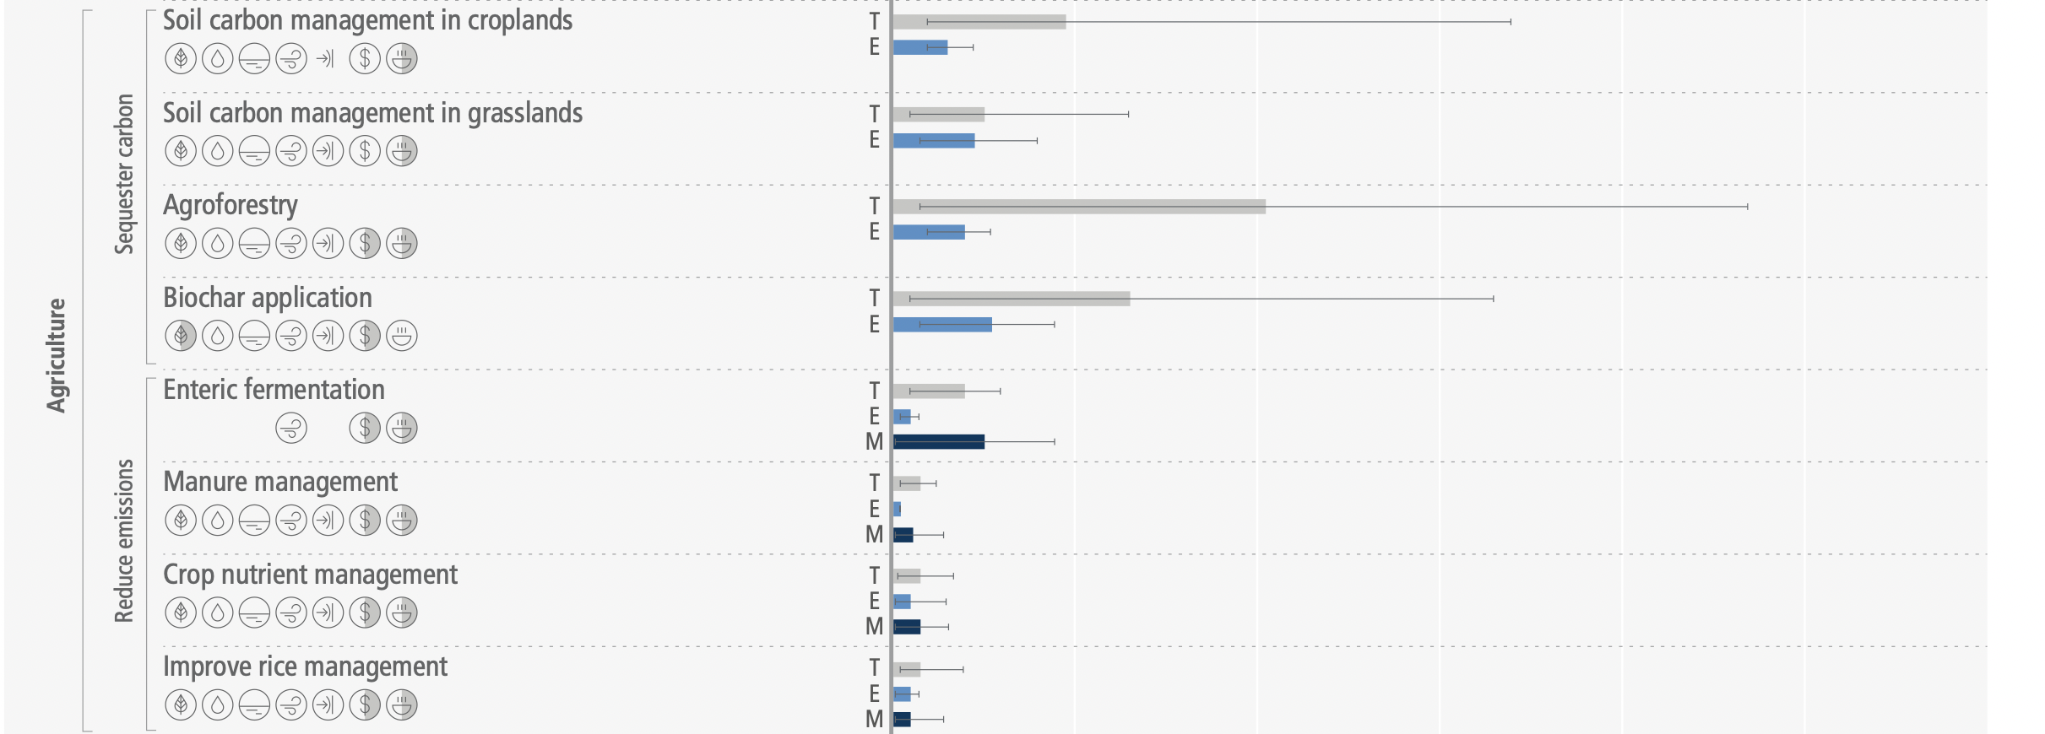
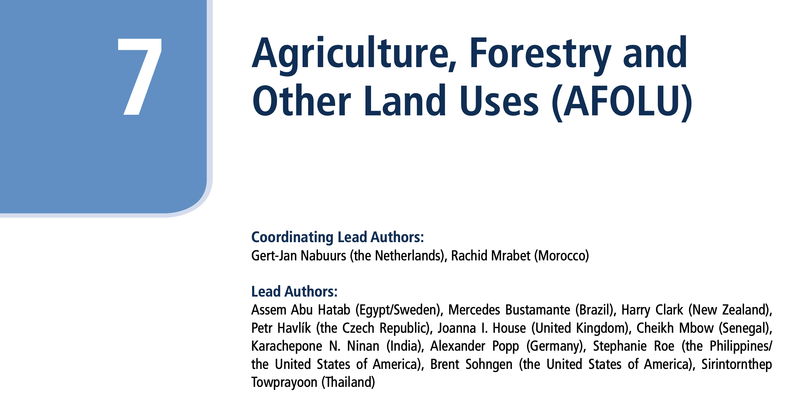
Mitigation Potential
Gt CO₂ / year

Slide 21
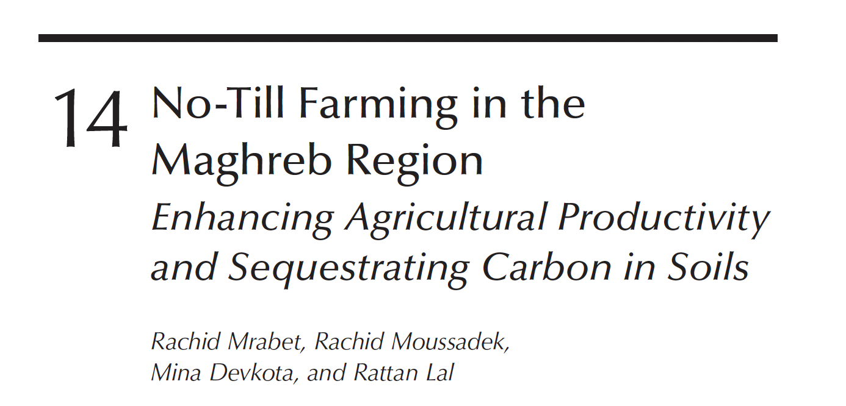
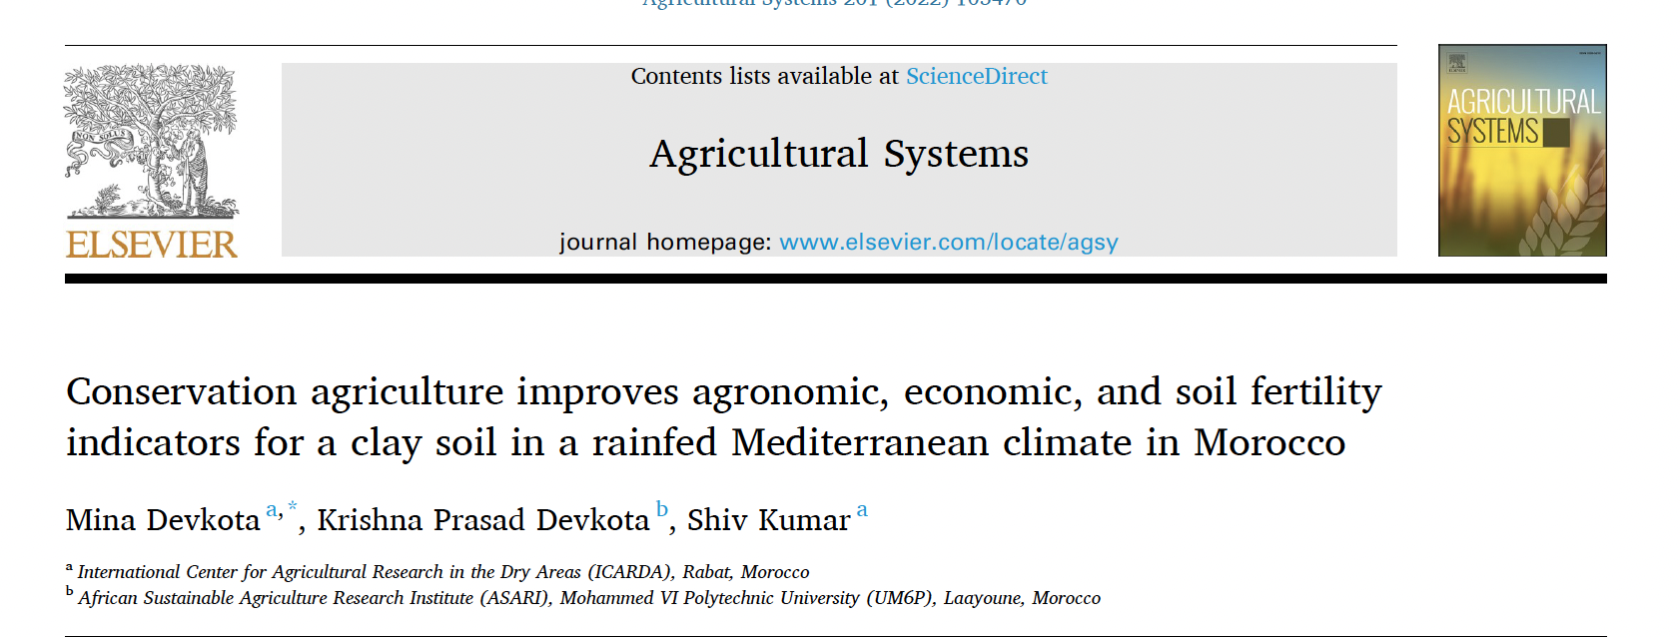
CSA Science-Based impacts

Slide 22
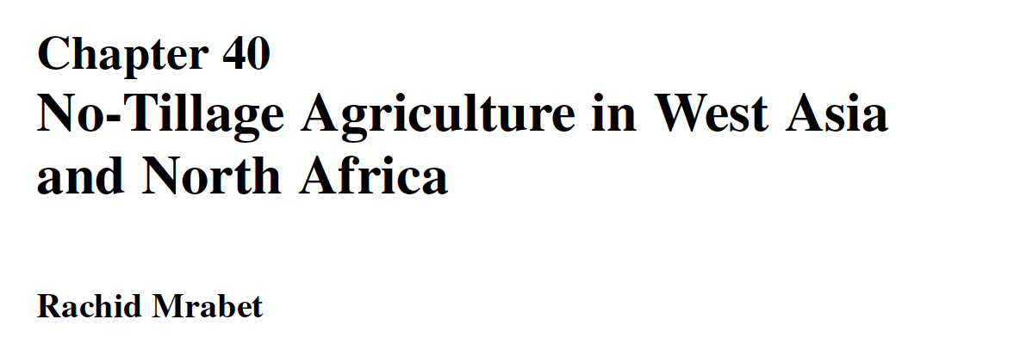
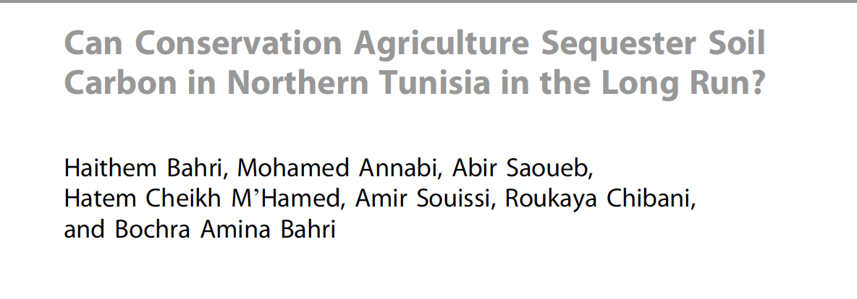
CSA Science-Based impacts
P. Tow et al. (eds.), Rainfed Farming Systems, DOI 10.1007/978-1-4020-9132-2_40, 1015 Springer Science+Business Media B.V. 2011
A. Kallel et al. (eds.), Recent Advances in Environmental Science from the Euro-Mediterranean and Surrounding Regions,
Advances in Science, Technology & Innovation, https://doi.org/10.1007/978-3-319-70548-4_30

Slide 23
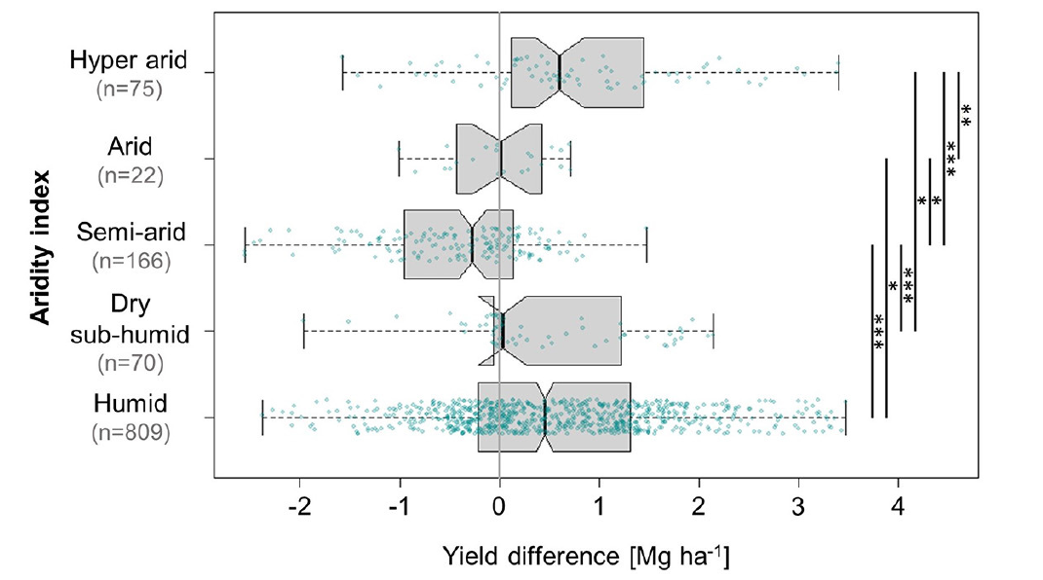
CSA Science-Based impacts
Agroforestry systems are productive in extreme arid conditions
Baier et al., 2023

Slide 24
The Future of CSA with emerging biotechnologies
Ultra-Resilient Crops
Extreme Weather Tolerance (droughts)
Pest and Disease Resistance
Sustainable Intensification
Enhancing Water Use Efficiency
Integrated Systems
Carbon Farming
Root Systems
Carbon markets
Nutrient Efficiency & sustainability
Income opportunities
Better quality with less inputs
Soil biodiversity
Enhanced Photosynthesis
Enhanced Carbon Sequestration
Higher Yields with Less Impact
Crop diversification
Nitrogen fixation
Phosphorus uptake

Slide 25
Combining CSA & Landscape-based approaches: The Bigger Picture
Recognizing that farms don't exist in isolation.
Managing larger interconnected systems that include forests, water resources, communities, and other land uses.
Ensuring multiple objectives:
Ecosystem services: Protecting and enhancing vital services like water provision, pollination, and soil fertility.
Biodiversity: Conserving and restoring biodiversity across the landscape.
Social equity: Ensuring that all stakeholders benefit from CSA and SLM.

Slide 26
Combining CSA & Landscape-based approaches: Moving beyond farm-level solutions
Synergies: Enhancing productivity at the farm level while supporting at the landscape level carbon sequestration and biodiversity conservation.
1
Addressing Trade-offs: Finding solutions that minimize negative impacts of CSA practices.
2
Enhancing resilience to droughts and pests through integration of tree, livestock & crops.
3

Slide 27
Advancing CSA with digital & frontier technologies
The digital and information era offers incredible potential to scale up CSA adoption and effectiveness.
Advanced CSA
Early Warning Systems
Supply Chain Optimization & market access
Knowledge Networks & platforms
Data-Driven Decisions
Targeted Interventions
Extension Services
Real-time Diagnostics

Slide 28
CSA as Driver of Sustainable Pathways
CSA approach should be
Long-term vision:
Guided by a long-term vision of a sustainable future, considering the needs of present and future generations..
Systemic change:
Require bold changes in policies, institutions, and individual behaviors.
Holistic approach:
Consider the interconnectedness of environmental, social, and economic systems.
Adaptive and flexible:
Are adaptive and flexible, recognizing that the path to sustainability need adjustments along the way.
Inclusive and participatory:
The participation of diverse stakeholders, ensuring that everyone has a voice in shaping the future while shifting to CSA.

Slide 29
In a Nutshell
While some studies and reports highlight the challenges of changing or transforming North African food systems, others recognize CSA's potential to support sustainability in all of its manifestations.

Slide 30
Take-home messages!
The core promise is that, while there are challenges, CSA offers a pathway towards a more sustainable and equitable future for North African farmers.
CSA isn't a magic bullet or a destination, but a journey.
It recognizes that continuous work, adaptation, and education are necessary to achieve sustainability in agriculture.
It's about continuous improvement and adjusting strategies as we gain more knowledge and experience.
CSA's emphasis on sustainability spans several dimensions and extends beyond productivity or profits:
Environmental sustainability includes biodiversity preservation, GHG emission reduction, and natural resource protection.
Economic sustainability is the ability of farmers to make a good living and the long-term and short-term viability of agricultural systems.
Ensuring food security for all, empowering farmers, and fostering fair access to resources are all components of social sustainability.

