Slide 1


"Vaping and Public Health: An Emerging Epidemic"
Rasha M. Youssef
Executive Manager of Science Park Unit-Alexandria University
Professor of Pharmaceutical Analytical chemistry
Faculty of Pharmacy- Alexandria University- Egypt
E mail: rasha.youssef@alexu.edu.eg
Orcid: https://orcid.org/0000-0001-8071-2187
Web of Science Researcher ID: H-7405-2016
Scopus author ID: 16065302500
Google scholar citation: https://scholar.google.com/citations?user=UoY4Q5sAAAAJ

Slide 2
Electronic cigarettes
The most common prototype (e-cigarettes or vapes) are devices that do not burn tobacco leaves but instead vaporize a solution for inhalation.
Electronic Nicotine Delivery System (ENDS) and Electronic Non Nicotine Delivery System (ENNDS) heat a solution (e-liquid or vape juice) to create an aerosol which contains flavorants, usually dissolved into Propylene Glycol or Glycerin.
ENDS solutions contain other chemicals, some of them considered to be toxicants. The ENNDS has e-liquid free of nicotine.

Slide 3
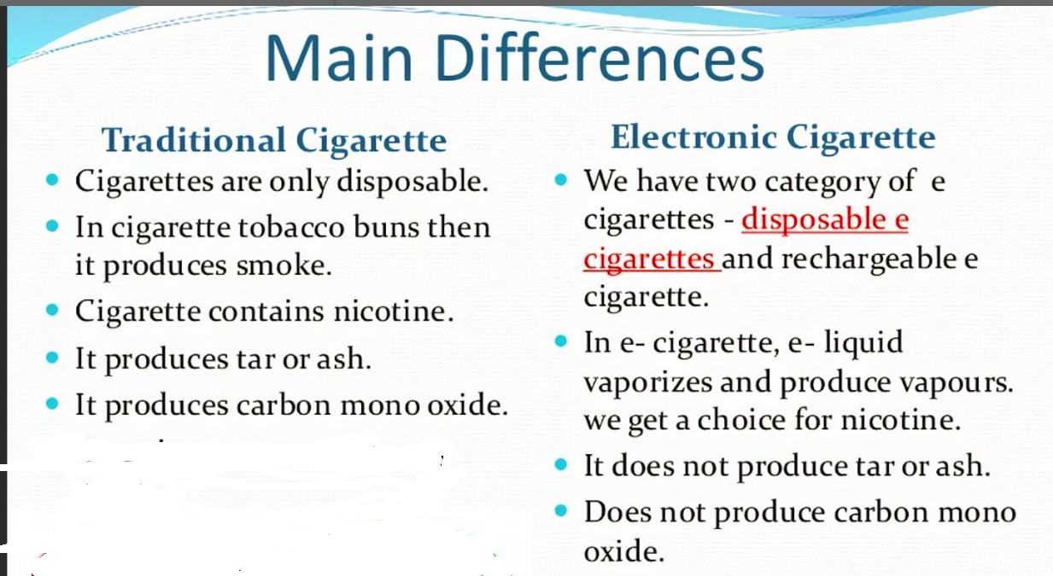

Slide 4
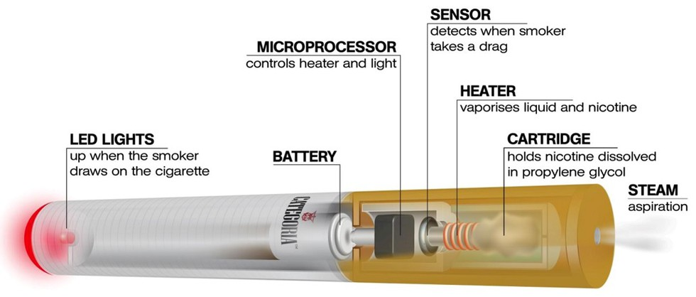
Components of an E-Cigarette:

Slide 5
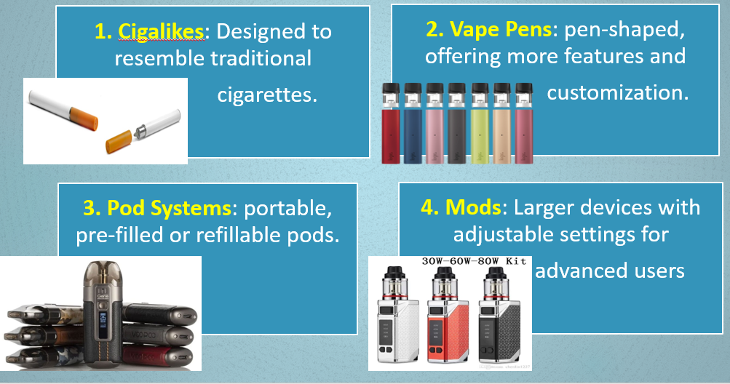
Common Types of E-Cigarettes:

Slide 6
Economic Prospects of the E-Cigarette Industry
1. Market Growth:
2. Job Opportunities:
3. Innovation and Investment:
4. Impact on Traditional Tobacco:

Slide 7
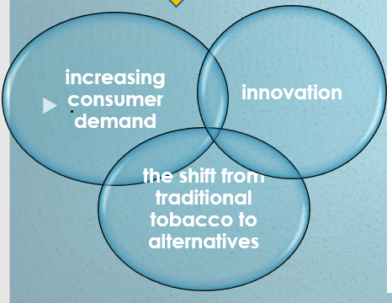
Economic Prospects of the E-Cigarette Industry
1. Market Growth:
The global e-cigarette market has seen substantial growth in recent years, driven by:

Slide 8
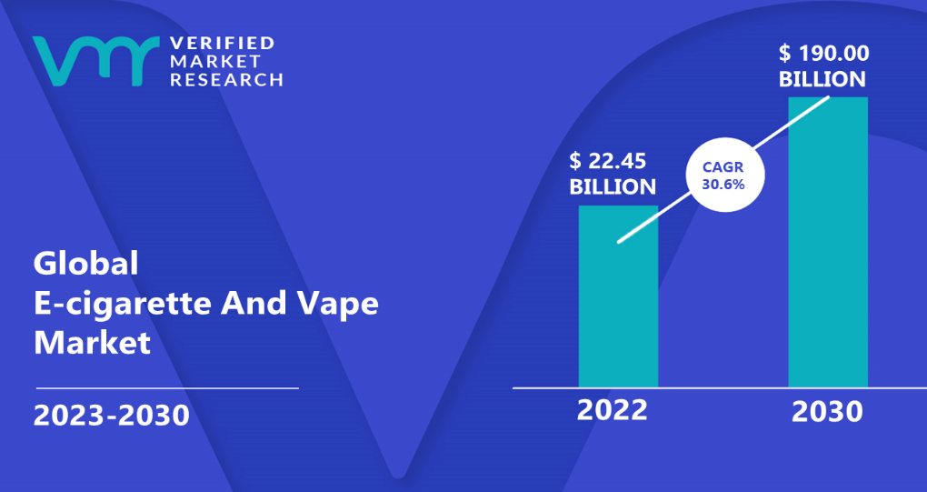
Economic Prospects of the E-Cigarette Industry
Market Growth:
During the forecast period 2022-2030, a Compound Annual Growth Rate (CAGR) is 30.6% .

Slide 9
Economic Prospects of the E-Cigarette Industry
2. Job Opportunities:
The E-Cigarette Industry has created jobs in manufacturing, marketing, and distribution. Specialized sectors like e-liquid production and vaping device design contribute to job diversity.
3. Innovation and Investment:
Start-ups and established companies are investing in research and development (R&D) for safer and more efficient products.
4. Impact on Traditional Tobacco:
The shift to vaping has disrupted traditional tobacco companies, forcing them into alternative nicotine products like e-cigarettes and heated tobacco.

Slide 10
Health Impact of Vaping
It is crucial to understand the potential health risks associated with vaping practice. While the long-term health effects of vaping are still being studied, evidence suggests that there are potential risks involved:
[1] Some devices contain Nicotine levels that exceed those found in traditional cigarettes. This Nicotine is highly addictive and can have high effects on brain development, especially in adolescents.

Slide 11
Health Impact of Vaping
[2] The Inhalation of Harmful Chemicals Can Cause Irreversible Lung Damage
The aerosol generated by e-cigarettes is inhaled and then exhaled by the user. Some of the generated aerosol may be discharged directly into the surrounding environment (second hand aerosol) and deposited on surface areas (third hand aerosol).
Harmful toxicants and carcinogens are found in e-cigarette emissions. Include: polycyclic aromatic hydrocarbons, volatile organic compounds, and fine and ultrafine particles.
Some Metal and silicate particles have been detected in e-cigarette aerosol, due to degradation of the metal coil used to heat the solution.
Pediatrics (2019) 143 (2): e20183652. https://doi.org/10.1542/peds.2018-3652

Slide 12
Health Impact of Vaping
In 2018, the National Academies of Science, Engineering and Medicine released a study report that reviewed over 800 different studies
Secondhand vape aerosol contains flavorings, such as diacetyl, that may impair the function of cilia in the airway linked to Chronic Obstructive Pulmonary Disease (COPD)
E-cigarettes also contain acrolein resulting from decomposition of glycerol by dehydration (CH₂OH)₂CHOH → CH₂=CHCHO + 2 H₂O
It can cause acute lung injury, COPD and may cause lung cancer.
E-cigarettes produce dangerous aldehydes (acetaldehyde, acrolein, and formaldehyde). These can cause lung disease, as well as cardiovascular (heart) disease.

Slide 13
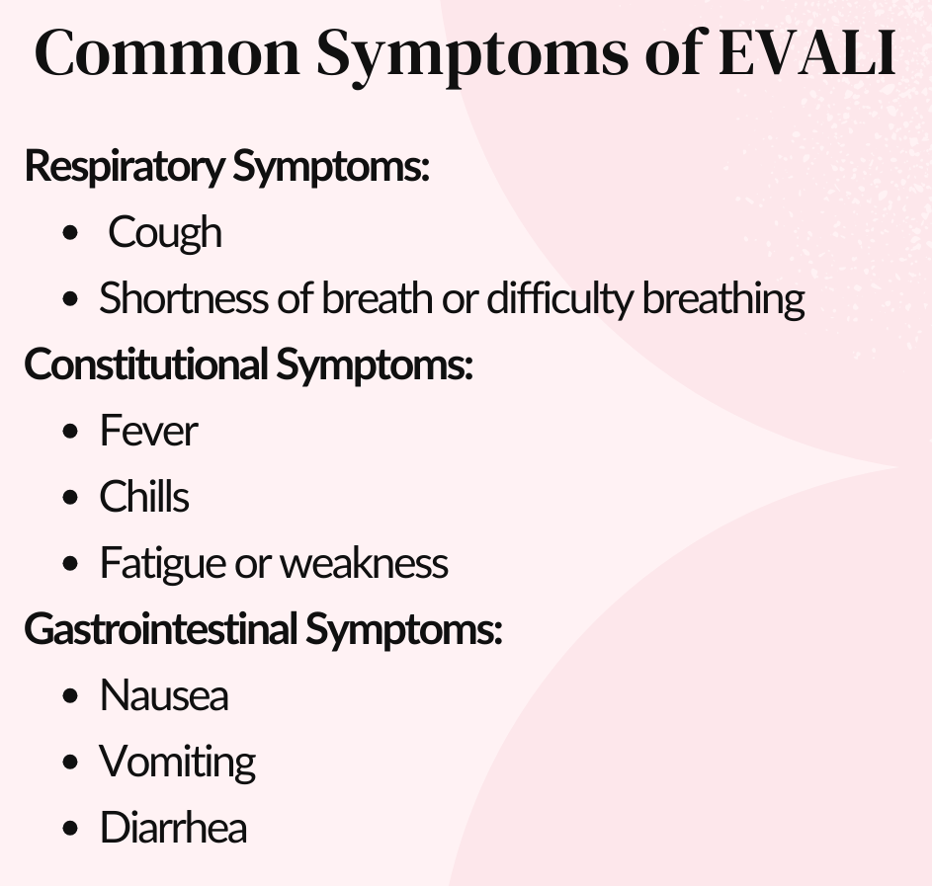
Health Impact of Vaping
In recent years, a concerning outbreak of E-cigarette or Vaping product use-Associated Lung Injury, known as EVALI, has emerged. As of early 2020, EVALI was responsible for nearly 3,000 hospitalizations and almost 70 deaths..

Slide 14
Health Impact of Vaping
The exact cause of EVALI is still under investigation, but evidence suggests that vitamin E acetate, an additive found in some THC vaping products, may play a role*. Vitamin E acetate was illegally used as a diluent in counterfeit, low-cost vapes cartridges. Its use as a diluent became common in 2019, coexisting with the EVALI outbreak.**
Vitamin E acetate has been found in bronchoalveolar lavage (BAL) fluid samples of individuals with EVALI, and it is believed to be associated with this condition.
Blount BC et all., Lung Injury Response Laboratory Working Group. Vitamin E Acetate in Bronchoalveolar-Lavage Fluid Associated with EVALI. N Engl J Med. 2020 Feb 20;382(8):697-705
**Cherian SV, Kumar A, Estrada-Y-Martin RM. E-Cigarette or Vaping Product-Associated Lung Injury: A Review. Am J Med. 2020 Jun;133(6):657-663

Slide 15
Health Impact of Vaping
Mechanisms for EVALI
Is due to the potential interaction of vitamin E with pulmonary surfactant (PS). PS is a phospholipid layer that lines alveoli. Its important function is to reduce the surface tension of the alveolar surface.
Vitamin E is lipophilic compound due to its nonpolar aliphatic carbon chain. It could penetrate the PS layer, disrupting the organization of lipid molecules and changing the surface tension lead to lipoid pneumonia characterized by lung inflammation.

Slide 16
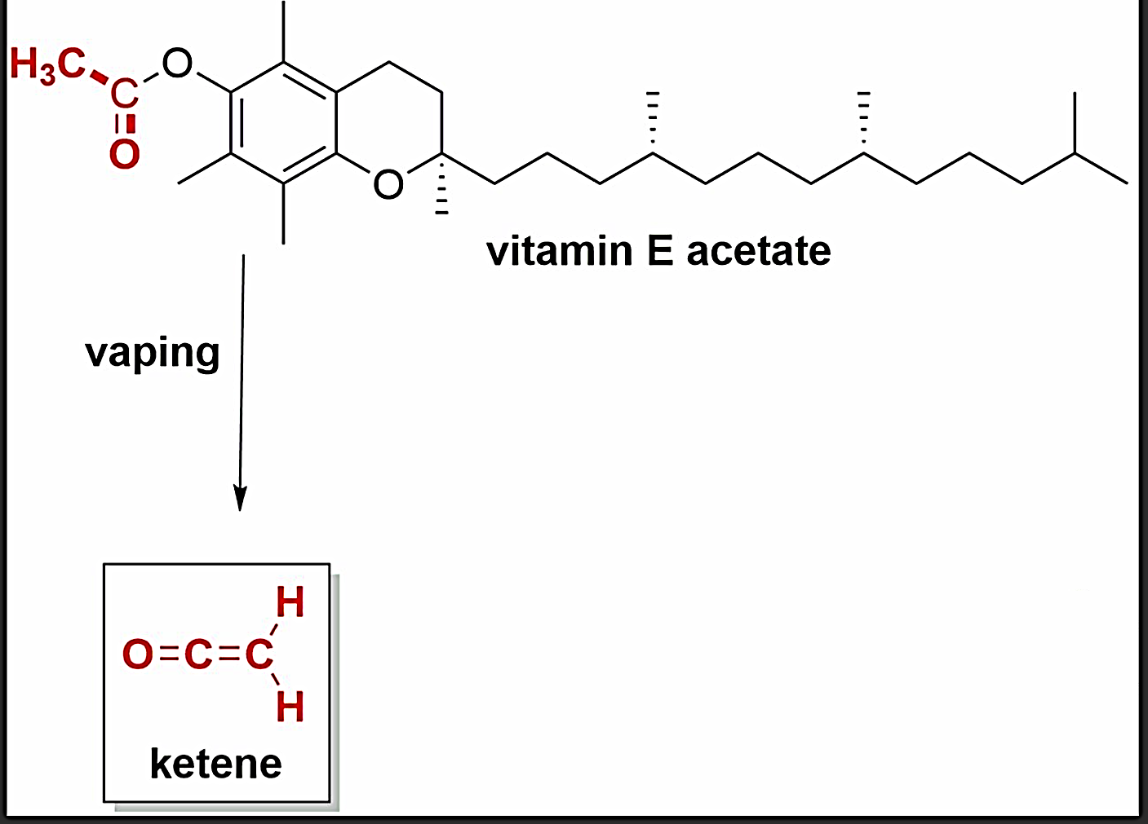
Health Impact of Vaping
Still, the EVALI mystery may be more complex than disruption of PS alone. Later studies of EVALI patient lung scans showed signs related to inhalation of toxic chemicals. Some experts argue the high temperatures achieved by vaping devices serve as a catalyst for unpredictable chemistries.
Scientists suggest that E-cigarettes can be considered uncontrollable mini-pyrolysis devices. It has been proposed that vaping induced pyrolysis of vitamin E acetate to produce ketene (highly toxic gas).
Inhalation of ketene can cause severe lung damage in low concentrations and death in high concentrations*
* Ketene – Acute Exposure Guideline Levels for Selected Airborne Chemicals – NCBI Bookshelf. Available at: https://www.ncbi.nlm.nih.gov/books/NBK224928/. (Accessed: 8th January 2020)

Slide 17
Health Impact of Vaping
Diagnosing of EVALI involves:
Reviewing vaping history
Chest imaging (e.g., X-ray or CT scan)
Exclusion of other respiratory conditions (e.g., infections or asthma).

Slide 18
Health Impact of Vaping
Treatment of EVALI:
Stopping vaping immediately.
Hospitalization for severe cases.
Corticosteroids to reduce lung inflammation.
Oxygen therapy in severe respiratory distress.
Prevention
Avoid using vaping products, especially
those obtained informally or containing THC.
Be cautious of products containing vitamin E or unknown additives.
Seek medical attention if symptoms arise after vaping.

Slide 19
Environmental Impact of Vaping
Type of waste comes from e-cigarettes:
E -Liquid
E-liquids leaking from vapes can harm aquatic life and contaminate drinking water.
E -Wast
Vapes generate electronic waste (e-waste) with circuit boards and batteries.
The massive influx of The lithium batteries into landfills increases the likelihood of landfill fires
Plastics
Littered vape packaging and devices contribute to plastic pollution (leach of microplastic.to waterways)
Disposable vapes are made from non-biodegradable plastics that are hard to be recycled.

Slide 20
Vaping and Smoking Cessation
Several studies have examined the effectiveness of e-cigarettes as a tool for smoking cessation.
Moreover, population studies have shown a higher success rate in quit attempts among smokers who use e-cigarettes compared to those who use other methods.
E-cigarettes are not approved by FDA as a smoking cessation devices. it's recommended to consult with healthcare professionals for guidance and support.

Slide 21
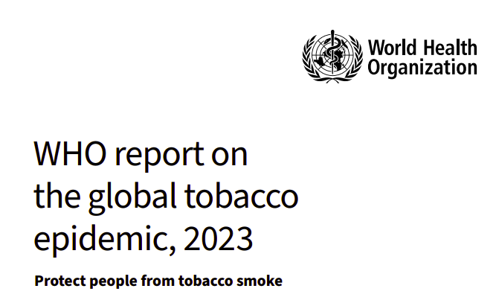
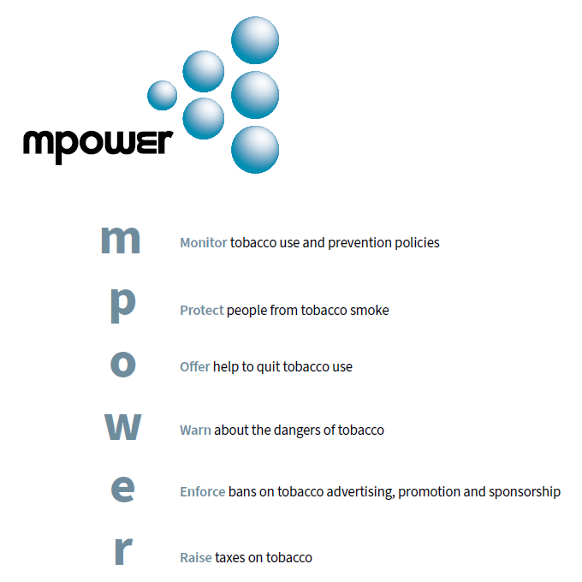
The WHO recommends prevention of using both e-cigarettes and tobacco products as the safest approach to safeguarding health.
According to WHO report on the global tobacco epidemic (2023), MPOWER measures, as well as other policy measures (including age restrictions on sales, and flavour bans) can be applied to E-cigarettes.

Slide 22
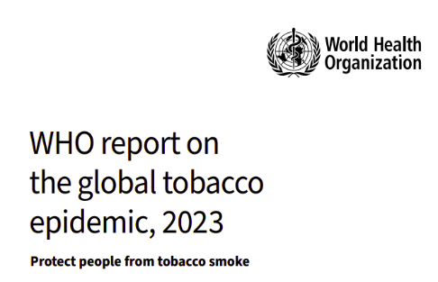
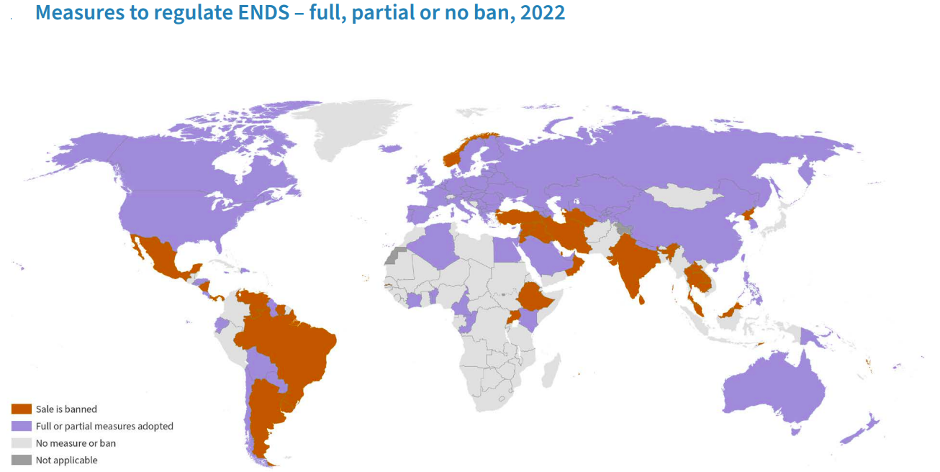
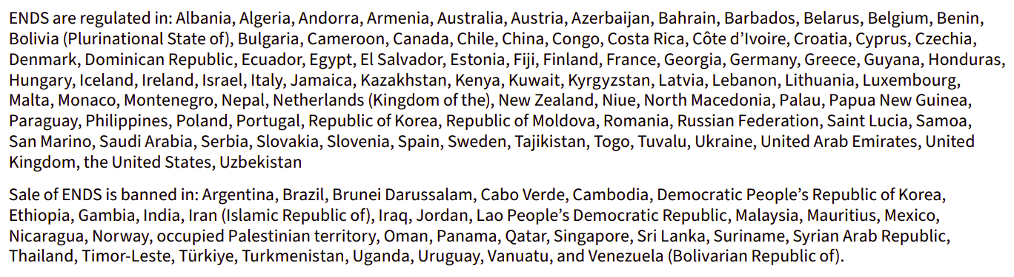
Notes:
This map represents the countries that make regulations for vaping allover the world. It is clear that, in red color countries the vaping is banned while violet color countries, apply full or partial measures. The grey color countries do not apply any measures to regulate vaping practice.

Slide 23
Summary and conclusion
E-cigarettes hold both economic promise and potential health risks. The industry's future depends on technology, and public perceptions. While it creates opportunities for innovation & employment, stakeholders must balance economic benefits with public health priorities.
The outbreak of EVALI highlights the importance of understanding the potential risks of vaping. The caution should be taken when using e-cigarettes, especially with the use of products from unregulated sources.
More research should be done on the newer variants of e-liquid components.
A lack of knowledge about the long-term effects of vaping may undermine the determination of e-cigarette regulations, so more studies should be conducted to acquire the required information.
Evidence-based policies and regulations should be implemented to protect individuals, especially young adults from potential harm.
Education campaigns should also focus on raising awareness about the risks of e-cigarette use and encouraging informed decision-making.

Slide 24


