Slide 1
HYDROPRIMING AND OSMOPRIMING: MITIGATING STRATEGIES TO IMPROVE SORGHUM PRODUCTION BY ENHANCING ITS SEEDLING VIGOR
Adrianne C. Gonzales, Christian Butch Andrew A. Balbas, Raymund Julius G. Rosales*, Micah Benize S. Gregorio-Balbas, Glisten Faith S. Pascua, Joanna P. Crosby
Department of Agricultural Sciences, College of Agriculture, Food and Sustainable Development, Mariano Marcos State University, City of Batac 2906 Ilocos Norte, Philippines
*Presenter: rgrosales@mmsu.edu.ph

Slide 2
OUTLINE
Introduction
Objective
Results
Discussion
Conclusion
2

Slide 3
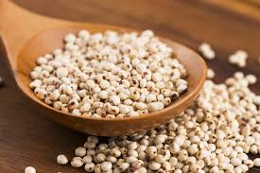
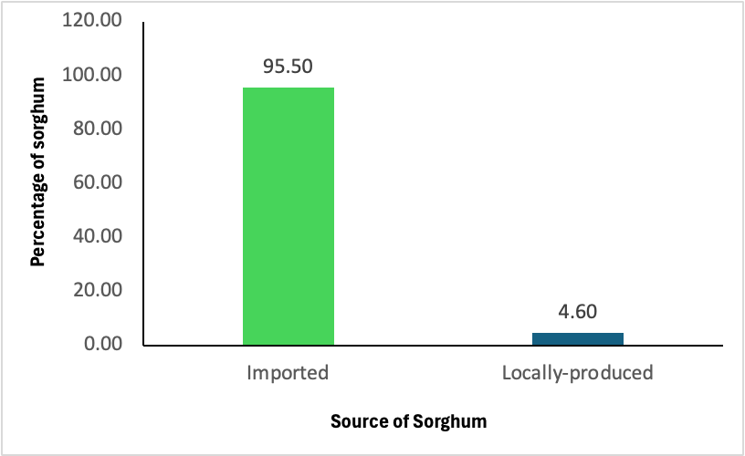
INTRODUCTION
<22000 MT
(Australia-<20000 MT)
Sorghum (Sorghum bicolor (L.) Moench))
annual crop
food and feedstuff for livestock
<580 kg or 0.588 MT
Concern
Sources: DA, 2023; wits.wordlbank.org
sustainable supply and production of good quality and high germination must be guaranteed
3
Source: DA, 2023

Slide 4
crop productivity
seeds
rapid and uniform seedling emergence
high seed vigor – uniform growth
priming
presoaking
SOD, CAT, APX, GPOX
TPC, vitamin C, carotenoids
imbibition
1st stage of germination
radicle emergence
original MC
seed sowing
Catiempo et al., 2020; Sen ad Puthur, 2020; Khan et al., 2020; Marthandan et al. 2020
activation of metabolism
dehydration
4

Slide 5
Studies on Seed Priming
enzyme activation
protein synthesis
improved antioxidant defense
OBJECTIVE
To evaluate the effect of hydropriming and osmopriming on sorghum seeds.
SOD, CAT, APX, GPOX
TPC, vitamin C, carotenoids
early germination and uniform seedling emergence
high seed vigor – uniform growth
5
Catiempo et al., 2020; Sen ad Puthur, 2020; Khan et al., 2020

Slide 6
Sustainable Development Goals Addressed
SDG 1 - No poverty
SDG 3 – Good health and well-being
SDG 12 – Responsible consumption and production
6

Slide 7
Materials and Methods
Priming
Potassium nitrate (KNO₃)
0.5
1.0
2.0
4-16 h priming
Hydropriming (h)
4
8
12
16
Growing conditions
Ambient condition
Temperature - 30 ± 2 ˚C
Relative humidity - 65 ± 5%
Sorghum seeds
Experiment
Complete Randomized Design
4 replications
Statistical analysis – STAR program; Tukey’s HSD test
Parameters (ISTA)
Percentage germination, seed length, root and shoot lengths, fresh weight, seedling vigor
7

Slide 8
RESULTS
8

Slide 9
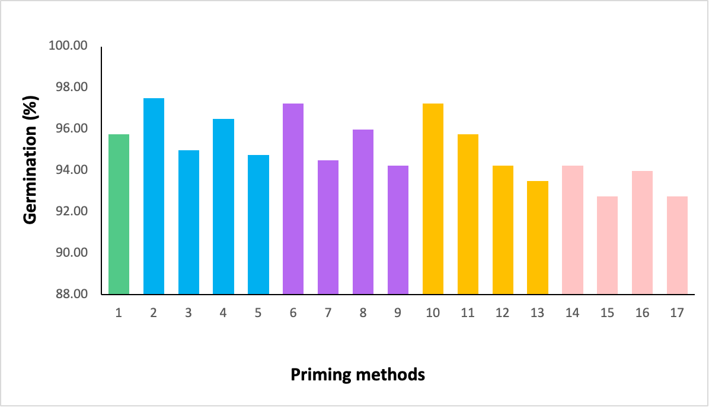
Percentage Germination
Hydropriming and KNO₃
comparable to each other
KNO₃
unprimed seeds provided similar germination with KNO₃ irrespective of concentration and duration
Hydropriming
hydroprimed and unprimed were similar to each other
0 4 8 12 16
4 8 12 16
4 8 12 16
4 8 12 16
Hydropriming (h)
KNO₃ (0.5%)
KNO₃ (1.0%)
KNO₃ (2.0%)
9
Figure 1. Seed germination of osmoprimed and hydroprimed sorghum seeds.

Slide 10
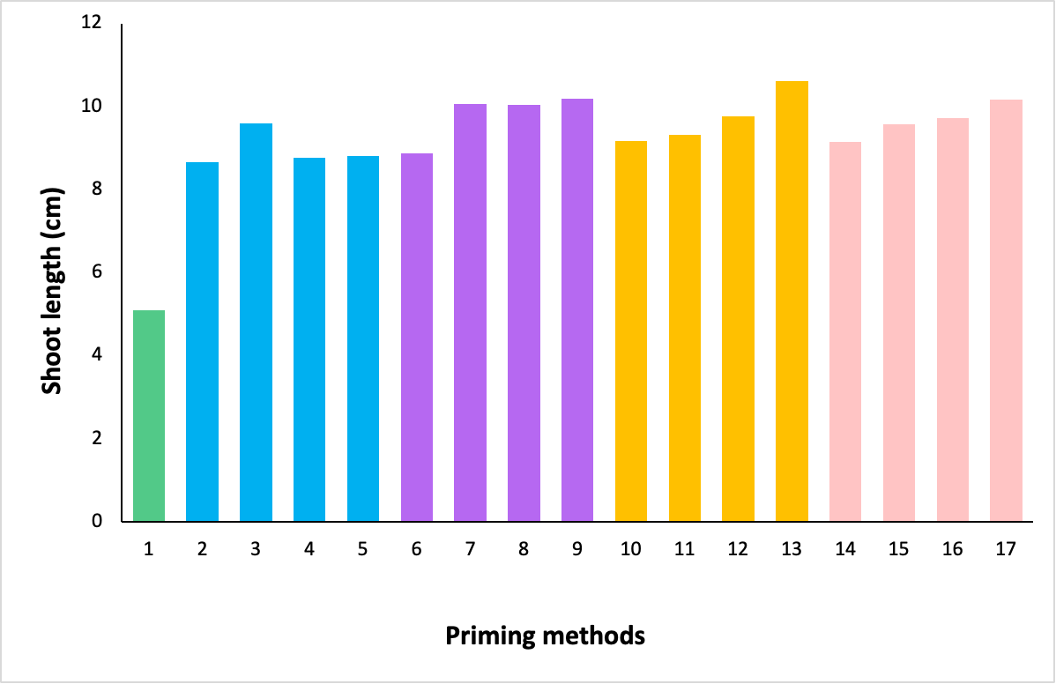
Shoot Length
shoot length was affected by seed priming
hydro and KNO₃ showed longer shoots
a
a
a
a
a
a
a
a
a
a
a
a
a
a
a
a
KNO₃
showed longer shoots than unprimed
similar among concentrations and durations
b
Hydropriming
showed longer shoots than unprimed
similar among durations
0 4 8 12 16
4 8 12 16
4 8 12 16
4 8 12 16
Hydropriming (h)
KNO₃ (0.5%)
KNO₃ (1.0%)
KNO₃ (2.0%)
Figure 2. Shoot length of osmoprimed and hydroprimed sorghum seeds.
10

Slide 11
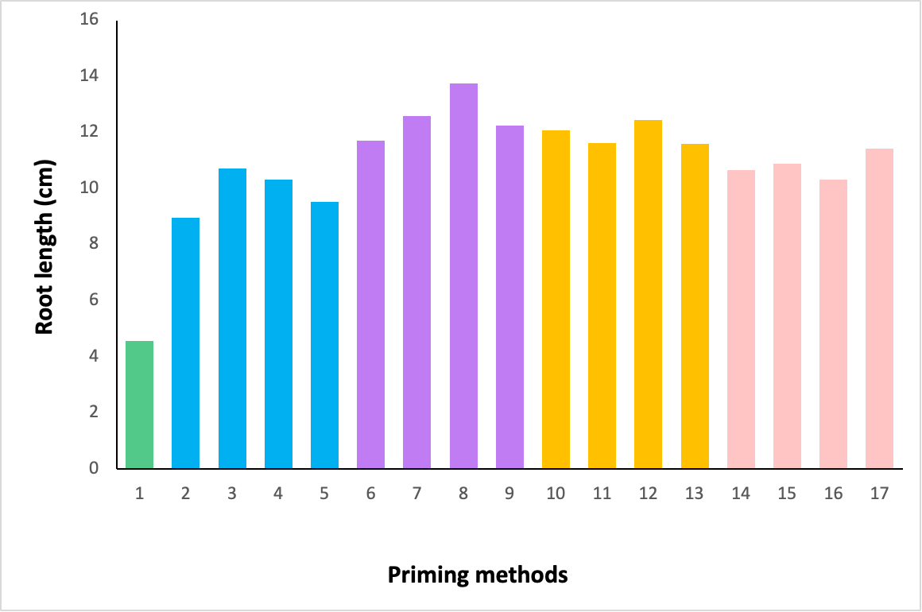
Root Length
shoot length was affected by seed priming
hydro and KNO₃ showed longer roots
a
ab
abc
abc
abcd
abc
abcd
abcd
abcd
KNO₃
0.5% KNO3 for 12 h showed longer shoots than unprimed and 2% KNO3 (4 and 12 h)
other concentrations and durations were similar to the above
bcd
bcd
abcd
bcd
bcd
d
cd
e
Hydropriming
8 h showed longer shoots than 4 h
no significant increase if longer than 8 h
0 4 8 12 16
4 8 12 16
4 8 12 16
4 8 12 16
Hydropriming (h)
KNO₃ (0.5%)
KNO₃ (1.0%)
KNO₃ (2.0%)
11
Figure 3. Root length of osmoprimed and hydroprimed sorghum seeds.

Slide 12
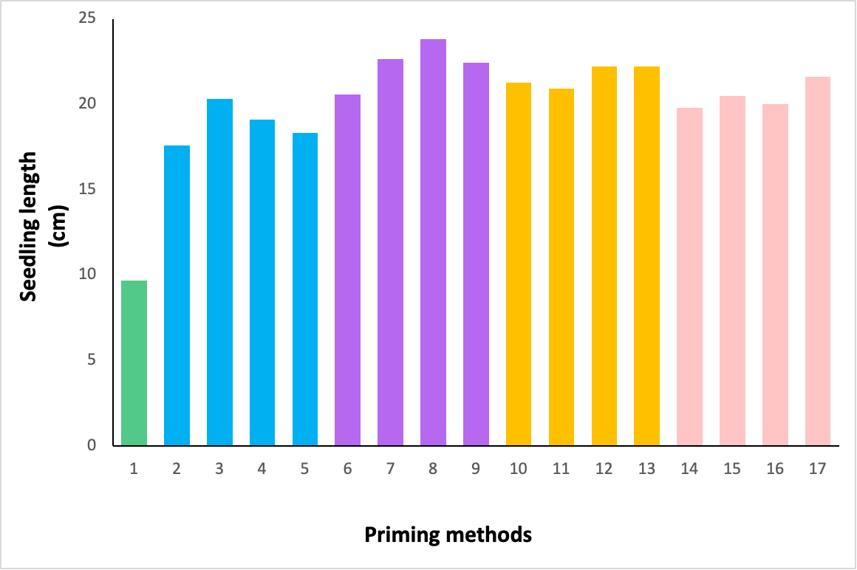
Seedling Length
shoot length was affected by seed priming
hydro and KNO₃ showed longer seedlings
a
ab
ab
ab
ab
abc
abc
abc
abc
abc
abc
abc
abc
bc
bc
KNO₃
0.5% KNO₃ for 12 h showed longer seedlings than unprimed
other concentrations and durations were similar to the above
c
d
Hydropriming
8 h showed longer seedlings than 4 h and unprimed
no significant increase if longer than 8 h
0 4 8 12 16
4 8 12 16
4 8 12 16
4 8 12 16
Hydropriming (h)
KNO₃ (0.5%)
KNO₃ (1.0%)
KNO₃ (2.0%)
12
Figure 4. Seedling length of osmoprimed and hydroprimed sorghum seeds.

Slide 13
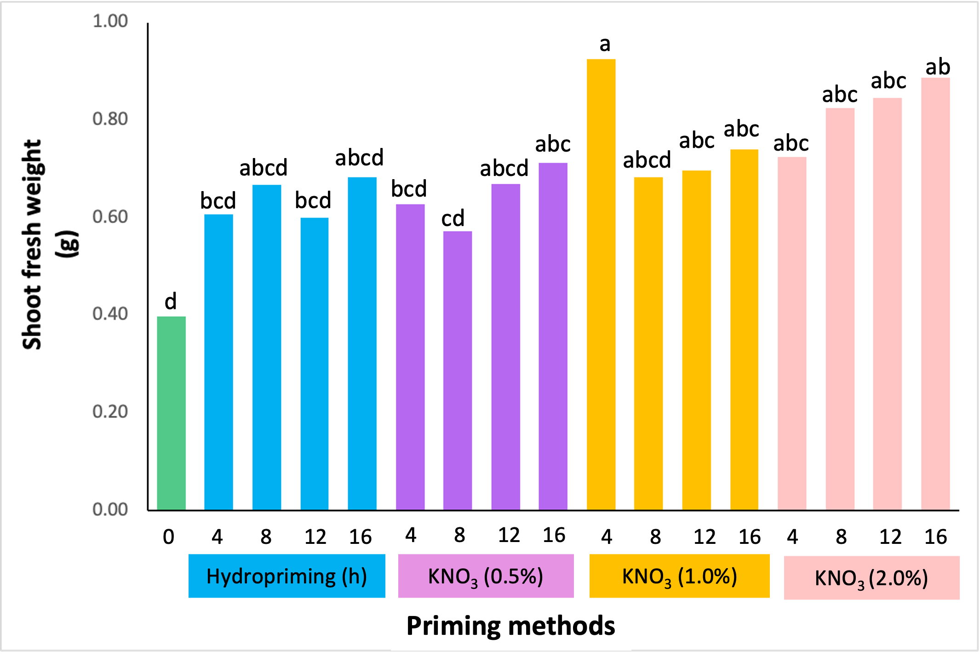
Shoot Fresh Weight
KNO₃
1.0% KNO₃ for 4 h showed a higher SFW than unprimed and 0.5% KNO₃ (4 and 8 h)
other concentrations and durations were similar to the above
Hydropriming
4 h hydroprimed seeds had higher SFW than unprimed
no further increase beyond 4 h
13
Figure 4. Shoot fresh weight of osmoprimed and hydroprimed sorghum seeds.

Slide 14
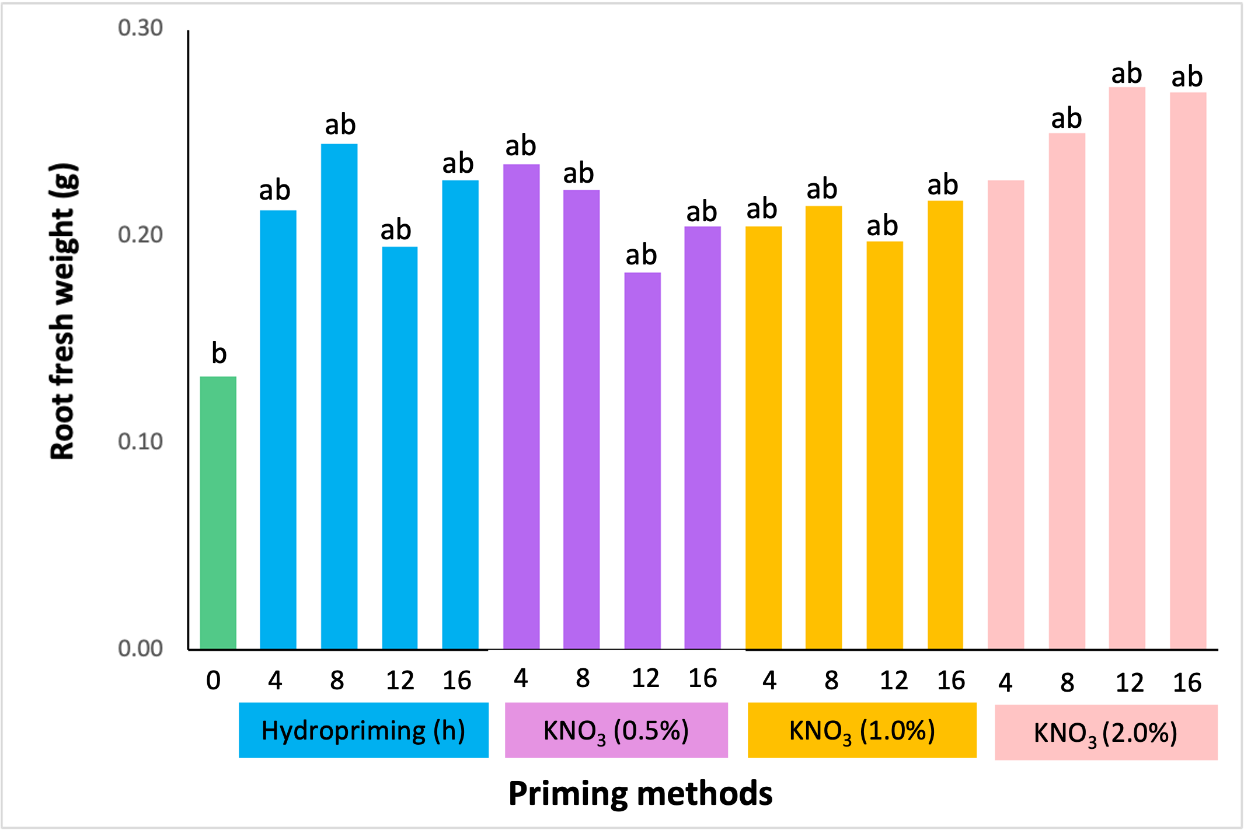
Root Fresh Weight
KNO₃
2.0% KNO₃ for 12 and 16 h showed a higher RFW than unprimed
but these concentration and duration were similar with other concentrations and durations
Hydropriming
4 h hydroprimed seeds had higher RFW than unprimed
no further increase beyond 4 h
14
Figure 5. Root fresh weight of osmoprimed and hydroprimed sorghum seeds.

Slide 15
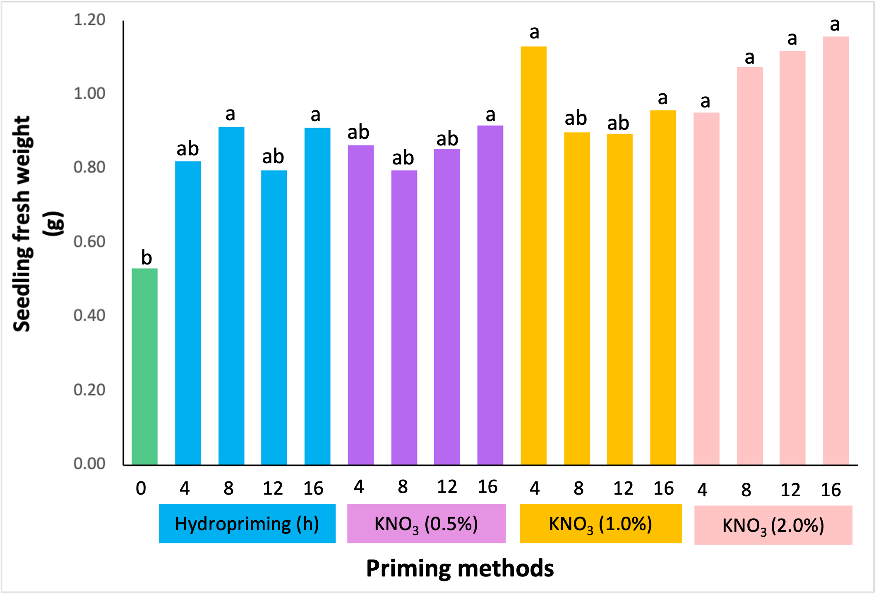
Seedling Fresh Weight
KNO₃
KNO₃-primed seeds had higher seedling FW than unprimed seeds
2.0% (12&16h) and 1.0% (4h) were higher than unprimed and other concentrations
others were comparable to the above
Hydropriming
4 h hydroprimed seeds had higher seedling FW than unprimed
no further increase beyond 4 h
15
Figure 6. Seedling fresh weight of osmoprimed and hydroprimed sorghum seeds.

Slide 16
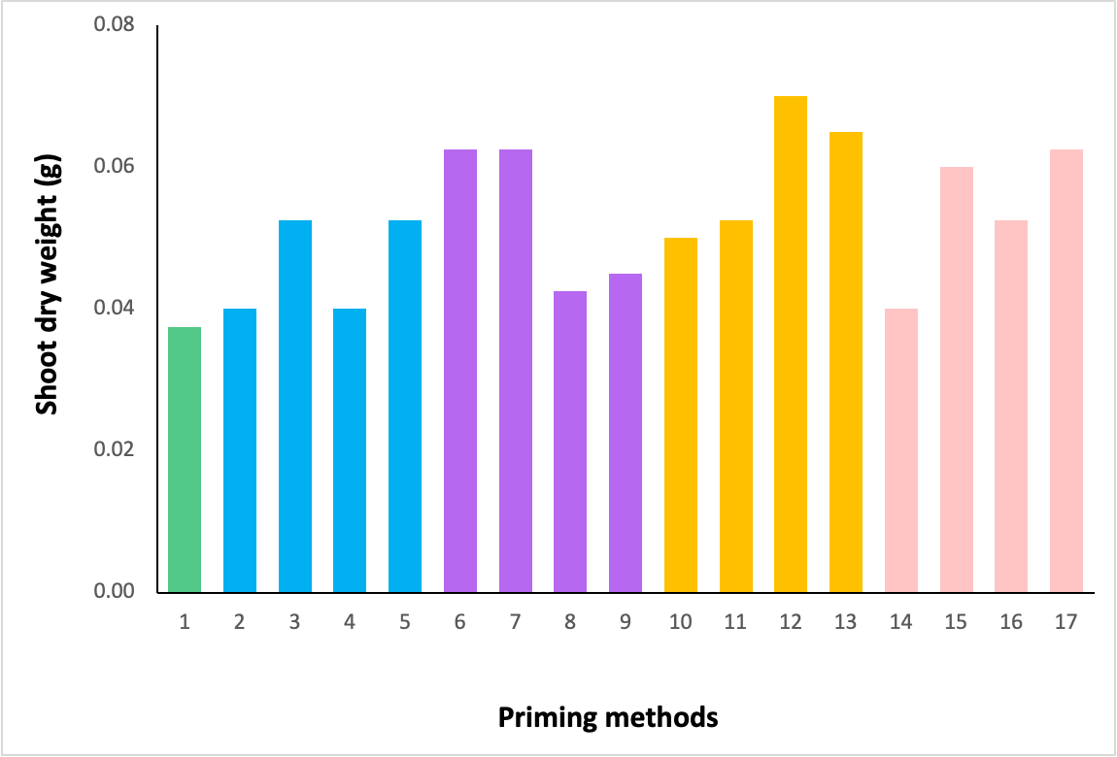
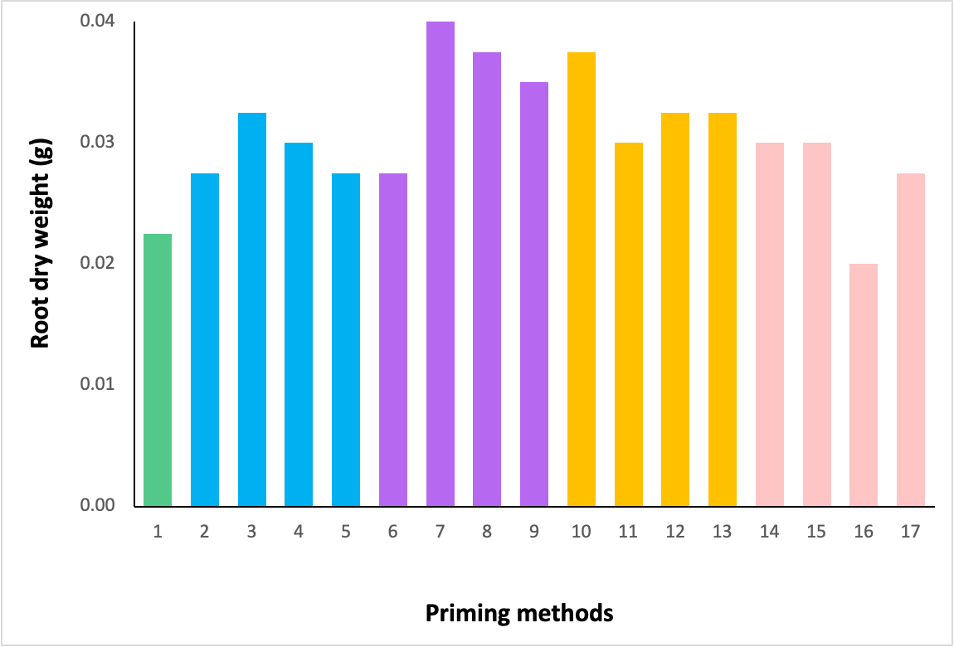
Shoot Dry Weight
Root Dry Weight
comparable all treatments
comparable all treatments
0 4 8 12 16
4 8 12 16
4 8 12 16
4 8 12 16
0 4 8 12 16
4 8 12 16
4 8 12 16
4 8 12 16
Hydropriming (h)
KNO₃ (0.5%)
KNO₃ (1.0%)
KNO₃ (2.0%)
Hydropriming (h)
KNO₃ (0.5%)
KNO₃ (1.0%)
KNO₃ (2.0%)
Priming methods
Priming methods
Figure 7. Shoot dry weight of osmoprimed and hydroprimed sorghum seeds.
Figure 8. Root dry weight of osmoprimed and hydroprimed sorghum seeds.
16

Slide 17
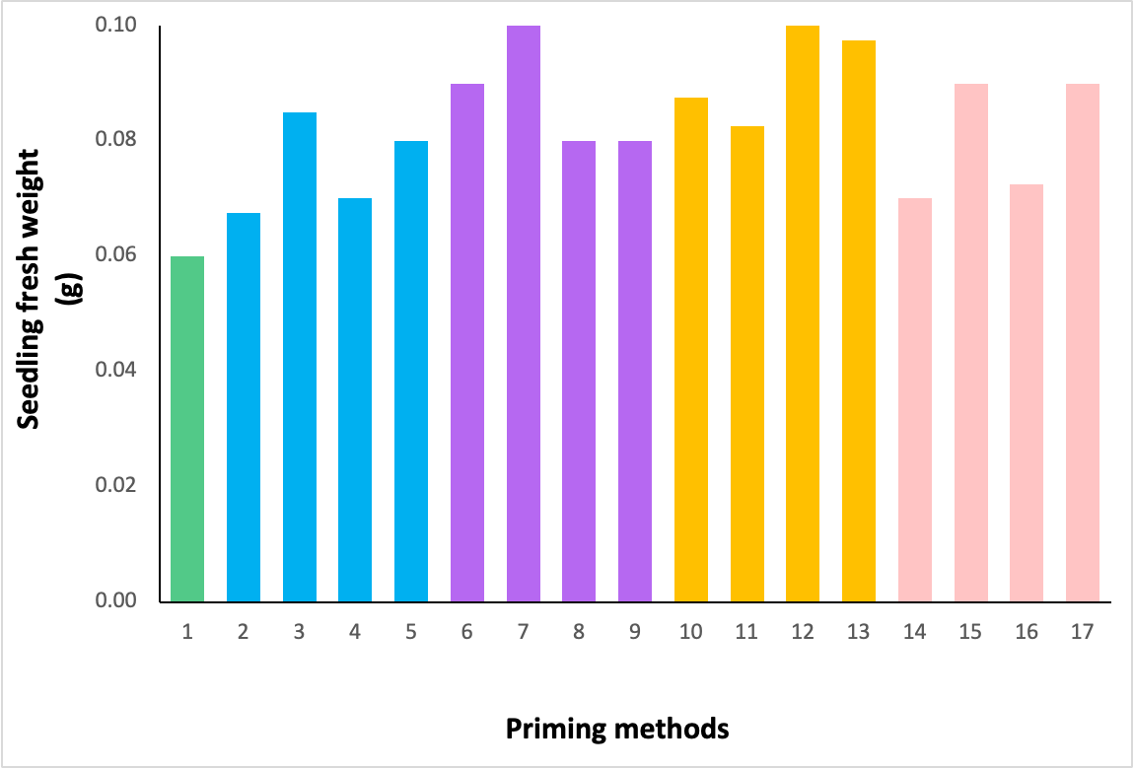
Seedling Dry Weight
0 4 8 12 16
4 8 12 16
4 8 12 16
4 8 12 16
Hydropriming (h)
KNO₃ (0.5%)
KNO₃ (1.0%)
KNO₃ (2.0%)
Priming methods
Figure 8. Seedling dry weight of osmoprimed and hydroprimed sorghum seeds.
comparable all treatments
17

Slide 18
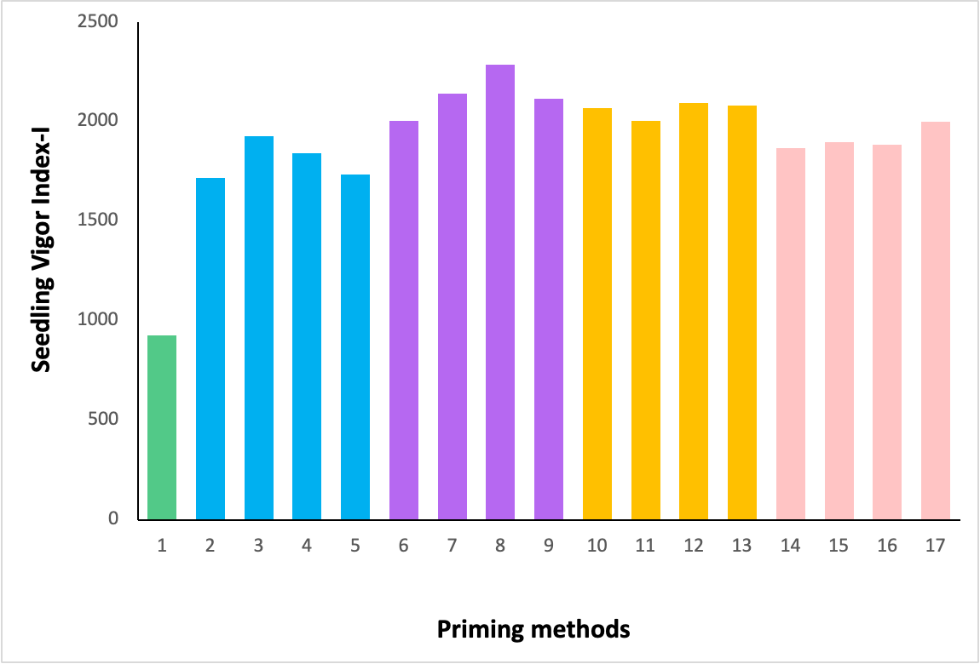
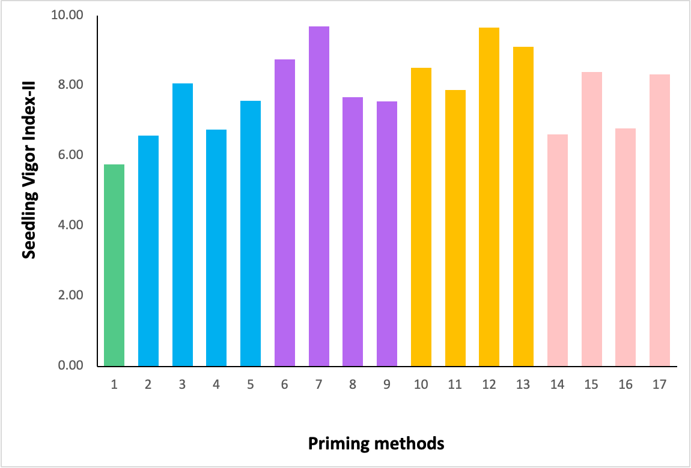
Seedling Vigor Index-I
Seedling Vigor Index-II
comparable all treatments
a
ab
ab
ab
ab
ab
ab
ab
ab
ab
ab
b
ab
ab
b
b
c
0 4 8 12 16
4 8 12 16
4 8 12 16
4 8 12 16
0 4 8 12 16
4 8 12 16
4 8 12 16
4 8 12 16
Hydropriming (h)
KNO₃ (0.5%)
KNO₃ (1.0%)
KNO₃ (2.0%)
Hydropriming (h)
KNO₃ (0.5%)
KNO₃ (1.0%)
KNO₃ (2.0%)
Priming methods
Priming methods
KNO₃
KNO₃-primed (0.5% for 12h) seeds had higher seedling vigor than unprimed and 2.0% KNO₃ (4 & 12 h)
further increased to 1.0% and beyond 4h did not increase SVI-I
Hydropriming
4 h hydroprimed seeds had higher SVI-I than unprimed
no further increase beyond 4 h
18

Slide 19
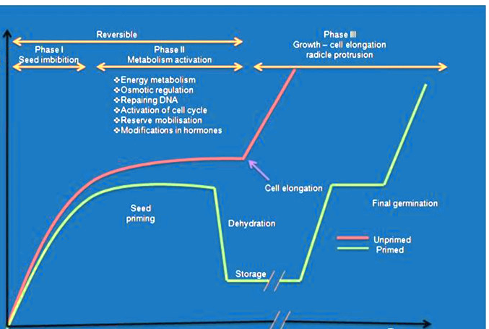
energy metabolism
reserve mobilization
modifications in hormones
Primed seeds
Water
content
SOD, CAT, APX, GPOX
TPC, vitamin C, carotenoids
Figure _. Phases of seed germination in primed and unprimed seeds (Marthandan et al., 2020).
Time
19

Slide 20
SOD, CAT, APX, GPOX
TPC, vitamin C, carotenoids
KNO₃-primed seeds displayed a better growth of sorghum than hydroprimed seeds
the controlled hydration in osmopriming reduces the production of ROS, since a shortage of water during hydration creates stress to produce ROS
early germination and uniform seedling emergence
high seed vigor – uniform growth
low water potential of osmotic solutions allows slow imbibition of water to activate pre-germinative metabolic processes without radicle protrusion
20
(Katarzyna et al., 2019; Sen and Puthur, 2020)

Slide 21
Conclusion
KNO₃-primed seeds displayed a better growth of sorghum than hydroprimed, particularly:
root length: KNO₃ (0.5%) for 12 h > hydroprimed seeds
seedling length: KNO₃ (0.5%) for 12 h > hydroprimed seeds (4, 12, and 16 h)
shoot fresh weight: KNO₃ (1.0%) for 4 h > hydroprimed (4, 12, and 16 h)
SVI-I: KNO₃ (0.5%) for 12 h > hydrorpimed (4, 12, and 16 h)
KNO₃-primed seeds
0.5 to 1.0% (4 h) due to the following:
high shoot and seedling fresh weight
high seedling vigor index
Hydroprimed seeds
8 h due to the following:
longer roots and seedlings
comparable shoot, root, and seedling fresh weight, and seedling vigor index
21

Slide 22
References
Catiempo, R., Photchanachai, S., Bayogan, E. and Wongs-Aree, C. 2021. Impact of hydropriming on germination and seedling establishment of sunflowers seeds as elevated temperature. Plant, Soil and Environment. 67, 491-498.
International Seed Testing Association. 2008. Seed Testing
Katarzyna, K., Beata, P. and Erwelina, R. 2019. Reactive oxygen species as potential drivers of the seed aging process. Plants.
Marthandan, V., Geetha, R., Kumutha, K., Renganathan, V., Karthikeyan, A. and Ramalingam, J. 2020. Seed priming: a feasible strategy to enhance drought tolerance in crop plants. International Journal of Molecular Sciences. 21, 8258.
Sun, A. and Puthur, J. 2020. Influence of different seed priming techniques on oxidative and antioxidative responses during the germination of Oryza sativa varieties. Physiology and Molecular Biology of Plants. 26, 551-565.

Slide 23
Acknowledgement
6th ACSTM
MMSU

Slide 24
Thank you!

