Slide 1

Title: Cardioprotective Potential of Nano-Vector (EAF-AC-NG) targeting Oxidative Stress in Cardiac Hypertrophy Rat Model
Prof. Dr. Sobia Tabassum
Head of Laboratory: Pharmaceutical Biotechnology
Department of Biological Sciences International Islamic University, Islamabad, Pakistan

Slide 2
Cardiovascular Diseases
Cardiovascular diseases (CVDs) are the primary cause of death worldwide and this epidemic is becoming a significant public health concern, posing a grave threat to healthcare settings .
Pakistan, CVD is prevalent at a significant rate. According to the 2019
Global Burden of Disease study, the estimated age-standardized incidence
of CVD in Pakistan was 918.18 per 100 000 (global, 684.33 per 100 000).
Benjamin et al., 2017; Roth et al., 2020; Pahlavani et al., 2023
Jafar et al., 2005; Akhtar et al., 2015; Samad & Hanif, 2023

Slide 3
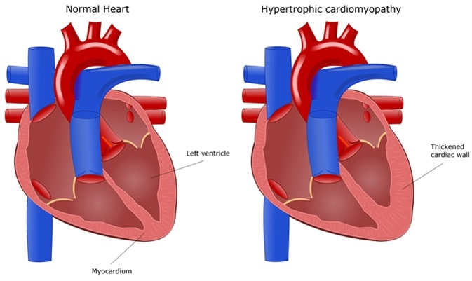
Cardiac Hypertrophy
Cardiac hypertrophy (CH)
heart’s muscular mass increases in response to internal or external stress.
sustained hypertrophy
  maladaptive remodeling
  contractile dysfunction
In setting of maladaptive Cardiac Hypertrophy apoptosis can become dysregulated.
  Excessive loss of cardiac muscle cells.
  Cardio myocyte's limited potential for proliferation
  Damaged parts of myocardial cannot regenerate and restore effectively
  heart failure
(van Empel & Windt, 2004; Liang et al., 2009, Riley et al, 2018 Nakamura & Sadoshima, 2018, Xu, et al., 2019, Peet et al., 2020, Richards et al., 2020, Caturano et al., 2022)

Slide 4
Research Gap
The current standard of care for treating CVDs especially cardiac hypertrophy calls for the administration of medicines in high concentrations, which can be hazardous to other organs.
Aim of the Study:
The study aims to design and formulate a biocompatible and targeted polymeric Nano vector system encapsulating medicinal compounds to achieve a therapeutic goal for apoptosis in cardiac hypertrophy.

Slide 5
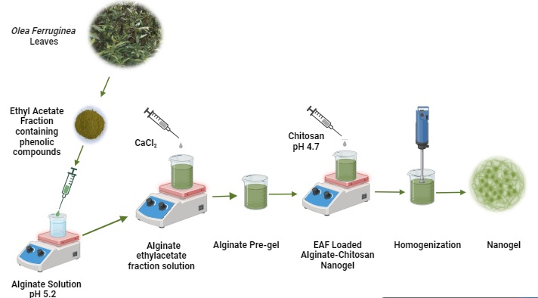
EAF-AC-NG
Nano vector
Figure. Diagrammatic Representation EAF-AC-NG Synthesis

Slide 6
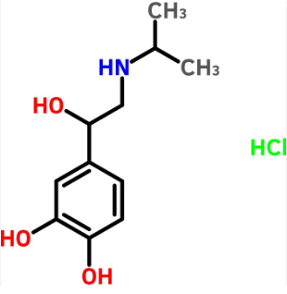
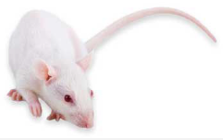
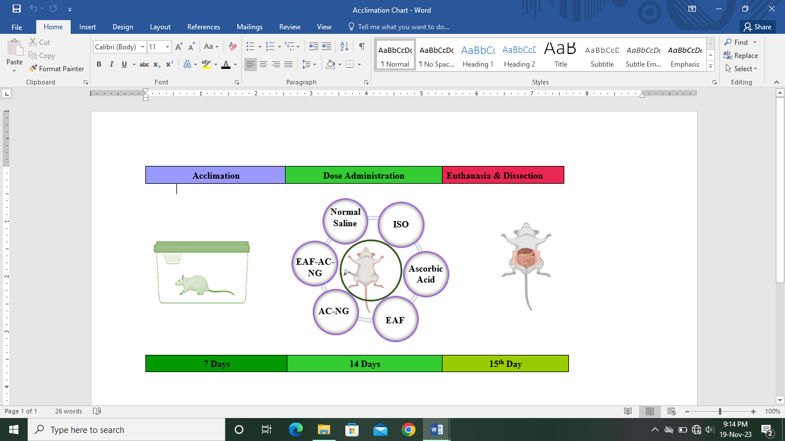

in vivo Study Design
In vivo Study

Slide 7
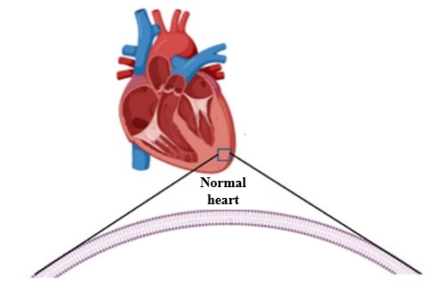
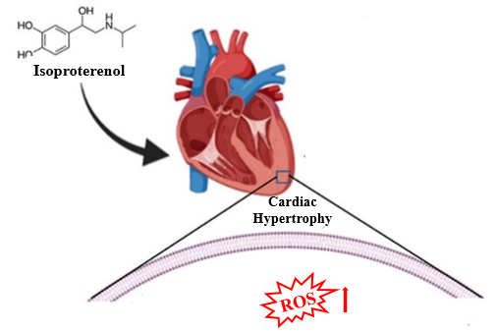

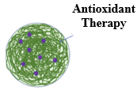
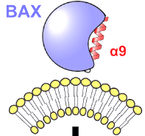
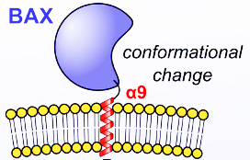


Isoproterenol induced Cardiomyocyte Apoptosis
Isoproterenol (ISO)
  Synthetic catecholamine & ß-receptor agonist
  ISO induced CH model is
      reproducible,
        reliable,
        well-studied,
        well-characterized.
MAPK Pathway
MAPK Pathway
The MAPK signaling system, has been shown to be activated by ISO treatment.
Conformational Change
EAF-AC-NG
No MOMP
MOMP
Activation of BAX and BAK creates the "point of no return" in the apoptotic process, called mitochondrial outer membrane permeabilization (MOMP).
Normal Cardio myocyte
Apoptosis
Isoproterenol induced Cardio myocyte Apoptosis
  (Szabo et al., 1975, Slee et al., 2001), Blanco & Saez., 2018, Kumar, et al., 2020, Fan et al., 2021, Romero et al., 2022)

Slide 8

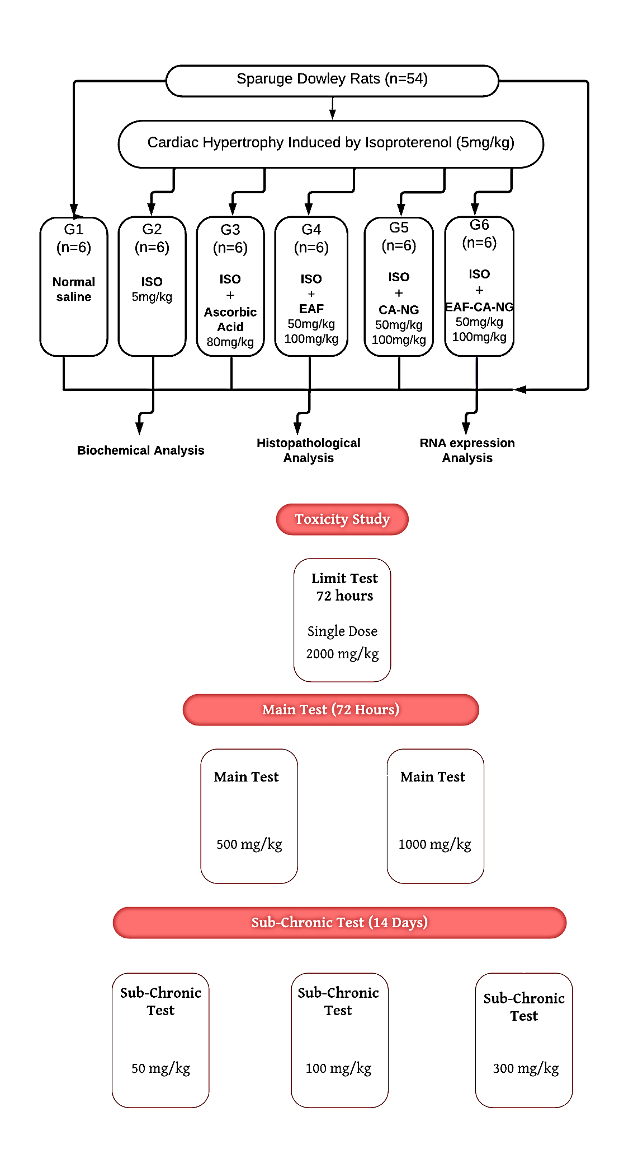
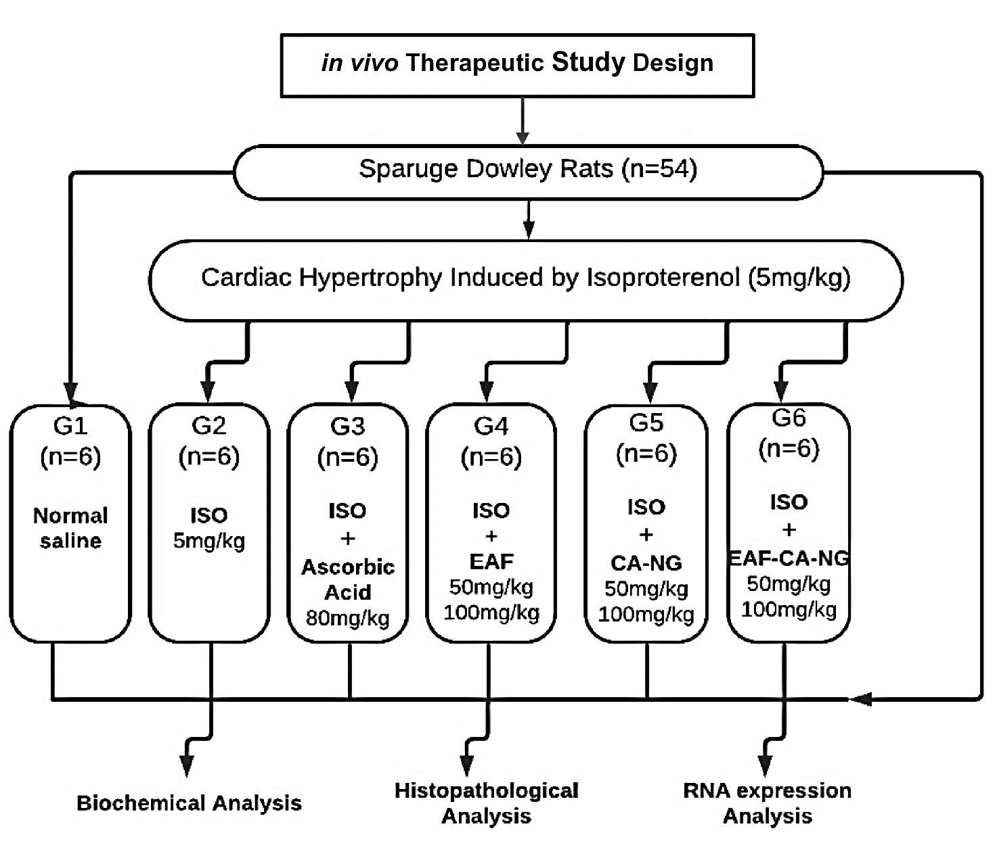
In vivo Toxicity & Therapeutic Study Design
Figure. Flow Sheet Representation of In vivo Toxicity Study and Therapeutic Study

Slide 9
In vivo Expression Analysis
in vivo BAX Expression
Table 3. GAPDH, BAX Primers
Genes | Primer Sequence (5′-3′)
GAPDH | F: CGGAGTCAACGGATTTGGTCGTAT
 | R: AGCCTTCTCCATGGTGGTGAAGAC
BAX | F: ATGGAGCTGCAGAGGATGA
 | R: CCAGTTTGCTAGCAAAGTAG
RNA Extraction
(TRIzol Reagent)
cDNA Synthesis
First Strand cDNA synthesis kit (Thermo Fisher Scientific, USA)
qPCR
GAPDH, BAX
Figure 13. Flow Sheet Expression Analysis
(Mushtaq et al., 2015, Jan et al., 2017)

Slide 10
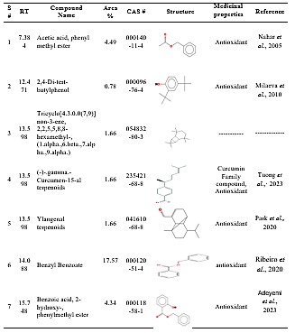
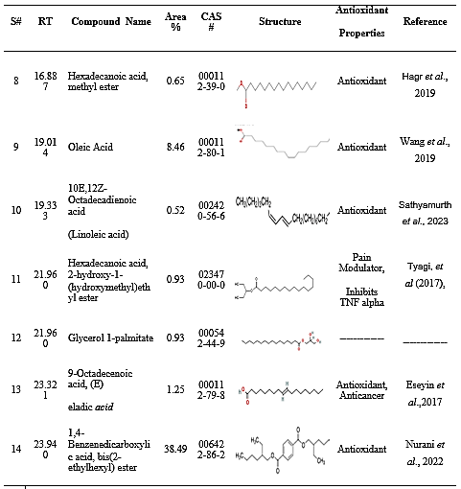
Table . Compounds Identified Using GCMS Analysis of Ethyl Acetate Fraction (EAF) of O. ferruginea Leaves

Slide 11
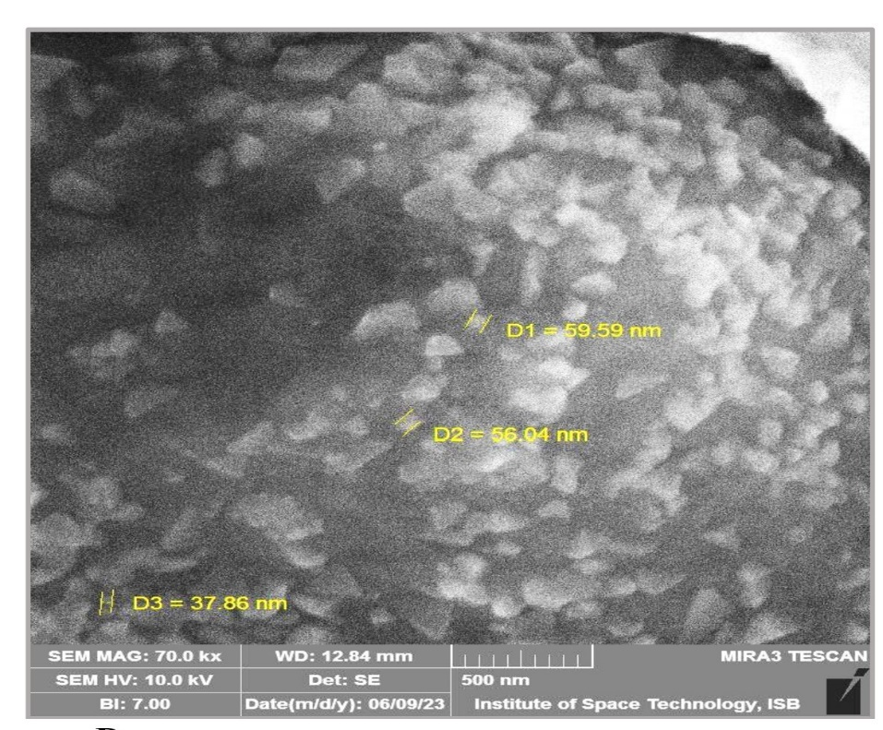
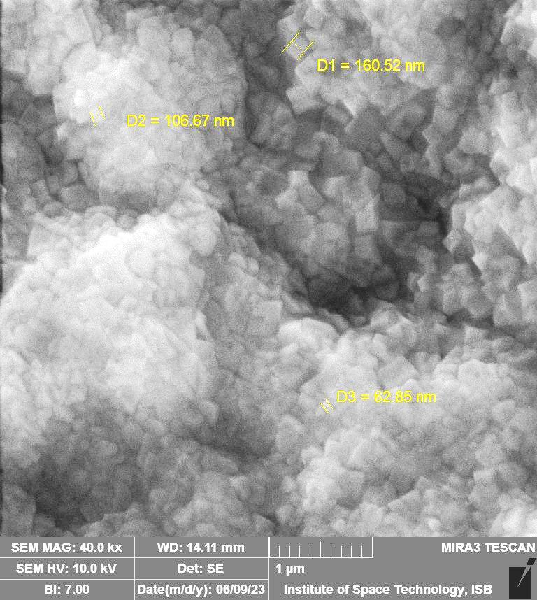
Nanogel Physicochemical Properties
(SIZE & shape)
AC-NG & EAF-AC-NG exhibited an average size of 51.16 nm and 110.01 nm
Figure. FESEM images of AC-NG and EAF-AC-NG Nanogel

Slide 12
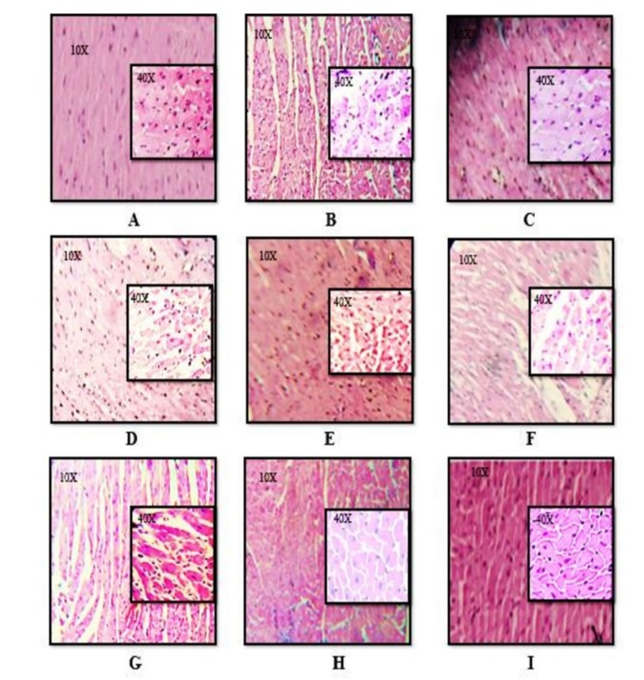

Anti-apoptotic Potential
Normal control group
ISO group 5mg/kg
ISO + ascorbic acid group 80mg/kg
ISO + EAF group 50 mg/kg
ISO + EAF group 100 mg/kg
ISO + AC-NG group 50 mg/kg
ISO + AC-NG group 100 mg/kg
ISO + EAF-AC-NG group 100 mg/kg
ISO + EAF-AC-NG group 50 mg/kg
Figure. Histological Study of Therapeutic Groups
Figure. BAX mRNA Fold Change

Slide 13

Antioxidant & Anti-apoptotic Potential
B
A
C
D
Figure. ROS Measurement (A), Apoptotic Cell Count percentage (B), SOD (C) and CAT (D) levels

Slide 14
Conclusion and Recommendations
Spectra and Chromatographic profiling revealed that EAF fractions has active compounds with potent antioxidant potential.
Our in vivo outcomes and toxicity tests showed that EAF-AC-NG is safe and nontoxic.
EAF-AC-NG Nanogel exhibited ideal small size, charge, higher encapsulation efficiency (EE), and loading capacity (LC) for in vivo delivery study.
In vivo study of EAF-AC-NG delivery decreased ROS level 3.5 folds, enhanced CAT and SOD activity, and reversed the pro apoptosis marker BAX mRNA expression in animal rat models.
Nanogel treatment exhibited no toxicity up to a Dose of 2000 mg/kg, toxicity markers Liver Function Tests (LFTs) and histological studies of liver, kidney, and heart were normal.
EAF-AC-NG Nanogel reversed the disrupted histological morphology in the myocardium.
EAF-AC-NG Nano gel treatment decreased the ROS levels, BAX mRNA levels, decreased biochemical profile more increased endogenous antioxidants activity.

Slide 15
Thank You

