Slide 1


Current Scenario on Antibiotic Misuse and Leaching in Soil: Contribution to the Development of Antibiotic-Resistant Waterborne Pathogenic Bacteria
Dr Souravh Bais
Institute of Pharmaceutical Sciences SAGE University Indore

Slide 2
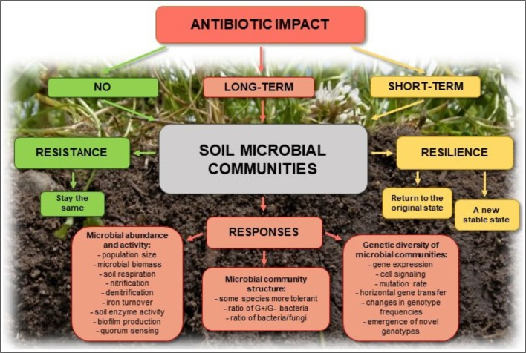
Introduction
Antibiotics are widely used in healthcare, agriculture, and animal husbandry.
Misuse and overuse of antibiotics have led to increased environmental contamination.
Antibiotic leaching into soil and water bodies promotes antibiotic resistance.
Place your data in this space
Mariusz Cyco´ n et al., 2019

Slide 3
Antibiotic Misuse – A Global Concern
Over prescription and self-medication of antibiotics.
Extensive use in livestock and aquaculture.
Inadequate wastewater treatment systems.
Improper disposal of pharmaceutical waste.
How our farmlands are becoming a breeding ground for superbugs?
The apple harvest in Himachal Pradesh's famed orchards has come up short this season, as the state’s collection centers have received only 3.61 lakh metric tonnes (LMT) of apples, a big drop from last year's 3.84 LMT.
According to a 2022 mBio study, 13% of sampled apples from northern India were found to harbour the drug-resistant fungus Candida auris, which has been linked to severe infections and carries a mortality rate of 34%, according to the Centres for Disease Control and Prevention (CDC) data.

Slide 4
Antibiotic Misuse – A Global Concern
The presence of drug-resistant fungus on fruits like apples is just the tip of the iceberg. The broader, underlying issue is antimicrobial resistance (AMR) in our food systems, where once-healthy soil has become a breeding ground for antibiotic-resistant bacteria.
How AMR enters our soil
As global food demand rises, so too does the use of antibiotics to speed up livestock growth and protect crops from disease. While these practices may offer short-term gains, they also inadvertently create a long-term problem: antibiotic-resistant bacteria in soil.

Slide 5
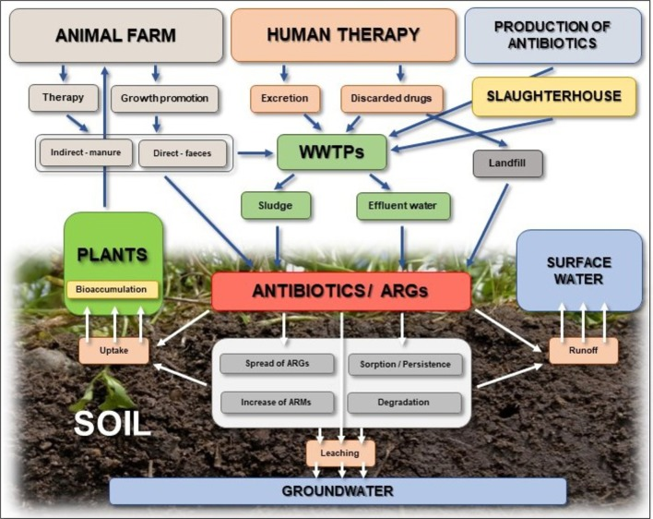
Sources of Antibiotic Contamination
These resistant bacteria can spread and survive in soil through multiple routes, including seeds, soil additives, irrigation water, and especially animal manure used as fertiliser. Antibiotics given to livestock often remain in their manure, and when this manure is applied to fields, it releases antibiotic residues and resistance genes into the environment.
Agricultural runoff from antibiotic-fed livestock.
Industrial and hospital wastewater discharge.
Direct disposal of expired antibiotics.
Soil application of manure containing antibiotic residues.
A recent study confirmed that animal manure often contains antibiotics like tetracyclines, sulfonamides, and fluoroquinolones, all of which contribute to the growth of AMR in soil. These resistant microbes can easily find their way onto nearby crops.
Mariusz Cyco´ n et al., 2019

Slide 6
Mechanisms of Antibiotic Leaching
Antibiotic adsorption and desorption in soil.
Influence of soil pH, organic matter, and microbial activity.
Transport through surface runoff and percolation into groundwater.
In a 2021 study, researchers at the University of Nebraska-Lincoln found that over 60% of the antimicrobial resistance (AMR) genes found on lettuce leaves were traced back to soil that had been fertilized with animal manure.
Moreover, antibiotics are sometimes applied directly to plants, enhancing crop health and yields. However, this practice also fuels the spread of resistant bacteria in the soil. "For instance, tetracyclines are injected into tree trunks to combat citrus diseases like huanglongbing (HLB) and sprayed on pears and apples to prevent fire blight.
Climate change then compounds the issue. "Rising temperatures create favourable conditions for bacteria to multiply, while excessive rains and water accumulation create an ideal environment for pathogens,"

Slide 7
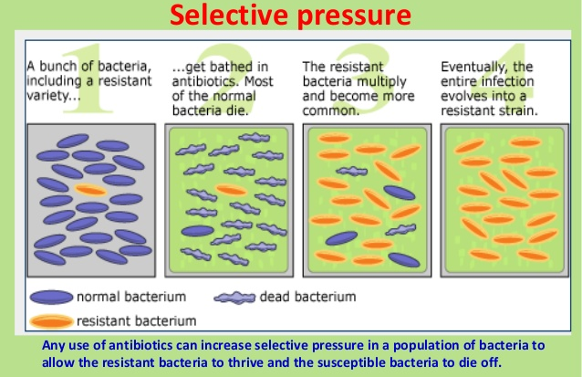
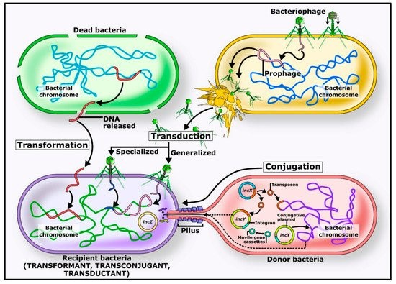
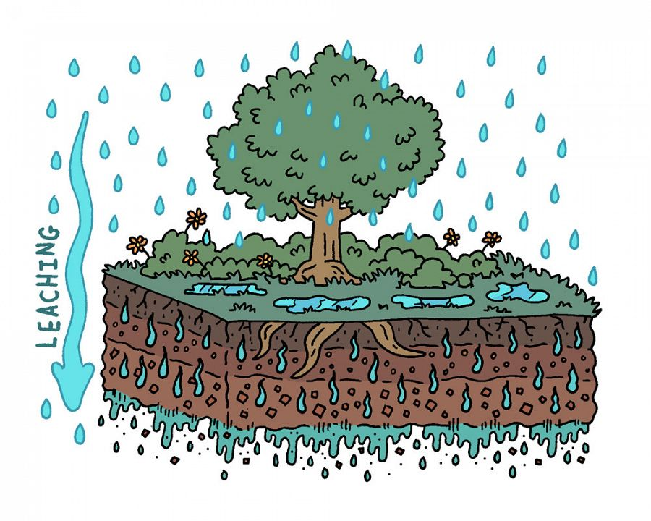
Development of Antibiotic Resistance in Soil Bacteria
Selective pressure promotes resistant bacterial strains.
Horizontal gene transfer spreads resistance genes.
Resistant bacteria reach water bodies through leaching and runoff.

Slide 8
Impact on Waterborne Pathogenic Bacteria
Contaminated water bodies become reservoirs of resistance genes.
Increased prevalence of resistant pathogens (E. coli, Pseudomonas, Vibrio, etc.).
Higher risk of antibiotic-resistant infections in humans and animals.
Humans and animals infected with ARB may spread resistance in the environment through wastewater and direct deposition of feces into surface waters. The fate and transport of antibiotic residues and resistant bacteria are influenced by the environment.
For instance, readily water-soluble antibiotics may dissolve in wastewater or runoff water, which may weaken their ability to cause AR before entering surface water. Some ARB are susceptible to extreme environmental conditions that reduce their chances of survival in the environment.
Antibiotic residues and resistant bacteria that are not readily affected by adverse conditions may persist during transportation and enhance the development and spread of AR in surface water.

Slide 9
Why it matters to Us?
In 2023, the WHO identified AMR as one of the top global public health threats. And the alarming part? These bacteria don’t respond to common antibiotics. "If they cause infections, doctors have fewer treatment options, turning a mild infection into a serious, potentially life-threatening condition. When people consume foods carrying antibiotic-resistant bacteria, they face the risk of infections that require longer hospital stays and can increase mortality rates

Slide 10
Case Studies and Research Findings
Examples of antibiotic-resistant bacteria detected in water bodies.
Studies on antibiotic persistence in soil and groundwater.
Real-world implications for human health and ecosystems.

Slide 11
Solutions for AMR-free farming
Go organic: Organic farming avoids antibiotics and synthetic pesticides, fostering healthier soil microbes that combat resistant bacteria. India has 2.6 million hectares under organic farming, fifth largest in the world, supported by the GOI’s Paramparagat Krishi Vikas Yojana, but broader adoption is needed.
Integrated pest management (IPM): By using natural pest predators, crop rotation, and habitat modifications, IPM reduces reliance on chemicals, limiting resistant bacteria in the soil.
Stricter regulation & awareness: Stronger enforcement of antibiotic regulations and educating farmers about AMR risks are essential. Public health campaigns should target rural areas to ensure greater awareness.
Monitoring soil health: Focus on Soil Health Management (SHM) under the National Mission for Sustainable Agriculture (NMSA), by combining chemical fertilisers with organic manures and bio-fertilisers to improve soil health and productivity.

Slide 12
Strategies to Mitigate Antibiotic Leaching and Resistance
Regulatory measures: Stricter policies on antibiotic use in agriculture and medicine.
Sustainable practices: Reduced antibiotic usage in farming, improved manure management.
Advanced wastewater treatment: Removal of antibiotic residues from effluents.
Public awareness campaigns: Educating the public on responsible antibiotic use.

Slide 13
Conclusion and Future Directions
Antibiotic misuse and leaching contribute significantly to antibiotic resistance.
Addressing this issue requires a multi-disciplinary approach.
Future research should focus on alternative antimicrobial strategies and better waste management solutions.
Call to action: Collaborative efforts from scientists, policymakers, and the public are crucial to mitigate this global crisis

Slide 14
References
Kusi J, Ojewole CO, Ojewole AE, Nwi-Mozu I. Antimicrobial Resistance Development Pathways in Surface Waters and Public Health Implications. Antibiotics (Basel). 2022 Jun 18;11(6):821. doi: 10.3390/antibiotics11060821. PMID: 35740227; PMCID: PMC9219700.
https://gfm.akshayakalpa.org/read/feature-article/antibiotics-misuse-is-poisoning-us-and-our-soil.

Slide 15
Q&A

