Slide 1
Characteristics of Pediatric and Adult Tuberculosis Cases at Pandak 1 Public Health Center, Bantul, 2020-2024
Ormy A. Mahendra^{1,2}, Yoseph L. Samodra^{3*}, Fasha S. Andampury¹
¹ Puskesmas Pandak 1, Bantul, Indonesia
² Rumah Sakit Panembahan Senopati, Bantul, Indonesia
³ Institute of Epidemiology and Preventive Medicine, National Taiwan University, Taipei, Taiwan

Slide 2
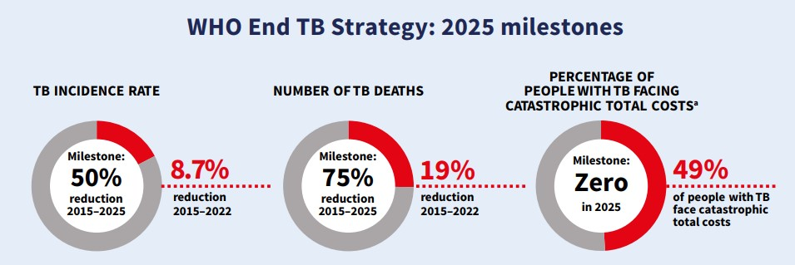
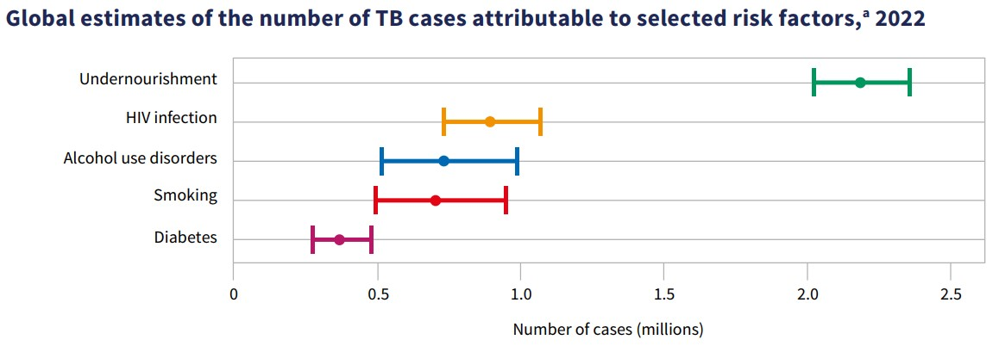
Tuberculosis
TB remained the world’s second leading cause of death from a single infectious agent in 2022.
The reported global number of people newly diagnosed with TB was 7.5 million in 2022.
Global tuberculosis report 2023. Geneva: World Health Organization; 2023.

Slide 3
Global tuberculosis report 2024. Geneva: World Health Organization; 2024.

Slide 4
TB care cascade in Indonesia
Tuberculosis in Indonesia: Epidemic Projections and Opportunities to Accelerate Control. Findings from an Optima TB Analysis. 2020. Washington DC: World Bank.

Slide 5
Estimated TB Cases for Each Province in Indonesia
Directorate General for Disease Control and Prevention Ministry of Health of the Republic of Indonesia. 2023. The 2022 Annual Report on the National TB Program

Slide 6
Results
Variable | Categories | Adult (n=27) | Pediatric (n=7)
Age | < 40 years | 14 (51.9%) | 7 (100%)
 | ≥ 40 years | 13 (48.1%) | 0 (0%)
Sex | Male | 15 (55.6%) | 2 (28.6%)
 | Female | 12 (44.4%) | 5 (71.4%)
Occupation | Laborer | 6 (22.2%) | 0 (0%)
 | Housewife | 2 (7.4%) | 0 (0%)
 | Student | 2 (7.4%) | 0 (0%)
 | Other | 5 (18.5%) | 0 (0%)
 | No data | 12 (44.4%) | 7 (100%)

Slide 7
Results
Variable | Categories | Adult (n=27) | Pediatric (n=7)
Contact tracing | No | 6 (22.2%) | 3 (42.9%)
 | Yes | 21 (77.8%) | 4 (57.1%)
Referral from | No referral | 11 (40.7%) | 1 (14.3%)
 | PHC | 2 (7.4%) | 0 (0%)
 | Hospital | 14 (51.9%) | 6 (85.7%)
Diagnosis type | Clinical | 7 (25.9%) | 7 (100%)
 | Bacteriological | 20 (74.1%) | 0 (0%)
TB location | Pulmonary | 24 (88.9%) | 7 (100%)
 | Extrapulmonary | 3 (11.1%) | 0 (0%)

Slide 8
Results
Variable | Categories | Adult (n=27) | Pediatric (n=7)
DM status | Yes | 0 (0%) | 0 (0%)
 | No | 15 (55.6%) | 5 (71.4%)
 | Unknown | 12 (44.4%) | 2 (28.6%)
HIV status | Yes | 0 (0%) | 0 (0%)
 | No | 21 (77.8%) | 5 (71.4%)
 | Unknown | 6 (22.2%) | 2 (28.6%)
TB therapy status | New | 24 (88.9%) | 7 (100%)
 | Recurrent | 0 (0%) | 0 (0%)
 | Unknown | 3 (11.1%) | 0 (0%)

Slide 9
Results
Variable | Categories | Adult (n=27) | Pediatric (n=7)
RIF sensitivity | Sensitive | 19 (70.4%) | 0 (0%)
 | Negative | 3 (11.1%) | 1 (14.3%)
 | Unknown | 5 (18.5%) | 6 (85.7%)
Outcome | Cured | 16 (59.3%) | 0 (0%)
 | Completed | 6 (22.2%) | 5 (71.4%)
 | Died | 1 (3.7%) | 0 (0%)
 | Ongoing | 4 (14.8%) | 2 (28.6%)

Slide 10
Discussion
The higher proportion of females in the pediatric group (71.4%) compared to males could suggest potential differences in exposure or healthcare-seeking behavior among children.

Slide 11
Discussion
A significant proportion of adults (44.4%) did not report occupational data, which may impact the ability to analyze socioeconomic risk factors for TB.
Among those who did report, laborers constituted the largest subgroup, which aligns with prior findings associating TB risk with physically demanding jobs and poor working conditions.

Slide 12
Discussion
Improving contact tracing efforts in pediatric cases could help in early identification and prevention of TB transmission within households.
A notable majority of pediatric patients (85.7%) were referred from hospitals, indicating that children may be more likely to be diagnosed in hospital settings rather than at public health centers.

Slide 13
Discussion
While 74.1% of adults were diagnosed through bacteriological confirmation, all pediatric cases were diagnosed clinically.
This emphasizes the diagnostic challenge of pediatric TB, as children often present with non-specific symptoms, requiring reliance on clinical criteria rather than microbiological confirmation.

Slide 14
Discussion
The relatively high proportion of unknown HIV statuses, particularly among adults (22.2%), indicates a need for better integration of TB-HIV screening protocols.
The high proportion of RIF-sensitive cases among adults (70.4%) suggests that drug-resistant TB may not be a significant issue in this cohort.

Slide 15
Discussion
While 59.3% of adults were cured, no pediatric cases were recorded as cured, with 71.4% completing treatment and 28.6% still undergoing treatment.
The absence of reported deaths among pediatric patients, compared to a 3.7% mortality rate in adults, suggests that disease severity or treatment adherence could differ between the two age groups.

Slide 16
Conclusion
Overall, while TB treatment outcomes were generally positive, efforts should focus on improving early detection, enhancing diagnostic methods for pediatric cases, and strengthening surveillance for drug resistance and comorbidities.
Addressing these gaps can contribute to better TB control and management strategies in the community.

