Slide 1


How to Minimize Wellbore Instability: Techniques and Strategies
Dr. Zohreh Movahed
Senior Reservoir Geologist Consultant-Editor/Alzare-
Journal of Petroleum Exploration and Production Technology

Slide 2
Resume
23 years of petroleum geoscience experience, technical sales in NIOC, Schlumberger, Karun energy, ANTAEUS, Teleperformance,Springer,UTM,PayamNoor,Tehran,ShahidBehehshti,PUT Universities, and Alzare.
10 years of international consultancy experience in Oil and Gas Industry.

Slide 3
Agenda
Orientations of regional stresses
Wellbore Stability Measurement
Challenges
Objectives
Multi-stage Image logging – Procedure
Stage1 - Quick look Answer product
Stage2 - Time lapse Answer Product
Benefits of Multi-stage Image logging
Conclusion

Slide 4
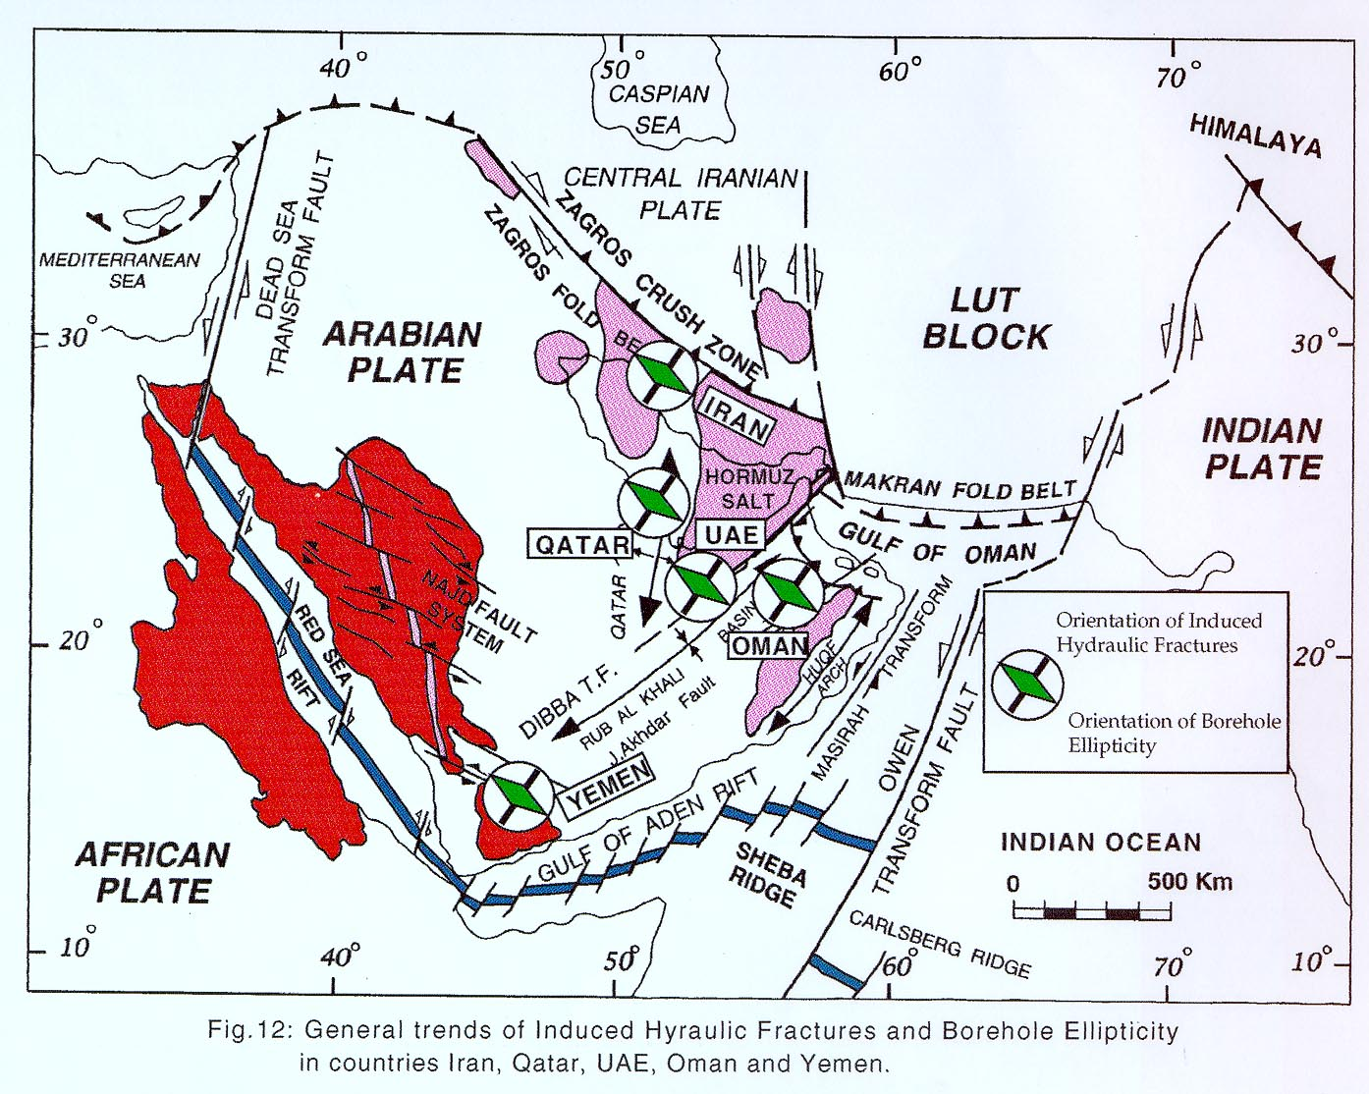
Orientations of Regional Stresses
Orientations of regional stresses in most part of the Zagros is NE-SW for the maximum horizontal stress and NW-SE for the minimum horizontal stress (Zagros stress).

Slide 5
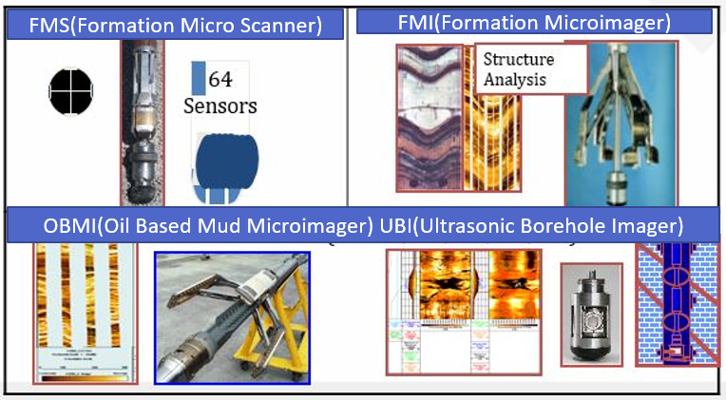
Wellbore Stability Measurement
The two main sources of information are:
Sonic measurements – Indicate rock strength and overall mechanical properties.
Image logs – Provide detailed well conditions, fracture types, and wellbore failure mechanisms.

Slide 6
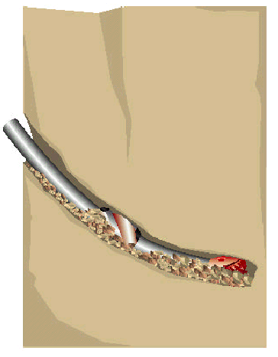
Challenge 1: Drilling problems in Iran – Pack-offs
Unstable formations
  Weak formations
  Induced or natural overpressure
  Reactive formations
Cutting and cavings build ups
Poor hole cleaning

Slide 7
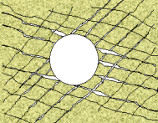
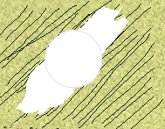
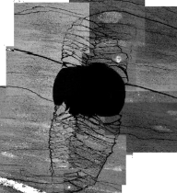

Challenge 2: Drilling problems in Iran –Fractures
Natural Fracture Zones
Closely-Spaced Fractures
Bedding-Parallel Wellbore
Breaking off of rock from the borehole wall.
Fault Activation

Slide 8
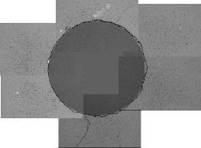
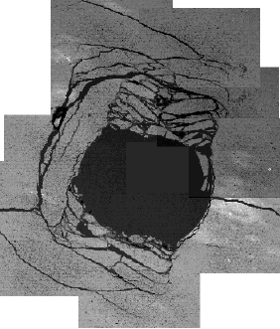
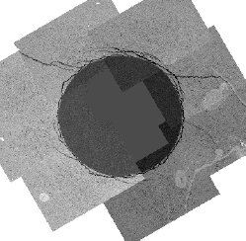
Challenge 3:Drilling problems in Iran – Bedding orientation
Hole normal to bedding:
Hole parallel to bedding:
Hole 10° off parallel to
bedding

Slide 9


Objective
To implement Multi-stage Image logging for improving the wellbore conditions

Slide 10
Multi-stage Image logging – Procedure
Stage 1: Run the first UBI log early if mud losses or pipe sticking happen, or right after drilling.
Stage2: Conduct the final log as late as possible, post-VSP, MDT, and other evaluations.

Slide 11
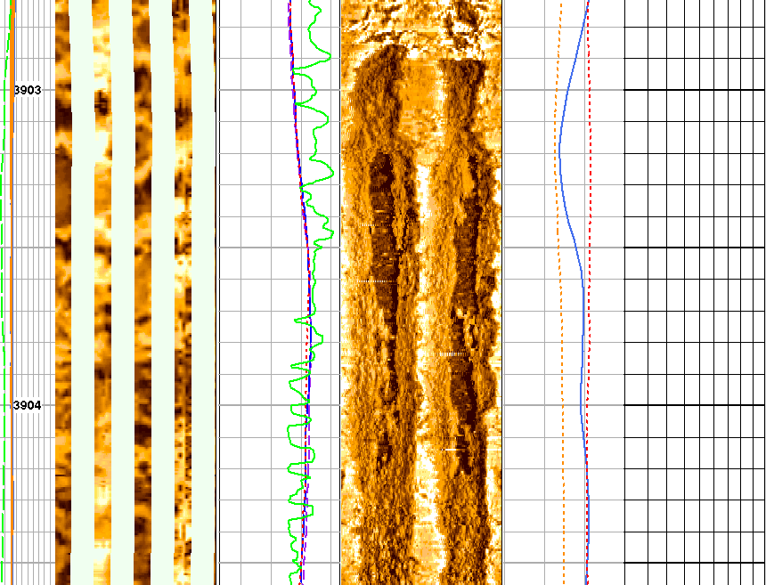
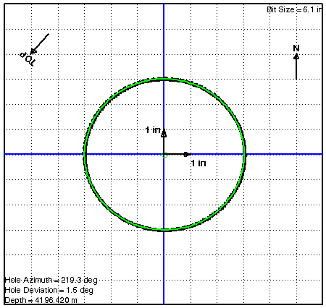
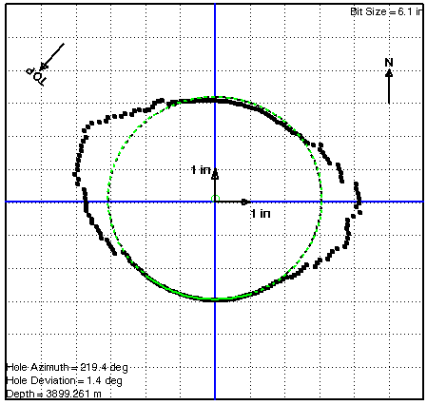
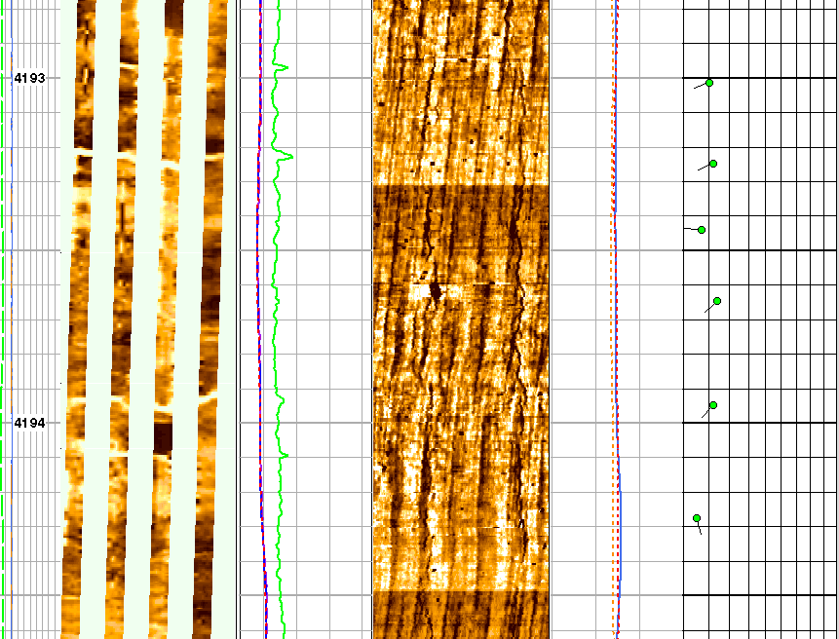
Multi-stage Image logging
2100 m
Stage 1: Run the first UBI log early if mud losses or pipe sticking happen, or right after drilling.
3800 m
Stage2: Conduct the final log as late as possible, post-VSP, MDT, and other evaluations.

Slide 12
Stage1 - Quick look Answer Product
Identifies drilling fractures, in-situ stress direction, and structural boundaries.
Conducts continuous well deviation surveys to assess trajectory.
Detects borehole damage zones, weak rock areas, and wellbore restrictions.
Provides early indications of unexpected geological structures and major bedding planes.

Slide 13
Stage1 - Wellbore Stability Analysis
Borehole restrictions like doglegs and ledges can be improved by reaming.
Drilling-induced fractures indicate extreme mud weight, while breakouts suggest insufficient weight.
Lost circulation can be controlled with precise slug/pill placement and careful drilling practices.
Well behavior varies based on alignment with maximum or minimum horizontal stress.
Notes:
when a borehole becomes narrower or filled due to anomalies like doglegs (sudden changes in wellbore angle)and ledges (uneven formations causing
step-like barriers), the drilling team can use reaming—a process of enlarging or smoothing the borehole with a specialized tool—to restore proper wellbore
size and improve drilling efficiency.

Slide 14
Stage1 - Optimization of mud weight
Too much mud weights are indicated by drilling induced fractures
Not enough mud weights are indicated by borehole breakouts
Wellbore geometry
STABLE WINDOW
σ_{min}
SAFE WINDOW
P_{Pore}
P_{Frac}
low
Relative Mud Weight or ECD
high

Slide 15
Stage2 - Time lapse Answer Product
By comparing the data from the various log passes a range of new information types should become apparent.
Borehole stability
Fracture characterization
Pressure & Fluid sampling points
Fluid movement / Invasion, Permeability

Slide 16
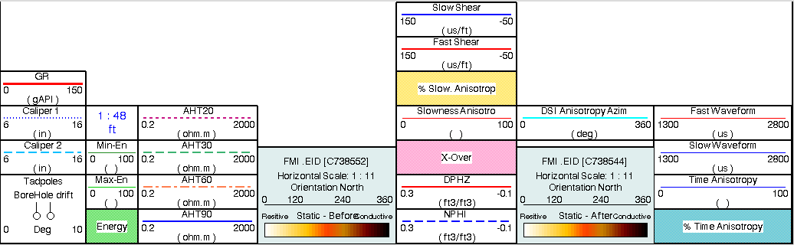
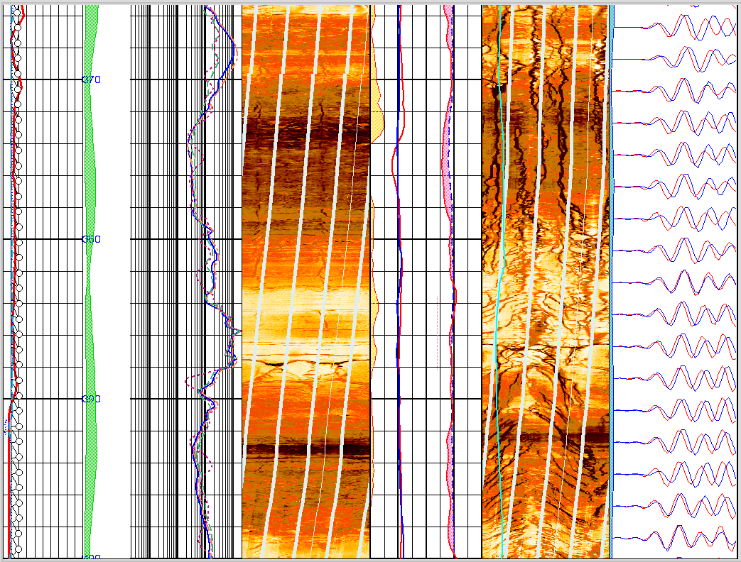
Stage2 - Time lapse Answer Product
FMI images acquired before and after hydraulic fracturing

Slide 17
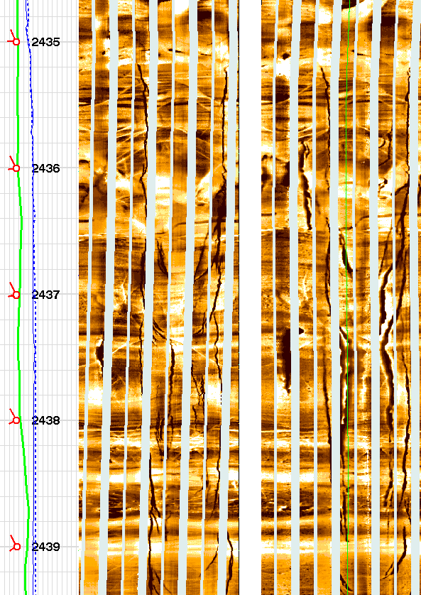

Stage2 - Time lapse - Progressive instability
Wellbore instability can either be immediate or progressive
Failure of the rock does not mean failure of the wellbore
Damaged rock can be protected by management of wellbore instability

Slide 18
Benefits of Multi-stage Image logging
Enhances drilling efficiency, reducing time and costs.
Minimizes lost circulation, washouts, and stuck pipes.
Improves fracture characterization and mud weight optimization.
Provides high-resolution well deviation surveys.
Ensures better log data for accurate formation evaluation.

Slide 19
Conclusion
UBI provides the most detailed image log data for wellbore stability analysis.
Image logs help in planning deviated side-track wells by extrapolating key information.
Multi-stage image logging is recommended to minimize wellbore instability.

Slide 20


Slide 21


